Slide 1
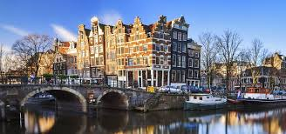
HISTORY OF MIGRATION IN NL
An Overview and a survey

Slide 2
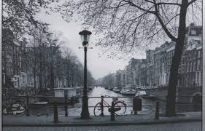
In the Past
Between 1590 and 1800 there were no more than 5% immigrants (mainly family migration).
Colonies and economic migrants (20th c.)
The immigrant population in the Netherlands is not based on nationality or country of birth, but on ethnicity (at least one parent who is born outside the Netherlands).
19.3% of the population ethnically not Dutch.

Slide 3
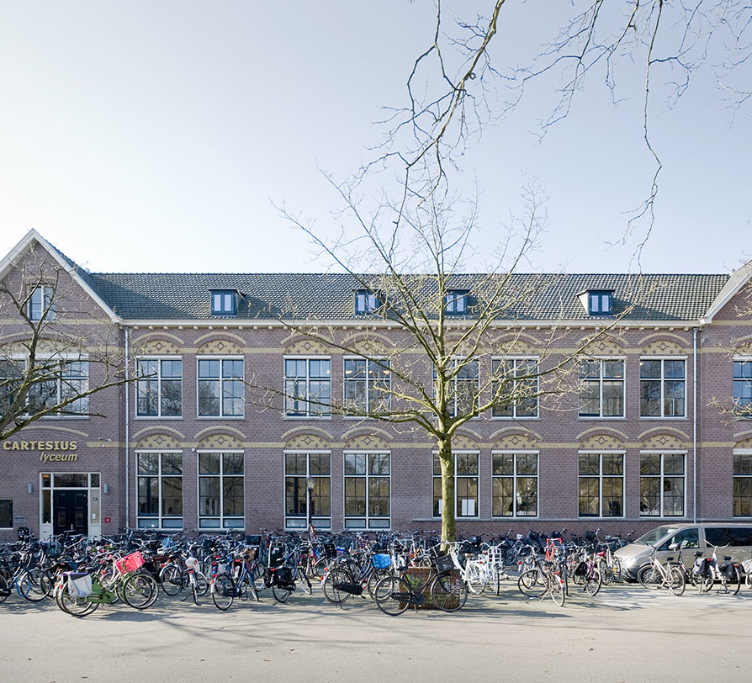
A survey among students of our school
How long has your family lived in the NL?
43% for generations
48% longer than 30+ years
9% came to the NL recently (10+ years)

Slide 4
What was the reason for coming to the NL?
86 % of students whose families immigrated to the NL chose the country for a so-called ‘better life’.

Slide 5
What are the differences between your country of origin and the NL?
Culture
Level of wealth (people are richer)
Healthcare
Voting system
Safety
Freedom
Clothing
Less nationalistic

Slide 6
What are the similarities between the country of your origin and the NL?
Feeling of freedom
High standards of living
Shopping possibilities
Landscape
Immigrants
People being judgmental

Slide 7
Do You feel part of the Dutch society?
70% of our students said “yes”
25% “partly”
5% “no”

Slide 8
What HELPS to be part of the dutch society?
Being born and growing up in the NL
School and education
Language (Dutch)
Welfare system
Parents helping and wanting you to integrate

Slide 9
How can we help the immigrants?
Standard education and schooling courses
Activities supporting integration
Language
Coaching how to survive in a new society
Jobs

Slide 10
What language do you speak at home?
40% only Dutch
60% different languages (a language of the origin and Dutch)

Slide 11
Is it important to follow the values of your new country?
82% YES
11% NOT ALWAYS
7% NO

Slide 12
WHAT IS YOUR IDENTITY?
31% just Dutch
50% different nationalities, mixed roots
19% mixed answers (a kid from Amsterdam, I follow my religion, not my nation etc.)

Slide 13
CONCLUSION
Until the 1970s, the Netherlands lacked an integration policy, as it was believed that most migrant groups, especially the guest workers, would eventually return to their countries of origin
Immigration Policy: rights, but also obligations (civic exams, language courses etc.)
Future challenges: refuges, economic migrations: from temporary into permanent
The end of multiculturalism?

