Slide 1
The architecture of the Netherlands

Slide 2
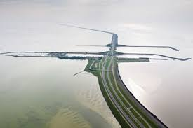
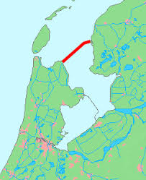
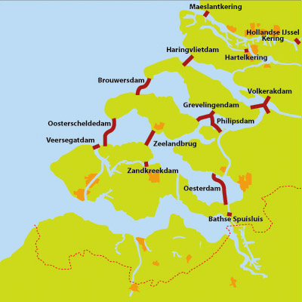
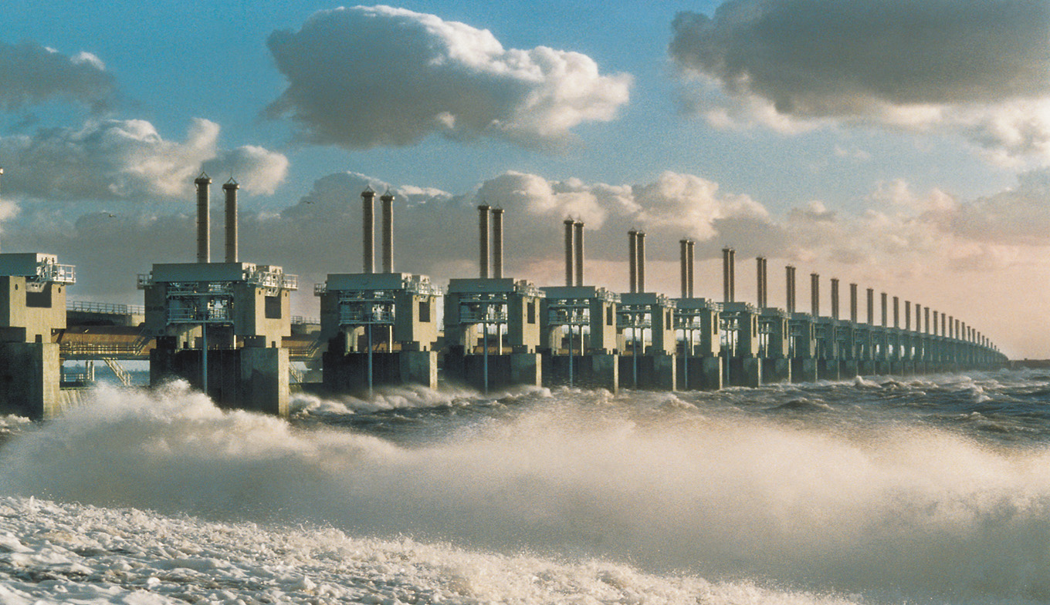
Dikes
Finished in 1933
Took 6 years to make
Finished in 1986
Took 33 years to make

Slide 3
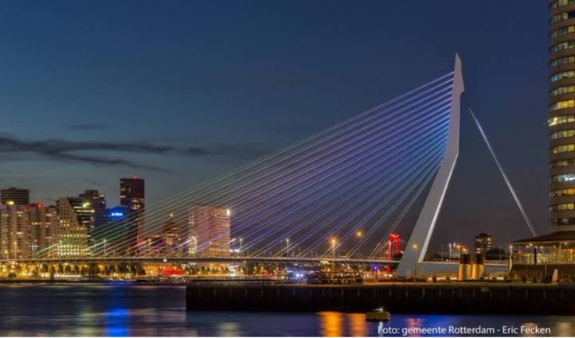
Erasmus bridge
In Rotterdam
800 meters
Crosses the river the Maas
Designed in 1996
Designed by Ben van Berkel
Nickname is ‘the swan’

Slide 4
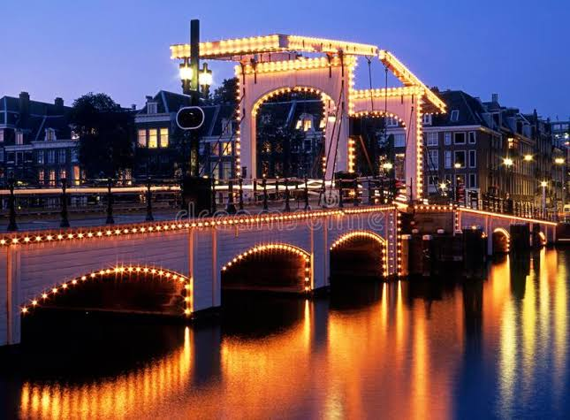
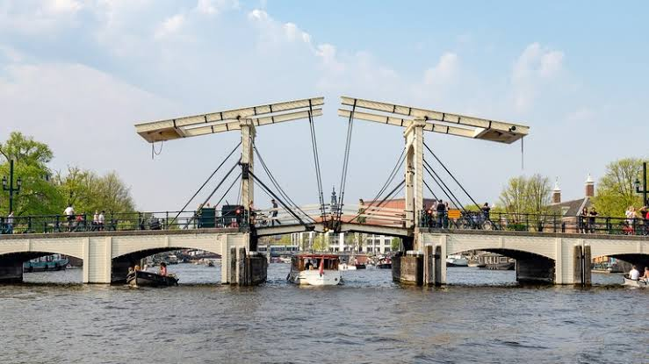
Magere brug (skinny bridge)
In Amsterdam
Storie skinny sisters
Most visited bridge from Amsterdam
Made in 1934
Crosses the river the Amstel
Designed by Piet Kramer

Slide 5
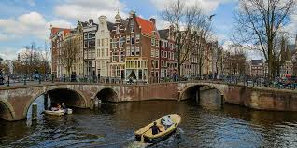
Amsterdam
Canal houses
Bridges

Slide 6
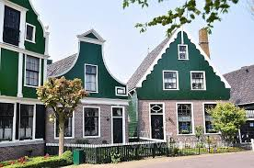
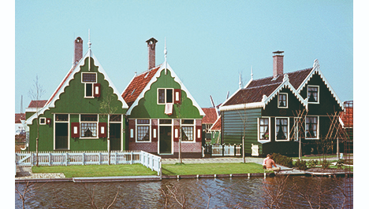
Zaanstreek

