Slide 1
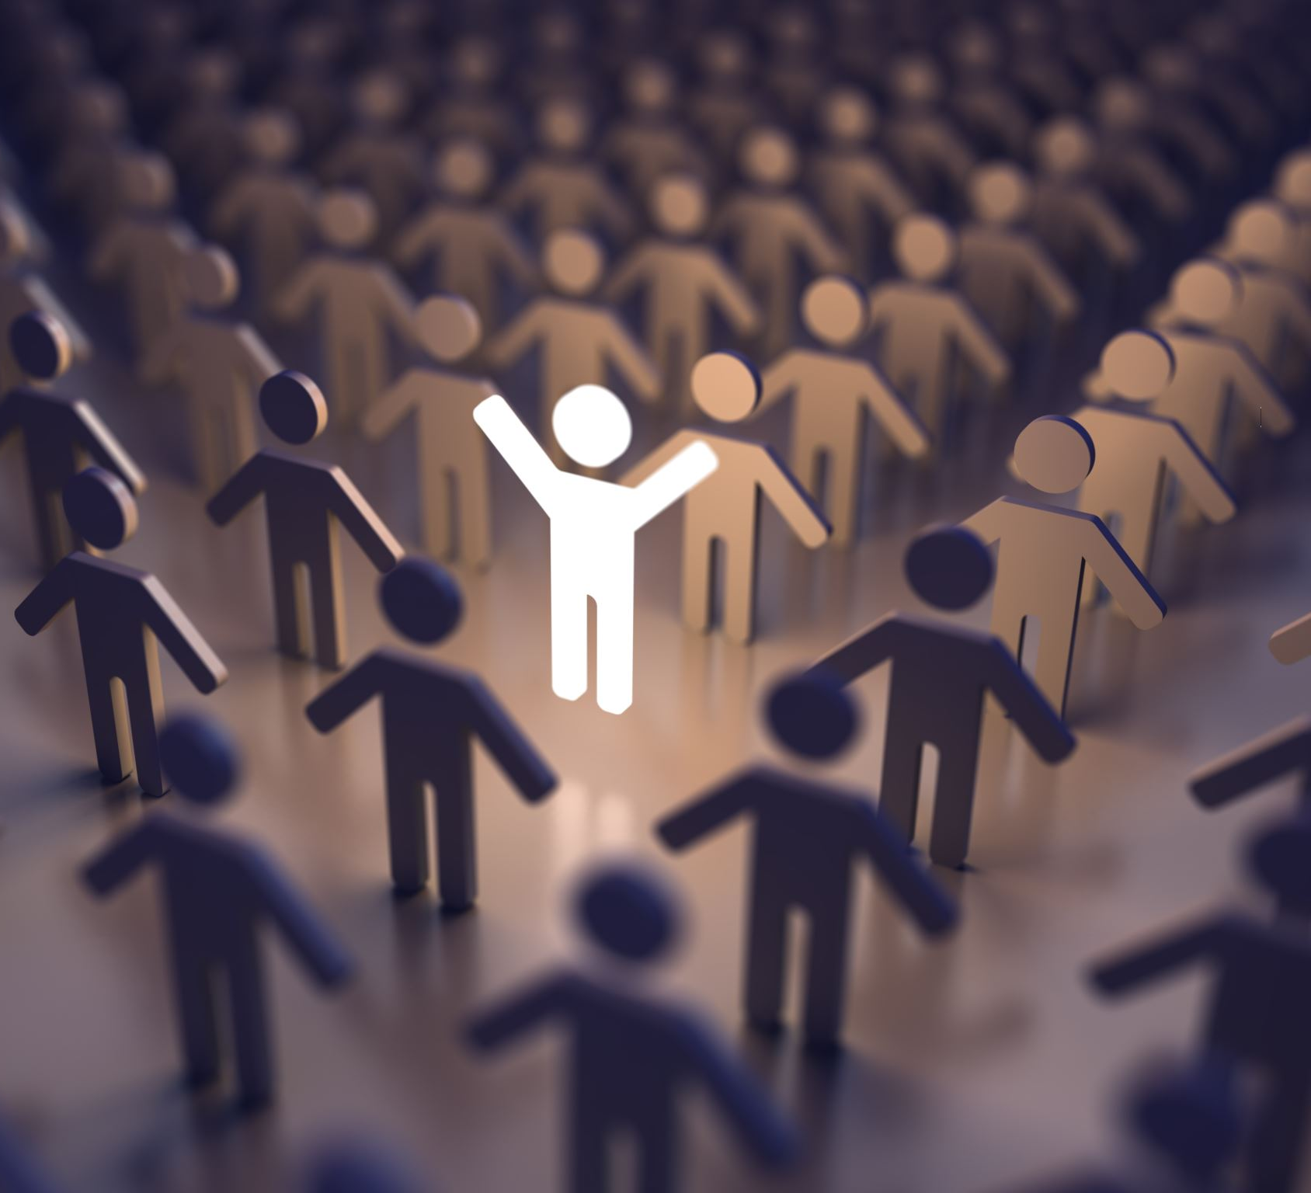
It’s all about relationships!
Positive solutions

Slide 2
BUILD TRUST
If you trust people at school, you can be open and honest with your thoughts and actions.

Slide 3
Develop Mutual Respect
When you respect people at your school, you value their input and ideas, and they value yours.

Slide 4
Be Mindful
Mindfulness means taking responsibility for our words and actions.

Slide 5
Welcome Diversity
People with good relationships not only accept diverse people and opinions, but they welcome them.

Slide 6
Appreciate Others
Show your appreciation whenever someone helps you. Everyone wants to feel that their work is appreciated.

Slide 7
Be Positive
Positivity is attractive and contagious, and it will help and strengthen your relationships with your colleagues or friends. No one wants to be around someone who’s negative all the time.

Slide 8
Practice Active Listening
People respond to those who truly listen to what they have to say.

Slide 9
Be Kind
Kindness first. Everyone has other things happening in their lives. Practice empathy so you can understand what others might be going through.

