Slide 1
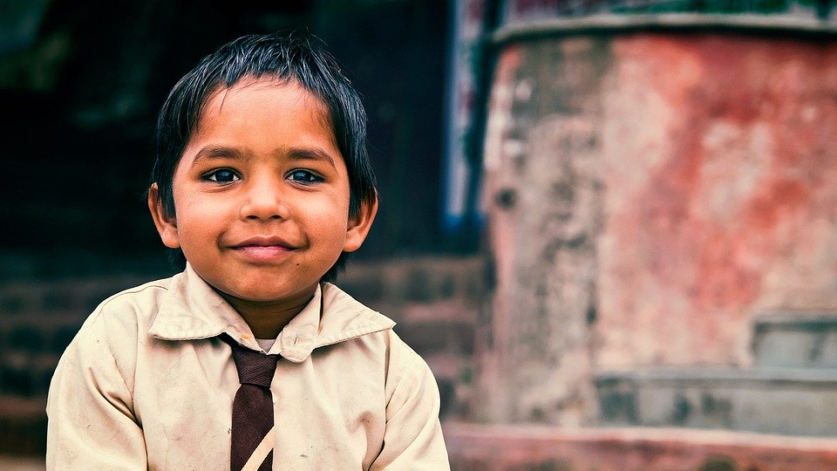
Children Immigrants in Sweden
Right to education and healtcare

Slide 2
Unaccompanied children

Slide 3
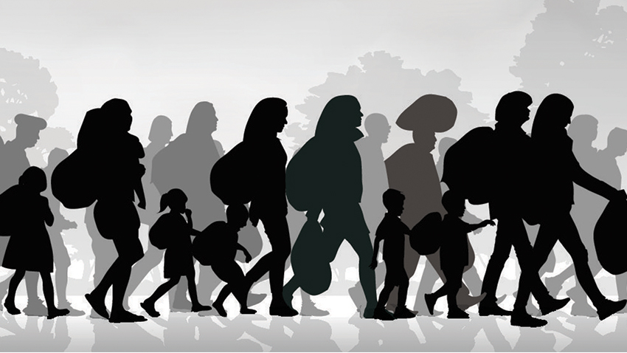
Being an immigrant in sweden

Slide 4
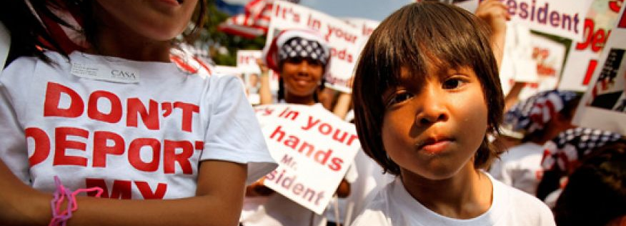
Young immigrants in sweden

