Slide 1
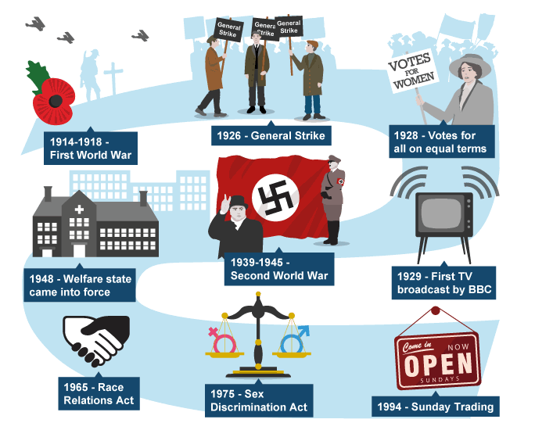
At the start of the 20th century, British society was divided into classes – aristocracy, middle class and working class. By the end of the 20th century, class boundaries became blurred as attitudes, fame and popularity played a bigger part in defining social groups rather than income.

Slide 2
Changes in social values in the UK
60s/70s:
Disregard for the establishment. Raise of divorce and abortion
Pop culture
Elimination of grammar schools, more egalitarian school system
Immigration of people to the UK mainly from ex colonies began to escalate , leading to racism.
80s:
Multiculturalism.
With immigration increase of other religious beliefs
Thatcherism and privatisation
The opportunity of buying council houses, more property owners
90s and new millennium:
More accepted views on homosexuality
Changes in family structure
Growing disparity in affluence ( globalisation)
Declining importance of social class
The 2011 London riots opened many public debates on the effects of growing minority Races and Religions in an established civilised society

Slide 3
Some interesting numbers:
When those born in 1970 reached 30:
19.5 per cent were single and never wed
20 per cent were cohabiting
54 per cent were married
69 per cent of women had a child in the household
29 per cent shared the cooking
29 per cent shared the cleaning
21 per cent shared ironing and laundry
19 per cent of women were housewives
74 per cent of women had paid work
63.5 per cent ate as a family daily
25.5 per cent of people rated their happiness as nine out of 10 or better
When those born in 1958 reached 30:
12.5 per cent were single and never wed
10 per cent were cohabiting
70 per cent were married
81 per cent of women had a child in the household
18 per cent shared the cooking
21 per cent shared the cleaning
11 per cent shared ironing and laundry
27 per cent of women were housewives
68 per cent of women had paid work
70 per cent ate as a family daily
23.5 per cent of people rated their happiness as nine out of 10 or better

Slide 4
British values: These are the 5 fundamental values that have been developed by the UK Government in an attempt to create social unity and prevent extremism.

