Slide 1
Cultural globalization
NL
Globalization is the economic and social process whereby global markets and cultures increasingly dominate local markets and cultures

Slide 2
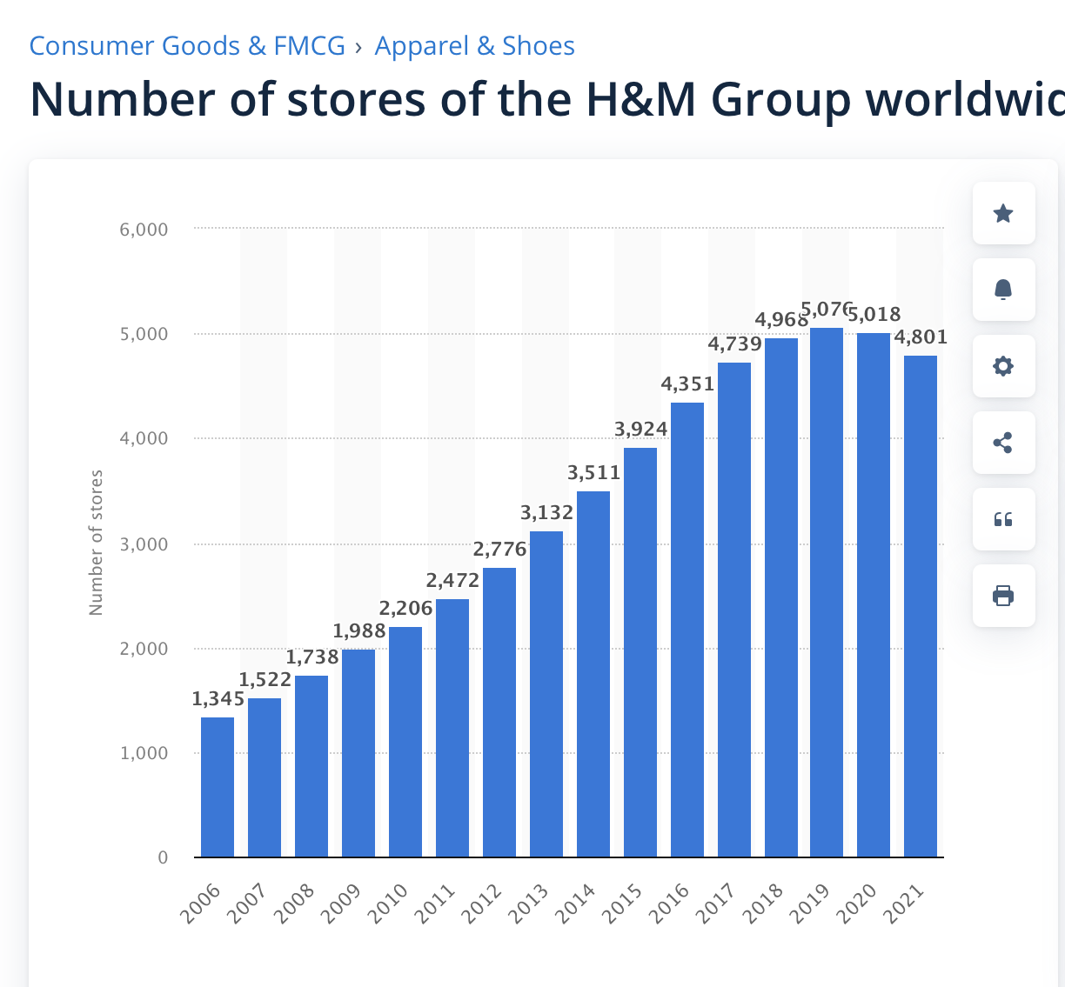
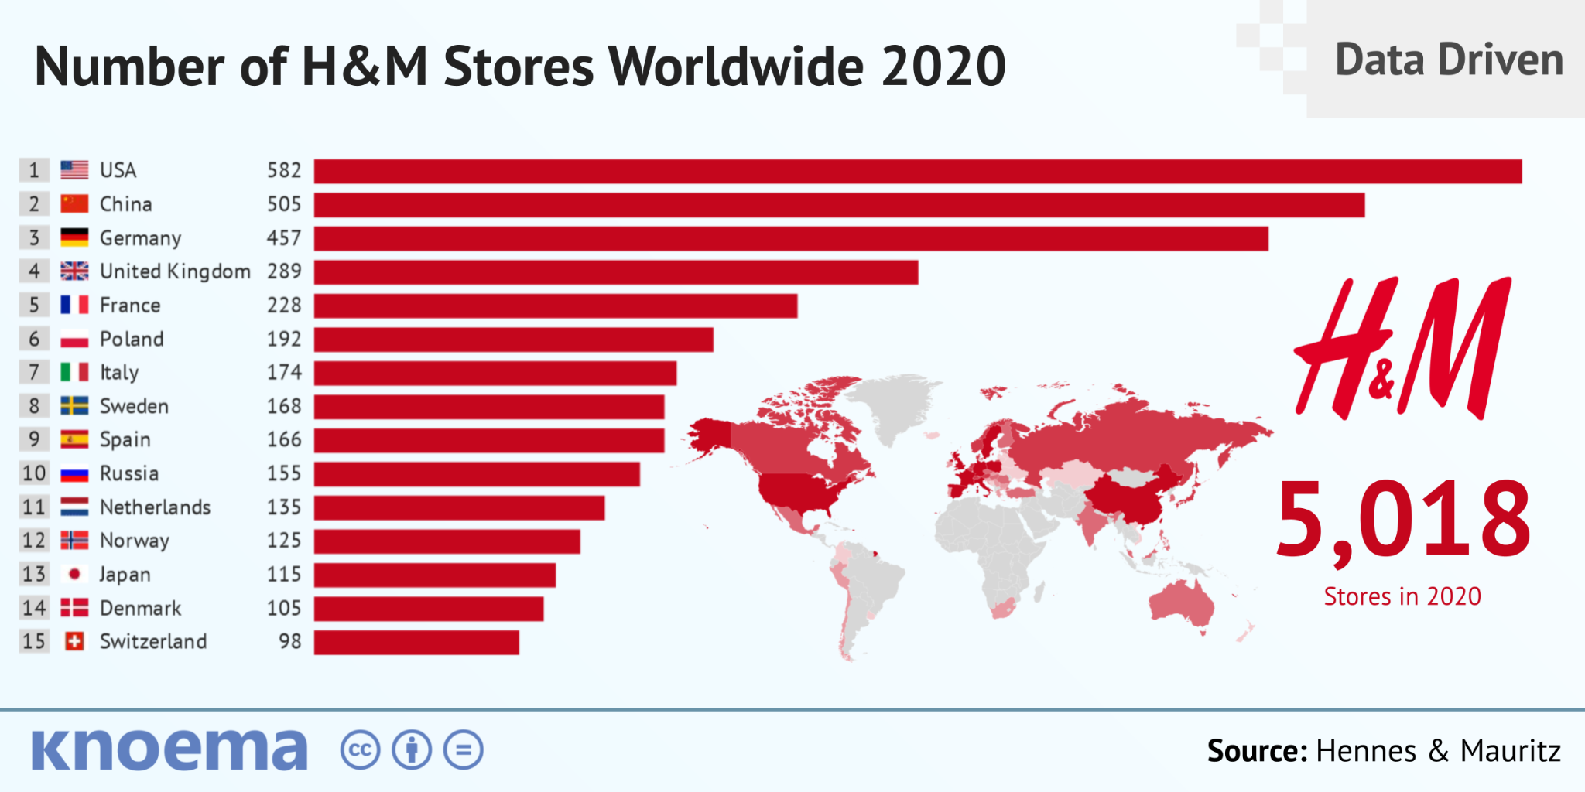
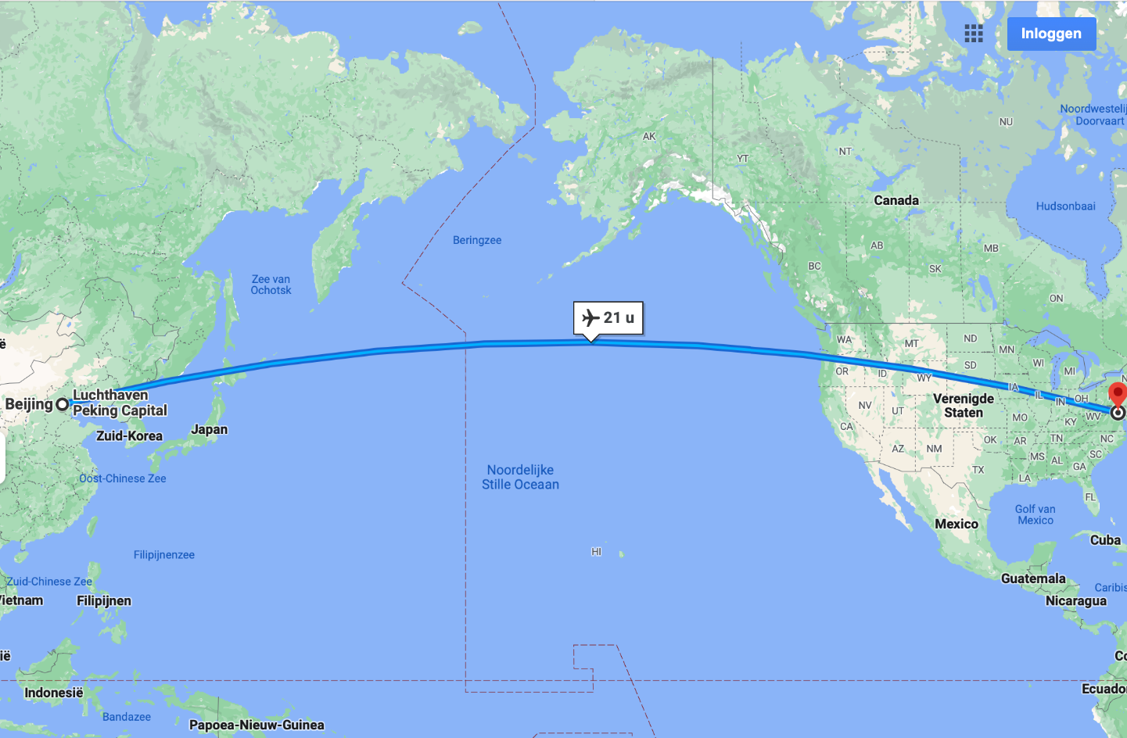
Clothing
Swedish clothing manufacturer and retailer
headquartered in Stockholm, Sweden.
1345 stores back in 2006
21 hour flight

Slide 3
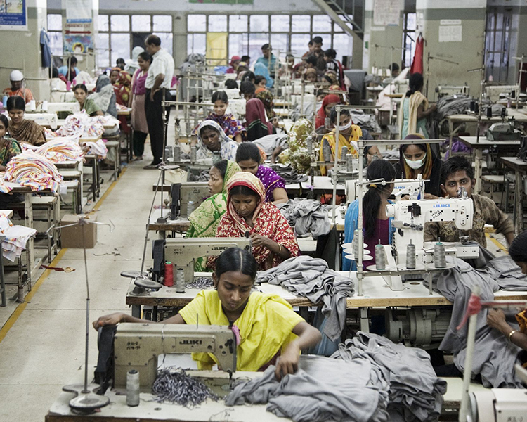
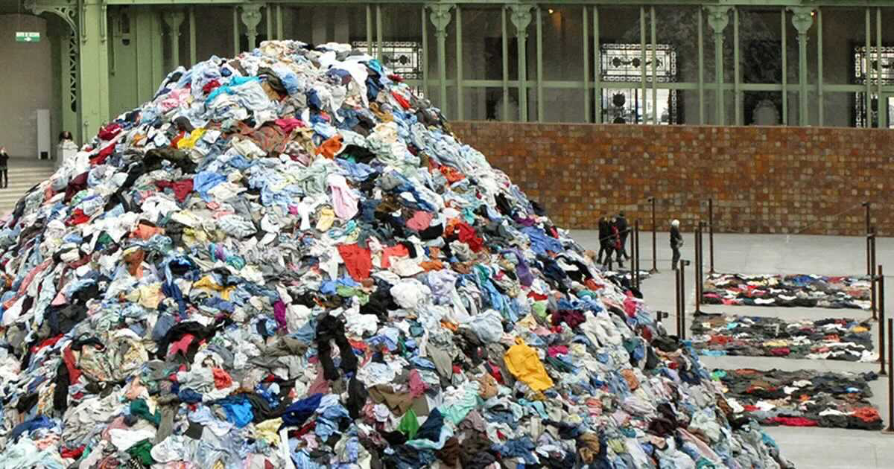
Fast fashion
New styles, influences and methods of production
New trends/ social media
Globalization provides low-cost labour
cheaper and faster production of clothing
Fast fashion
Climate change and environmental pollution
Poor working conditions
child labor
Low quality
Waste

