Slide 1
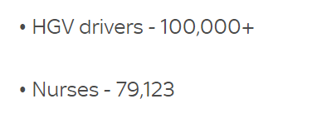
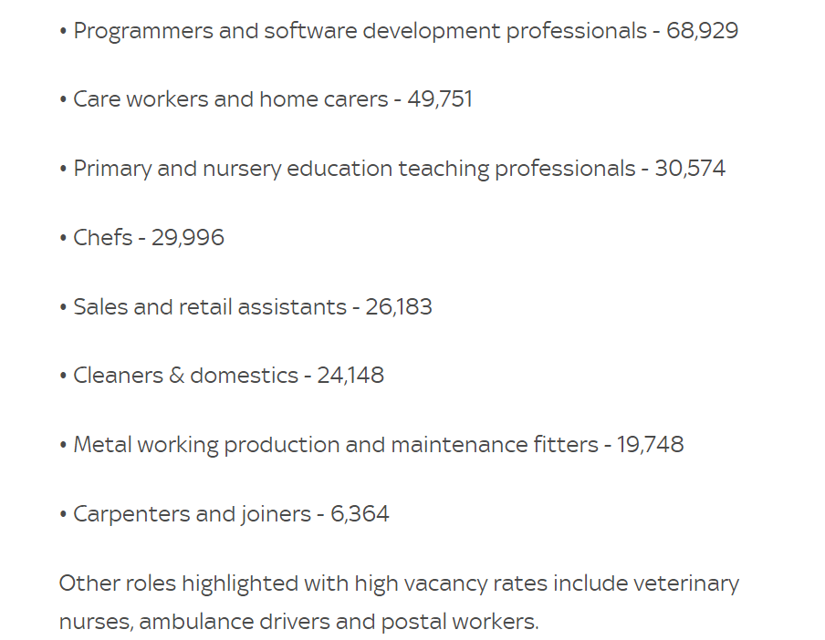
Most Demanded Jobs in the UK (data from September 2021)
The government has created a short skilled work visa to fill vacancies on those fields

Slide 2
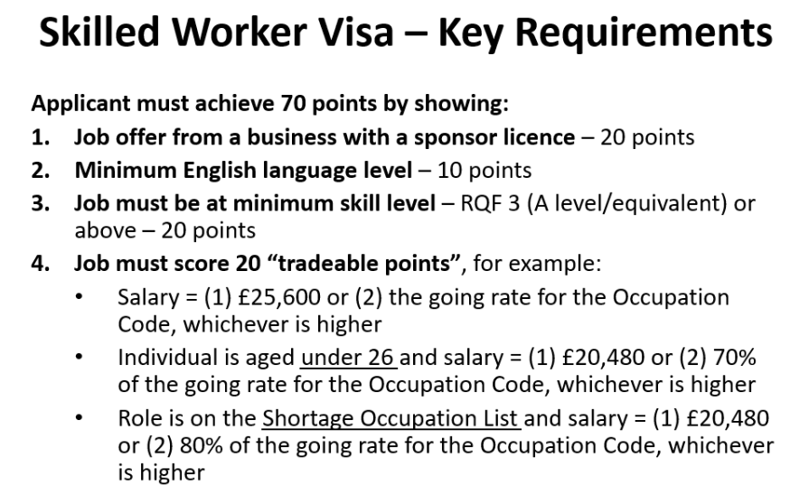
Working in the Uk- from January 2021 new point system introduced to be able to work in the UK

Slide 3
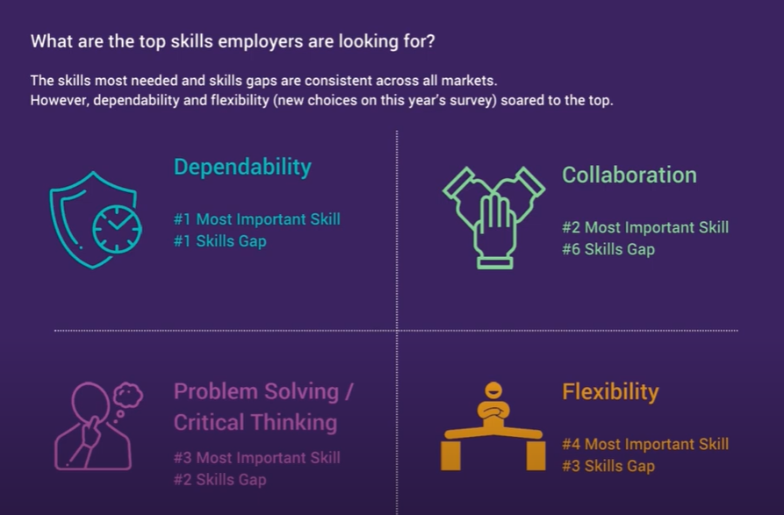
What will the future of jobs be like? - YouTube

Slide 4
Improving your skills:
- The National Careers Service- provides advice on careers and training
-Free courses to help improve literacy and numeracy at work
- free English courses
-apprenticeships

