Slide 1
‘Multiculti' at Cartesius
Amsterdam in London - 2022.04 - Erasmus+ Roots & Roads

Slide 2
‘Multiculti’
Expectations:
Our school ‘Cartesius Lyceum’ is located in one of the more diverse area’s in Amsterdam;
And since about 6 years Amsterdam schools have a lottery system, diversifying most schools’ student bodies.
So, our expectation was that our school would indeed be quite multicultural, ‘multiculti’.

Slide 3
Results:
Multicultural? Yes. Though…
Based on our research (48 responses) we have found oud that:
For one, our school is indeed multicultural, but by heritage. Most of the pupils who originate from other cultures are still born in the Netherlands and are therefore in a lot of instances second or third generation migrants.

Slide 4
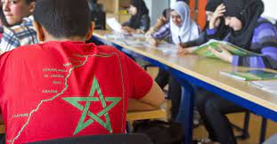
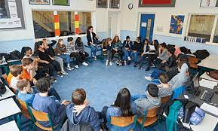
Results:
Multicultural? Yes. Though…
Also, yes, the school is very multicultural, though there are a few backgrounds which make up most of the student body. Those being Dutch, Turkish and Moroccan primarily.

Slide 5
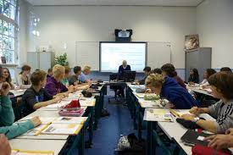
Results:
Multicultural? Yes. Though…
Lastly, most pupils with a non-Dutch background still speak Dutch at home. Either solely, or in combination with their mother tongue.

Slide 6
Government and Integration
We also asked how people thought the government was helping immigrants learning Dutch and integrating into Dutch society.
The response was… negative. For both points the majority response was ‘no’. The government does not succeed in this.
Most solutions proposed were based around education. Free Dutch classes, more classes with Dutch nationals, more classes for adults and so forth.

