Slide 1
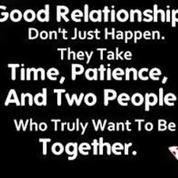
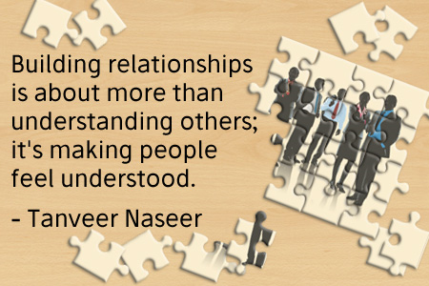
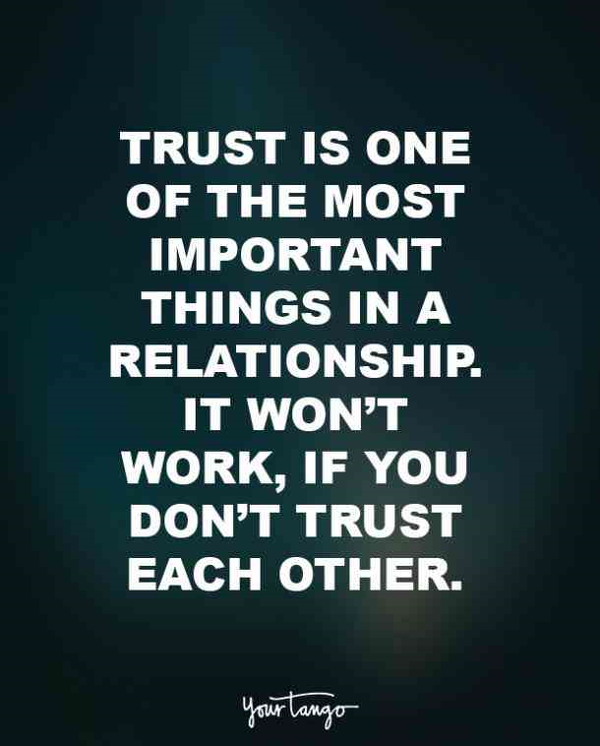
How to build relationships with people from another country?
Make an effort to try to communicate and show interest in the other person
Spend time with the person to create a bond
Share your interest and hobbies
Be patient , respectful and understanding of different cultures and values
Be self- aware of your culture to educate them about your culture
-Think of others
-Listen carefully instead of speaking all the time
-Really listen with your head and your heart
-Take the time to understand how others are feeling
-Create an atmosphere where you can say what's on your mind and share how you feel
-Be warm and friendly
-Show respect when you respond
Notice non verbal clues
Be genuinely interested in everyone you meet and everyone you meet will be genuinely interested in you

