Slide 1
Immigrants’ Achievements in Sweden

Slide 2
Nationalities in Sweden
20% of Sweden’s population are immigrants.
Year 2019-2021 the biggest immigration group came to sweden.
Most immigrants are from Syria, second biggest group is from Iraq and third Finland.
After the crisis in Afghanistan 2021, 1488 Afghans came to Sweden.

Slide 3
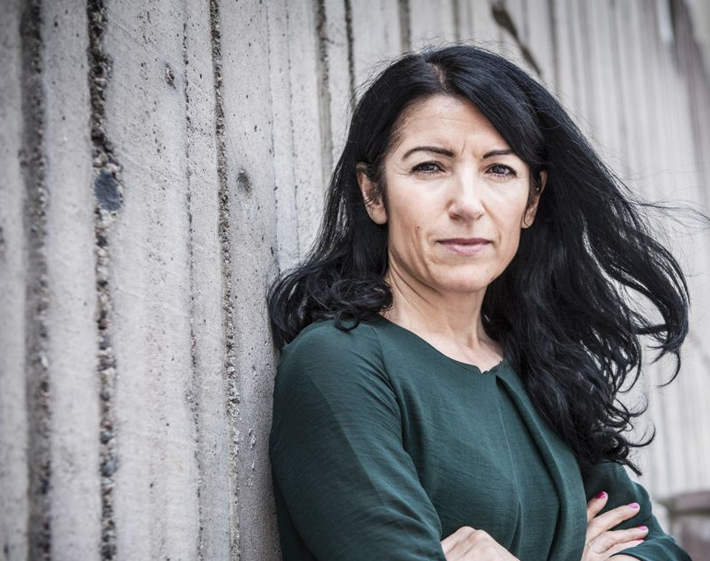
Amineh Kakabaveh
Amineh Kakabaveh is a Swedish independent politician of Iranian Kurdish descent. She immigrated to Sweden at the age of nineteen and has since then become a member of the Parliament of Sweden.

Slide 4
Political career
Inspired by the French movement Ni Putes Ni Soumises, Kakabaveh, in 2005, founded the feminist and anti-racist organization "Varken hora eller kuvad". In the parliamentary elections of 2008 she became a member of the Swedish Parliament. In 2019, she was threatened to be expelled from the Left Party, as a result of a prolonged conflict with the party leadership. Before the issue was settled, she left the party voluntarily.

Slide 5
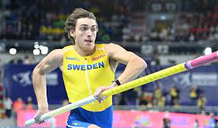
Immigrant track and field athlete, representing Sweden
Armand Duplantis is a great track a field athlete who has the current world record in pole-vault. Duplantis has also won a gold medal in the Olympics.

Slide 6
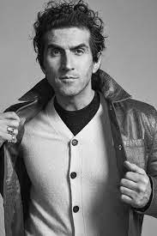
Josef fares
Josef Fares is a Swedish Film director, scriptwriter, actor and game developer who was born in Beirut, Lebanon. He has made many famous movies and computer games!

