Slide 1
The current situation of migrants in the UK

Slide 2
After the second world war, fewer than one in 25 of the population had been born outside the country; today that figure is closer to one in seven.
The Office for National Statistics (ONS) estimate that in 2017, just under 9.4 million people living in the UK were born abroad, (14.3% of the total population of the UK). Of these, 3.7 million were from countries now in the European Union and just under 5.7 million were from non-EU countries.
There are many things that have contributed to this important change of immigration in the UK which are on the following slides.

Slide 3
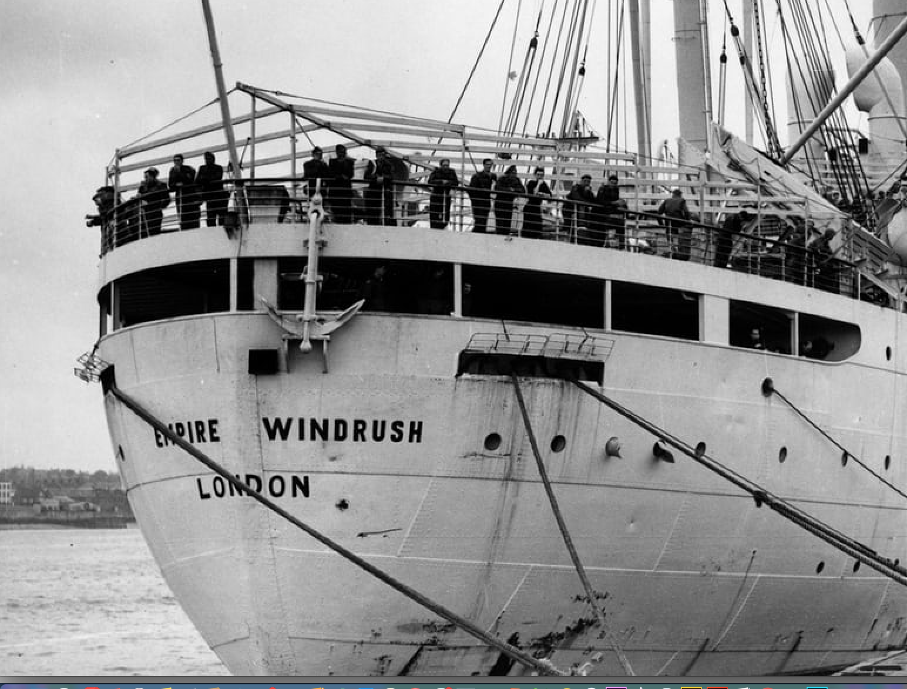
After the war people from all over the Commonwealth came to the UK to help fill the labour shortage. In 1948 a group of 500 or so Caribbean migrants, who arrived on former troopship called the ‘Empire Windrush’. They and the 300,000 West Indians who followed them over the next 20 years, were known as the Windrush generation.
1971 Immigration Act that came into place after riots in London and Nottingham occurred as a result of racial tensions. It stated that Commonwealth immigrants did not have any more rights than those from other parts of the world. This effectively marked the end of the Windrush generation.

Slide 4
In 1992, the UK joined other EU nations in signing the Maastricht Treaty on European integration. This granted all EU citizens equal rights, with freedom to live in any member state they chose.
In the following decade, tens of thousands of EU citizens came to live and work in Britain.
Few people protested, possibly because these newcomers were balanced out by the tens of thousands of British people who moved away to other parts of the EU.
However, we have voted to leave the EU and plan to leave on January 31st so what the impact of this will have on immigration in the UK we are yet to find out.

Slide 5
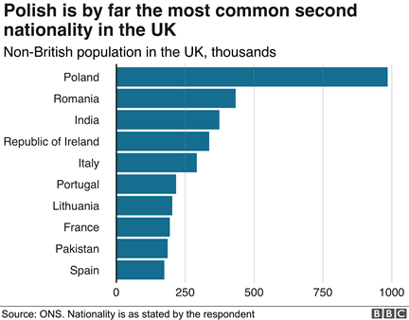
Migration in the UK in the last years

Slide 6
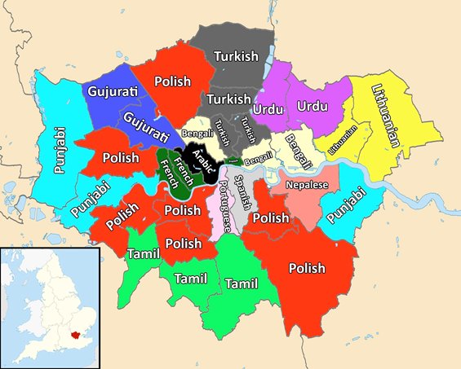
Immigrants in London
Most spoken second language spoken in London

Slide 7
Immigration in Prendergast school
No official data available but similar to the data from London.

Slide 8
Survey between immigrant students at Prendergast School
Reasons their families move to the UK:
Most families for or a better education/life
2 families to scape from a civil war/ conflict in their country
Differences between the UK and their original country
Colder weather
More open-minded people
Different educational system
More diverse
Food
Better transport
More job opportunities

Slide 9
What helped them to feel part of the British society:
Friendly people
The diverse population
Receiving their British citizenship
Having friends here
Being able to communicate with people
Following british customs
Finding open minded people
The school
Being part of the community church

Slide 10
Is there anything else that could/should be done to help immigrants to integrate:
More events where immigrants and british people come together.
More school clubs
More community centres
Culture exchange programmes
Asylum seekers should be able to work when they arrive.
More free English courses
Have more MFL languages at school

