Slide 1
Migration History - Sweden

Slide 2
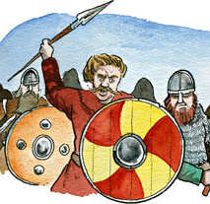
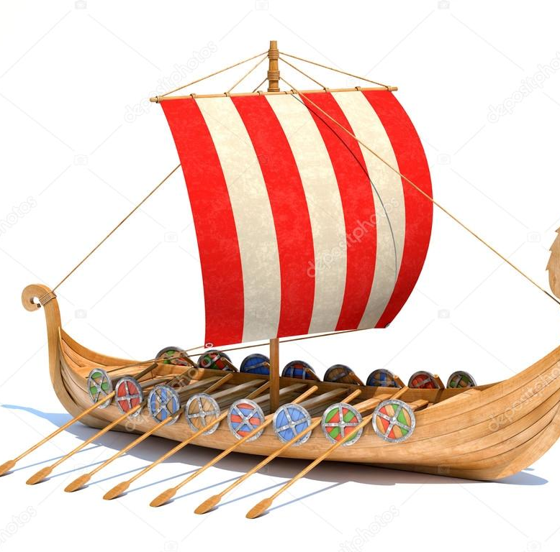
The Vikings
Between 8th century – 12 century a.d.

Slide 3
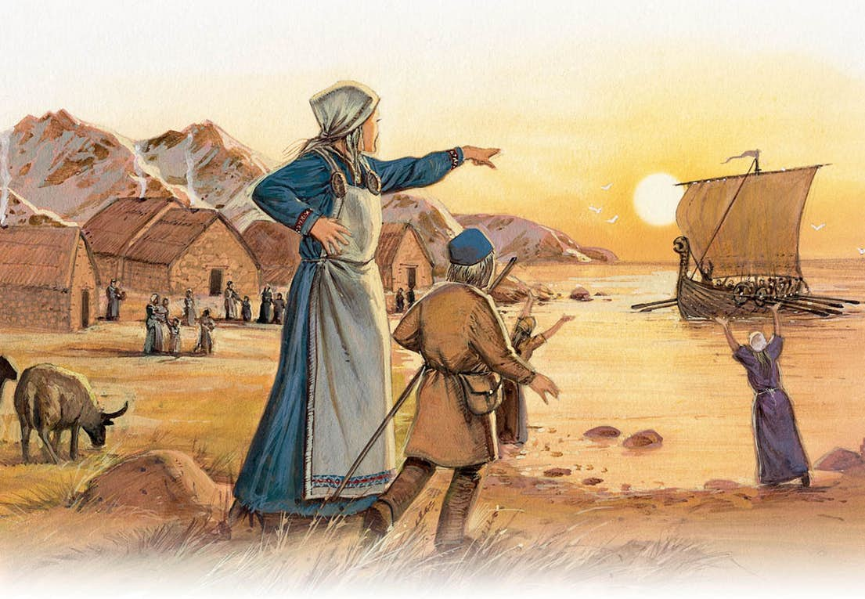
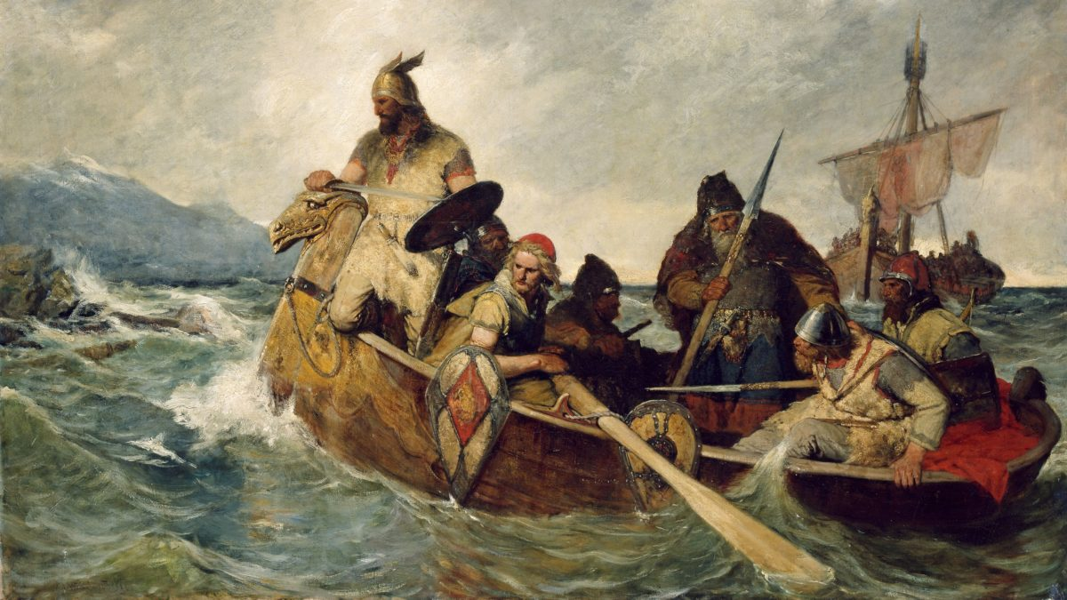
Where did the Vikings come from?
The Vikings came from Scandinavia, mainly from Sweden, Norway and Denmark. They all talked the same language, Norse.
Who were the vikings?
The Vikings were tradesmen and raiders, they ruled in the north. They went on trade trips and created kingdoms. They were also farmers, craftsmen, storytellers and explorers.

Slide 4
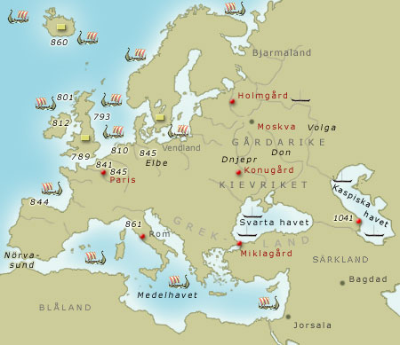
The Vikings' looting trains and trade journeys
Some examples of where Vikings went on their loot trains and some big venues. For example Paris , Holmgård and so on.

Slide 5
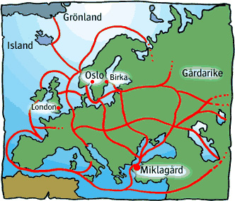
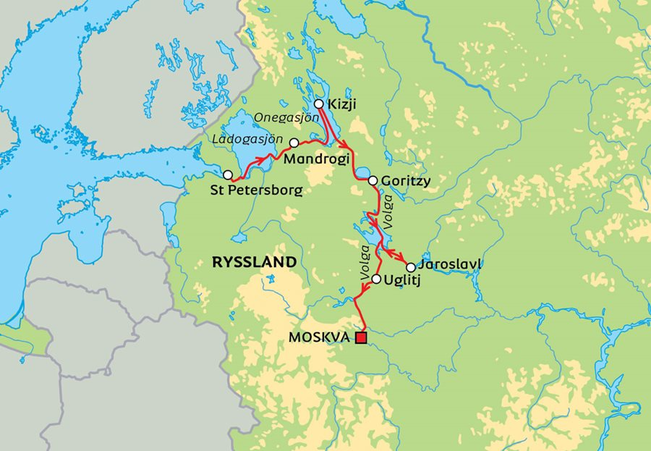
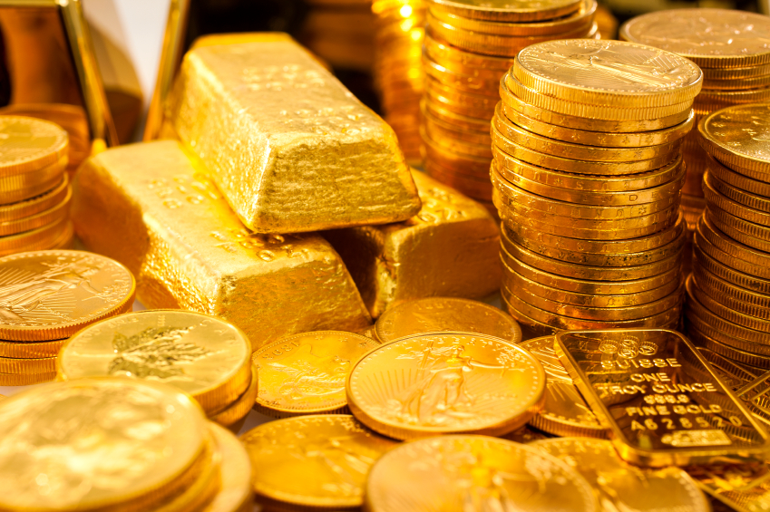
What did this lead to?
Minerals and jewelry
Economically linked rivers
The Vikings trading venues

Slide 6
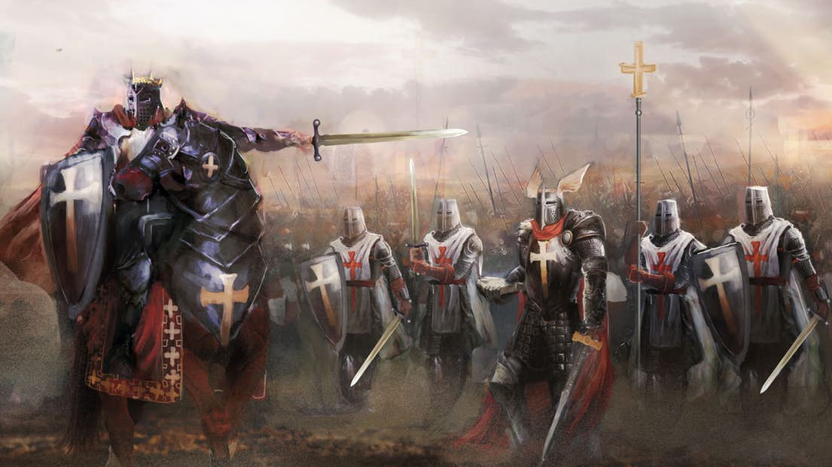
The Three Crusades

Slide 7
The red area is Tavastland.
the circled area is Karelen and Savolax.
.

Slide 8
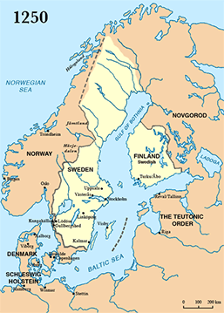

Slide 9
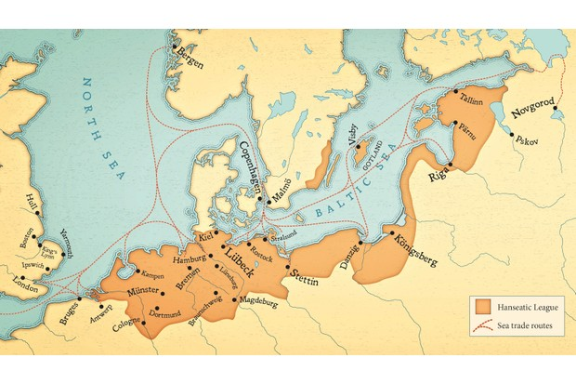
The hanseatic league
1100 - 1600

Slide 10
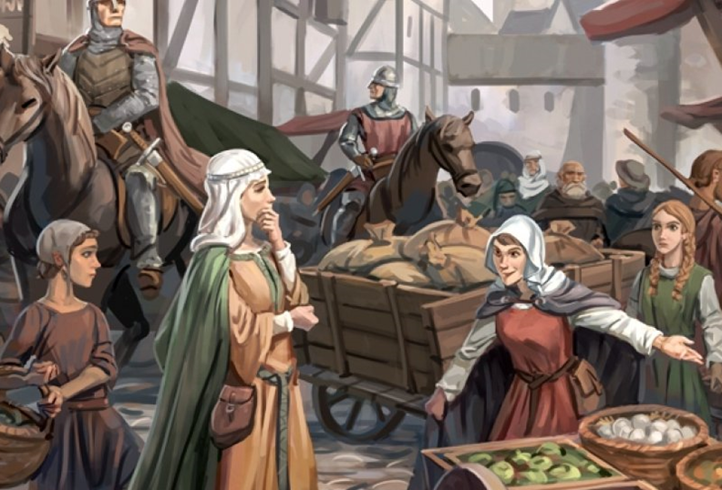
What was the hanseatic league?
Commercial
Defensive
11oos

Slide 11
What did the hanseatic league do/cause?

Slide 12
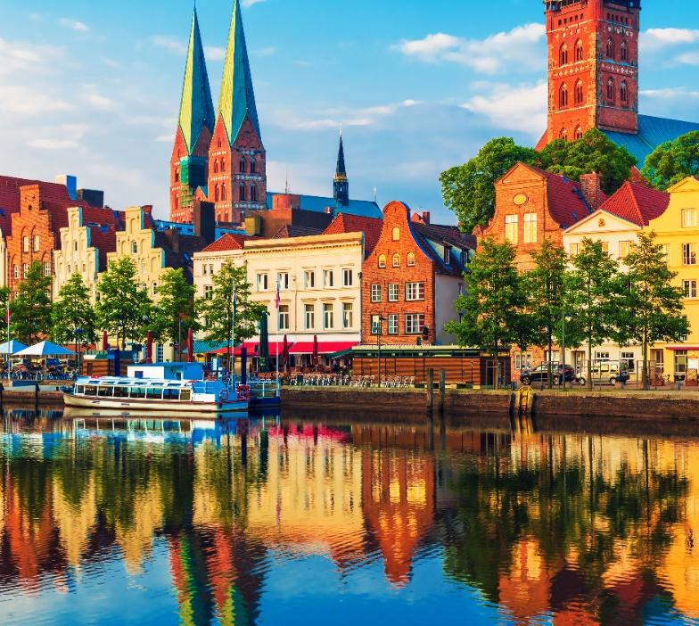
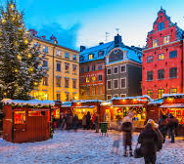
ARCHITECTURE
Lübeck
Stockholm

Slide 13
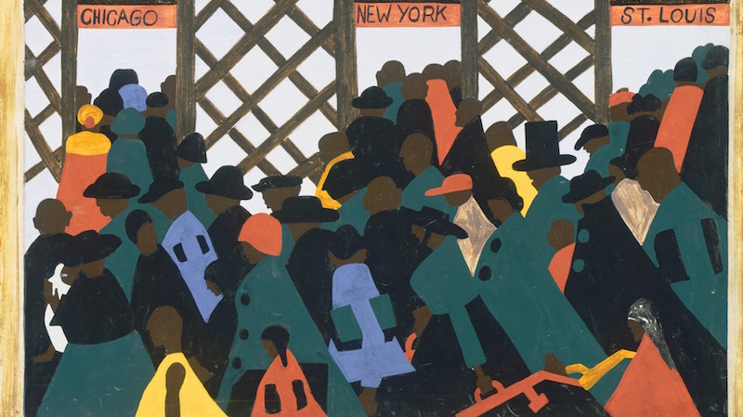
MIGRATION
Walloons, Scots, Dutch and jewish immigration
Det här fotot av Okänd författare licensieras enligt CC BY-SA-NC

Slide 14
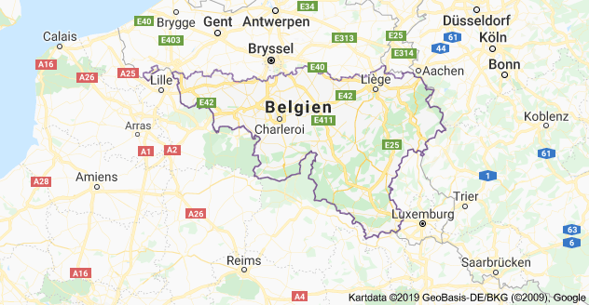
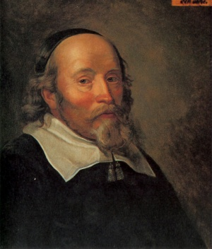
Walloons
Det här fotot av Okänd författare licensieras enligt CC BY-SA
Det här fotot av Okänd författare licensieras enligt CC BY-SA

Slide 15
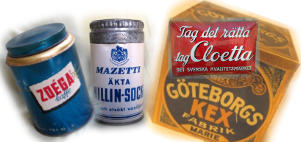
Scots

Slide 16
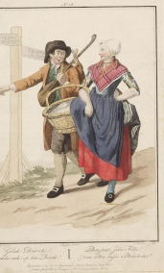
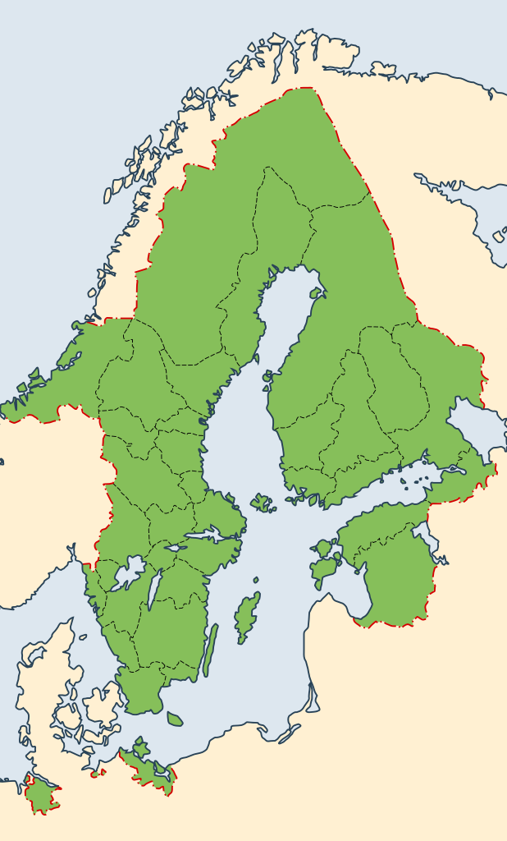
Dutch
Det här fotot av Okänd författare licensieras enligt CC BY-SA
Det här fotot av Okänd författare licensieras enligt CC BY-SA

Slide 17
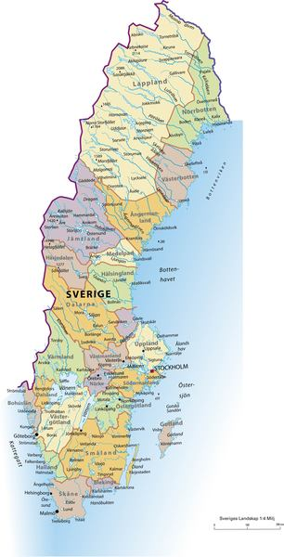
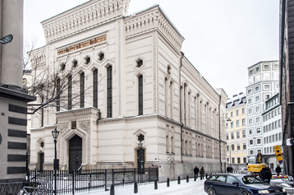
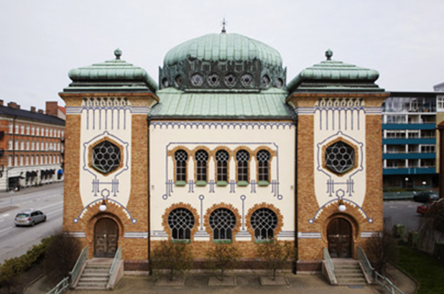
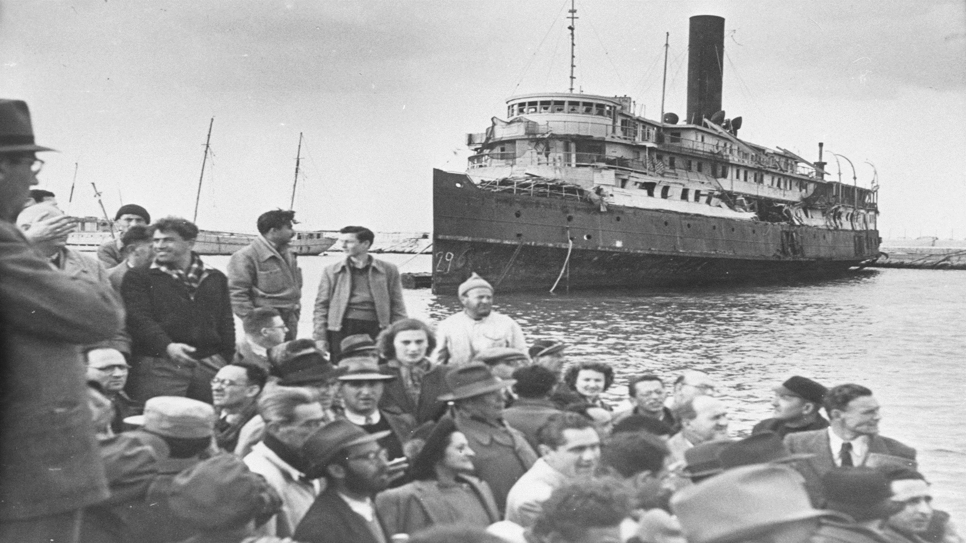
J
E
W
I
S
H
I
M
M
I
G
R
A
T
I
O
N

Slide 18
Thanks for listening

Slide 19
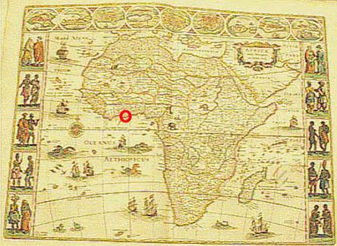
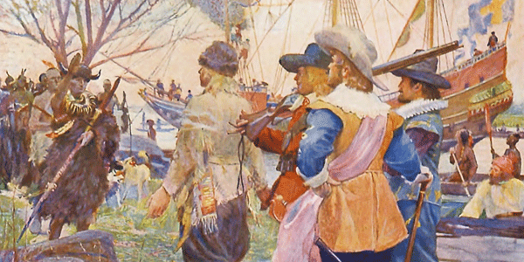
Swedish Colonies

Slide 20
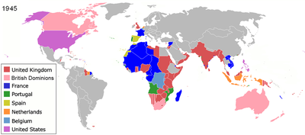
What is a colony?

Slide 21
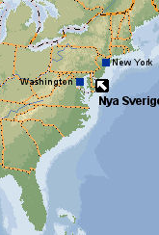
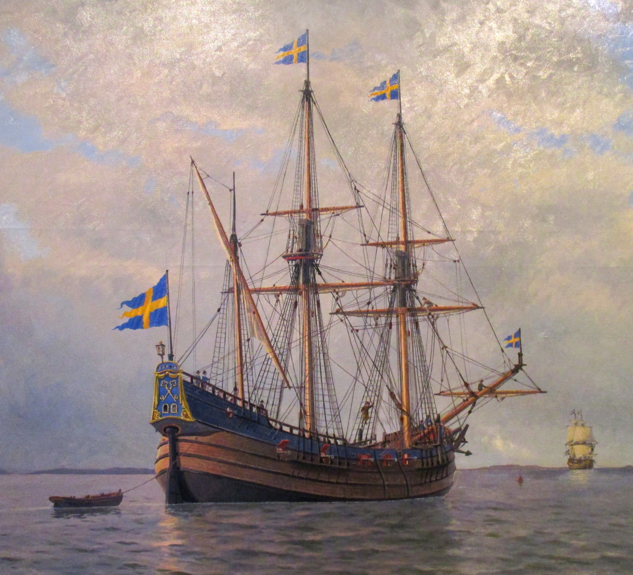
New Sweden
Founded 1638-1655
Covered Delawere, new jersey and Pensylvania
Swedens first colony

Slide 22
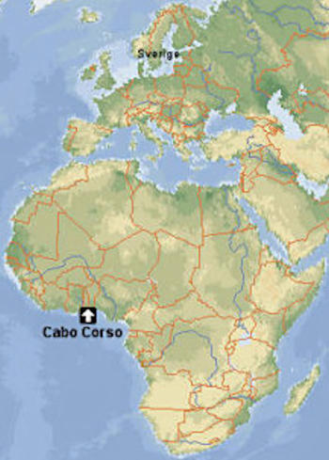
Cabo Corso
Swedish trading colony 1650
The Swedish African Company
Swedish ownership for 11 years, 1650-1658, 1660-1663

Slide 23
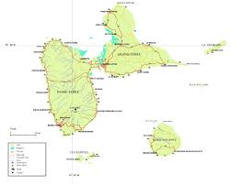
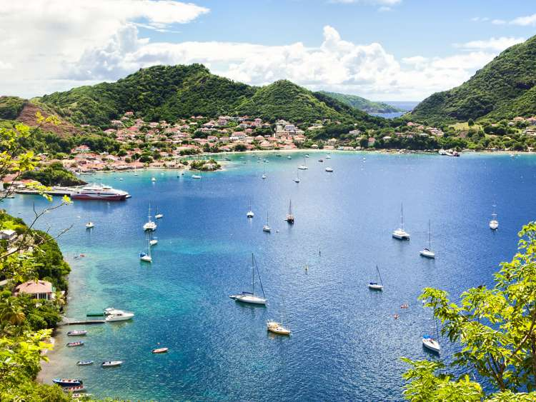
Guadeloupe
Guadeloupe was a Swedish colony in West India 1813-1814
Belonged to the Swedish king and was a gift from the British
Returned to France, replaced by 24 million gold francs

Slide 24
To America

Slide 25
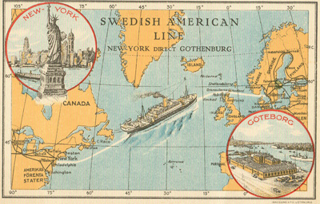
Where did they go?

Slide 26
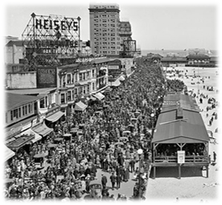
Sweden USA
Agricultural crisis
Cheap arable land
More well-paid jobs

Slide 27
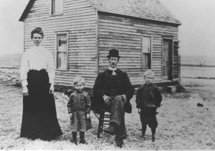
Swedish immigrants in USA

Slide 28
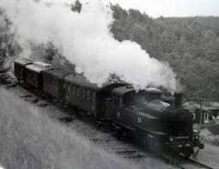
The impacts of the Swedish emigration

Slide 29
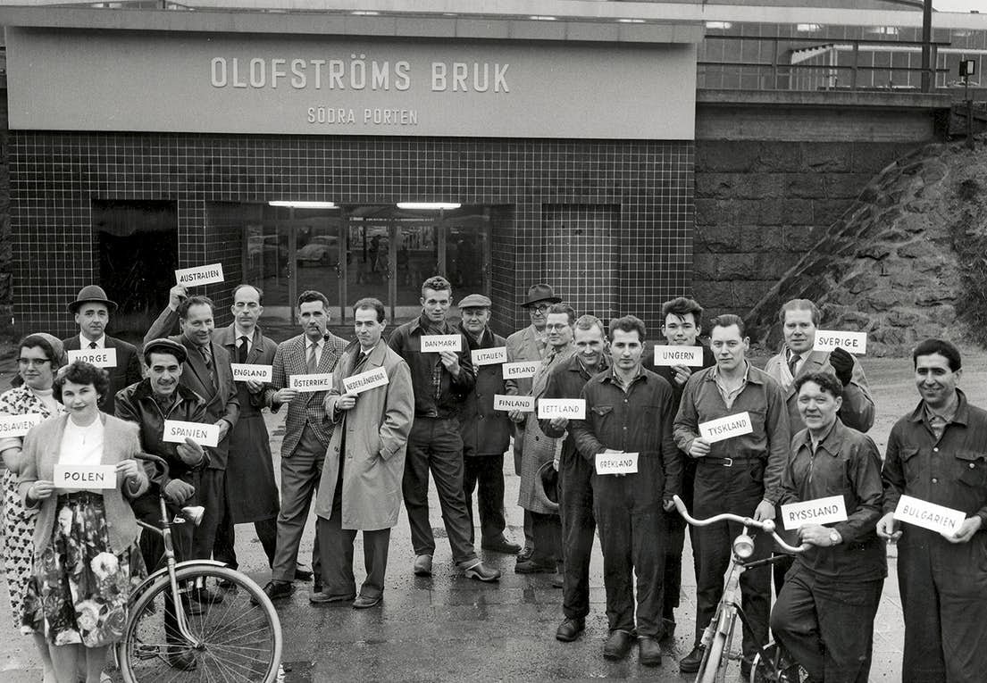
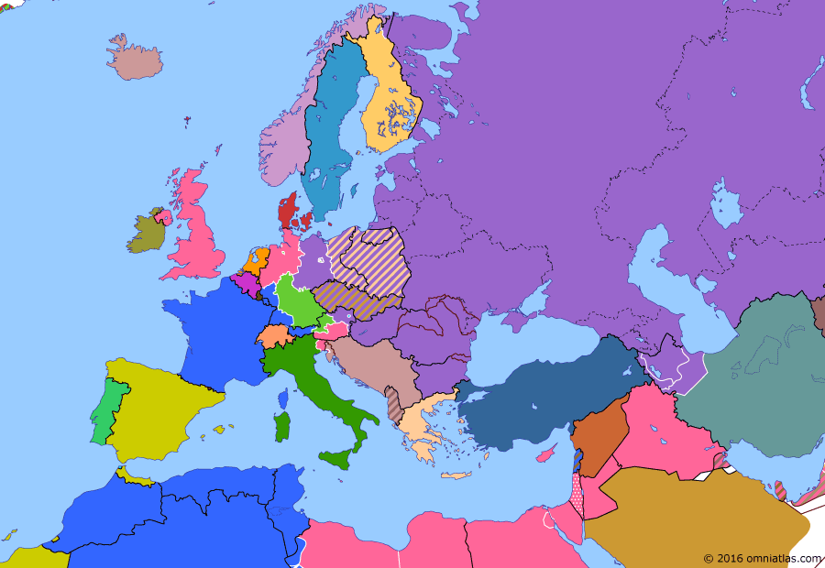
Labor Migration post WW2

Slide 30
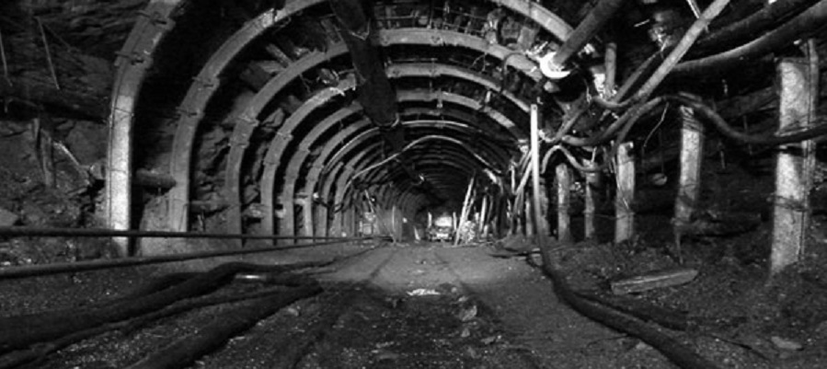
Background
Sweden had a great economy and a lot of factories that needed workers
Other countries didn’t have work possibilities

Slide 31
Overview 1945-1955

Slide 32
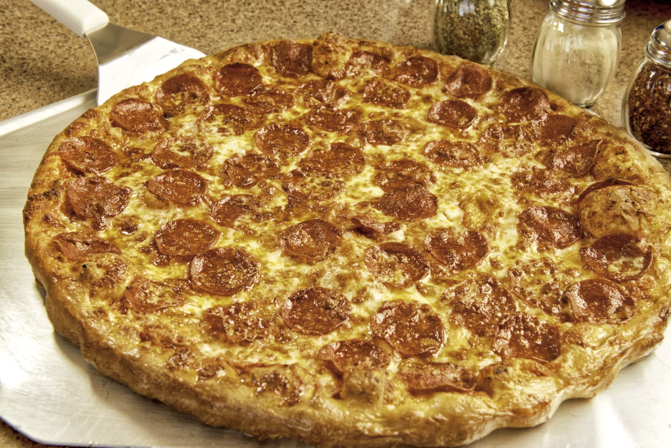
Consequences

Slide 33
Refugee immigration during the last decade

Slide 35
Consequences

Slide 36
Reasons for emigration
- War
- Better job opportunities
- To reunite with family
- Fresh start

