Slide 1
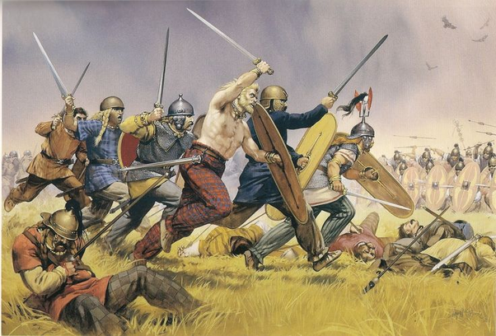
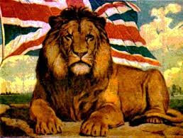
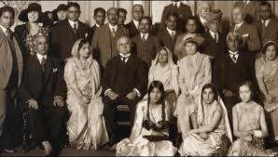
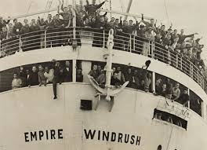
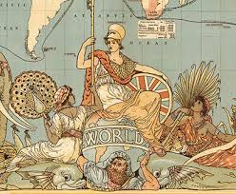
History of migration to Britain
Anglo Saxons, Vikings and Normans
African Migration
European Migration
Asian Migration
Commonwealth Migration

Slide 2
Anglo Saxons, Vikings and Normans
The Vikings were Scandinavians came to Britain in AD 793 to invade it as it was wealthy. At the time England was divided into seven kingdoms and so it was an easy and desirable target.
Anglo Saxons first came to Britain in the 4th Century AD and they created early medieval Britain.
The Norman conquest began in 1066. When William the Conqueror became King of England in 1066 he introduced a new kind of feudal system into Britain. William confiscated the land in England from the Saxon lords and allocated it to members of his own family and the Norman lords who had helped him conquer the country.

Slide 3
African and Caribbean Migration and the Commonwealth
During the 16th Century there was a growing awareness of the slave trade was very ludicrous and the first by-products of African Migration was the importation of a small number of unwilling Africans. By the start of the 17th Century there was an established African community in Britain. By the late 18th Century there was a record of tens of thousands of Africans living in Britain.
Small numbers of people born in the colonies of Australia, New Zealand, Canada and South Africa also migrated to Britain. The British Nationality Act 1948 granted the subjects of the British Empire the right to live and work in the UK. Commonwealth citizens were not, therefore, subject to immigration control but the Home Office estimate is that the net intake from January 1955 to June 1962 was about 472,000. From 1962 onwards, successively tighter immigration controls were placed on immigration from the Commonwealth. In 1998, net Commonwealth migration leapt to 82,000 and continued to grow before peaking at 156,000 in 2004 before beginning to decline.
Windrush generation: British colonies in the Americas and the Caribbean were invited by the British Government to come to work in England; very often as bus drivers. Britain was seen as the mother country of the Brtish Empire. Windrush carried 492 migrants who were coming to a country promising prosperity and employment.

Slide 4
European Migration
French Huguenots were French protestants who first arrived to England in the late 17th Century after escaping political unrest. French Huguenots were viewed as very sophisticated and wealthy. A lot of them opened banks and became very successful in England.
In 1709 German refugees known as ‘Poor Palatines’, fleeing French invasion, began to move to England with perhaps as many as 13,000 arriving.
There is also a long standing history of migration from Eastern Europe to the UK. Polish merchants began arriving in England in the sixteenth century, and in the eighteenth century, a number of Polish Protestants immigrated to England. By the 1901 Census there were 82,844 Eastern Europeans living in Britain.
Around 3.7 million people living in the UK in 2018 were citizens of another EU country which is 6% of the population of the UK.

Slide 5
Asian Migration
A large majority of Pakistani migrants in the UK originate from Mirpur in Kashmir, which has a long history of out-migration. Sailors from Mirpur found work as engine-room stokers on British ships sailing out of Bombay and Karachi, some of whom settled in the UK in the late 19th and early 20th centuries.
Pakistani migrants who came to Britain after the war found employment in the textile industries of Lancashire, Yorkshire, Manchester and Bradford, cars and engineering factories in the West Midlands, and Birmingham, and growing light industrial estates in places like Luton and Slough.
Other groups who migrated from Pakistan in the 1960s include Punjabis who mainly settled in Glasgow, Birmingham and Southall in London, and migrants from urban areas who were more likely to be professionals and who worked for the NHS.
When India gained its independence from British rule, the country was partitioned creating a new state of Pakistan. Most Bangladeshi families in the UK in the present time are the result of large scale migration in the early 1970s from the Sylhet region of Bangladesh, as people fled from the civil unrest in their homeland, to seek a better life in Britain.

