Slide 1
Children’s rights: Unity in diversity and why should we listen to kids?
The Netherlands

Slide 2
Index
Article 12
Article 29
The basics of respects for a child
The results of your survey
What’s our opinion?
Sources

Slide 3
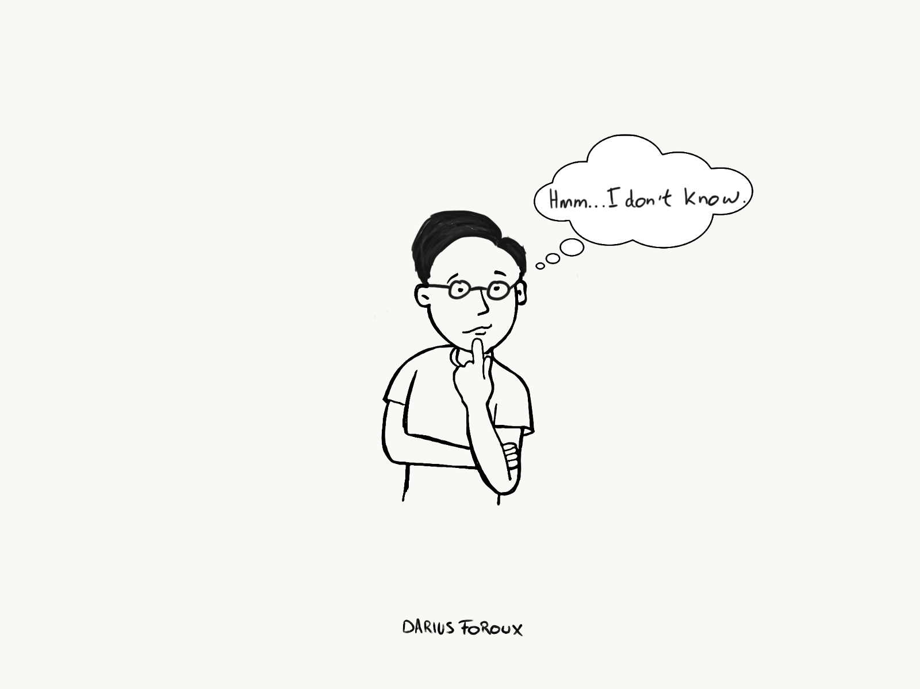
Article 12
‘’12. You have the right to give your opinion, and for adults to listen and take it seriously.’’
‘’Children must be taught how to think, not what to think’’
Parents
‘’Children aren’t coloring books. You don’t get to fill them with your favourite colours’’

Slide 4
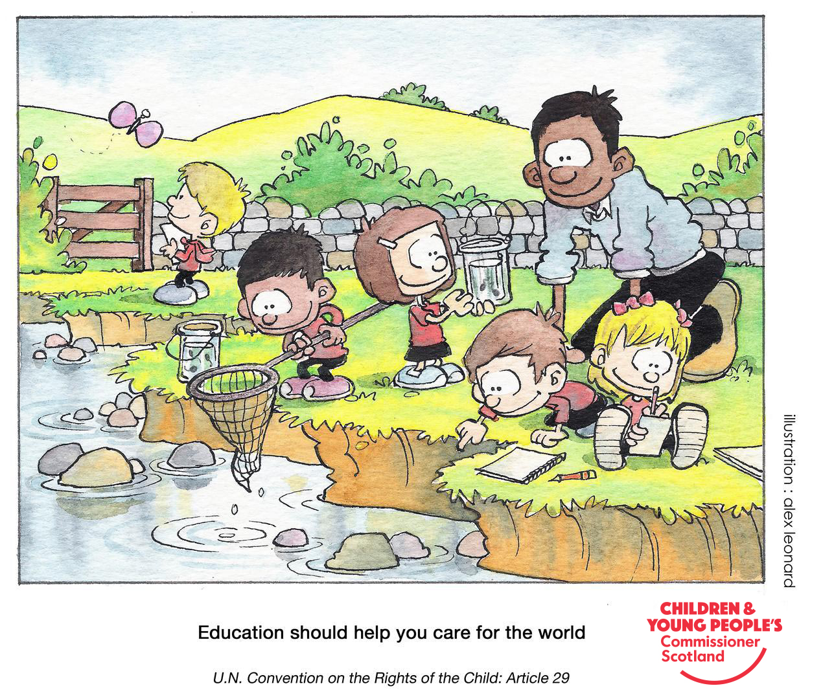
Article 29
Article 29: Your education should help you use and develop your talents and abilities. It should also help you learn to live peacefully, protect the environment and respect other people.
Guide how to live in peace Kids should respect
Seek to love, not control others. … - Their rights and the rights
Find Your Inner Peace. … and the rights of others.
Moderate your convictions. … - Their parents
Be tolerant. …
Be Peace. …
Reflection of thought. …
Seek forgiveness, not revenge. ...
Live in joy.

Slide 5
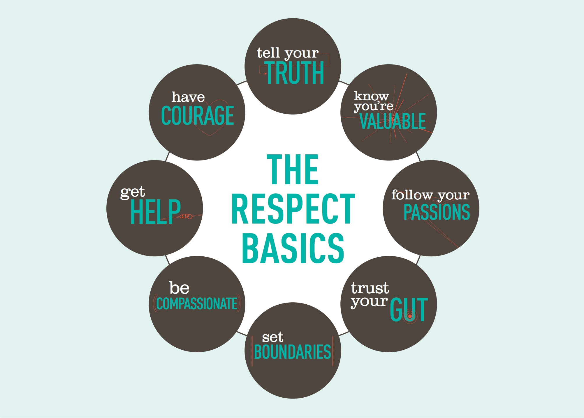
The basics of respect for a child

Slide 6
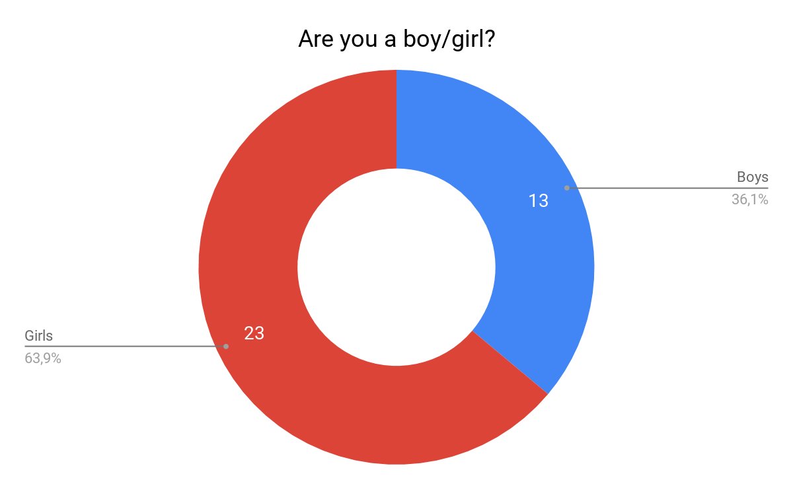
Results of the survey:

Slide 7
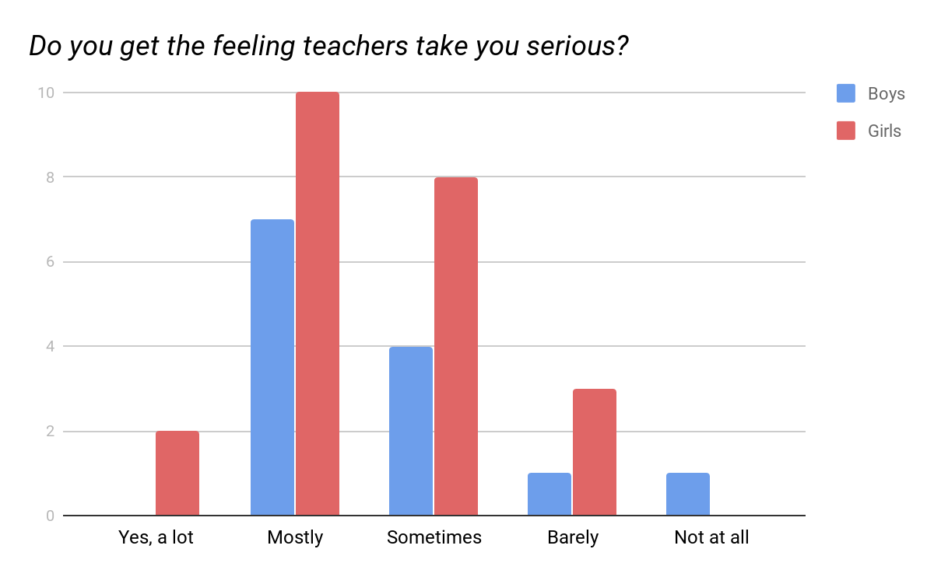
Results of the survey (cont.):

Slide 8
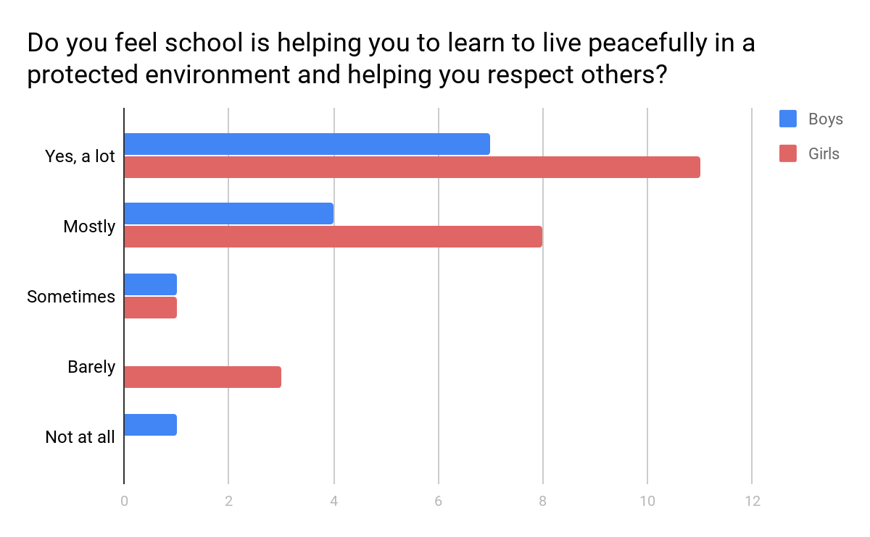
Results of the survey (cont.):

Slide 9
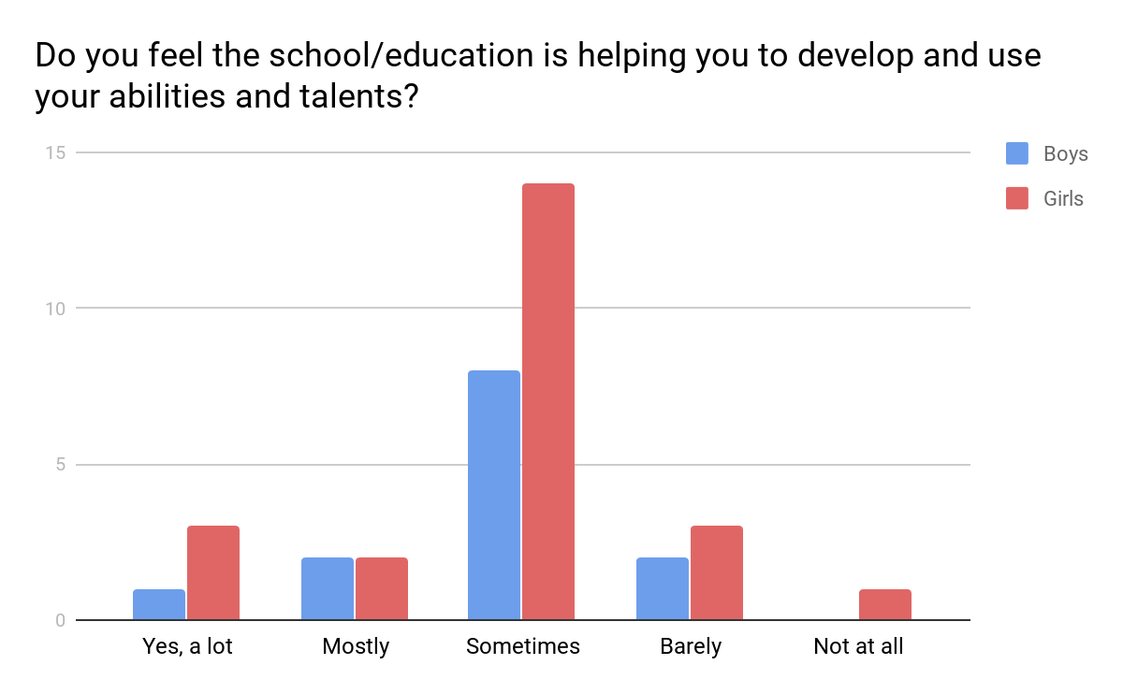

Slide 10
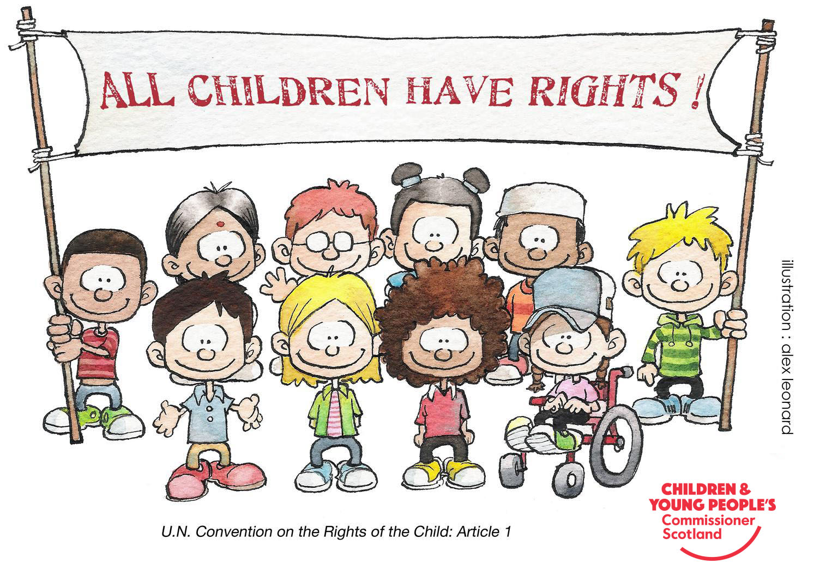
What’s our opinion?

Slide 11
Sources
https://www.cypcs.org.uk/rights/uncrcarticles/article-29
https://www.youtube.com/watch?v=hiHLjrPEHf0
https://en.wikipedia.org/wiki/Children%27s_rights
https://www.nji.nl/nl/Download-NJi/Publicatie-NJi/Being_Young_in_the_Netherlands_2012.pdf
https://nl.surveymonkey.com/dashboard/
Our Brains

