Slide 1
Language in Sweden

Slide 2
What other languages than Swedish do you think are quite frequently spoken at Bromma gymnasium?
Greek
English
Arabic

Slide 3
What foreign languages have had an impact on the Swedish language?
German
French
English
Arabic

Slide 4
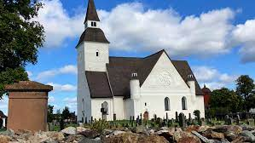
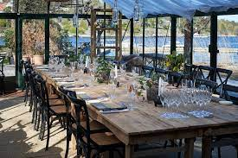
Words or phrases that have had an impact on the Swedish language and what language it originate from
Kyrka- kirche
Restaurang- restaurant
Shoppa- Shop
Yalla- Yalla

Slide 5
Swedish words or phrases that cannot be directly translated into other languages (easily)!
Knas
Vabba
Lagom
Mol äta
Sisådär
Fika
Sitter på sniskan
Hinna
Lördagsgodis
Levebröd

Slide 6
I was over 10 and I came from Greece. I speak Greek and Swedish at home. It took me Three years to learn Swedish and I took extra language lessons. I am able to make more friends since I can talk to more people. The easiest way to learn was by reading and talking to new friends!

Slide 7
I was younger than 10 when I moved to Sweden from Germany. At home I speak both German and Swedish but I´m most comfortable speaking Swedish. It took me less than one year to learn Swedish. The easiest way to learn for me was listening to others speak and in school.

Slide 8
I was younger than 10 when I moved to Sweden from Finland. I can only speak Swedish sadly.

Slide 9
I moved to Sweden when I was younger than 10 from Thailand. At home I speak both Thai and Swedish but I prefer Thai. It took me less than one year to learn Swedish. The easiest way to learn was by speaking with others.

Slide 10
Language barriers
The lack of language skills in Europe affects the jobmobility
Common language barriers
• the use of slang
• different accents
• different spelling of words
• lack of practice

Slide 11
Languages in danger
Icelandic
Latvian
Lithauanian
Maltese
Even Bulgarian, Greek and polish are at risk

Slide 12
How do we overcome language barriers?
•speak slowly and clearly
•avoid local slang
•provide more language classes
•use visual methods to communicate
•learn a universal language ( English for example )

Slide 13
Immigrants and language barriers
Language barriers can make refugees feel isolated, hopeless and anti-social.
Having okey language skills allows immigrants to progress along the job-ladder and access to better-paying jobs.
Having easy access to language learning also makes integration more effective. Language is important to social life.

