Slide 1
“Our Town Our Country”
Our Lady of Fatima school,
Carrigeen St.,
Wexford

Slide 2
IMAGE FROM WEXFORD BRIDGE

Slide 3
Wexford Town Ireland
Wexford town is situated in the South East of Ireland
Population 69,850
5 Second Level Schools, 5 Primary and 1 Special School.
Partnership College with Carlow IT
1 County Hospital

Slide 4
MAP OF WEXFORD STREETS

Slide 5
Local Attractions
Opera house
Marina
Historical monuments
Heritage park
Hook lighthouse
Famous twin churches (Bride St. & Rose St.)

Slide 6
WEXFORD OPERA HOUSE

Slide 7
JOHNSTOWN CASTLE CO. WEXFORD

Slide 8
HOOKHEAD LIGHTHOUSE

Slide 9
WEXFORD FLAG

Slide 10
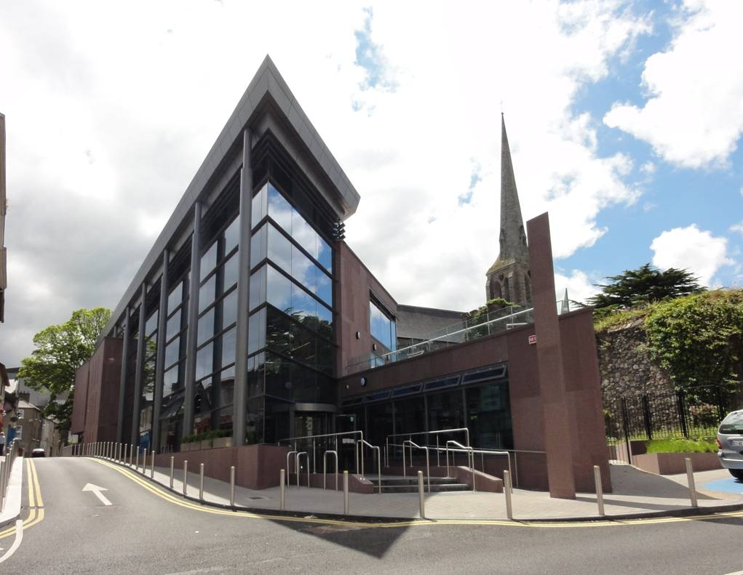
WEXFORD TOWN NEW LIBRARY

Slide 11
WEXORD BULLRING

Slide 12
WEXFORD MAIN STREET

