Slide 1
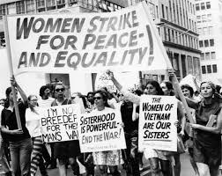
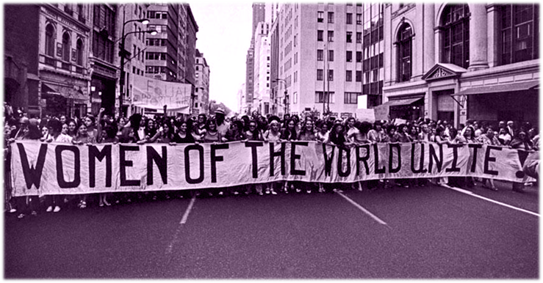
International Women's Day

Slide 2
celebrated on the 8th of March every year
global day of recognition celebrating the social, economic, cultural and political achievements of women and girls
it raises awareness of the work left to be done when it comes to gender equality
purple is historically associated with efforts to achieve gender equality, wearing the color purple can show support for women and equality
it is segnificant for Civil awareness day, Women and girls day, Anti-sexism day and Anti-Discrimination Day
German poster for International Women's Day, March 8th, 1914

Slide 3
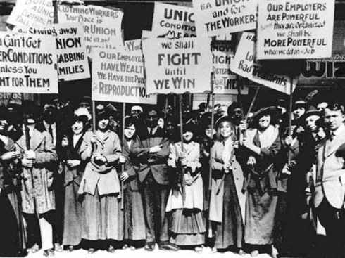
GENDER EQUALITY
the world has made unprecedented advances, but no country has achieved gender equality
women earn 23% less than men globally
women occupy only 24% of parliamentary seats worldwide
1 in 3 have experiences physical or sexual violence

Slide 4
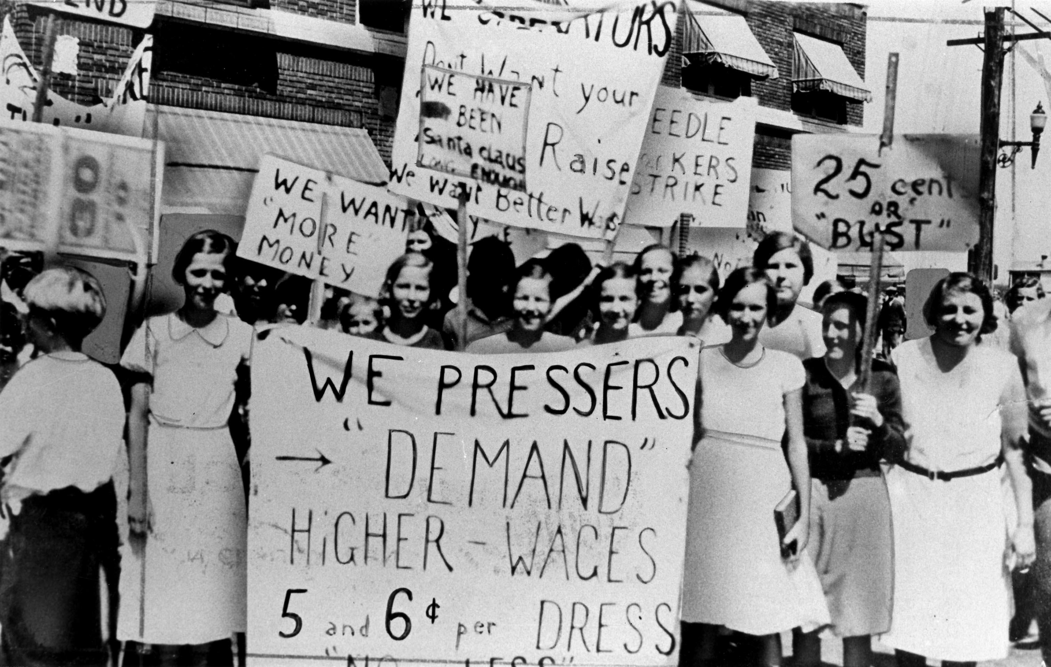
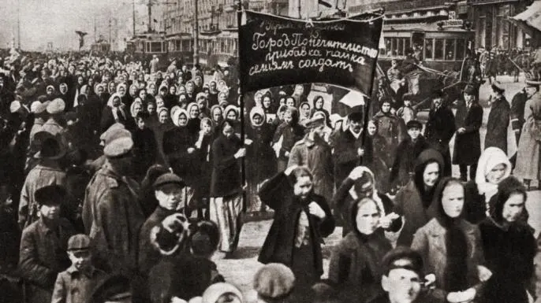
HISTORY
the frist Women’s Day was held in New York City on February 28th, 1909 organized by the Socialist Party of America at the suggestion of activist Theresa Malkiel
the very first international women’s conference was organized in Copenhagen in 1910 by the Socialist International where it was decided that International Women’s Day would be celebrated every year on March 8th

Slide 5
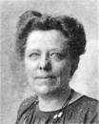
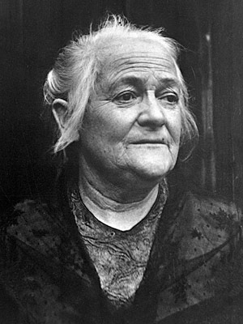
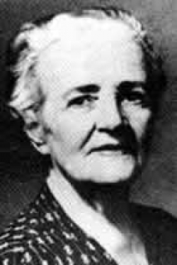
WOMEN WHO STOOD UP FOR WOMEN’S RIGHTS
Luise Zietz- a German socialist and feminist, first woman to occupy a leading party post in Germany
Clara Zetkin- a German Marxist theorist, activist, and advocate for women’s rights
Käte Duncker- a German political and feminist activist

Slide 6
THANK YOU FOR YOUR ATTENTION!
MADE BY: TENA ĆORKO, 8.D

