Slide 1
WINTER HOLIDAYS IN MOLDOVA
BY EȘANOV CRISTI

Slide 2
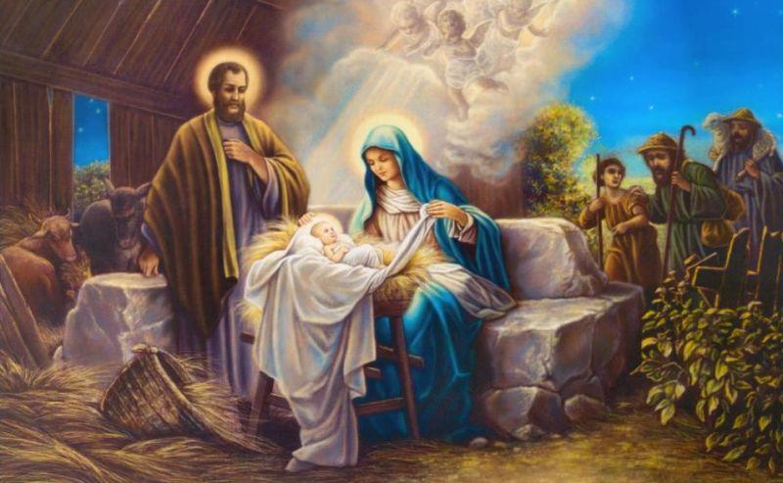
CHRISTMAS

Slide 3
Christmas is celebrated on 7th January. However, unfortunately, this holiday isn’t widely celebrated inside the country. Usually just old people celebrate it and all others just have free day. Some people this day go to their grandparents.

Slide 4
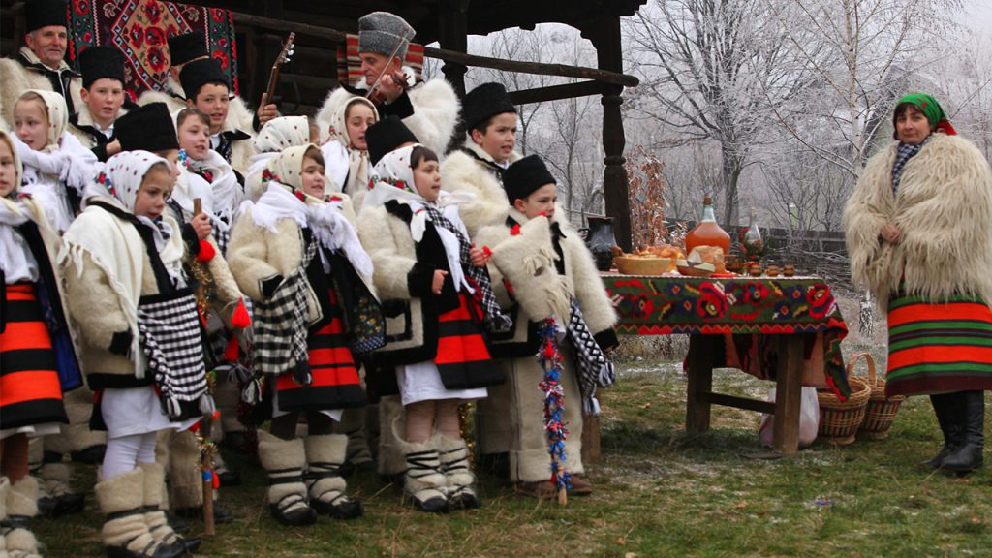
CAROLING

Slide 6
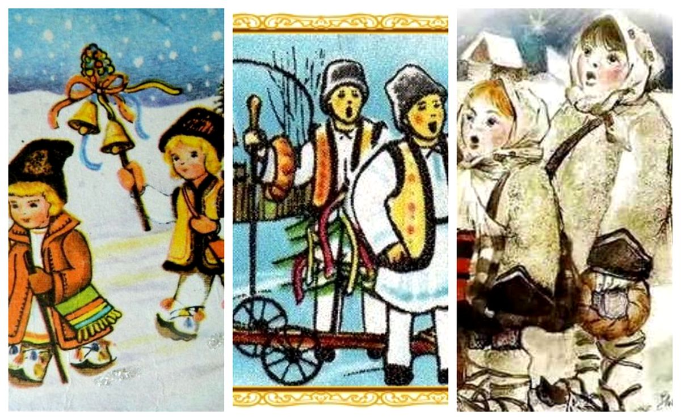
“SORCOVA’’ AND “PLUGUȘORUL‘’
Kids go around houses carolling, then around New Years with the “Sorcova” and “Plugușorul” to bless who they visit. They all wear specific clothing or traditional elements when doing this.

Slide 7
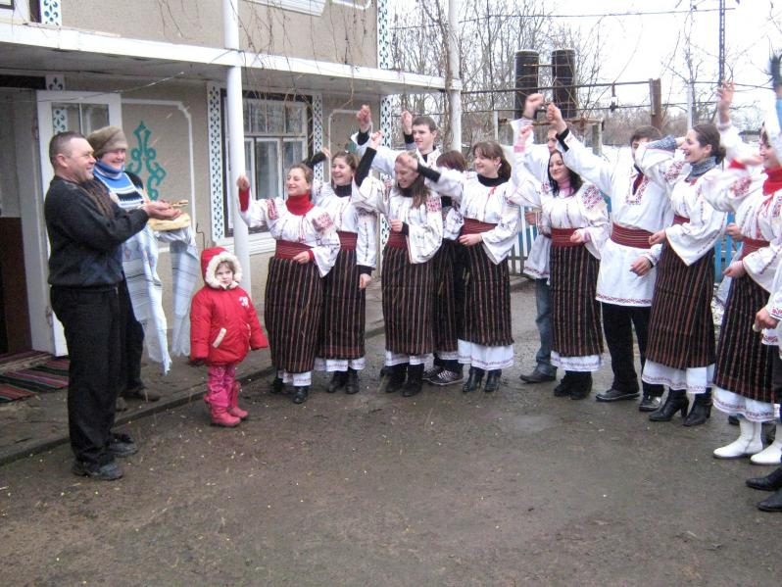
SOWING
On the morning of the New Year, as a continuation of Plugușor, the children walk with the sowing . They throw wheat, corn or rice seeds through homes and over people.

Slide 8
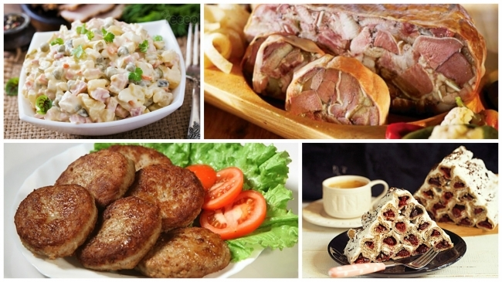
CHRISTMAS FOOD IN MOLDOVA

Slide 9
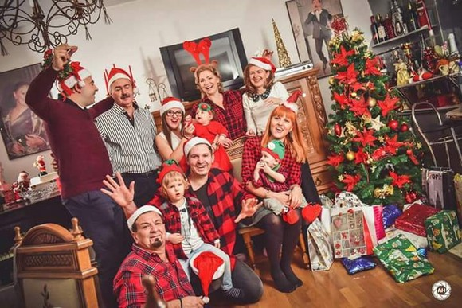
FOR CHRISTMAS FAMILY IS GETTING TOGETHER

