Slide 1
Holidays Celebrations
in Romania

Slide 2
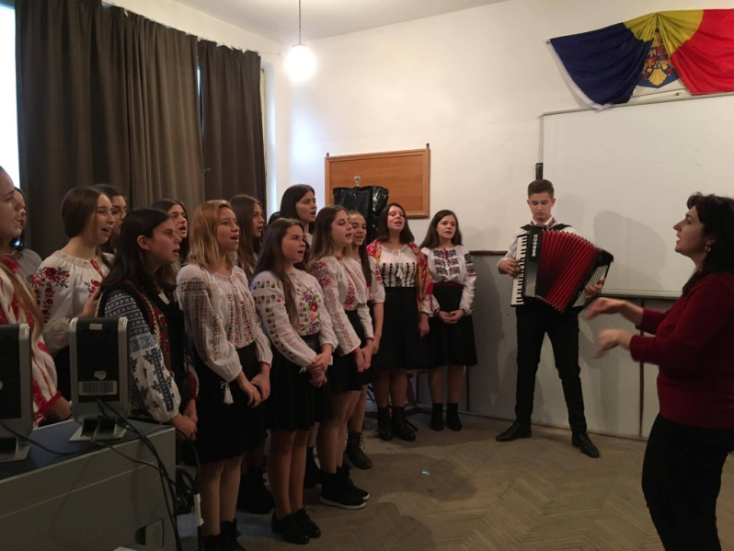
The most important tradition of the romanian people is carol singing.
Colegiul National “Grigore Ghica” , Romania

Slide 3
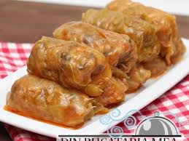
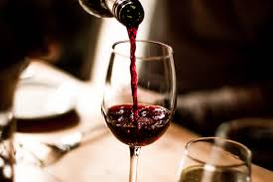
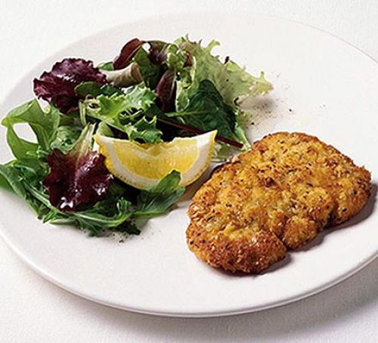
Romanian cabbage rolls:
Vegetable oil – We’ll be using this to saute the onion and rice. You can use any type of oil that you have handy.
Onion – I used a large onion because this recipe makes a lot of cabbage rolls. Every bite should have onion in it!
Long grain rice – Basmati rice is best. I wouldn’t use brown rice- it takes a lot longer to cook than white rice and you may end up with crunchy bits in your rolls.
Ground pork – I love to use pork because it has a higher fat content and makes for some nice juicy rolls.
Traditional drink for Christmas : WINE
4 thin pork steaks (about 100g/4oz each)
3-4 tbsp plain flour
1 egg
, well beaten
85g breadcrumb (fresh or bought)
3 tbsp chopped roasted hazelnut ,1 tsp dried thyme 1 lemon ,zest only 3 tbsp light olive or sunflower oil 1 knob of butter
Colegiul National “Grigore Ghica”, Romania

