Slide 1
Christmas traditions in Republic of Moldova
By Adelina Juncu

Slide 2
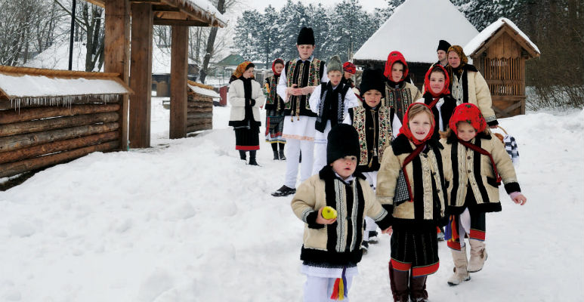
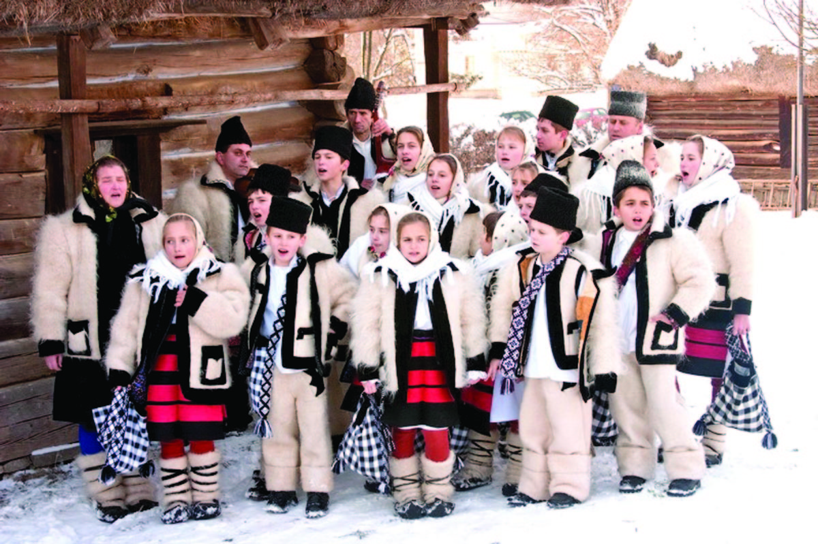
Caroling
At Christmas, children walk with the carol from house to house, bringing the news of the birth of Christ. Children, properly dressed, are rewarded with sweets. It is said that if you open the door of the carol and receive their wish with joy, then you will have a better new year.

Slide 3
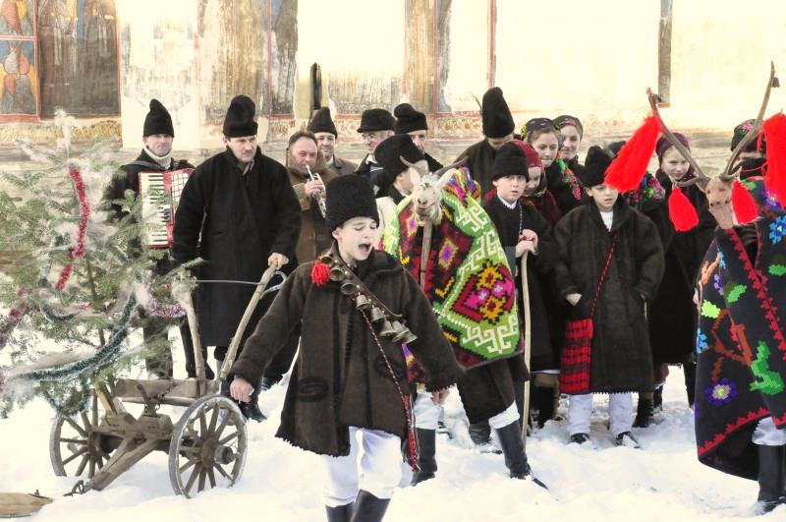
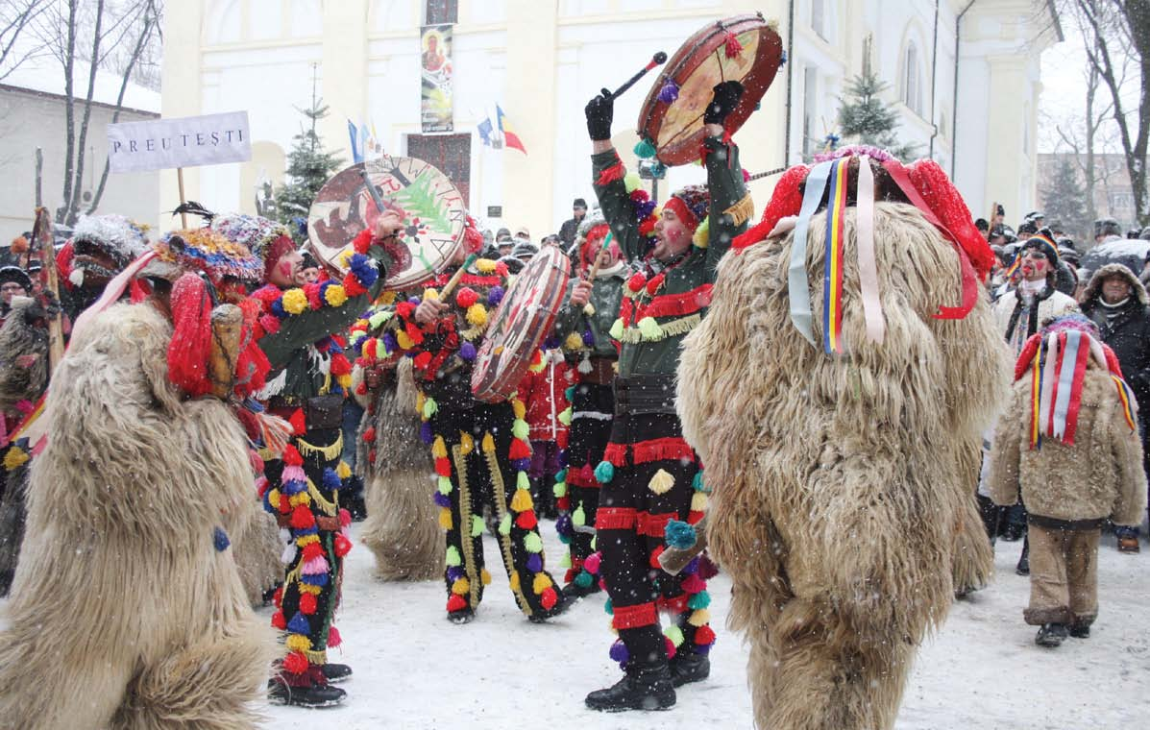
Plugușorul
Plugușorul, as it is told in the people, is an ancient agrarian custom, which is practiced even today, usually on the eve of the New Year.
The boys called „urătorii” , gathered in large groups, often dressed in different costumes, carry with them bells, whips, improvised plows.
All this creates a theatrical atmosphere in the courtyard of those where the band stays.

Slide 4
Sowing and Sorcova
In the old days, children used to bring home branches of apple that they kept in the water until they gave a sprout or even a leaf. On New Year's Eve, the branches were tied with red woolen thread. This bouquet was called "sorcova". In the morning of the new year, the children went with the sorcova to the houses and, gently touching the master with the sorcova, wished them a happy year. It was believed that coming into contact with man, the green branch transmits beauty, strength and other qualities.
On the morning of January 14, children go with the sowing, throwing corn or oat grains, thus blessing the families they stay . The seeds that fall in the yard or in the house symbolize the belief in prosperity and rich harvest.

Slide 5
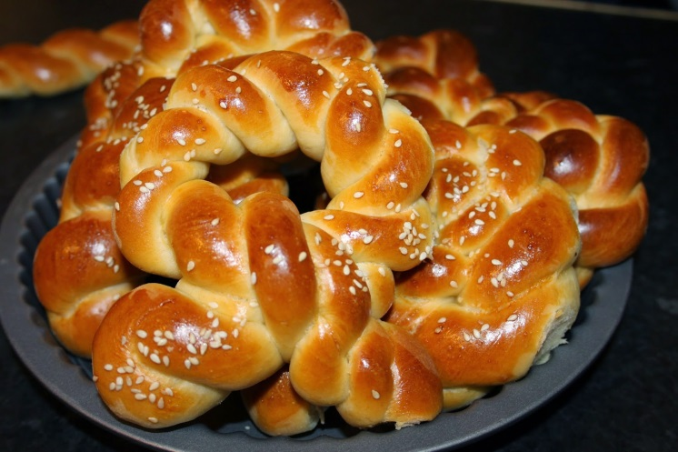
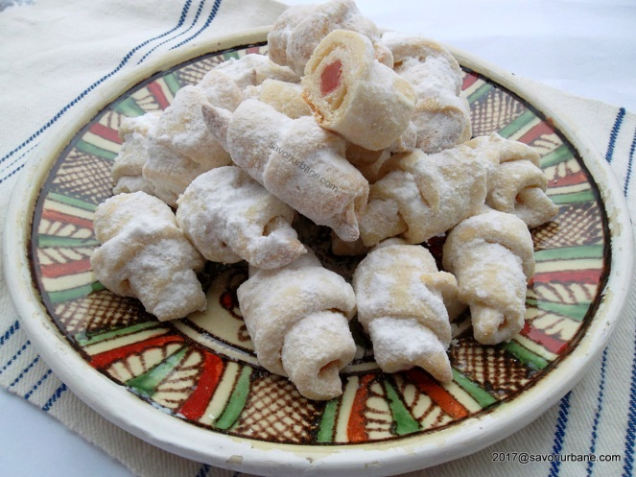
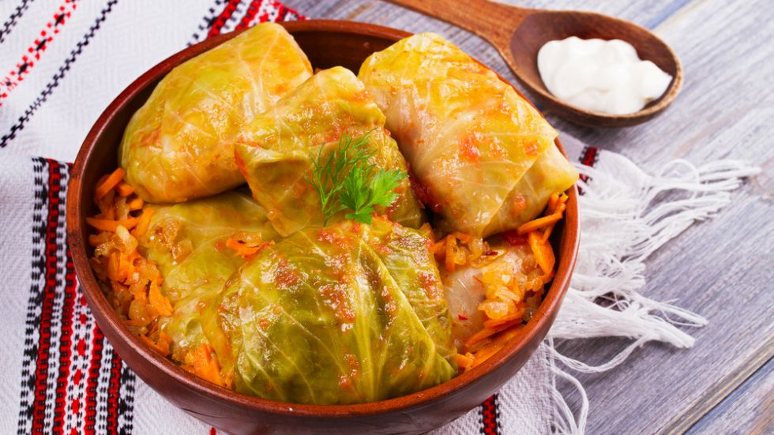
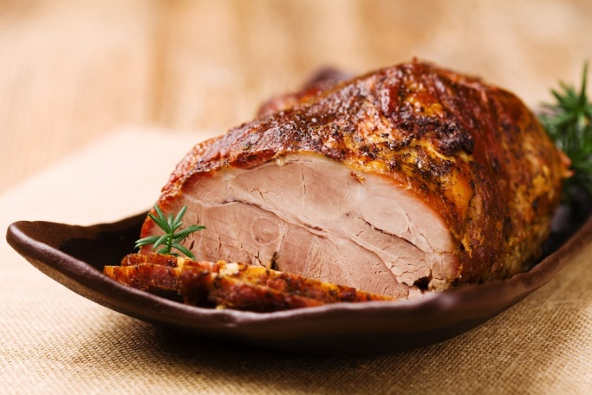
Moldovan Christmas food
Craciunei
Cozonaci
Roasted pork
Sarmale

