Slide 1
THE CONCEPT OF BEAUTY
A multidimensional perspective

Slide 2
The concept of beauty
If I say the Word BEAUTY, what is the first image / idea that comes to your mind?
1 minute thinking and writing it down
Brainstorm the ideas of the students.

Slide 3
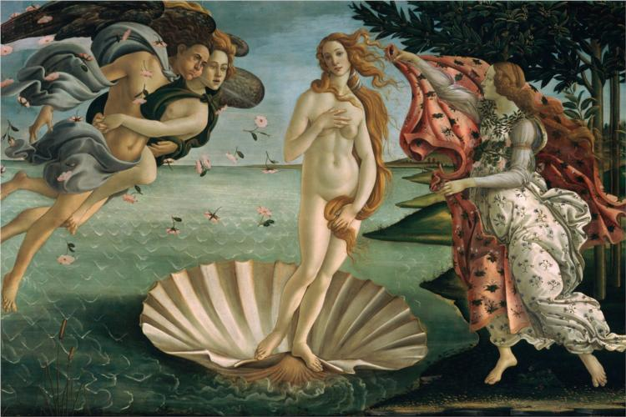
What beauty means to me…

Slide 4
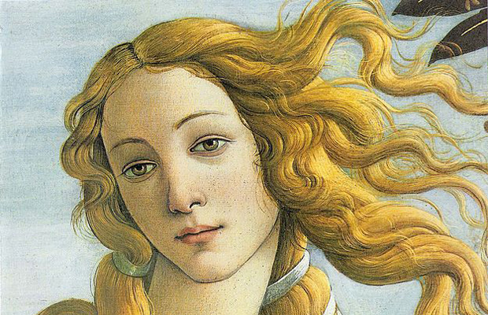
The Birth of Venus is a painting by Sandro Botticelli made in the mid 1480s
It depicts the goddess Venus arriving at the shore after her birth, when she had emerged from the sea fully-grown
The painting is in the Uffizi Gallery in Florence, Italy

Slide 5
The concept of beauty
How many of you have chosen a picture or something you perceive with your eyes?
How many of you have chosen something that you perceive using a different sense?
Discuss in pairs (5 minutes)
Is beauty an static or a dynamic concept?
Why is it something different for each one of us?
What influences our perception of beauty? Factors
Is there a “common sense” related to beauty?

Slide 6
FROM INDIVIDUAL TO GROUP-WORK
Work individually. Then discuss in groups of four.
Find elements that reflect beauty:
One picture
One song
One job
One person
One book
One film
One advertisement.

Slide 7
For the next session…
Homework:
Bring something (it can be anything) that is somehow beautiful to you
Be ready to explain why does it reflect beauty

