Slide 1
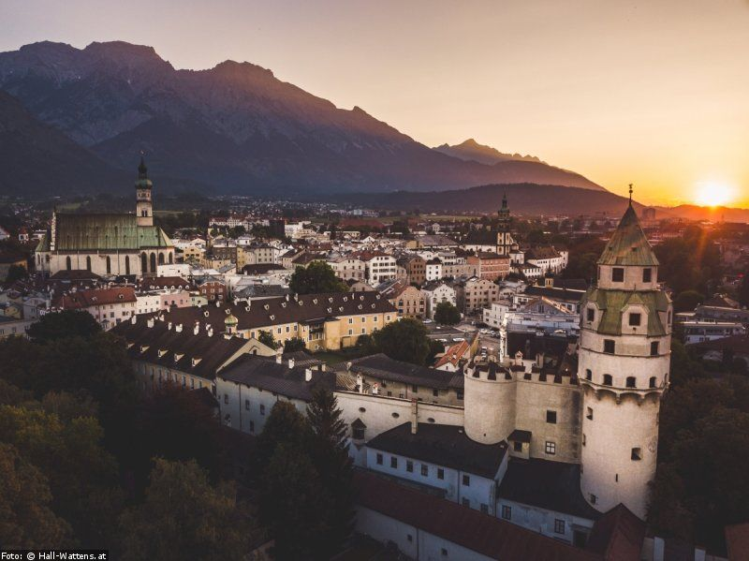
Hall in Tirol
Presentation by
Katharina Juretic & Mirjam Berger

Slide 2
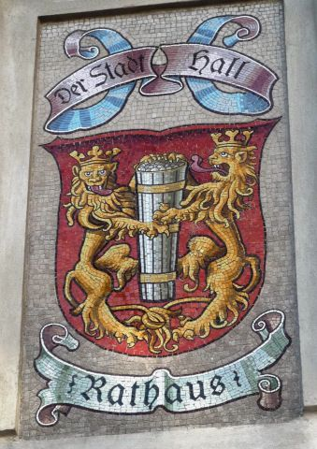
In general:
located in the Innsbruck-Land district of Tyrol, Austria
10 km east of the state’s capital Innsbruck
inhabitants: 14.153
One of the largest and most beautiful medieval old towns of Austria
Coat of arms: Two lions which are holding a cask of salt

Slide 3
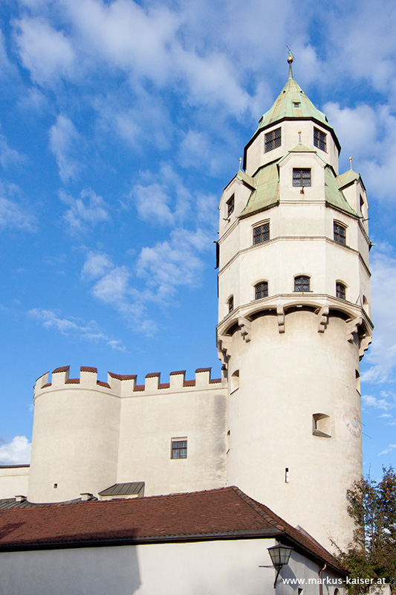
History of Hall:
Hall is derived from the Celtic word for salt
since the 13th century the salt mine formed the main industry of Hall and its surrounding
the coat of arms reflects the importance of the salt trade
the goods were exported as far as Switzerland…
Hall was founded as a town in 1303
in 1447 large parts of the upper town were razed by a fire
in 1477 coins were also made in Hall

Slide 4
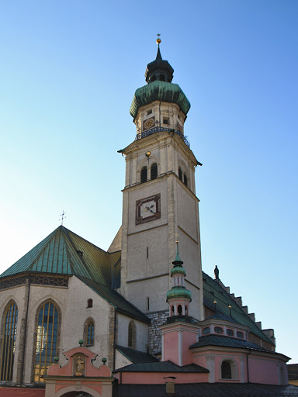
Sights of Hall:
1. Parish church St. Nikolaus
2. Castle Hasegg
3. ”Münzturm”
4. “Bergbaumuseum”
5. Upper town square

Slide 5
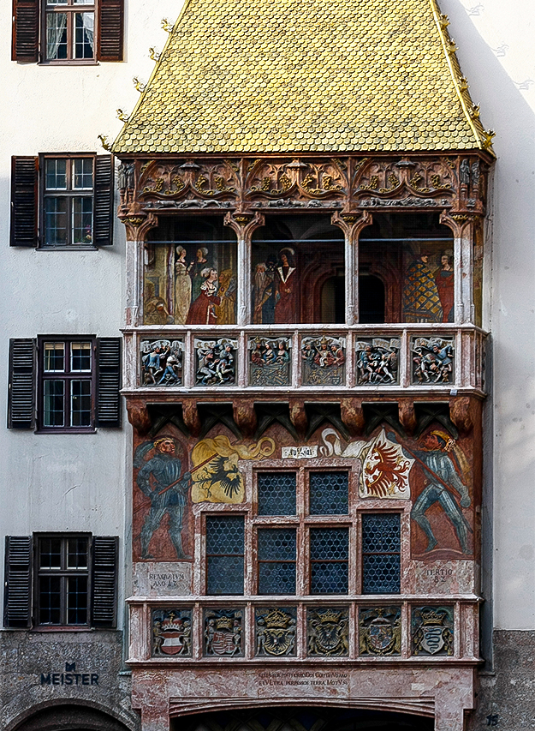
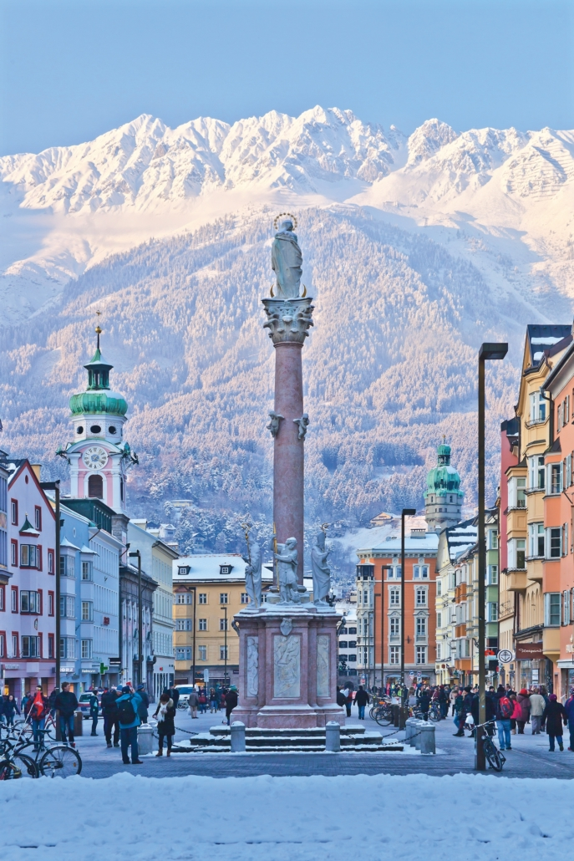
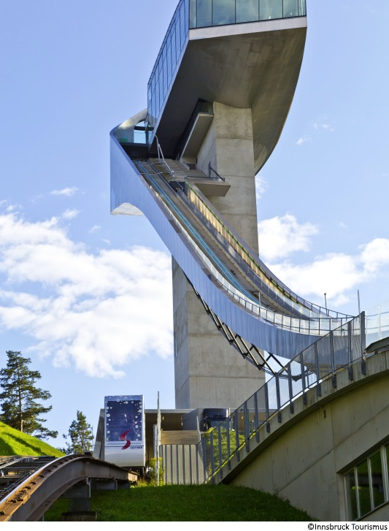
Surroundings:
“Bergiselschanze”
“Goldenes Dachl”
Swarovski Cristal Worlds
Highline
Alps

Slide 6
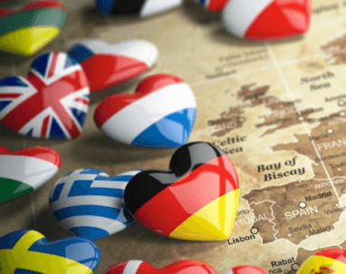
Thank you for your attention!
Danke für eure Aufmerksamkeit!
Hvala na pažnji!
İlginiz için teşekkür ederim!
Dziękuję za uwagę!
Grazie per l'attenzione!

