Slide 1
Despite the Coronavirus …
Gökay S.

Slide 2
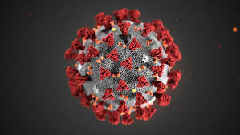
Because of the coronavirus, some measures were taken all around the world such as lockdowns, wearing masks, keeping social distance, hygiene and many more.

Slide 3
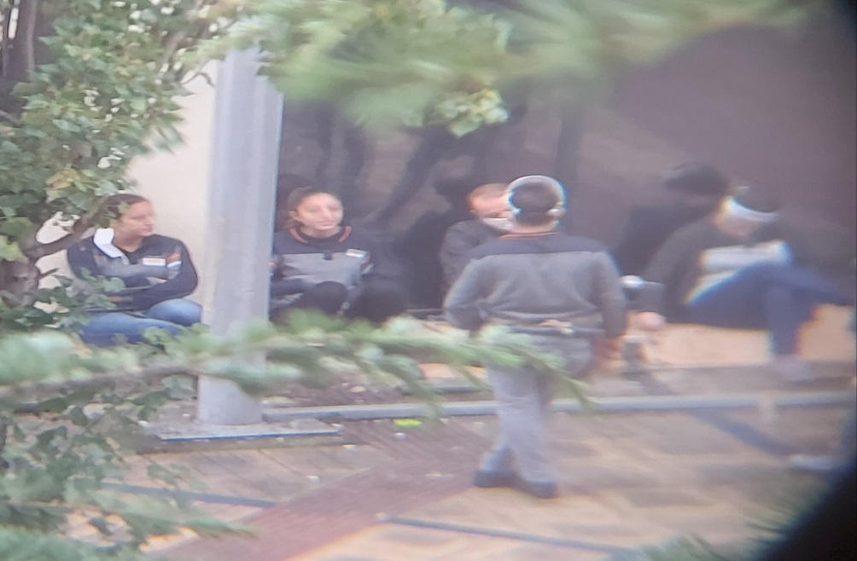
But some people are breaking the rules and put the others in danger.They don’t think even themselves. For example; these employees spending their break time outside don’t pay attention to social distance.
Photo by Gökay S.

Slide 4
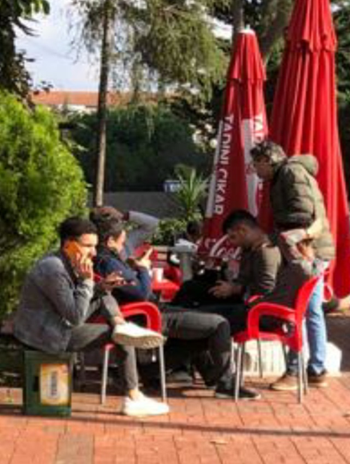
Cafés and restaurants are especially dangerous because while people are eating or drinking something they take out their masks.
I took this photo at a café near my house. As you can see people are drinking their tea and having a chit-chat.
Photo by Gökay S.

Slide 5
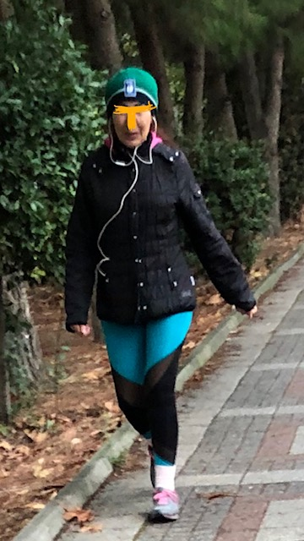
While I was walking in my
neighbourhood I saw this
woman without her mask.
She thinks that she walks alone
but she passes people nearby.
She has to wear her mask
all the time when she is out.
Photo by Gökay S.

Slide 6
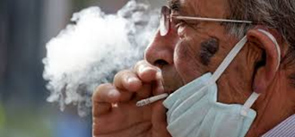
Although in Turkey smoking is forbidden, most of the people don’t care about this rule. Because of the smoke virus spreads more quickly.
Smoking also causes damage in the lungs, for that reason, people who smoke are more likely to die because of the coronavirus.

Slide 7
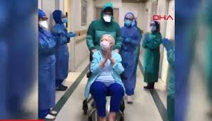
People are social living beings. They want to communicate and use their body language. In addition to this, they want to be free. It is difficult to live with the restrictions but for our and other people’s health we must obey the rules.
We can beat corona together!

