Slide 1
5 Stages Of My Life With Coronavirus
Kaya a.

Slide 2
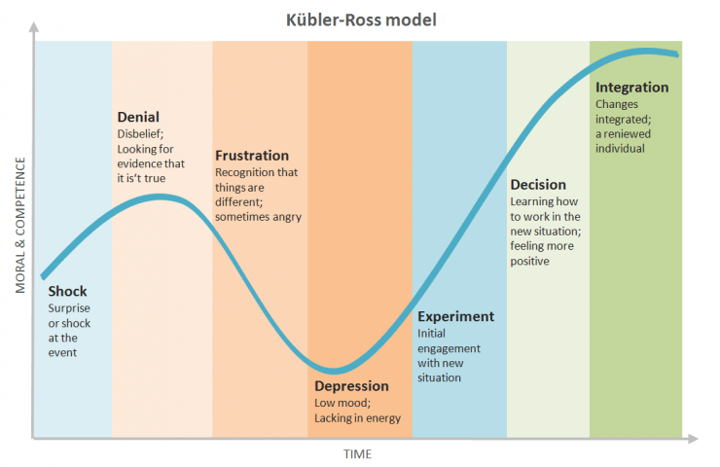
Kübler-Ross Model
The Kübler-Ross Model is a map of feelings felt by somebody experiencing grief.
I will be using this model to make my experiences easier to understand.

Slide 3
Denial
The first step is denial. When the pandemic started, the whole world was in disbelief and this included me as well.
I couldn’t believe the situation we were in therefore i had thought of it as an ordinary flu and I couldn’t be more wrong.
Then it reached my country. For the first several weeks, I still attended to school, went outside with friends and still made plans for the near future.
As the common opinion, i had believed that this situation would come to an end in summer.

Slide 4
Anger
I was furious when the lockdown was announced because it only affected a small percentage of the population and I was a part of it. Life still went on but we were the only ones isolated from life.
My social life including sports, art, travel came to a halt.
All of my plans were cancelled without reschedules and everything was uncertain.
Nobody knew anything about the path we were going to choose. All we had was questions without answers.

Slide 5
Bargaining
I had finally accepted the severity of the pandemic but I started questioning the precautions all governments had set.
I was thinking alternative precautions we could have made. One of my main toughts were about the closure of «Hıfzısıhha». If it was active we could’ve started the vaccine research sooner.
I questioned China’s decisions regarding WHO and the case count of COVID.
I was stuck thinking about «What if?» scenarios.

Slide 6
Depression
The count of death by the virus started to rise and people we knew started to catch the virus.
The situation started to feel endless and inescapable.
The idea of losing my relatives and the possibility of being responsible for someone’s death had captured me.
I had no motivation to do anything,I didnt want to talk, attend online school or develop hobbies.
Everything was uncertain and I had no plans.

Slide 7
Acceptance
Slowly I started to get used to being inside and life still goes on with the new normal.
I still have a life and a future that I can use to be better.
The news about multiple succesful vaccines being in research, gave me hope about a brighter future.
I am as busy as I was before the pandemic, I have projects to do and hobbies to pursue.

