Slide 1
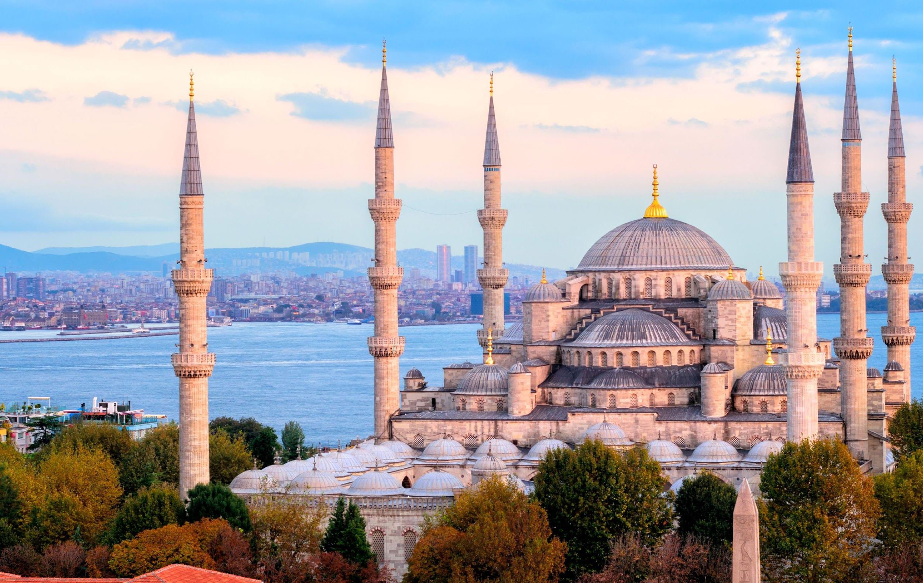
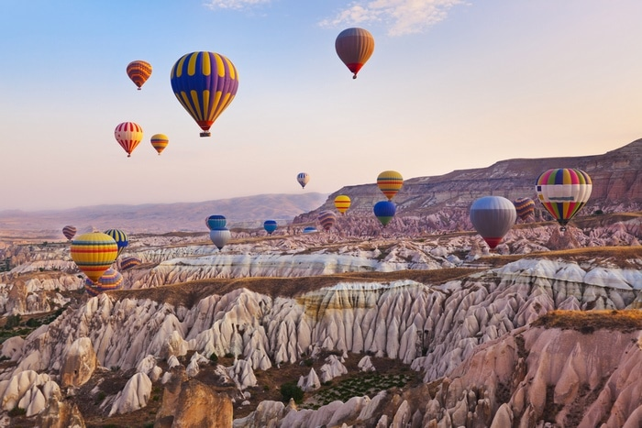
MY COVID EXPERIENCES
Erasmus+`HEADS UP´
Hello, my name is Adrián, I am 14 years old and my school is called IES Blas Infante. I live in Córdoba. I am super happy since I am in an Erasmus project called “Heads up”. The project is about travelling to Turkey and learning English and that those from that country learn Spanish.

Slide 2
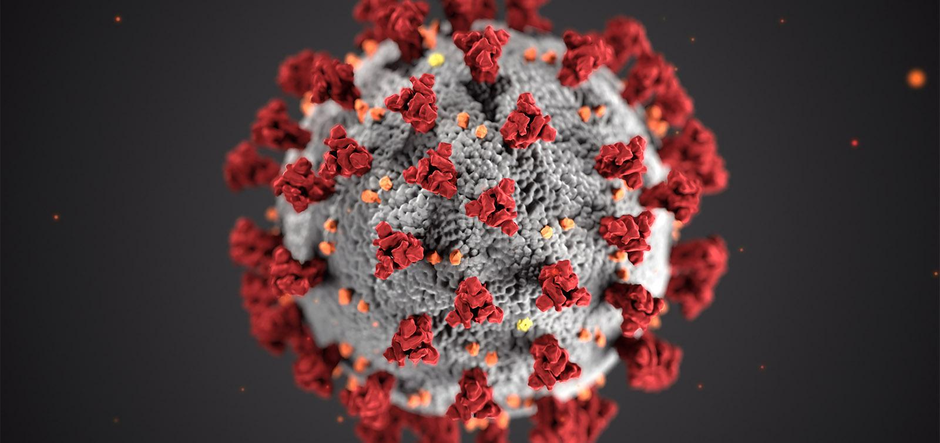
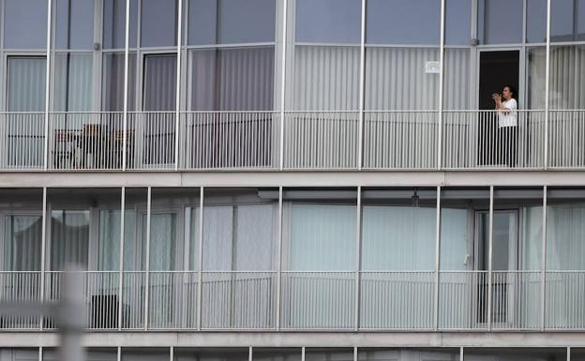
-Unfortunately the project can not be carried out as scheduled due to this COVID-19, so I'm going to tell you everything I did during the lockdown.
Since we couldn't go to school due to COVID-19, we had lessons from home. I woke up super early since we started at 9 o'clock every day to do homework. We planned a trip to Alicante that we could not do because of COVID-19. I also had the bad luck of not being able to celebrate my birthday due to COVID-19 as well we were all locked at home.

Slide 3
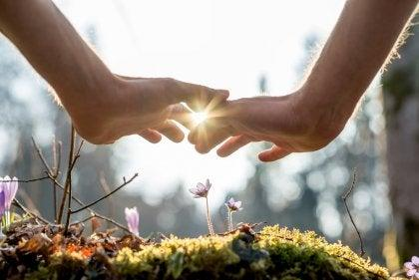
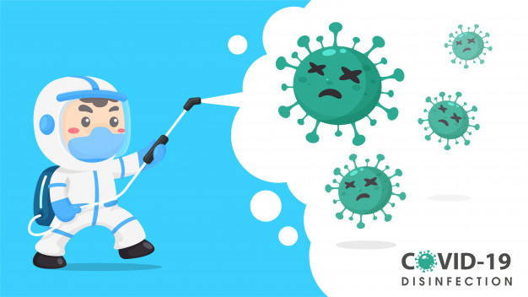
-I hope this is over soon and I can do the project and celebrate my birthday.
In the meantime, stay home and take care of each other :)

Slide 4
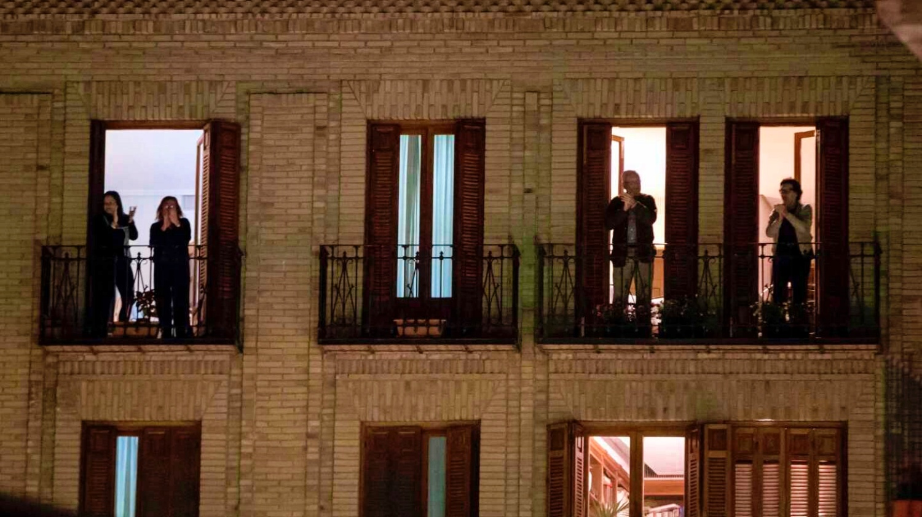
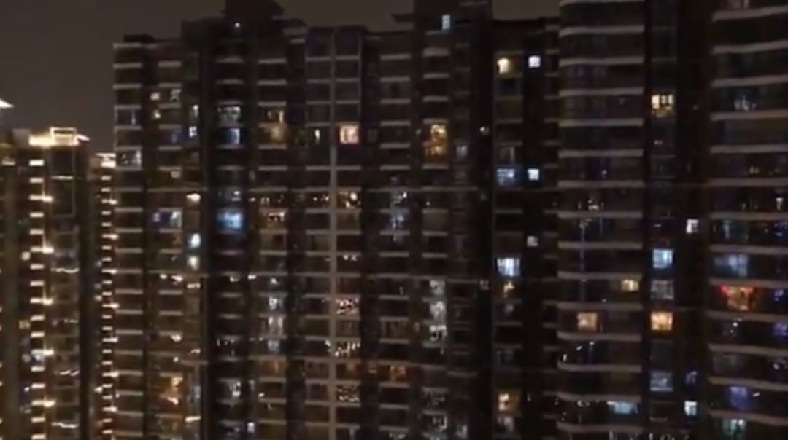
-The only thing about lockdown that made me happy was that everyone went out to their balconies at night to clap all the people who were trying to make this end like doctors and nurses. This brought me an inmense happiness.

Slide 5
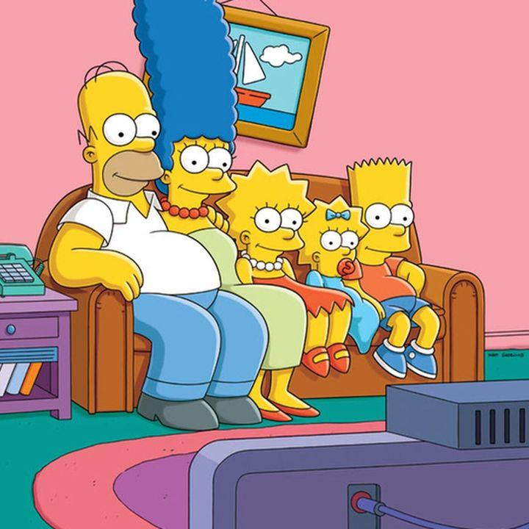
END
Adrián de Torres Campos 3ºE

