Slide 1
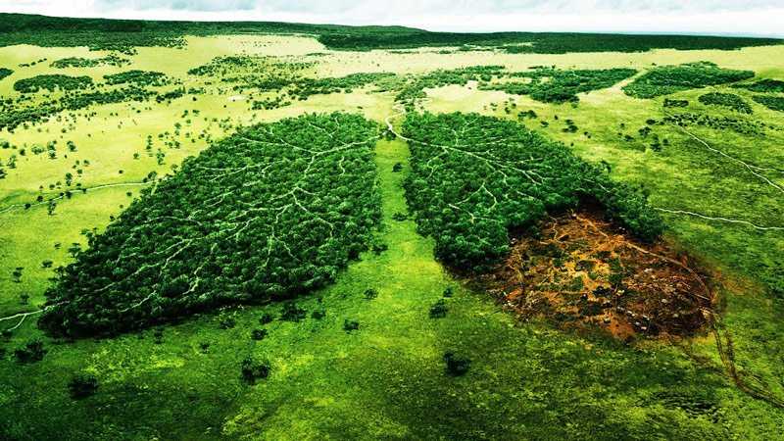
SAVE NATURE
Our planet is in danger because of the high level of pollution due to full landfills, exhaust gasses, trash, relase of the harmful substances and waste of energy and water.
The only way to save it is to adopt ecological proceedings.

Slide 2
THE WATER
Check and fix any water leaks. A leaky faucet can waste a lot of water.
Install water-saving devices on your faucets and toilets. A low-flow showerhead could be a good start.
Don't wash dishes with the water running continuously. Use a method that requires less water to get the dishes clean.
Turn off washing machine's water supply to prevent leaks. It doesn't need to be on all the time.
Replace old toilets with new ones that use a lot less water.
Wash and dry only full loads of laundry and dishes. Doing a half-load wastes water.
Don't use too much water to water your lawn.
Don't leave the faucet running while you brush your teeth.

Slide 3
CHEMICALS
Learn about alternatives household cleaning items that do not use hazardous chemicals. For example, using a solution of 1/2 white vinegar and 1/2 water works as well as most commercial cleaners for basic cleaning jobs. Baking soda and salt are cheap, nontoxic cleansers, but should be used in moderation.
When no good alternatives to a toxic item exist, determine the least amount required for an effective, sanitary result and use a minimal amount each time you clean. Paying close attention to the requisite amount will help you reduce and also save money.
Instead of using chemical-laden shampoos and soaps, try making your own.
Instead of using pesticides and herbicides, find natural ways to get rid of weeds and pests.

Slide 4
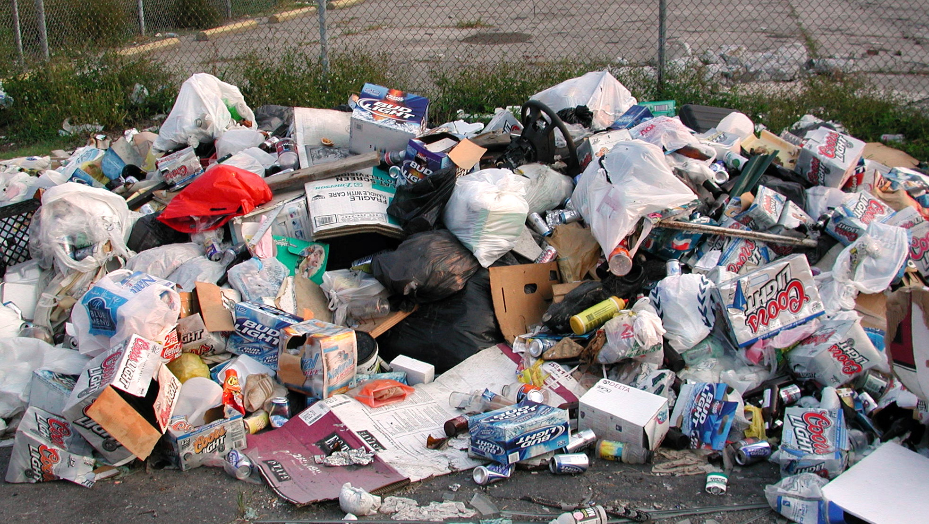
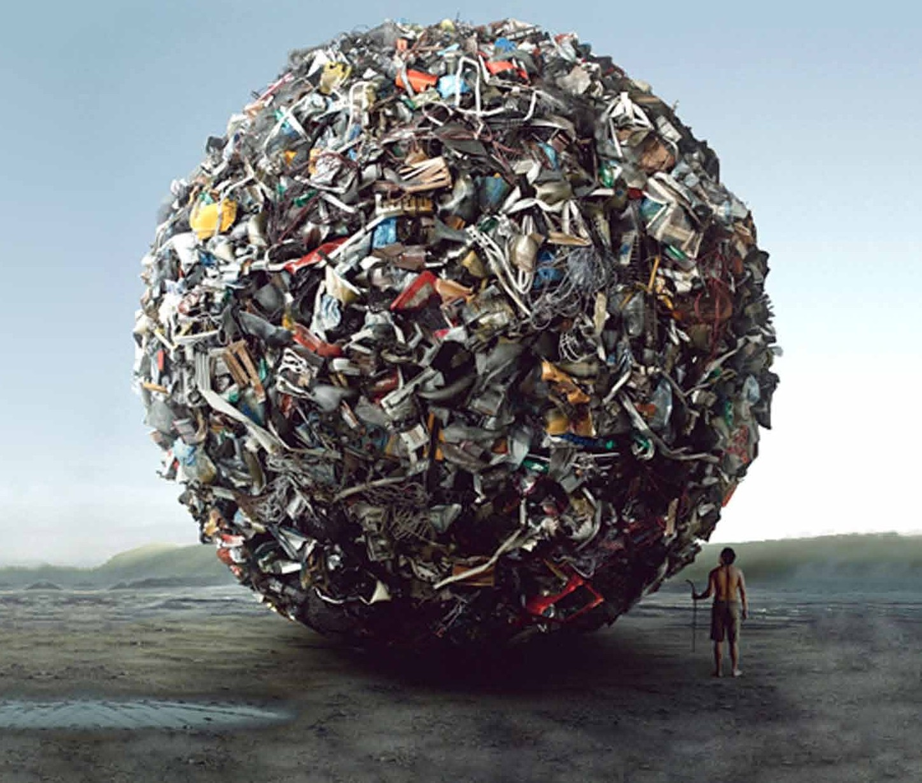
WASTE
Buy products that you can reuse. Get glass containers instead of flimsy plastic ones, for example.
Don't use plastic bags - use cloth.
Maintain and repair durable products instead of buying new ones.
Avoid products with several layers of packaging when only one is sufficient. About 33% of what we throw away is packaging.
Use reusable plates and utensils instead of disposable ones. Use reusable containers to store food instead of aluminum foil and cling wrap.
Buy rechargeable batteries for devices used frequently.
Copy and print on both sides of paper.
Reuse items like envelopes, folders and paper clips.
Use e-mail or texting as a substitute for paper correspondence.
Use recycled paper.
Mend clothes instead of buying new ones.
Buy used furniture - there is a surplus of it, and it is much cheaper than new furniture.

Slide 5
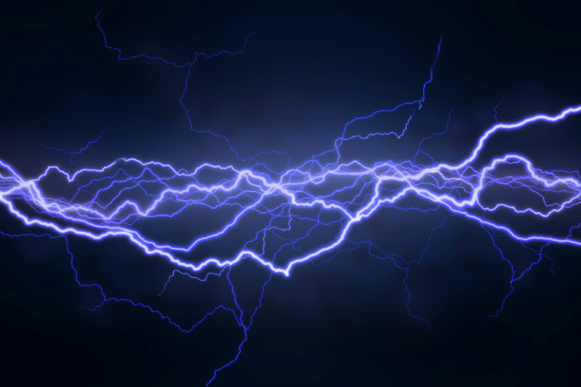
USE LESS ELECRICITY
Use solar power for home and water heating.
Shut off electrical equipment in the evening when you leave work.
If you have central air conditioning, do not close vents in unused rooms.
Lower the thermostat on your water heater to 120.
Turn down or shut off your water heater when you will be away for extended periods.
Turn off unneeded lights even when leaving a room for a short time.
Set your refrigerator temperature at 36 to 38 and your freezer at 0 to 5 .
When using an oven, minimize door opening while it is in use; it reduces oven temperature by 25 to 30 every time you open the door.
Clean the lint filter in your dryer after every load so that it uses less energy.
Wash clothes with warm or cold water instead of hot.
Turn off lights, computers and other appliances when not in use.
Use compact fluorescent light bulbs to save money and energy.
Plant trees to shade your home.
Replace old windows with energy efficient ones.
Keep your thermostat higher in summer and lower in winter when you are away.
Insulate your home as best as you can.

