Slide 1
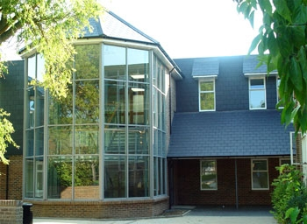
SCHOOL LIFE!!
This is the front of our school!

Slide 2
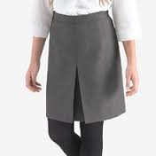
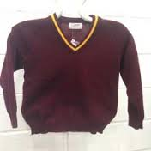
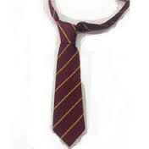
SCHOOL UNIFORM!
This is our skirt! Only girls wear this
This is our blazer!
This is our jumper. Only girls wear this
This is our tie. Mostly boys wear this but girls can too
On the next slide is my timetable

Slide 3
WEEK A
 | Lesson 1 | Lesson 2 | Lesson 3 | Lesson 4 | Lesson 5
Monday | PE | English | French | Maths | History
Tuesday | Drama | Science | Technology | French | Maths
Wednesday | Geography | Computer Science | Science | Art | English
Thursday | Technology | Maths | PE | RE | English
Friday | Science | ECL | RE | Music | Geography
WEEK B
 | Lesson 1 | Lesson 2 | Lesson 3 | Lesson 4 | Lesson 5
Monday | History | Art | ECL | Science | PE
Tuesday | Geography | Technology | English | Science | French
Wednesday | Maths | English | Science | PE | French
Thursday | Maths | French | Music | History | RE
Friday | Computer Science | English | P4C | Technology | Maths

Slide 4
Our school day!!!
8am-REGISTRATION
8:30-Lesson 1
9:30-Lesson 2
10:25-10:40-Break
10:45-Lesson 3
11:45-Lesson 4
12:45-1:25-Lunchtime
1:30-2:30-Lesson 5

Slide 5
Thanks FOR WATCHING!!
THE END!!

