Slide 1
LAMEZIA TERME
Beautiful city

Slide 2
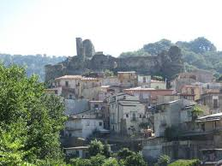
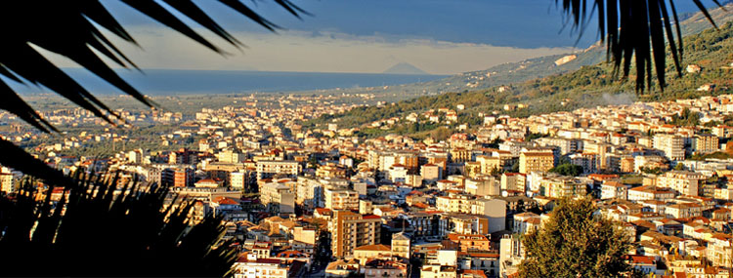
History of Lamezia
Lamezia was born in 1968 from the union of three towns, Nicastro, Sambiase and Sant’Eufemia.
In Lamezia there is a big Norman castle.

Slide 3
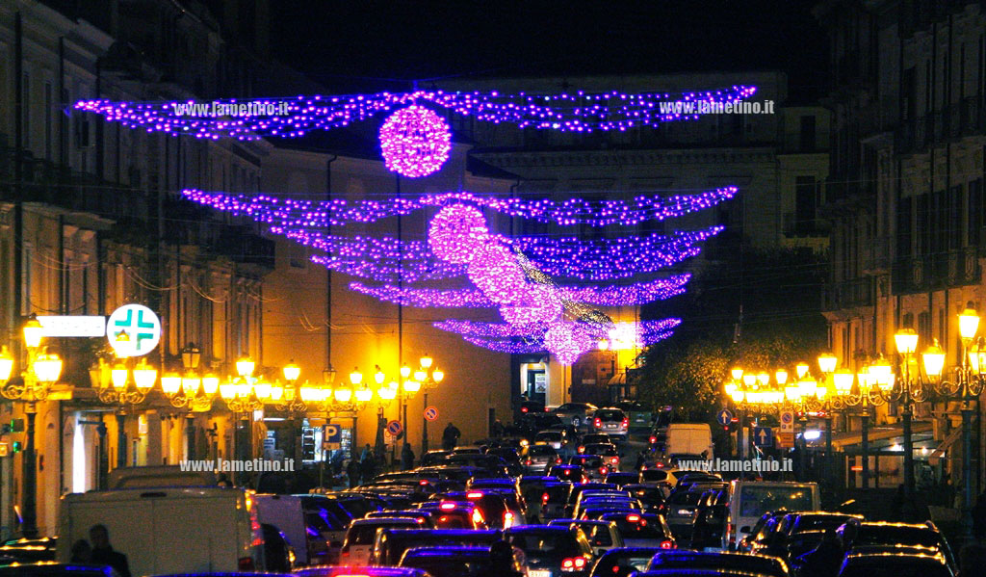
Now let’s talk about us…
We live in Nicastro, the largest municipality of Lamezia.
We usually walk across Corso G. Nicotera with our friends.

Slide 4
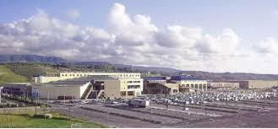
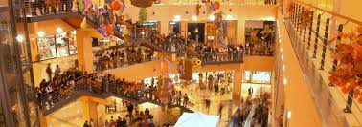
The shops
In Lamezia there is a large shopping center, called “Due Mari” , very famous throughout our area.
On the main street there are also many beautiful shops.

Slide 5
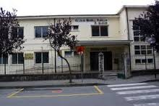
Our school
We attend IC Ardito-Don Bosco. It is a very big school with students from 3 to 13.
In the school there are a lot of laboratories, a big theatre and a big gym.
At school we have great fun and we love our teachers.

Slide 6
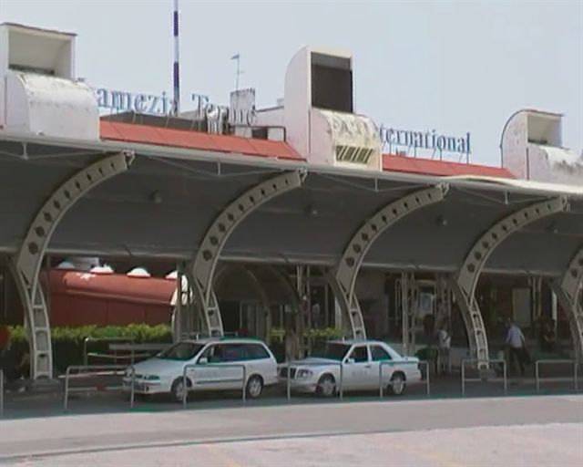
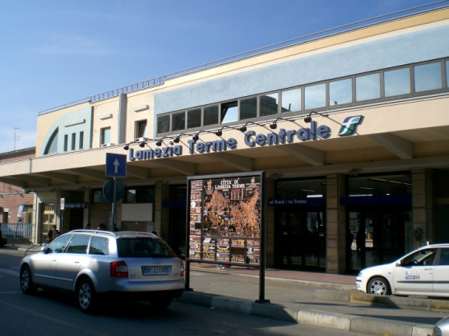
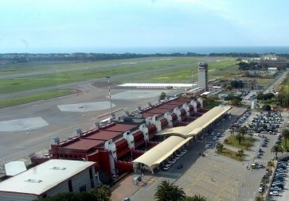
Travel
In Sant’ Eufemia there are a railway station and a big international airport.
The airport is very important and central to our region. It links us to the rest of Europe.

Slide 7
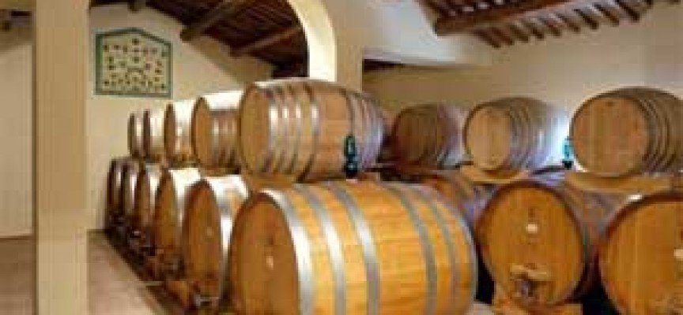
The agricultural production
Lamezia is also a big agricultural centre, above all of wine and oil production.
There are several companies producing wines famous all over Italy.
Lento and Statti are our main producers.

Slide 8
See you soon
By II A

