Slide 1
TURKEY
In order to decipher our secret message, first you must solve the puzzle☺
https://www.jigsawplanet.com/?rc=play&pid=3caff7a1ca87

Slide 2
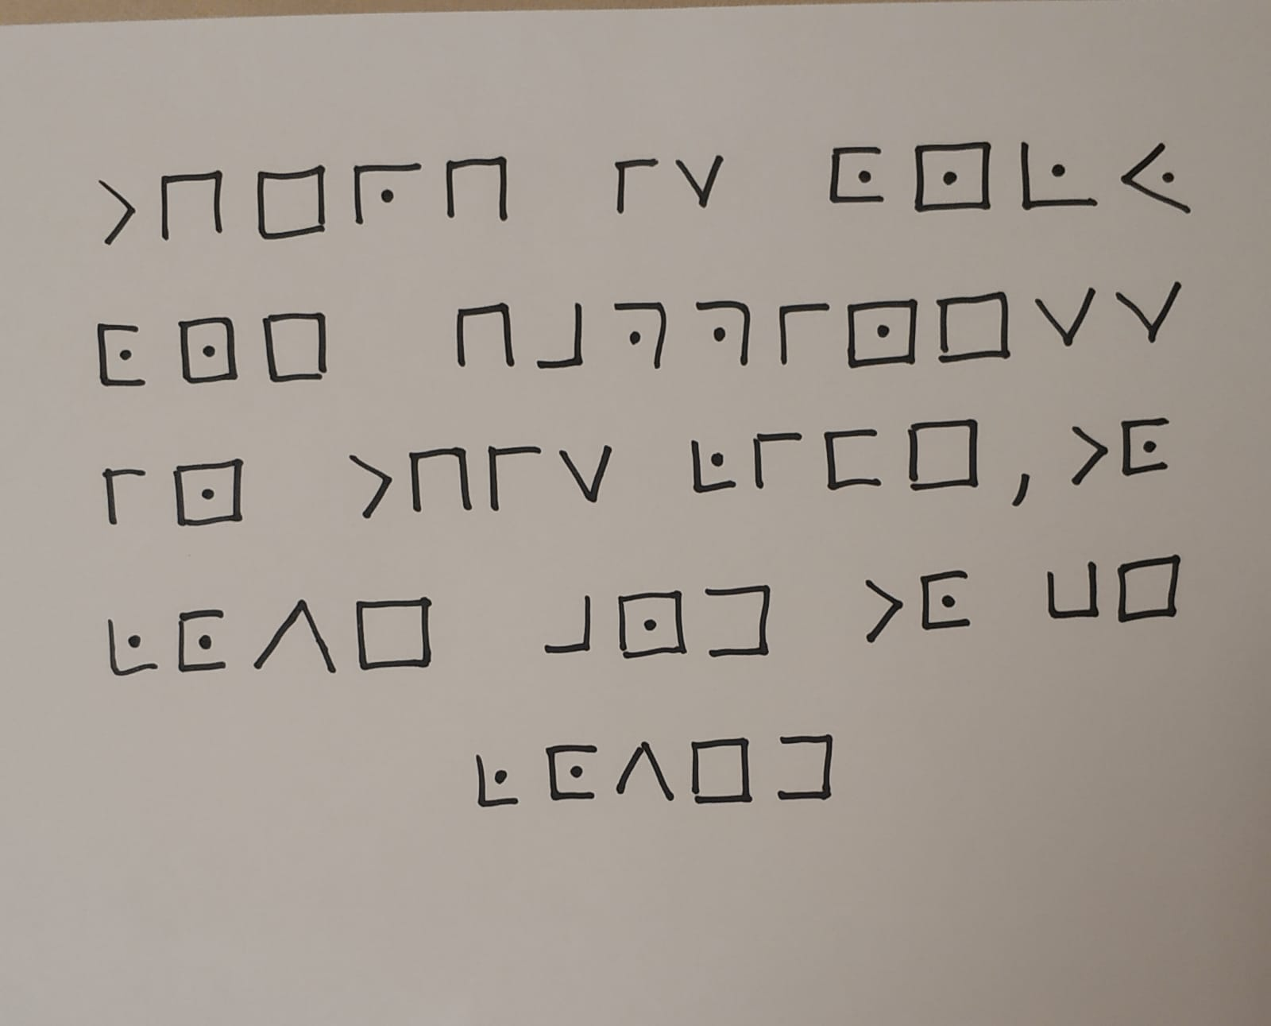
Our Secret Message

