Slide 1
Innovating New Teaching Techniques for Our Future Schools
ERASMUS+ KA2 project
Germany, Romania, Turkey, Poland, Greece, Spain

Slide 2
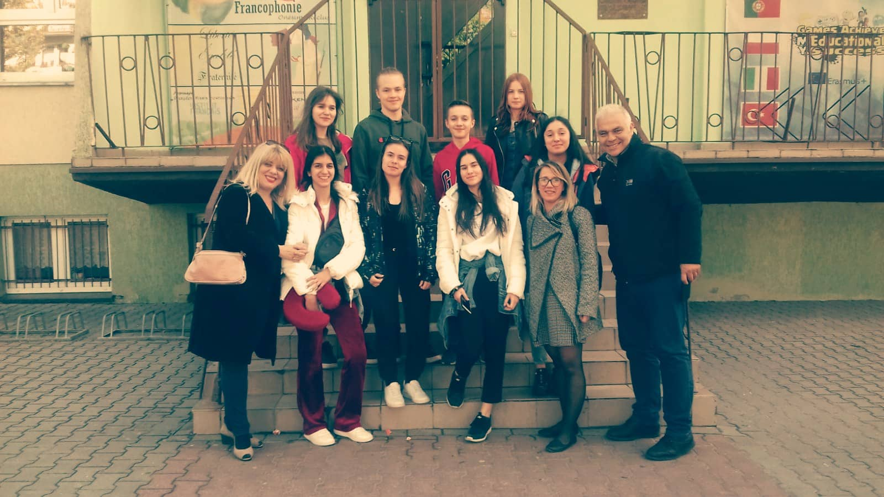
DAY 1
Arrival at school. Meeting with families!

Slide 3
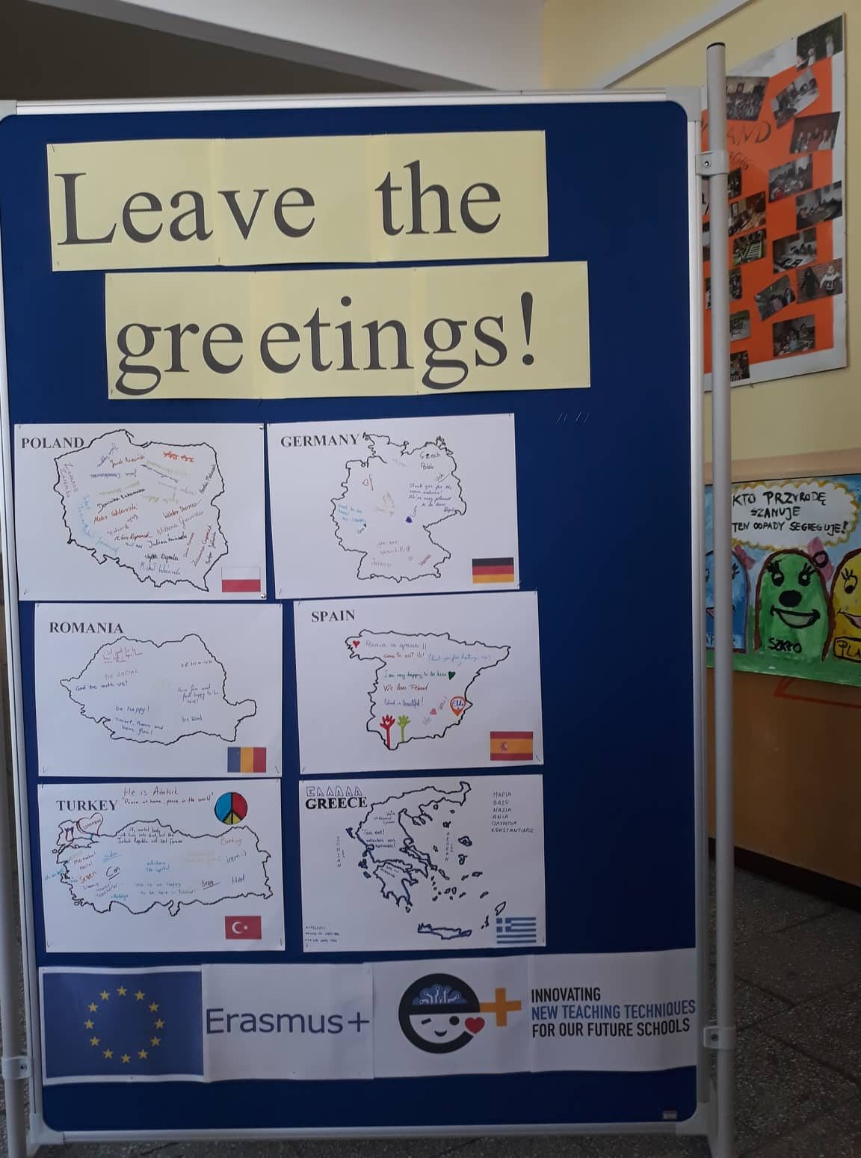
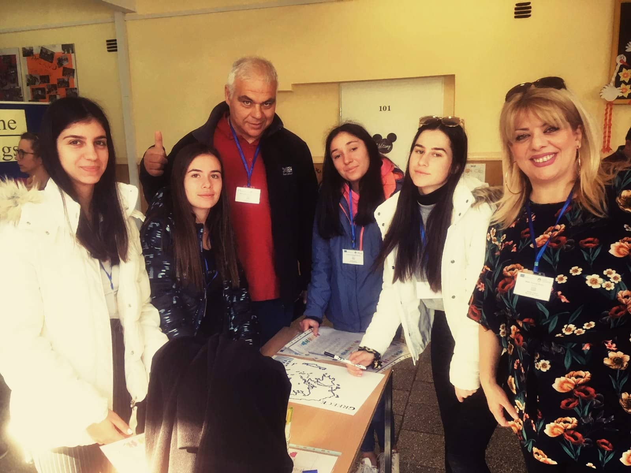
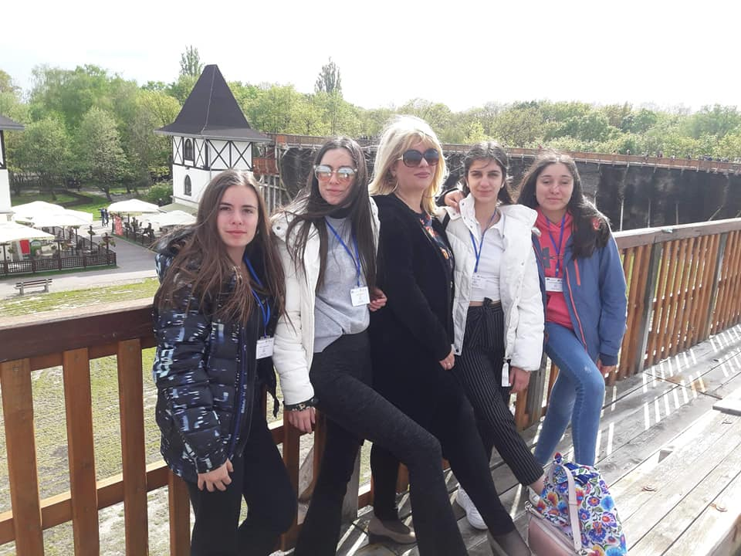
DAY 2
First day at school. Welcome activities and discovering Solanski Park!

Slide 4
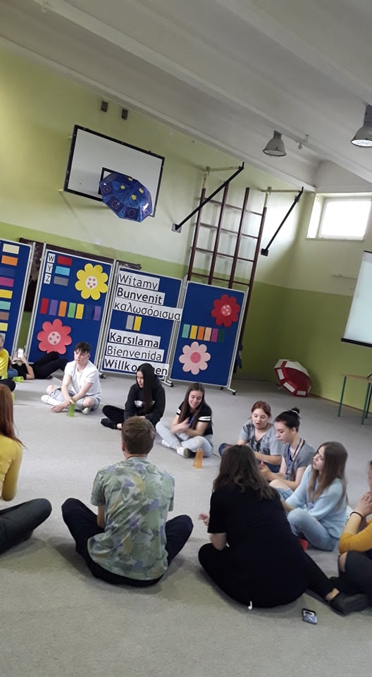
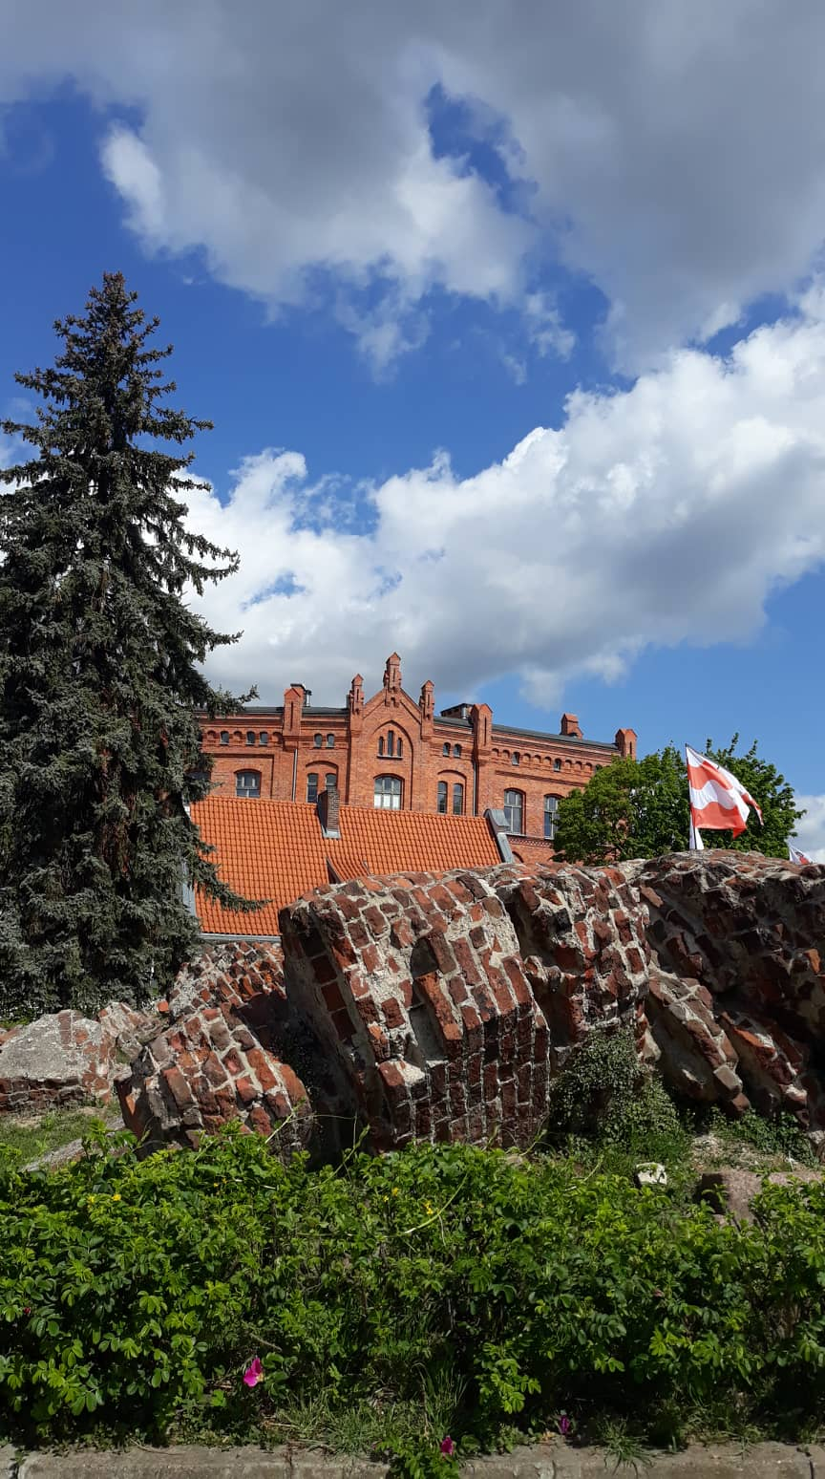
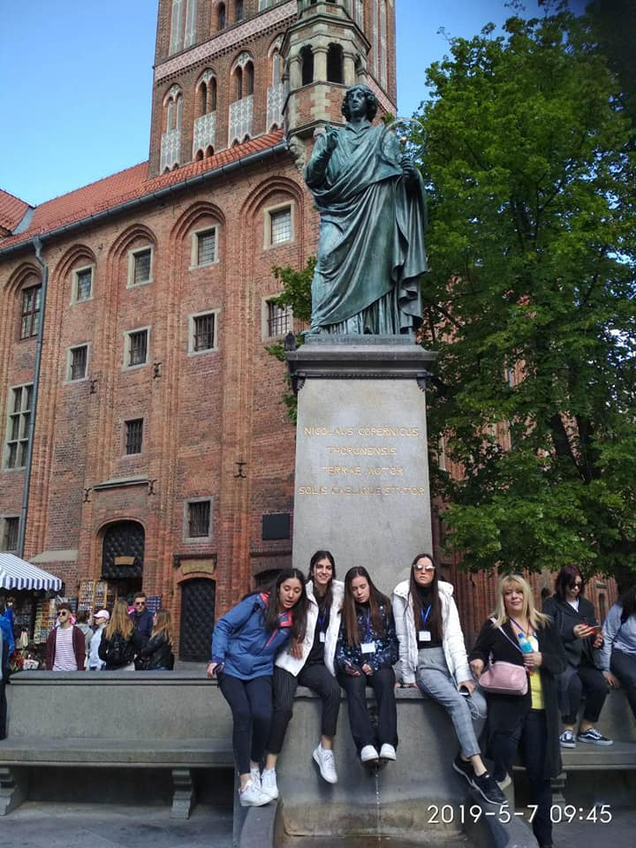
DAY 3
Tuesday: trip to Torun, educational game, escape room!

Slide 5
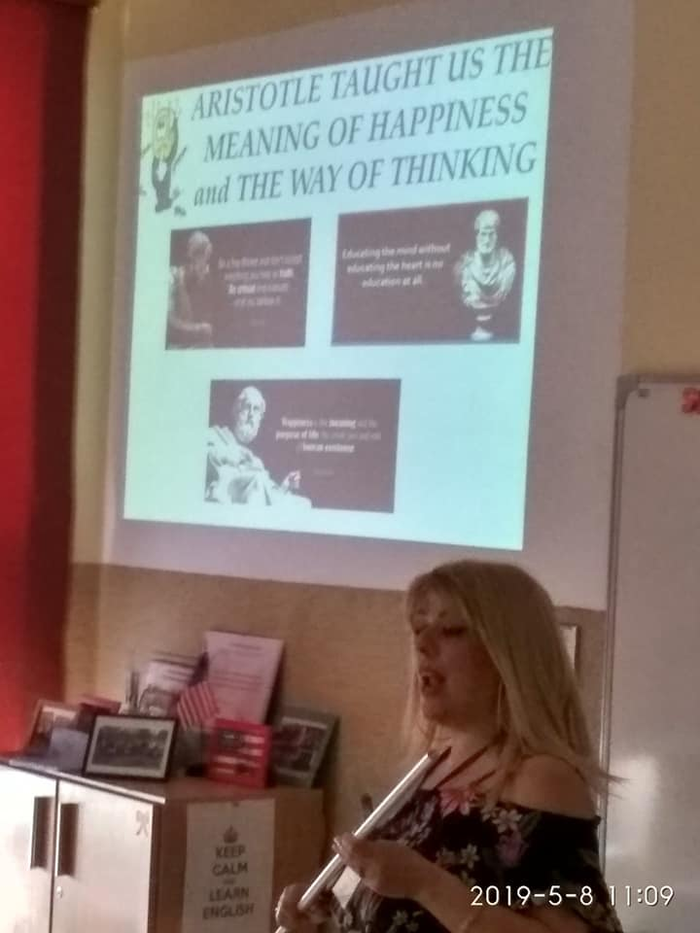
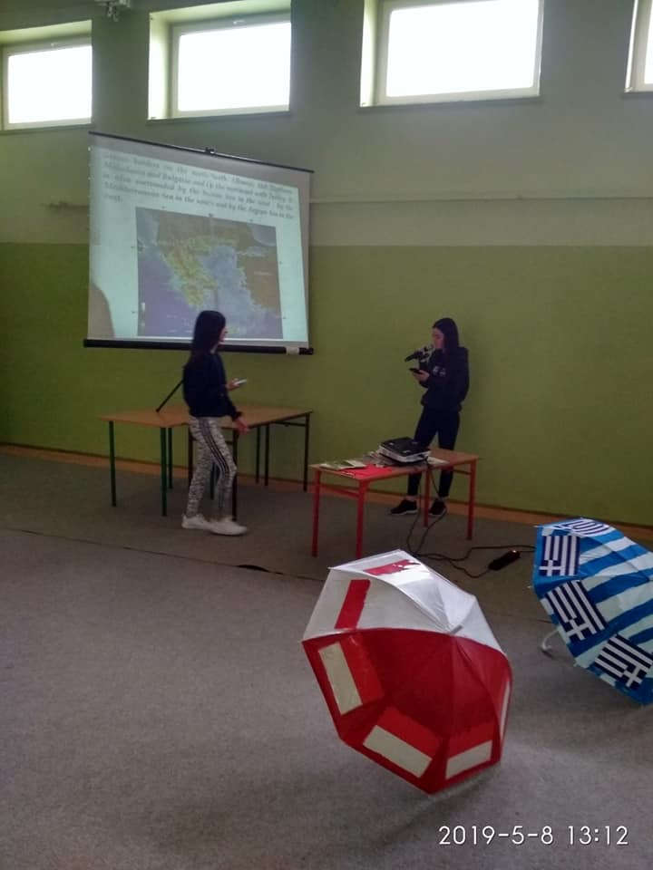
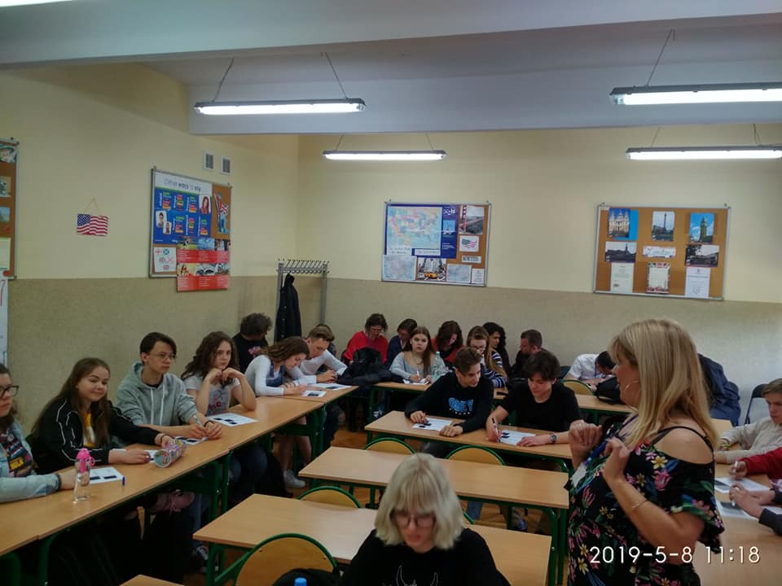
DAY 4
Wednesday: students’ presentations of school, town and school and teachers’ lessons!

Slide 6
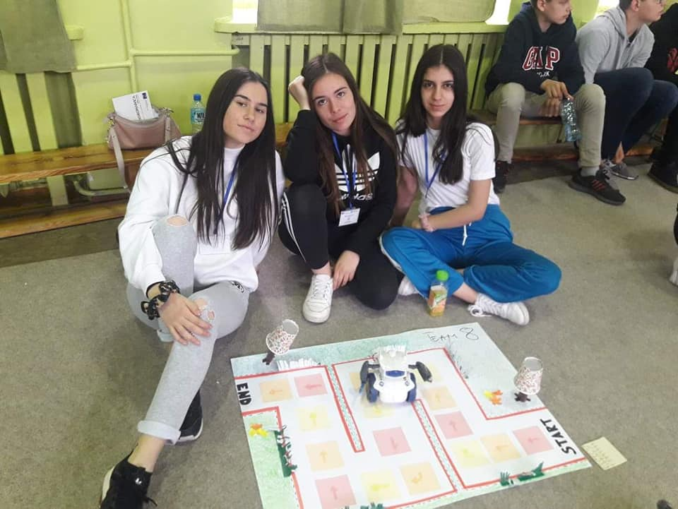
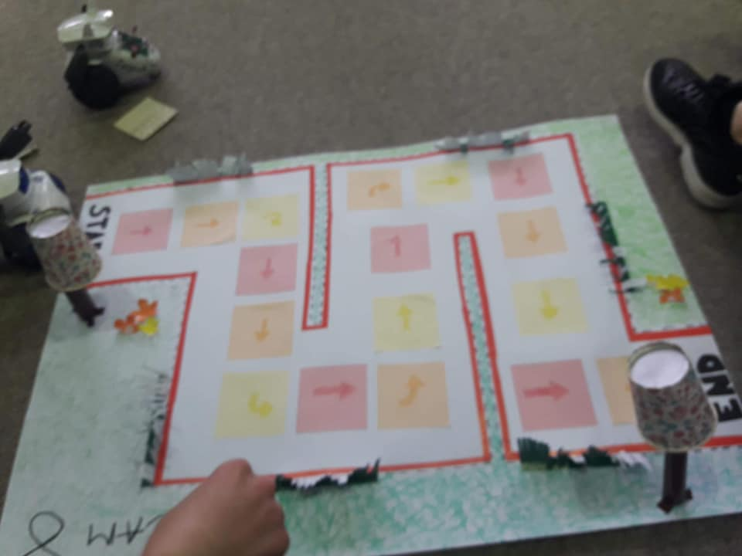
DAY 5
Thursday: Playing with robots!

Slide 7
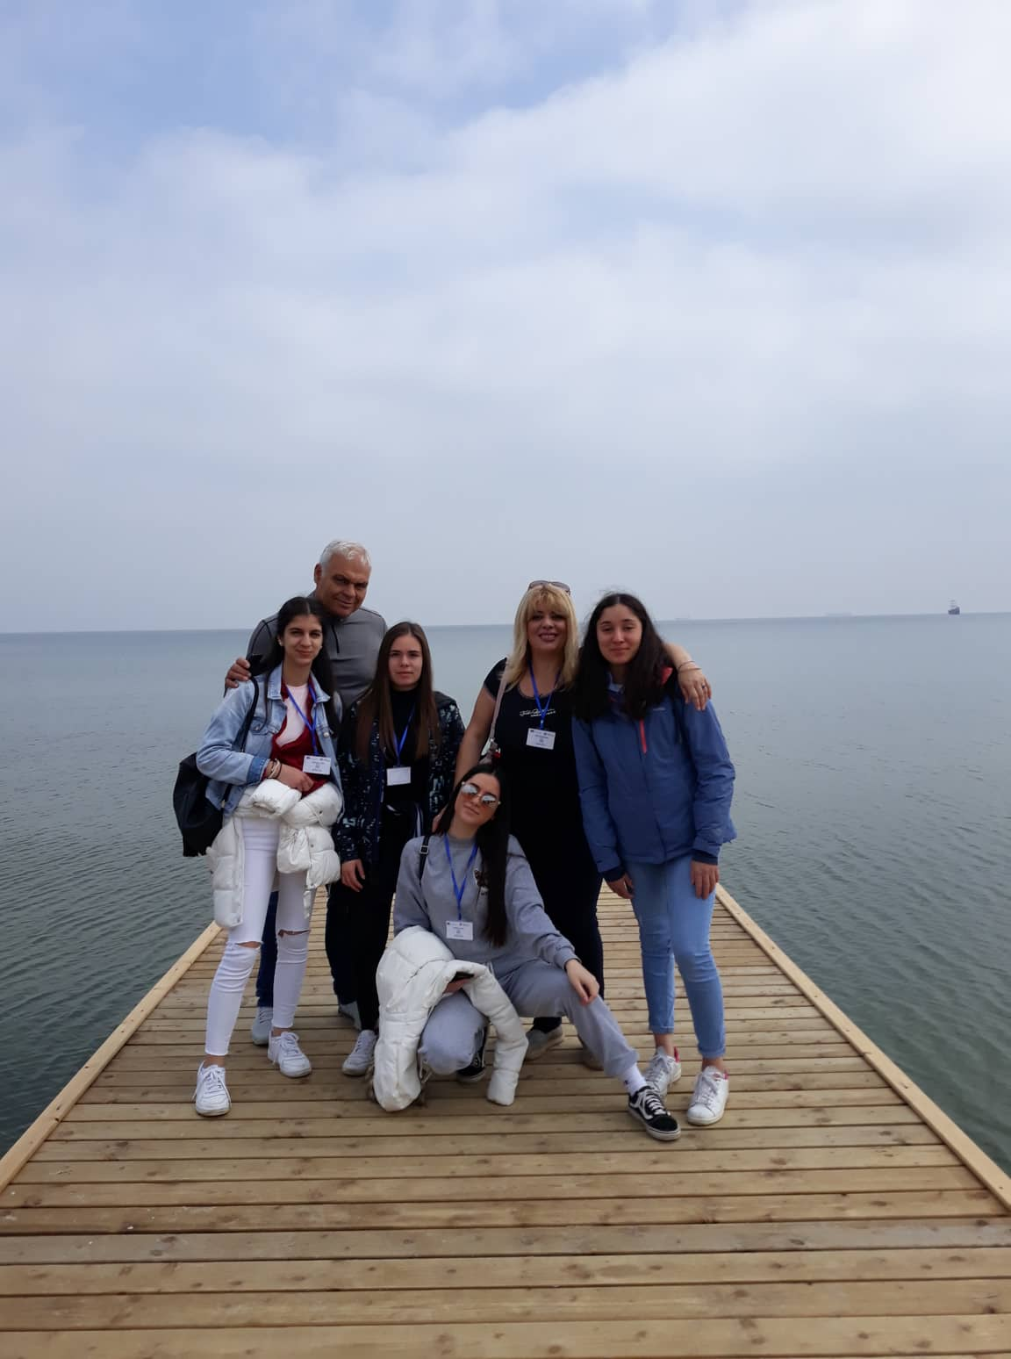
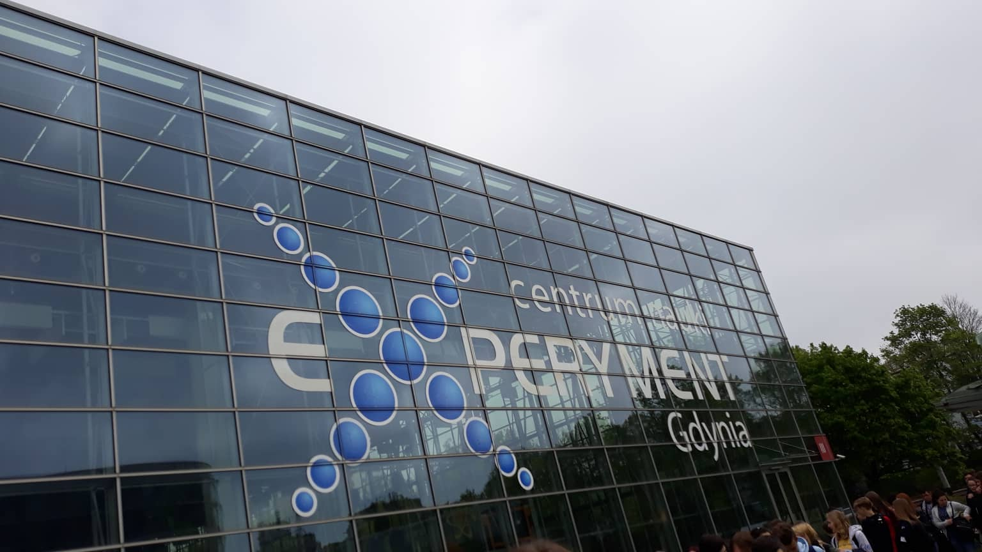
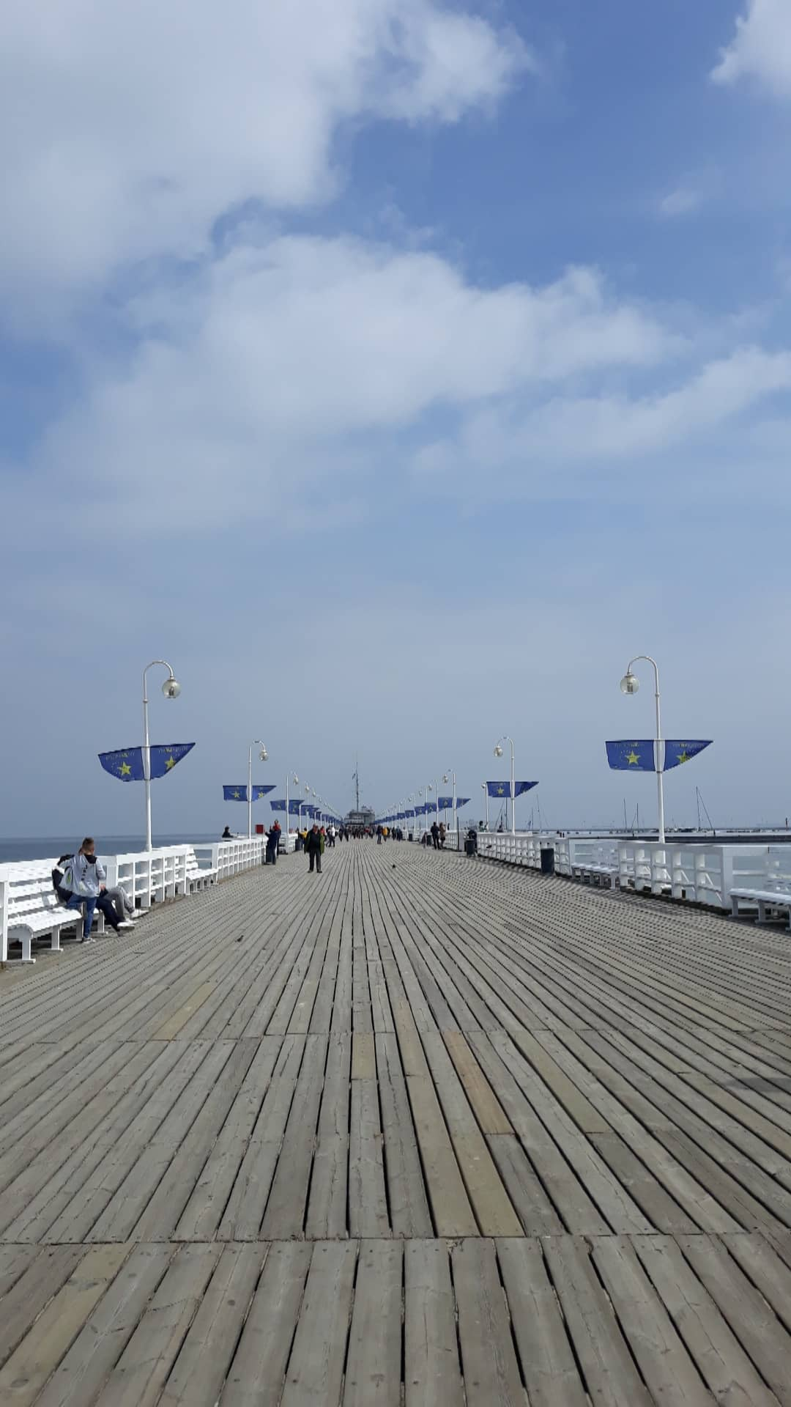
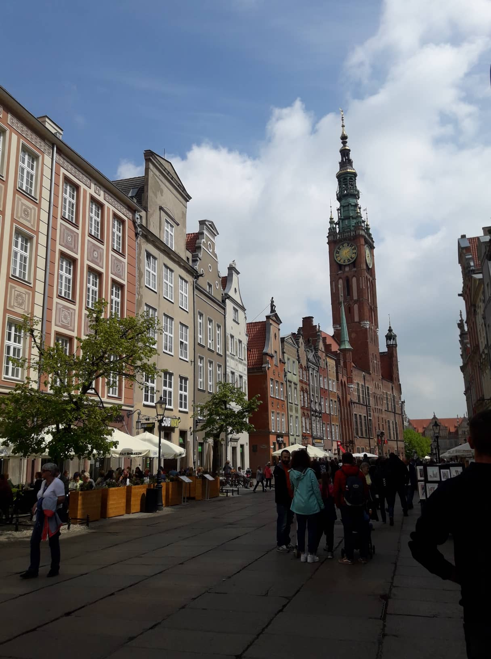
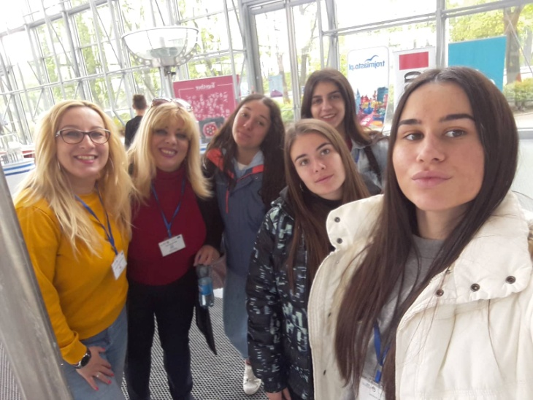
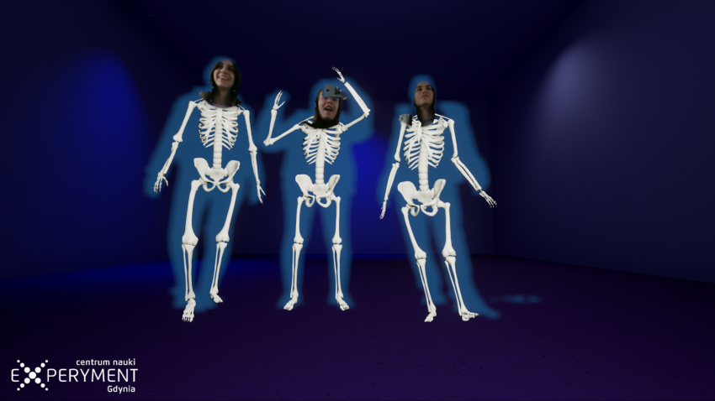
DAY 6
Friday: visit to Experiment Center of Gdynia, walking on Sopot’s pier, learning about Gdansk with an educational application!

Slide 8
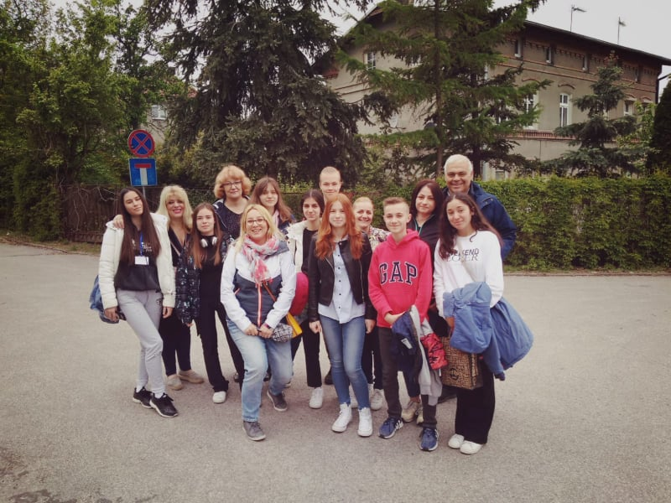
DAY 7
Saturday: Returning to Greece with many beautiful memories!

Slide 9
Looking forward for the next meeting in Turkey…

