Slide 1
Exchange in Hamm

Slide 2
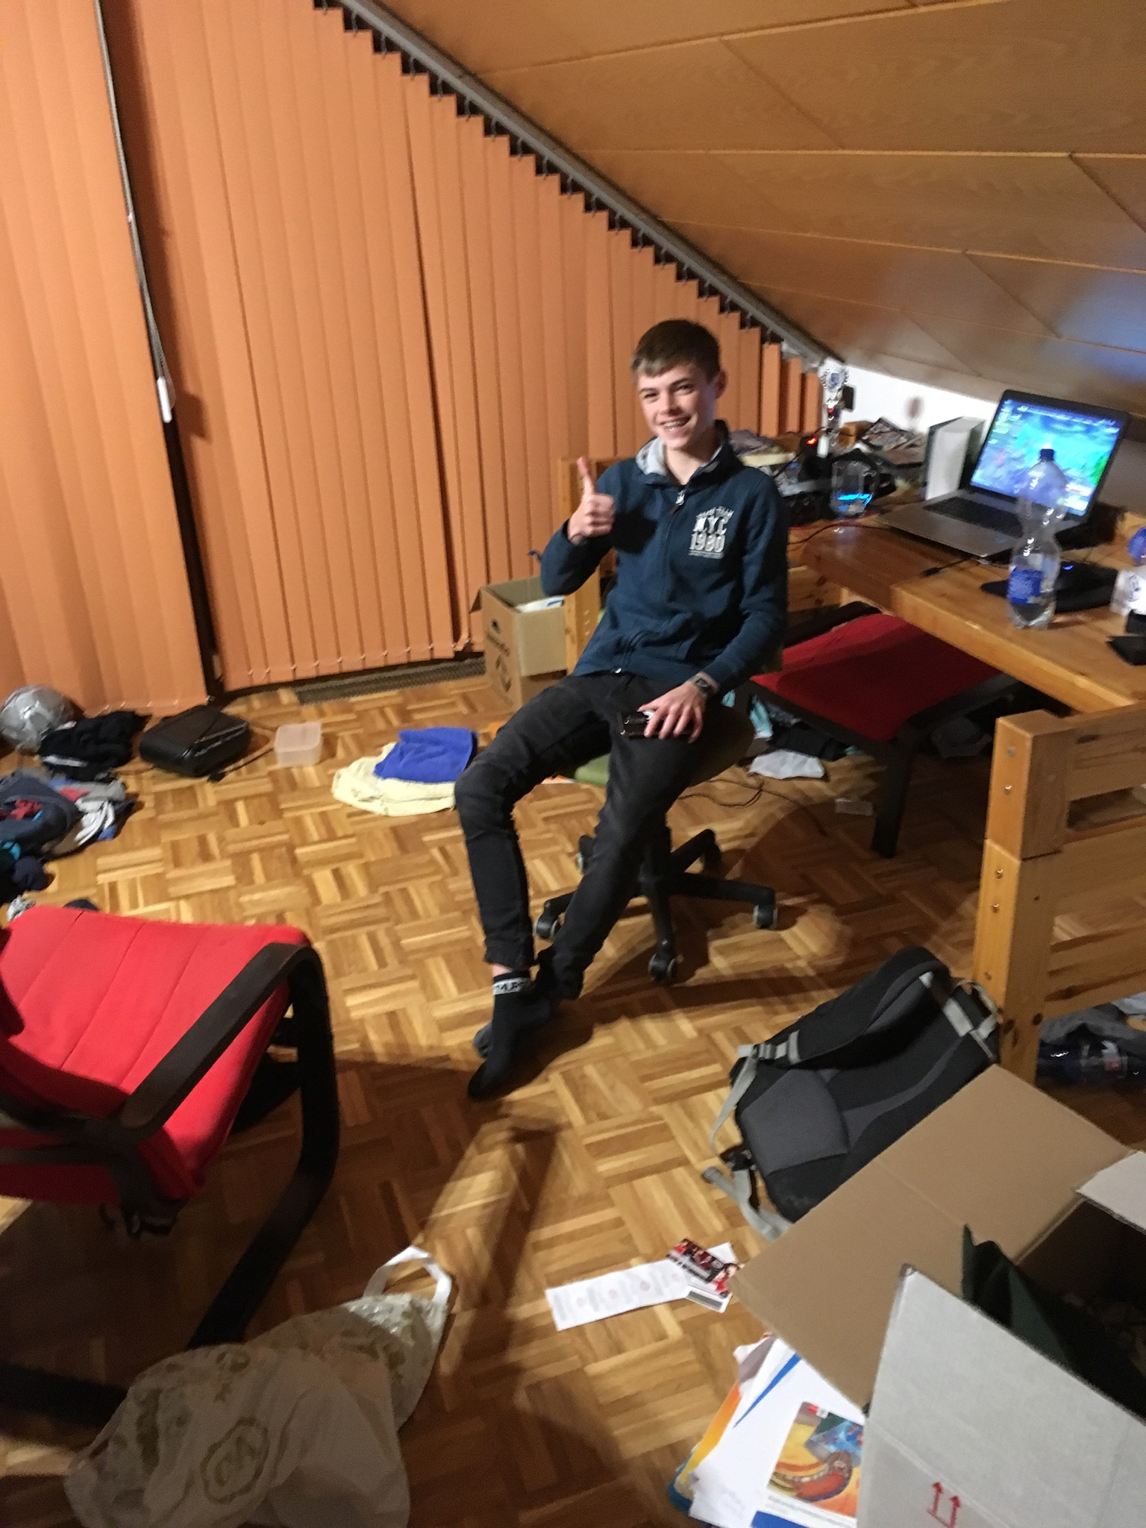
A few words about my partner
My partner was 13 years old boy named Jona.
He has 3 sisters and a brother.
Jona’s parents are teachers, his father teaches German language and history, his mother teaches music.
On the photo you can see Jona in his room.

Slide 3
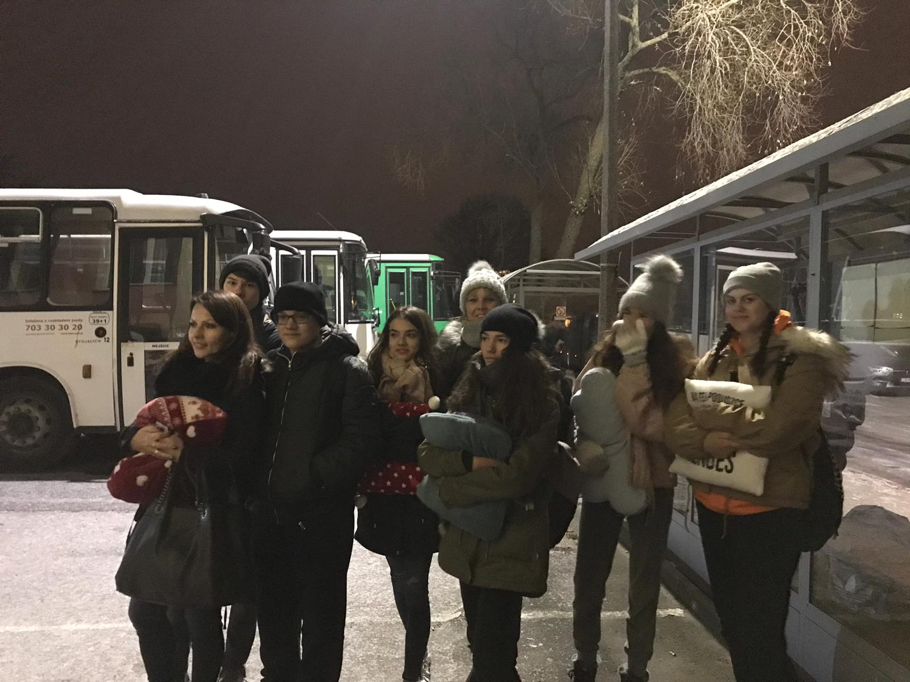
Beggining of exchange
On 1st of December at 6 pm we left Inowrocław, and the next day around 7.30 I was at Jona’s house.

Slide 4
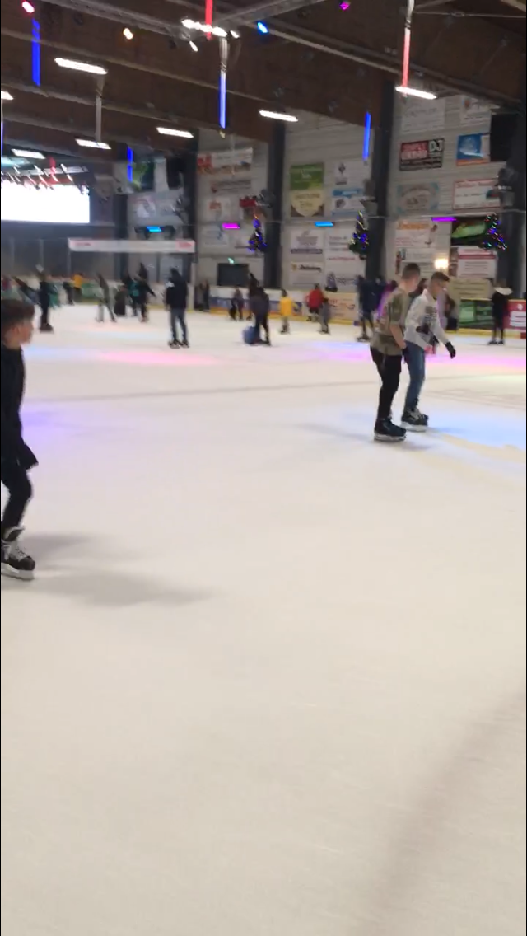
DAY 1
In the morning on Sunday, during breakfast, I met Jona’s siblings and parents. In the afternoon we went ice skating.
I spent the rest of the day playing computer games with Jona.

Slide 5
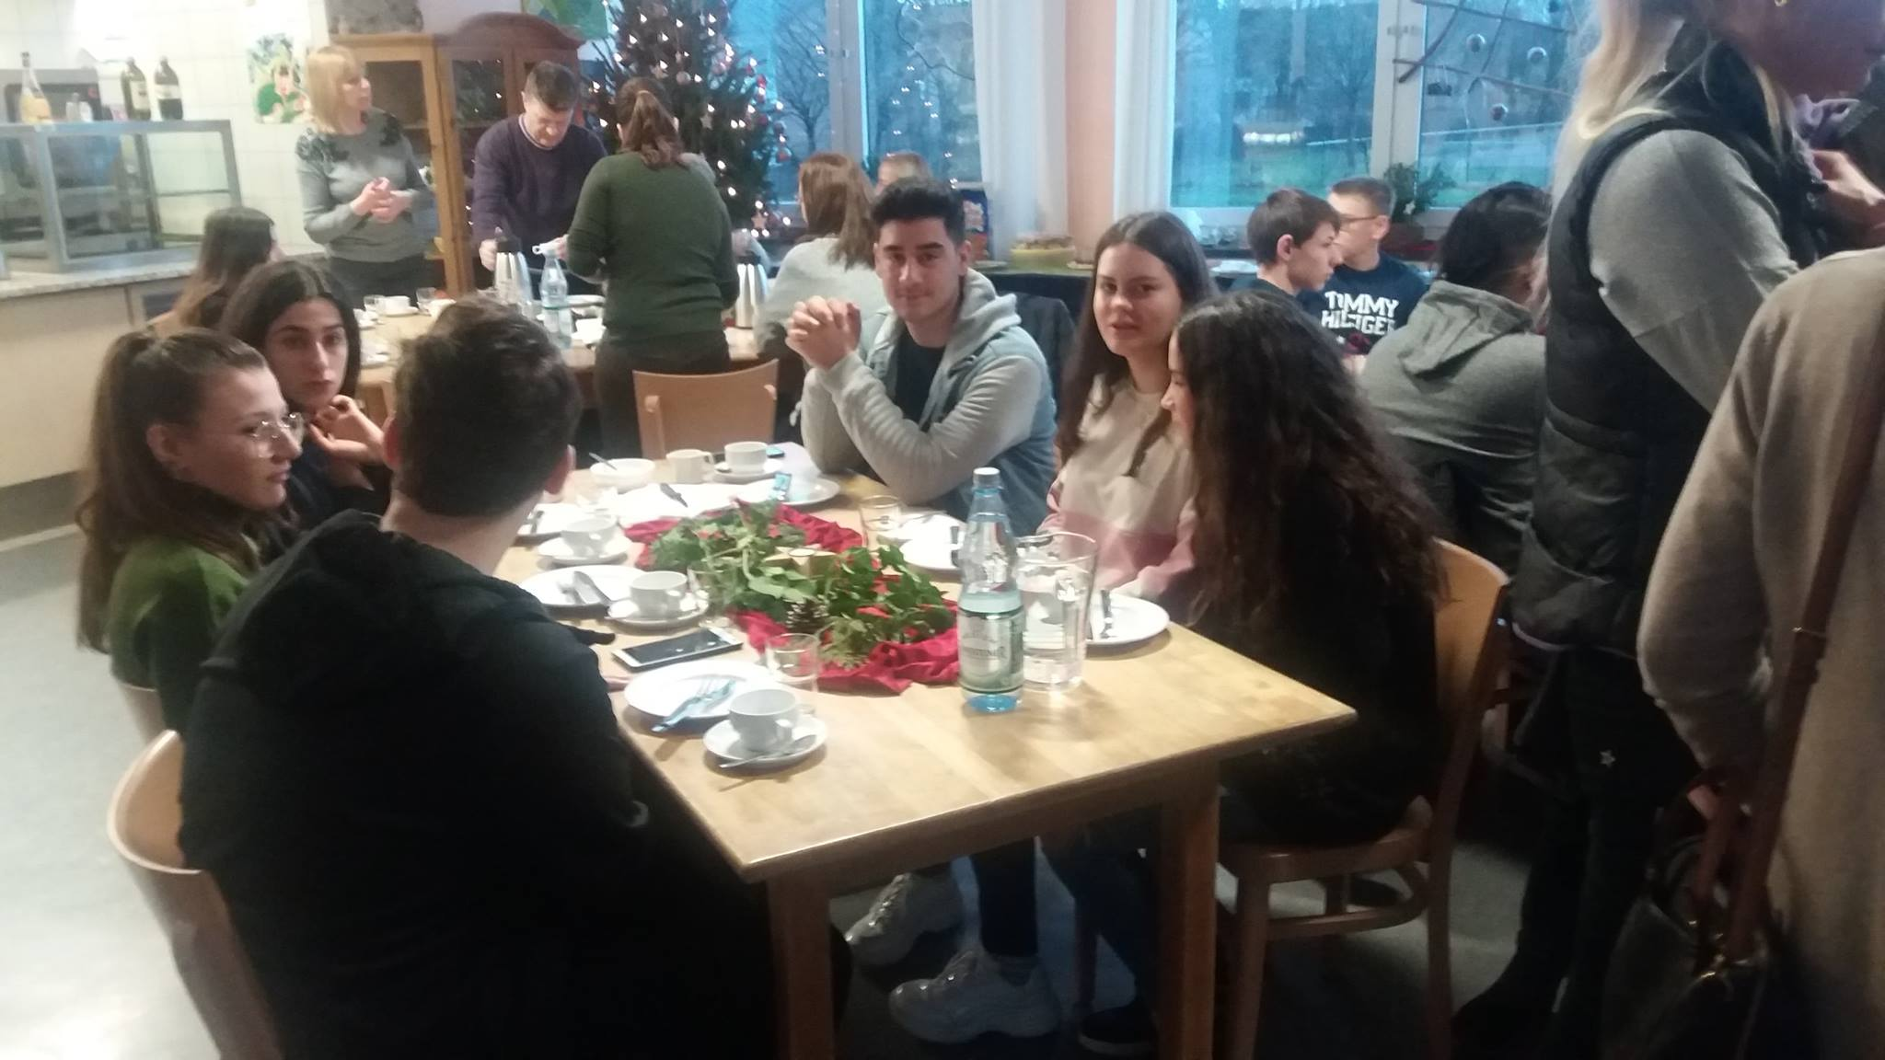
DAY 2
In the morning we came to school for breakfast together with other students from the project. After breakfast we went to the city hall to meet with the mayor, then we came back to school and had activities in art and woodwork.

Slide 6
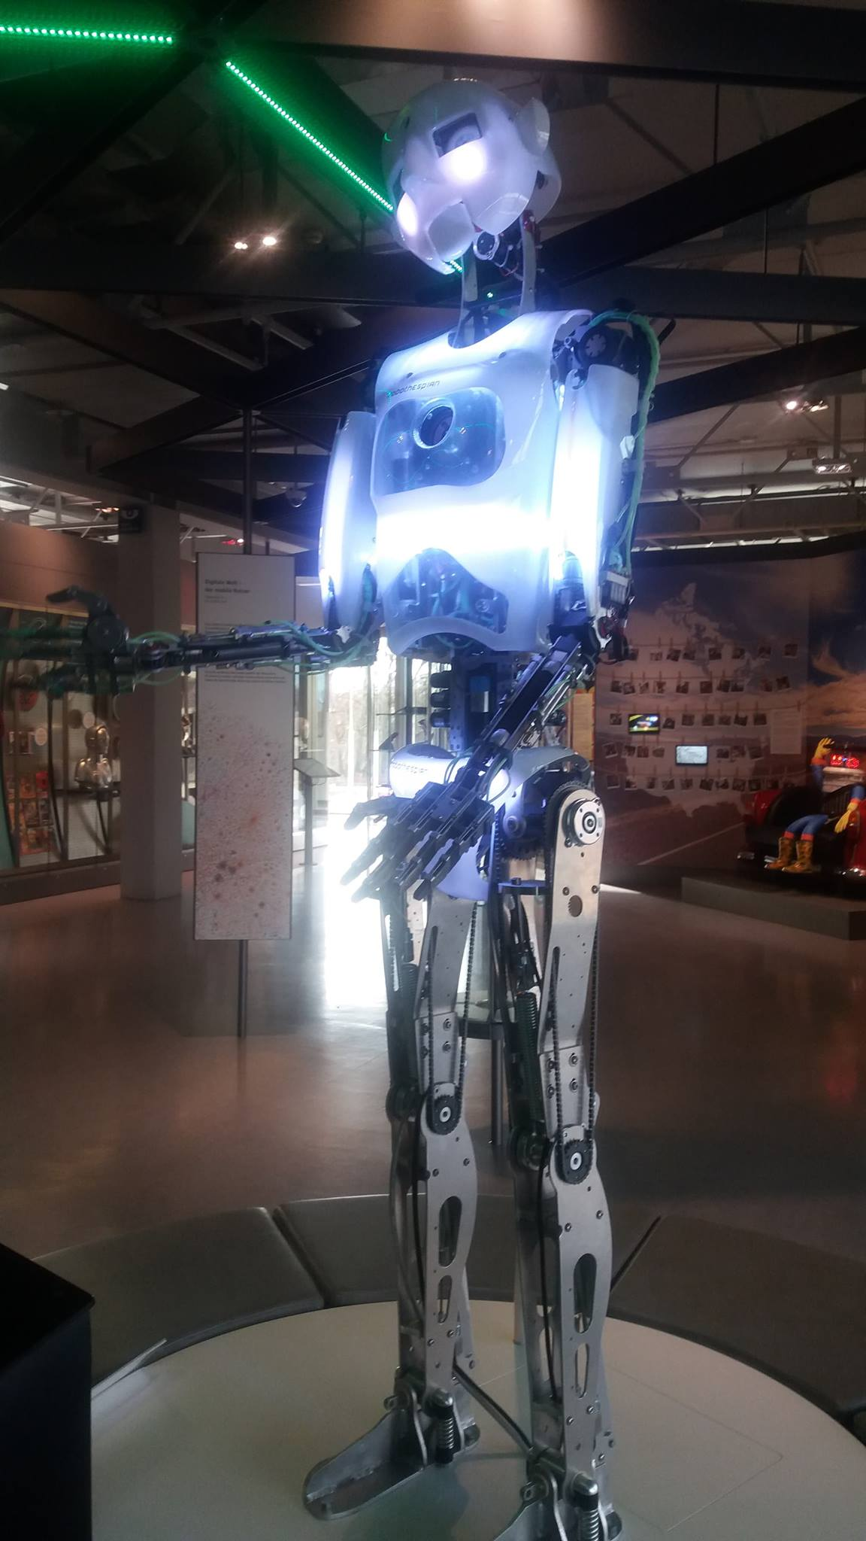
DAY 3
On 3rd day we went to Heinz Nixdorf Museum in Paderborn. Guide showed us around the museum and showed how computers were made over the years.

Slide 7
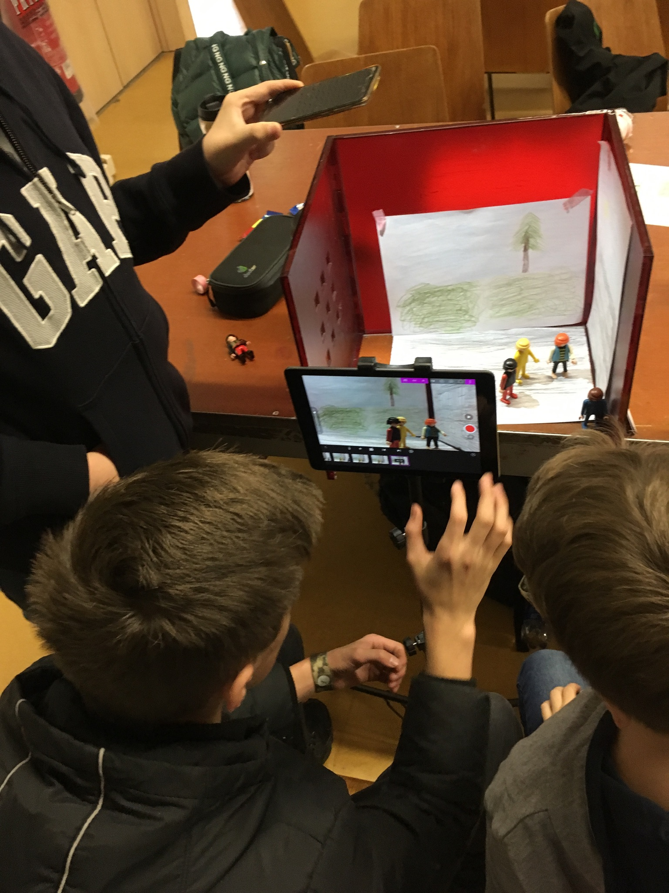
DAY 4
We came to school early in the morning, we were divided into groups and created videos about cyber bullying and selfies.

Slide 8
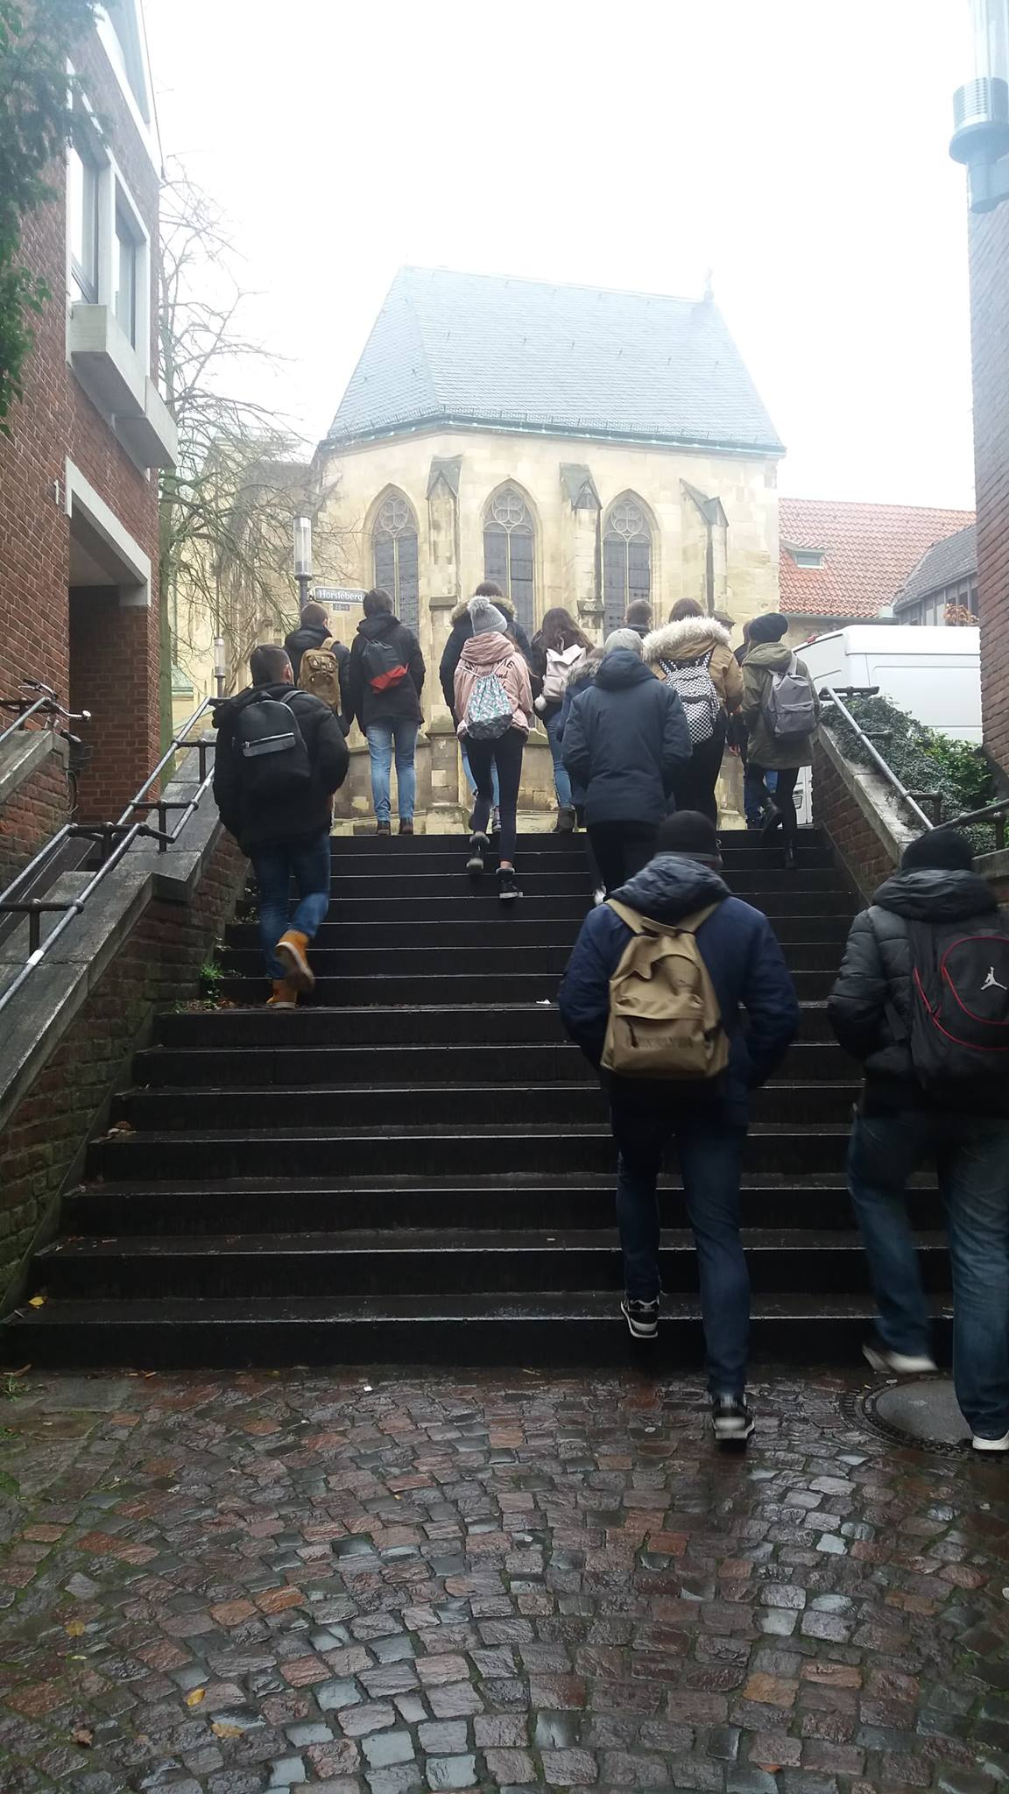
DAY 5
On 5th day of our exchange we went to the Münster city. Guide told us the hisotry of the city and showed the most interesting monuments. In the evening we ate a farewell dinner in school.

Slide 9
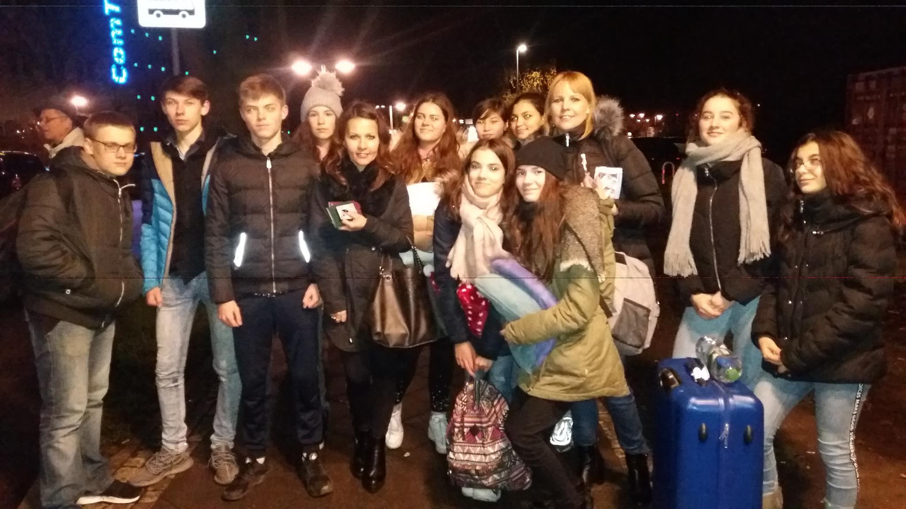
DAY 6
On last day of exchange we came to school to see presentations about other students schools and to present a presentation about our school. Late in the evening we left for Inowrocław

