Slide 1
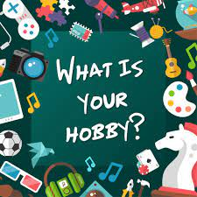
Everyday life Hobbies
Class P4
Greek Section
School of European Education
Heraklion, Greece

Slide 2
Golf
I like to play golf in my free time because it relaxes me. I usually play alone.

Slide 3
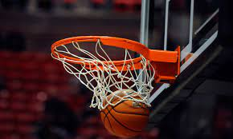
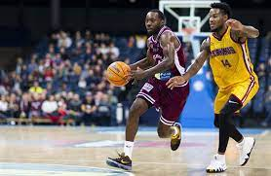
Basketball
I like to play basketball because it is a team sport. So, I play with my friends.

Slide 4
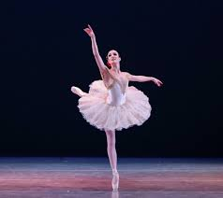
Ballet
I like ballet because it relaxes me and keeps me calm when I’m under a lot of pressure.

Slide 5
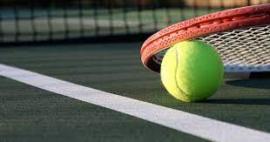
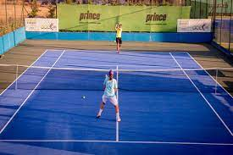
Tennis
Playing tennis energizes me. I can play with my friends or instructor.

Slide 6
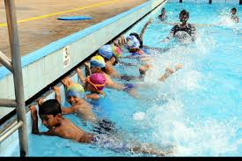
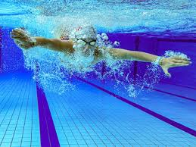
Swimming
I love swimming because it keeps me fit.

Slide 7
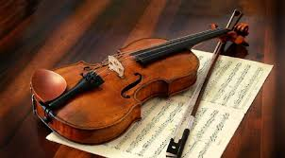
Violin
The violin is my favorite musical instrument because I like the sound it makes.

Slide 8
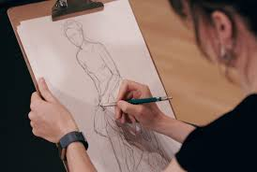
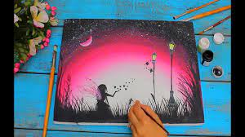
Drawing
I am really good at drawing. It opens my imagination and I am very creative.

Slide 9
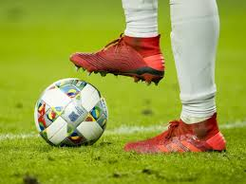
football
I am a member of the local football club “OFI”. I like football because it’s a team sport and we play against other football clubs.

Slide 10
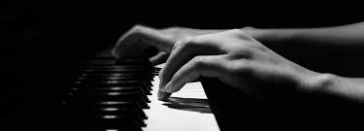
piano
I like playing the piano because the music and melodies it makes, calm me down.

Slide 11
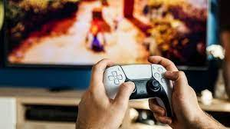
Video games
In my spare time, I play video games. Video games are exciting and I get to chat with other players.

Slide 12
Reading books
When I read books, I feel like travelling to imaginary worlds and have adventures just like the characters of the story.

Slide 13
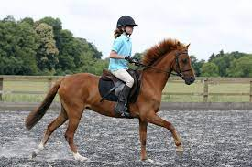
Horse riding
I really enjoy this activity but you need to train hard to keep your balance on horse back.

Slide 14
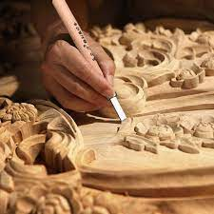
Wood carving
I enjoy this activity because I make something different every time. My parent say, I’m very creative.

Slide 15
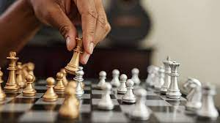
Chess
I really like chess because you need to have a good strategy and think quickly.

Slide 16
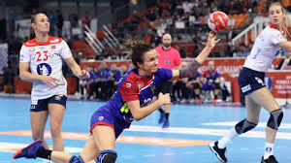
handball
This is a team sport and easy to learn. I play against other teams.

Slide 17
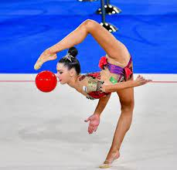
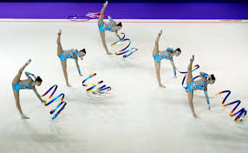
Rhythmic gymnastics
This is a wonderful form of exercise. I love the music that accompanies the choreographies but it need a lot of practice.

Slide 18
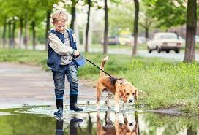
Walks with my pet
I really enjoy to take my dog for a walk. At the afternoon or at the weekend. We usually go to the park.

Slide 19
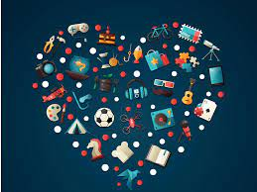
THANK YOU FOR WATCHING!

