Slide 1
School of European Education Heraklion

Slide 3
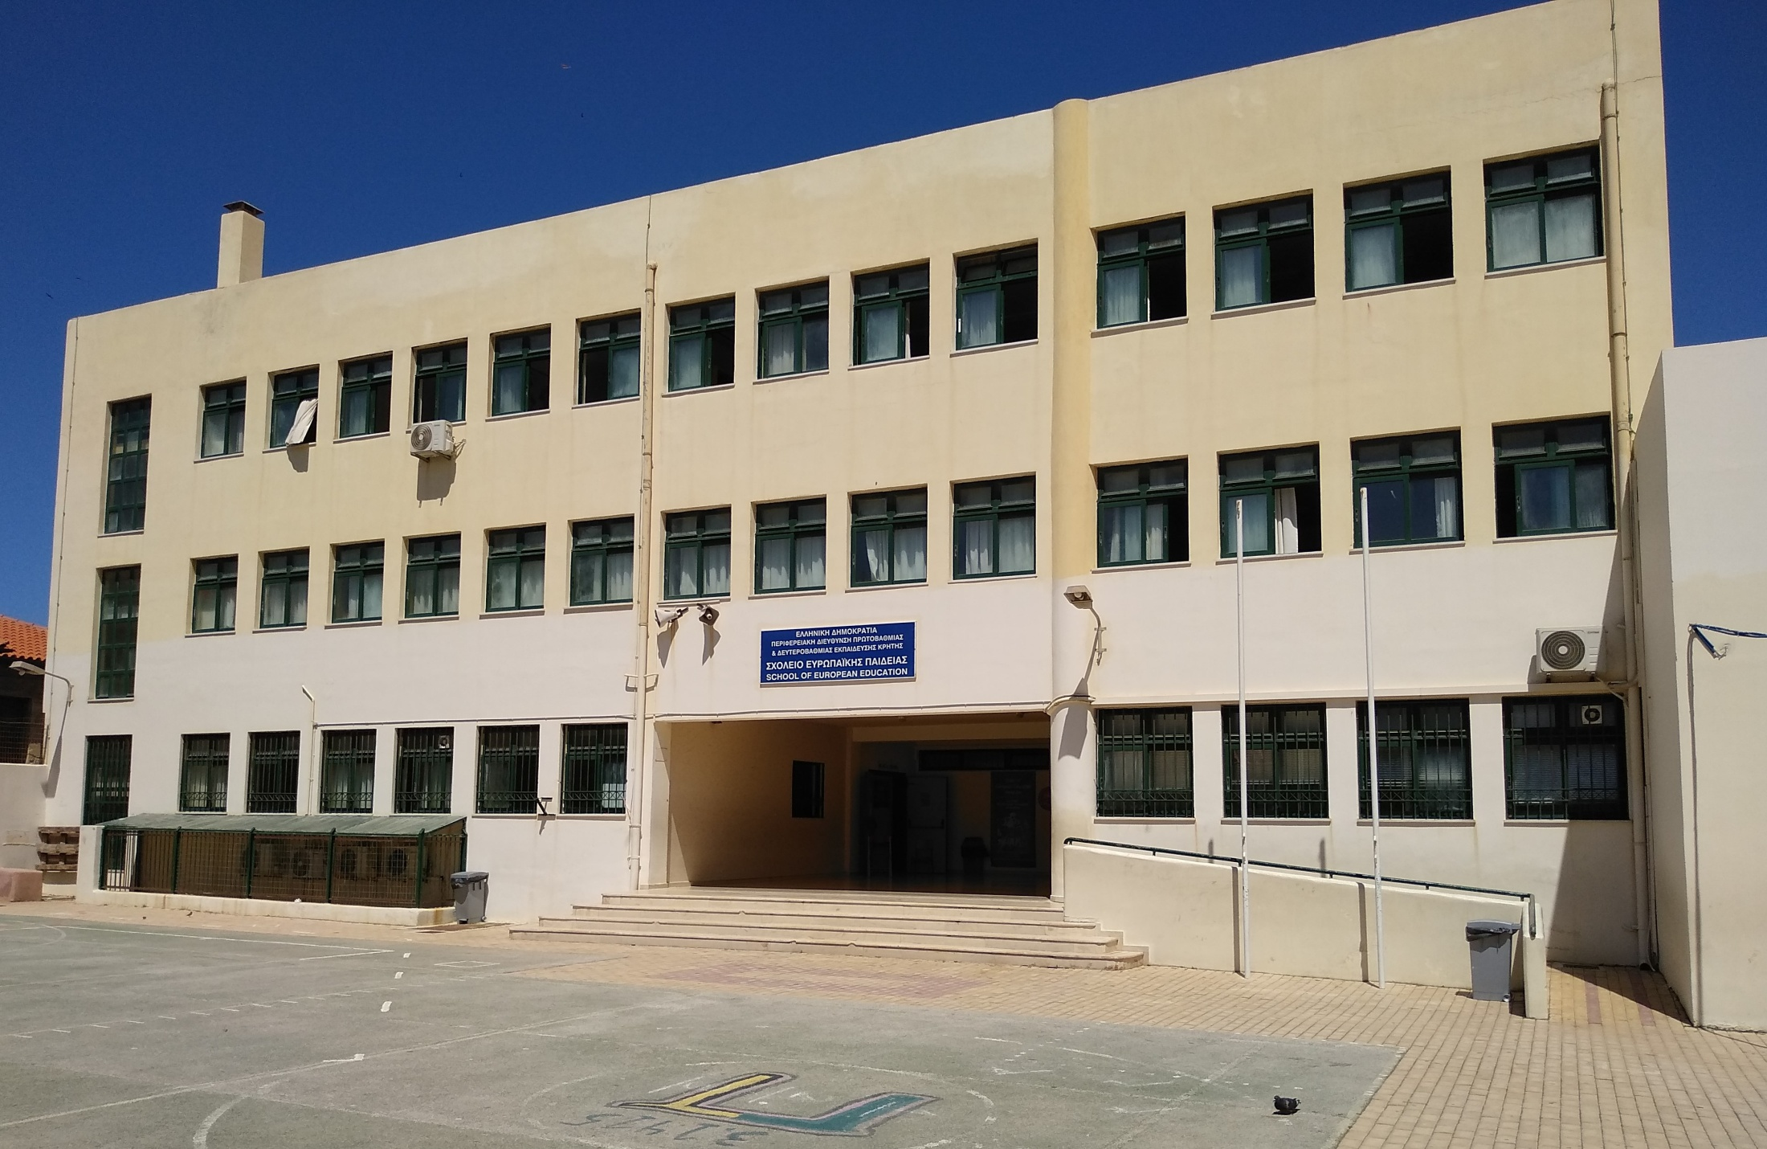
School of European Education Heraklion
The only European School in Greece
(Heraklion, Crete)
6 languages taught
Core subjects taught in various languages
Student ages 4 to 17/18
School hours: 8:30am – 15:30pm
Educational Support
School Breaks

Slide 4
School of European Education Heraklion
Greek section
English section
Nursery (4-6 year olds)
Primary (6-10/11 year olds)
Secondary (11/12- 17/18 year olds)

Slide 5
Primary Cycle
L1 (Greek or English)
L2 (English or German or French)
Mathematics
Discovery of the world
European Hours
Ethics or Religion
Art & Music
Physical Education

Slide 6
Secondary Cycle
L1 (Greek or English)
L2 (English or German or French)
L3/L4 (Spanish or Italian)
Mathematics (4p/6p)
Human Sciences (History, Geography)
Integrated Sciences (Physics, Chemistry, Biology)
Ethics or Religion
Art & Music
Physical Education
ICT

Slide 7
Secondary Cycle
S1 – S3 core subjects
S4 – S5 core and optional subjects
S6 – S7 Baccalaureate curriculum:

Slide 8
Secondary Cycle
B tests (once or twice each term): S4 – S7
Exams (once each term): S5 – S6
Baccalaureate Examination: S7
(written and oral exams)

Slide 9
Extracurricular activities
Photo club
Weaving club
Math club
Erasmus+ programs
Graduation Ceremony

Slide 10
Thank you for your attention!

