Slide 1
FAMOUS EUROPEAN MONUMENTS
MONUMENTS AS UNIQUE AND PRECIOUS AS DIAMONDS

Slide 2
HUNGARIAN PARLIAMENT, BUDAPEST

Slide 3
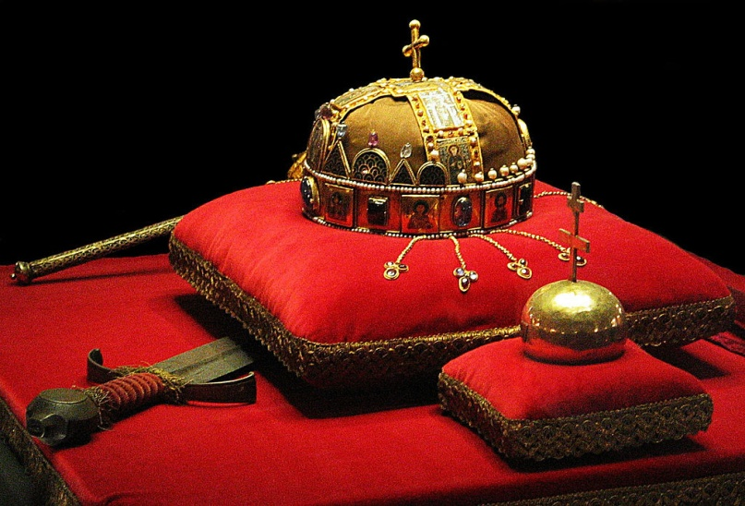
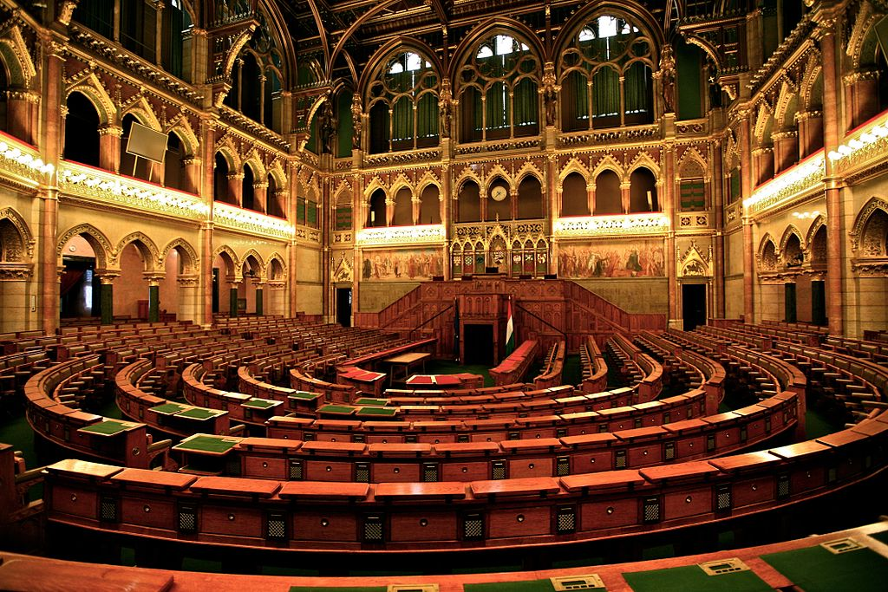
HUNGARIAN PARLIAMENT, BUDAPEST

Slide 4
BUDA CASTLE, BUDAPEST

Slide 5
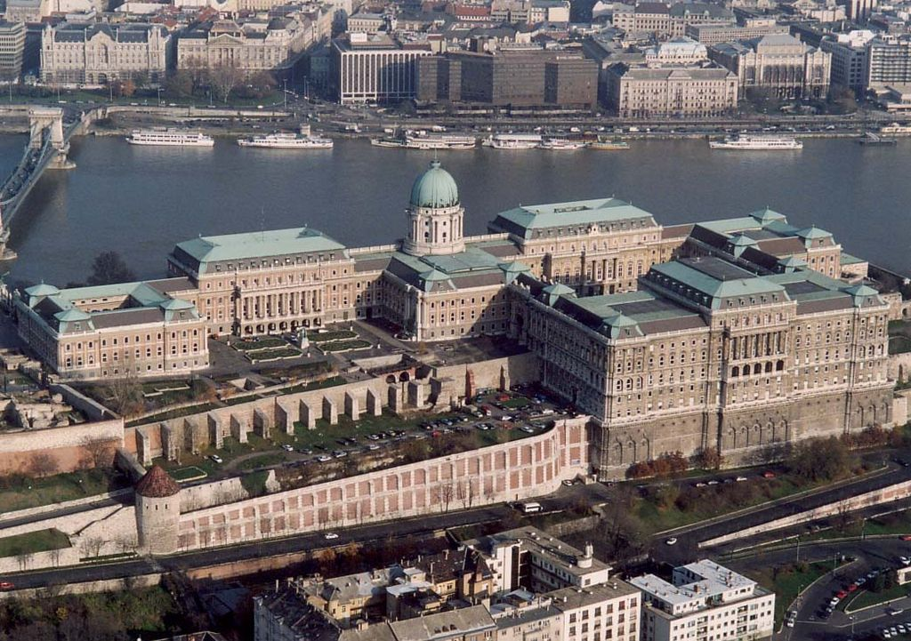
BUDA CASTLE, BUDAPEST

Slide 6
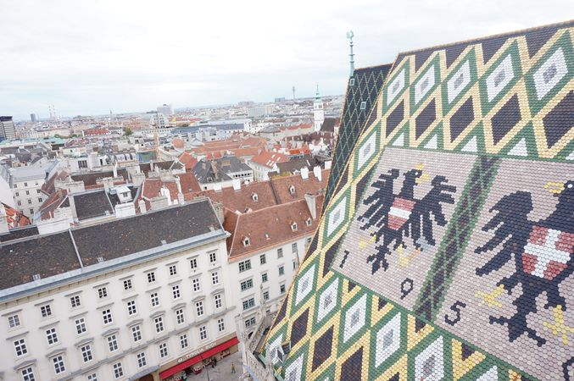
SAINT STEPHEN’S CATHEDRAL, VIENNA

Slide 7
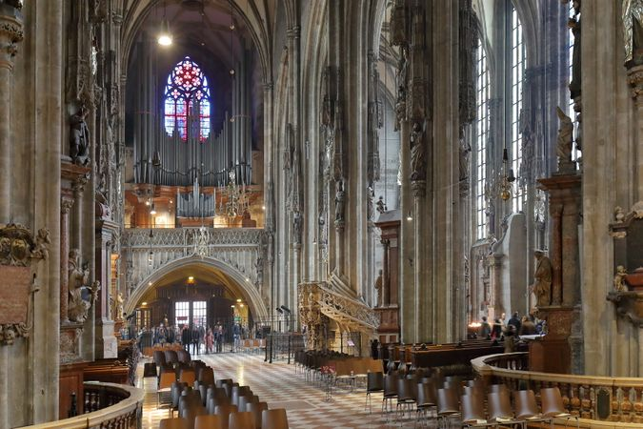
SAINT STEPHEN’S CATHEDRAL, VIENNA

Slide 8
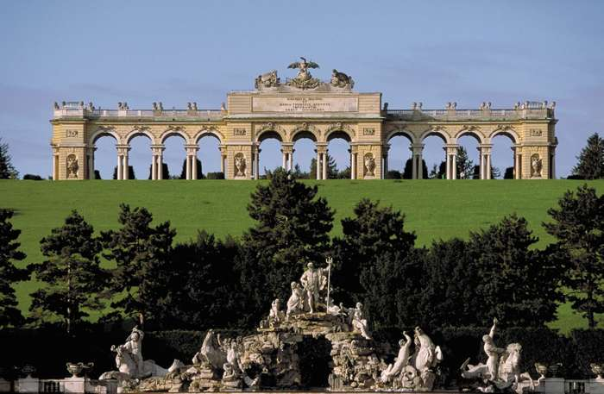
SCHÖNBRUNN PALACE, VIENNA

Slide 9
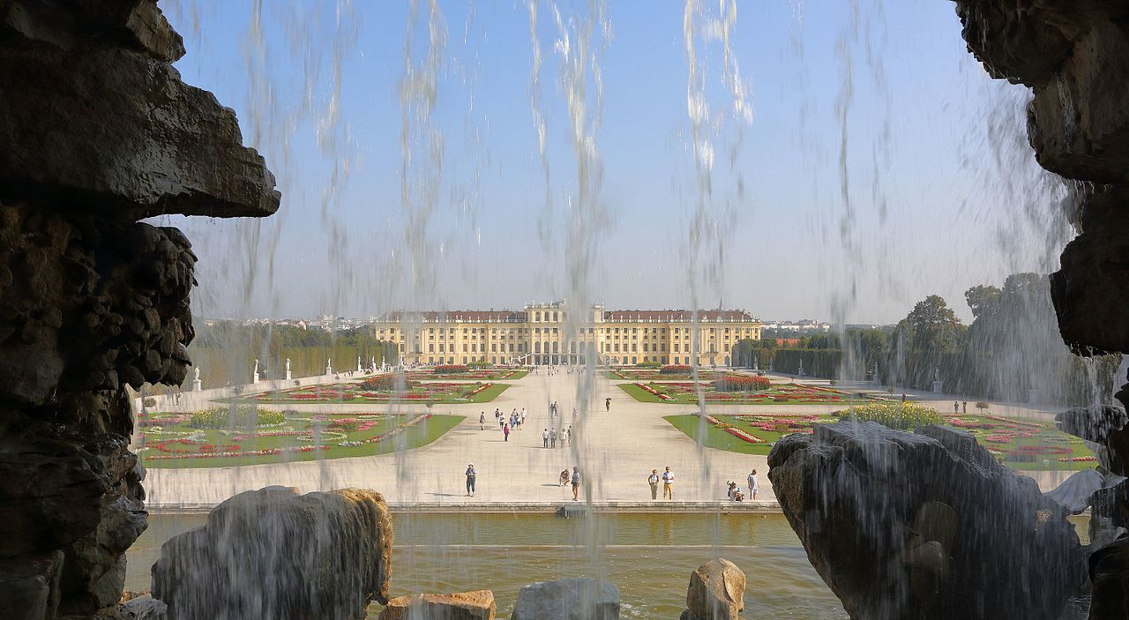
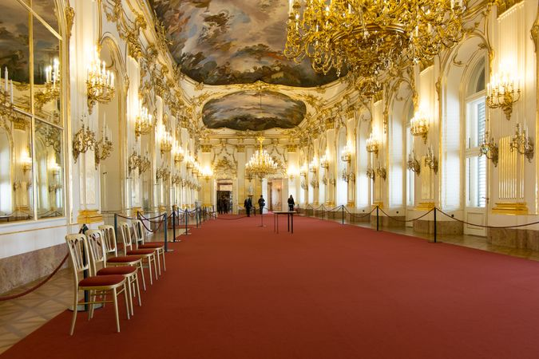
SCHÖNBRUNN PALACE, VIENNA

Slide 10
BRANDENBURG GATE, BERLIN

Slide 11
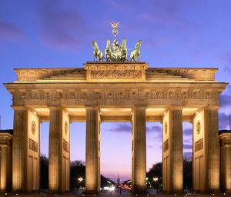
BRANDENBURG GATE, BERLIN

Slide 12
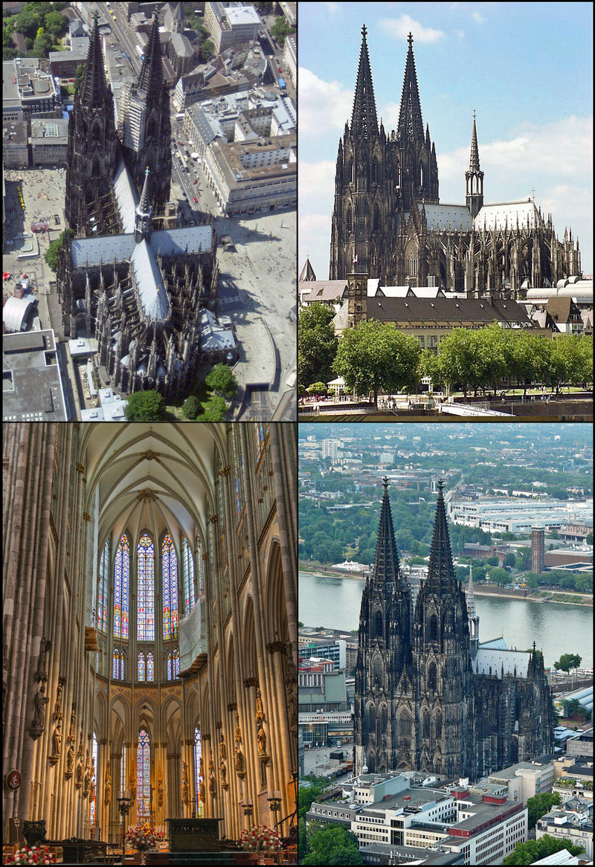
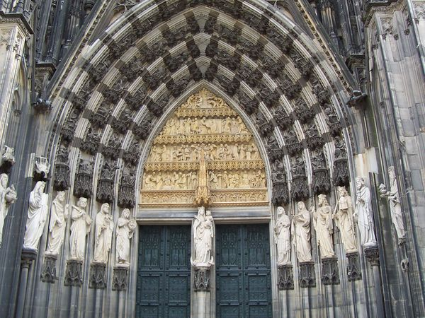
COLOGNE CATHEDRAL, COLOGNE

Slide 13
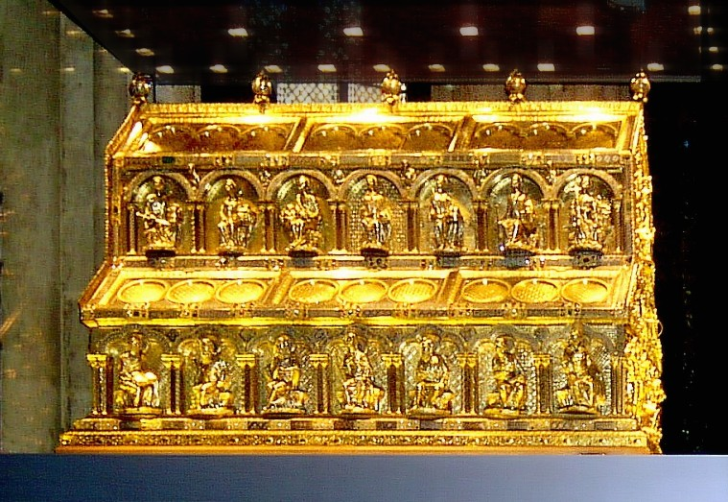
COLOGNE CATHEDRAL, COLOGNE

Slide 14
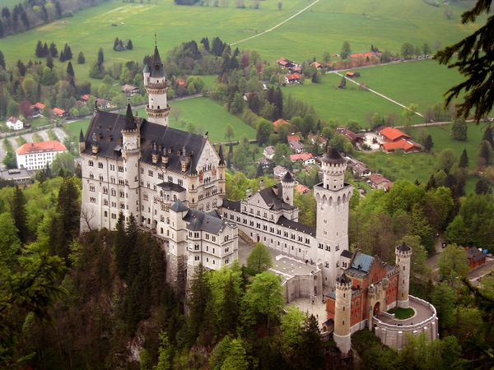
NEUSCHWANSTEIN CASTLE, SCHWANGAU

Slide 15
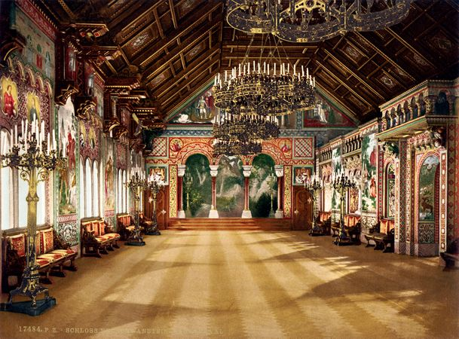
NEUSCHWANSTEIN CASTLE, SCHWANGAU

Slide 16
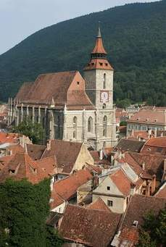
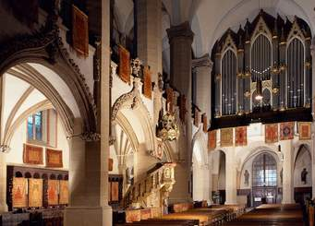
BLACK CHURCH, BRASOV

Slide 17
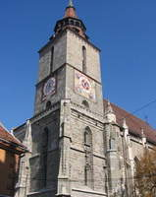
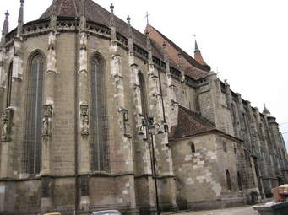
BLACK CHURCH, BRASOV

Slide 18
SIGHISOARA CITADEL, SIGHISOARA

Slide 19
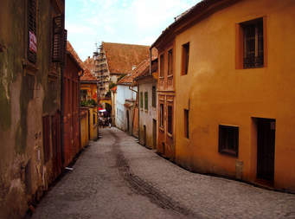
SIGHISOARA CITADEL, SIGHISOARA

Slide 20
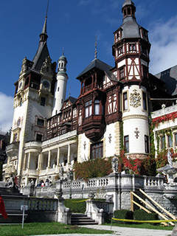
PELES CASTLE, SINAIA

Slide 21
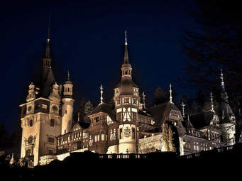
PELES CASTLE, SINAIA

