Slide 1
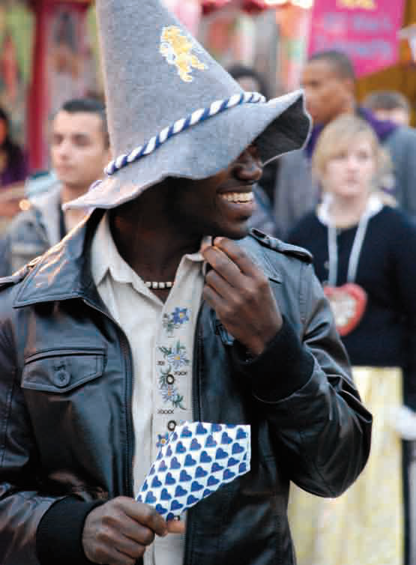
Migration & Culture

Slide 2
1
Introduction

Slide 3
“Almanya - Welcome to Germany”
Watch a scene from the movie.
What do you think is the story behind the scene?

Slide 4
Use the letters of the word “migration”
example:
W ide
O ceans
R estless
L andscapes
D ifferences
to create an acrostic

Slide 5
2
Vocabulary

Slide 6
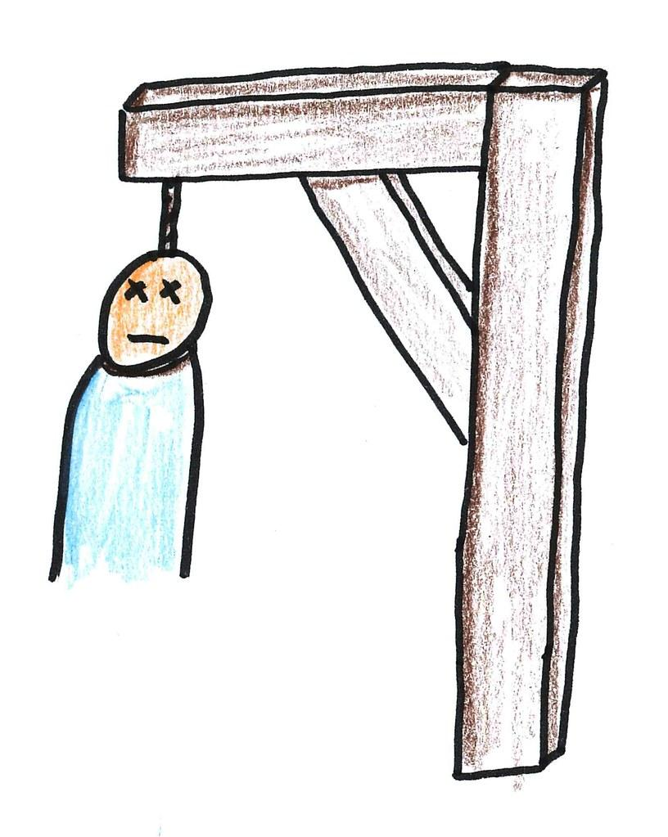
hangman

Slide 7
3
the Interviews

Slide 8
4
Migration
4.1 Intro - Migration Blues
4.2 What is Migration?
4.3 History
4.4 Push and Pull factors
4.5 Who, where from, where to

Slide 9
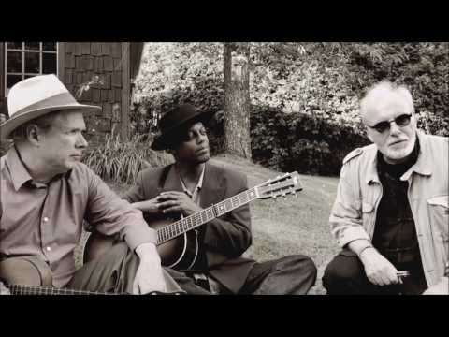
4.1 migration blues
1 What does the singer Eric Bibb think about migration?
2 Which is the point that you agree with the most? Why?

Slide 10
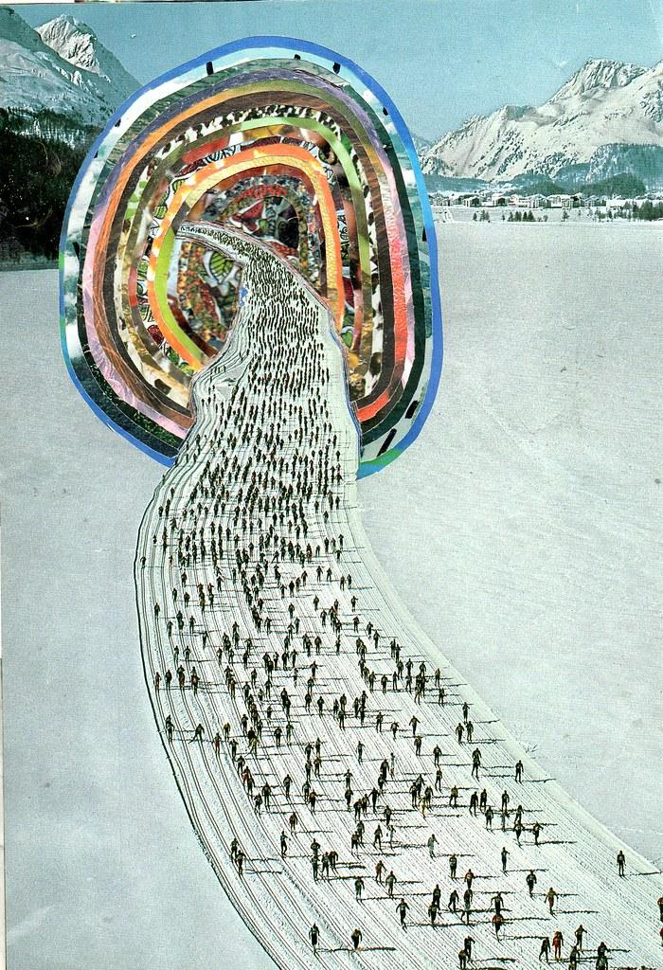
Of the 7.7 billion people who populate the world, more than 200 million live outside their country of birth.

Slide 11
4.2 What is Migration?
A People move to a city or region close to their home region because it is nicer there.
B People commute every week or every month to another country or region for a better job, better salary or better working conditions.
C People move to another country or distant region to settle there permanently or temporarily

Slide 12
4.3 The History of Migration
1 Since when do people migrate?

Slide 13
4.3 The History of Migration
1 Since when do people migrate?
2 Watch video 1 about human migration and complete the timeline on learningapps.

Slide 14
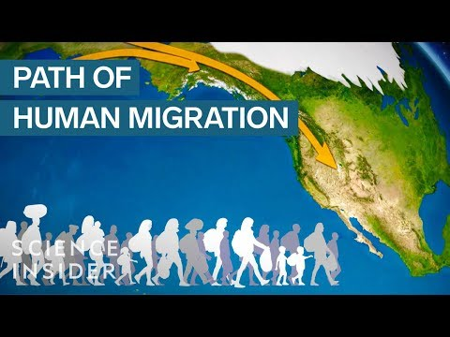

Slide 15
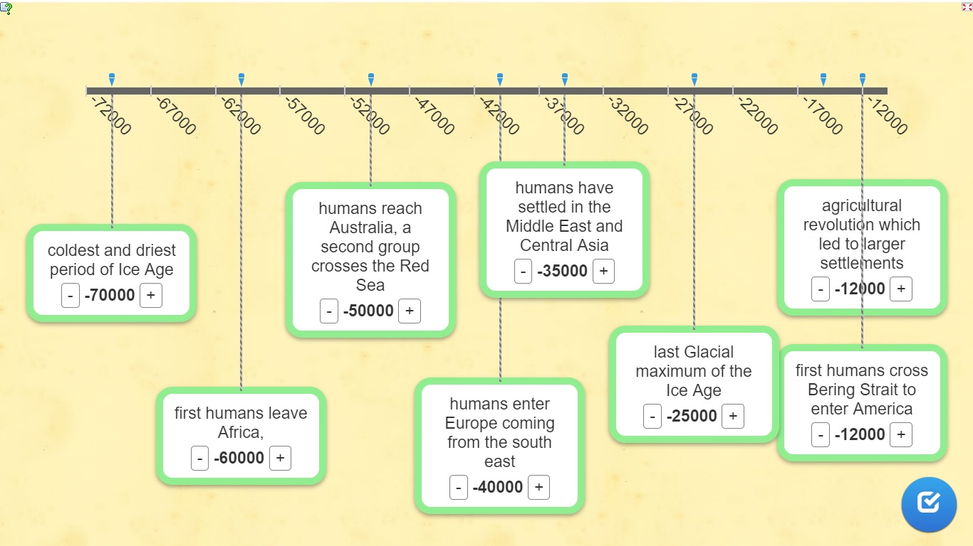

Slide 16
4.3 The History of Migration
1 Since when do people migrate?
2 Watch video 1 about human migration and complete the timeline on learningapps.
3 Watch video 2 about human migration and complete the text with the given words in italics.

Slide 17
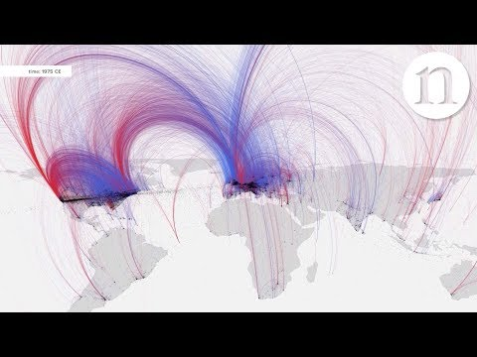

Slide 18
4.3 The History of Migration
1 Since when do people migrate?
2 Watch video 1 about human migration and complete the timeline on learningapps.
3 Watch video 2 about human migration and complete the text with the given words in italics.
4 Since when do people migrate?

Slide 19
4.4 Why do people migrate? Push and Pull factors
What words do you associate with the word ‘push’?
What words do you associate with ‘pull’?
Not clear, yet? Go to https://visuwords.com/ and type in the words ‘push’ and ‘pull’.

Slide 20
4.5 Who migrates, where from and where to?

Slide 21
4.5 Why do people migrate? Push and Pull factors
Are these statements true or false?
1. The main movement of population is from developing countries to developed countries.
2. There are 4 million foreign born residents in Germany.
3. Most OECD* countries have a foreign population of between 5% and 15%.
4. Many countries in the north would be unable to function without a large population of foreign workers.

Slide 22
4.5 Why do people migrate? Push and Pull factors
Are these statements true or false?
1. The main movement of population is from developing countries to developed countries.
2. There are 4 million foreign born residents in Germany.
3. Most OECD* countries have a foreign population of between 5% and 15%.
4. Many countries in the north would be unable to function without a large population of foreign workers.

Slide 23
5
migration & culture

Slide 24
5.1 vocabulary
cultural identity
cultural stereotype
culture shock
is defined by nationality, ethnic group, language, culture, traditions and education
label someone based on who they are, where they are from, ethnic group, language etc.
the realization that another culture is very different from yours

Slide 25
5.2 Greetings around the world
Look at the students greeting each other. Some greeting gestures will probably seem strange to you ...

Slide 26
5.2 Greetings around the world
Look at the students greeting each other. Some greeting gestures will probably seem strange to you ...
1. Which greetings were nice, which were unpleasant? Give reasons.
2. Could there be misunderstandings? Why?
3. Why is it important to know about the correct greetings when you meet someone with a different cultural background?

Slide 27
5.3 Culture (Shock) - Example
Part of our cultural identity is also how we usually behave in certain situations and what is acceptable to us.
Behaving “normally” can be cultural shocking for other people!

Slide 28
5.4 Cultural identity - Similarities & Differences
Remember the aspects of cultural identity (language, traditions, …)!
Think about what you have in common and what is different.
Create spidergrams that show similarities and differences within your group. Use colours!

Slide 29
6 Meet the Somalis

Slide 30
6 Meet the Somalis
Choose one migrant from Somalia. Look at and read the comic.
Create a profile of the person.
Talk about him or her (Who, Where now, reasons to leave / to come, difficulties, culture shock situations, family, problems with who? adapted? …)

Slide 31
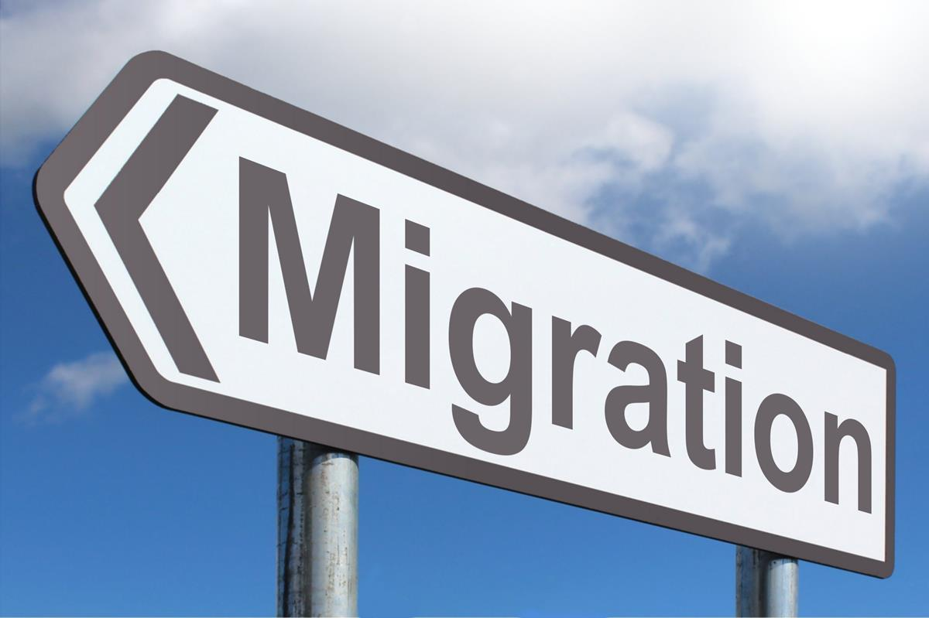
Thanks a lot!

