Slide 1
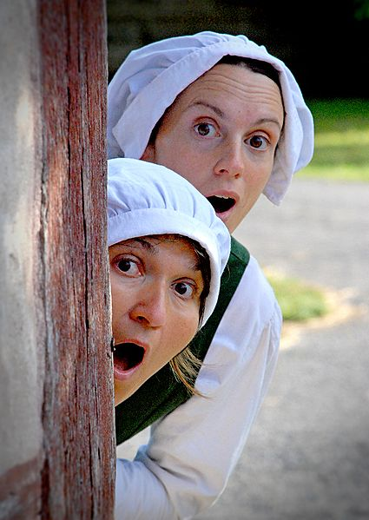
Best of europe
Our smashing traditions and customs

Slide 2
Game:
Word-Definition-Circle
FEAST?
A FESTIVAL, CELEBRATION or EVENT!

Slide 3
My favourite holiday

Slide 4
Weird traditions of europe

Slide 5
Watch It
-> Match:
video
tradition/festival
country
text
This will blow your mind!

Slide 6
Play
Video 1
Video 2
Video 3
Video 4
Video 5
Video 6
Video 7
Video 8

Slide 7
What is your group’s favourite one? Give reasons.

Slide 8
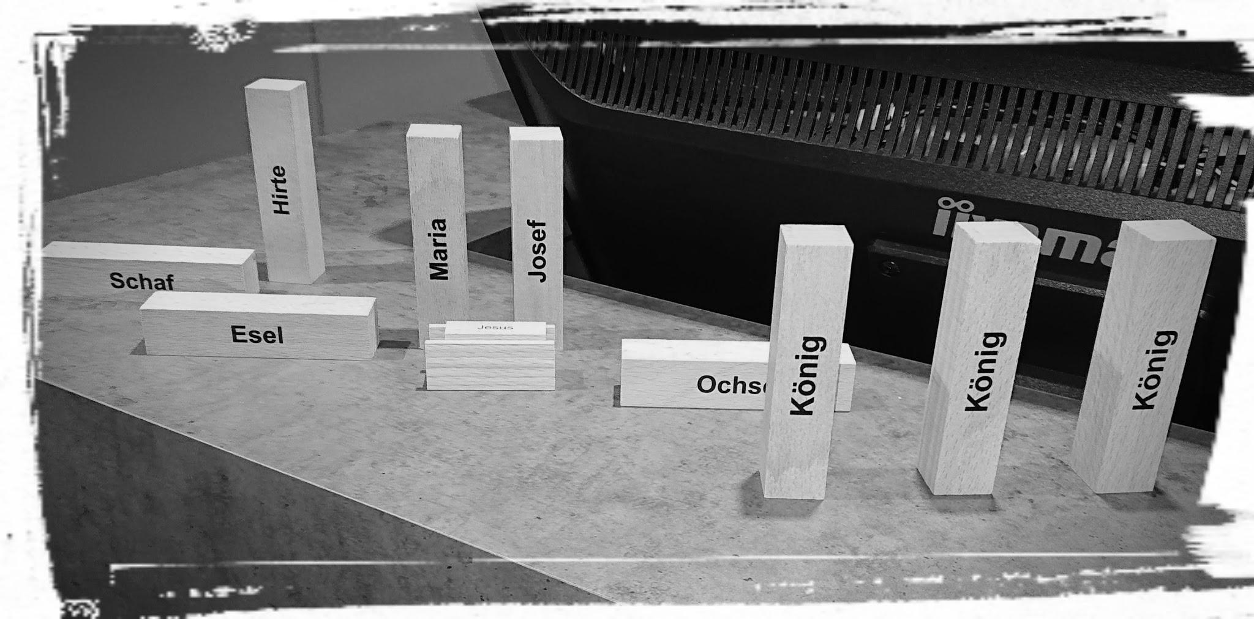
European Christmas traditions

Slide 9
You will listen to an American tourist talking about Christmas traditions in Europe.
Watch the video and fill in the text afterwards.

Slide 10
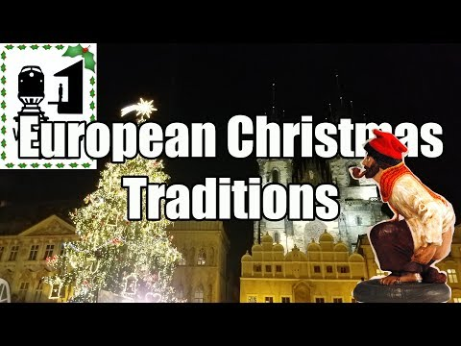
Xmas traditions

Slide 11
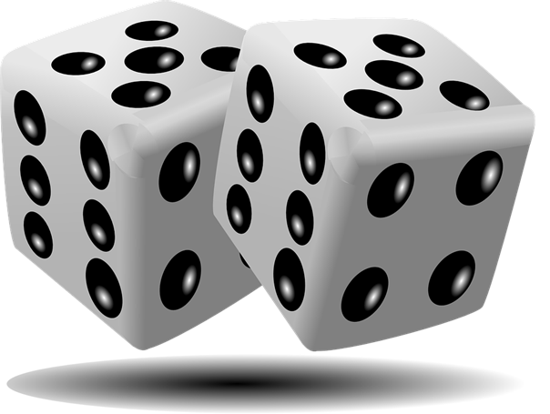
WOW, WHAT A TREE …
IT’S PARTY TIME!
ON THE FIRST DAY OF CHRISTMAS MY TRUE LOVE …
WOOHOO, A GAME!

Slide 12
Interviews

Slide 13
15 minutes

Slide 14
Brainstorming

Slide 15
THE 7 RULES OF BRAINSTORMING
Do not say “no” or “but”.
Wild and crazy ideas are good.
Build on others’ ideas
Stay on topic
One conversation at a time
Be visual
Go for quantity

Slide 16
Brainstorming
10 Minutes

Slide 17
Working time
85 Minutes

Slide 18
YeeHAW!
It Is Presentation time!

Slide 19
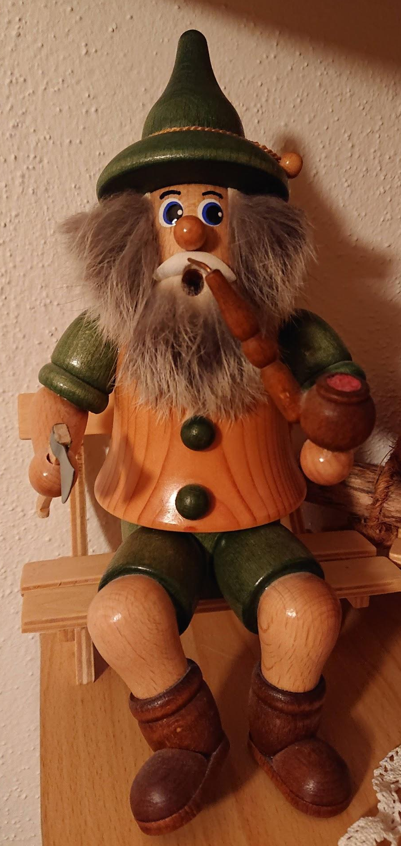
THX A LOT!
:-)

Slide 20
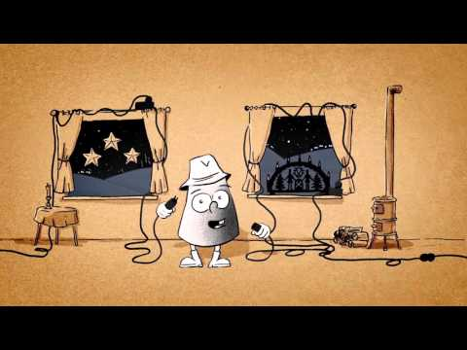
‘S KARZL

