Slide 1
10 Most Important People From Portugal

Slide 2
Sports
Cristiano Ronaldo was born in Madeira.
He won 5 Golden Balls, 4 European Golden Boots.
He started playing for a small team and now he plays in Juventus and for the Portuguese National Team.

Slide 3
Literature
Luís Vaz de Camões (1524-1580) was one of the greatest writers of Portugal.
His most famous book is “Os Lusíadas” which tells the history of Portugal.
He also wrote poetry.

Slide 4
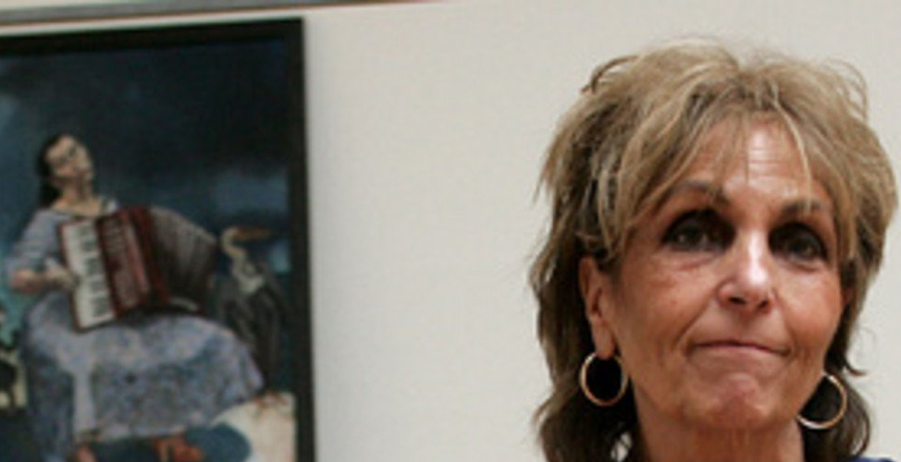
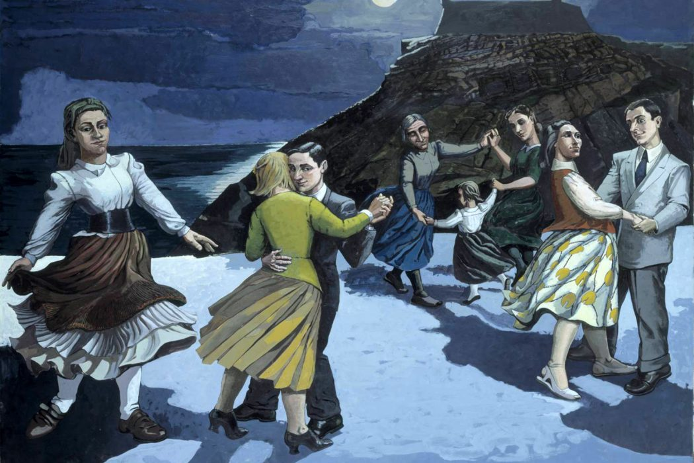
Arts
Paula Rego is a famous painter of surrealism and expressionism.
She studied in London at “Slade school of fine art”
She won many prizes at United Kingdom and Portugal

Slide 5
Politics
António Guterres
He was prime minister and deputy for 17 years in Portugal
Since 2017, he works as the general secretery at ONU.

Slide 6
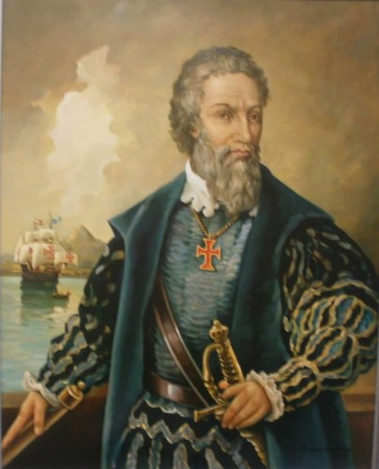
Navigators
Vasco da Gama was a Portuguese explorer and the first European to reach India by sea
Pedro Álvares Cabral was also a navigator and explorer. He was the European discoverer of Brazil and claimed it for Portugal.

Slide 7
Kings
D. Sebastião
He became king of Portugal at 14.
Passed Esposende from village to city.
He disappeared in battle on a foggy day.

Slide 8
Music
Amália Rodrigues
She was the best known portuguese singer(Fado).
She has countless known songs: Coimbra, Lisboa Antiga, Gaivota, etc….

Slide 9
Science
António Damásio
He is a neuro surgeon.
He published a book about his studies, “O Erro de Descartes”.
He is a professor of neurology at a University of California called University of Southern California.

Slide 10
Marcelo Rebelo de Sousa
Current President of the Portuguese Republic

