Slide 1
CHRYSANTHEMUM
A verbal bullying story at school

Slide 2
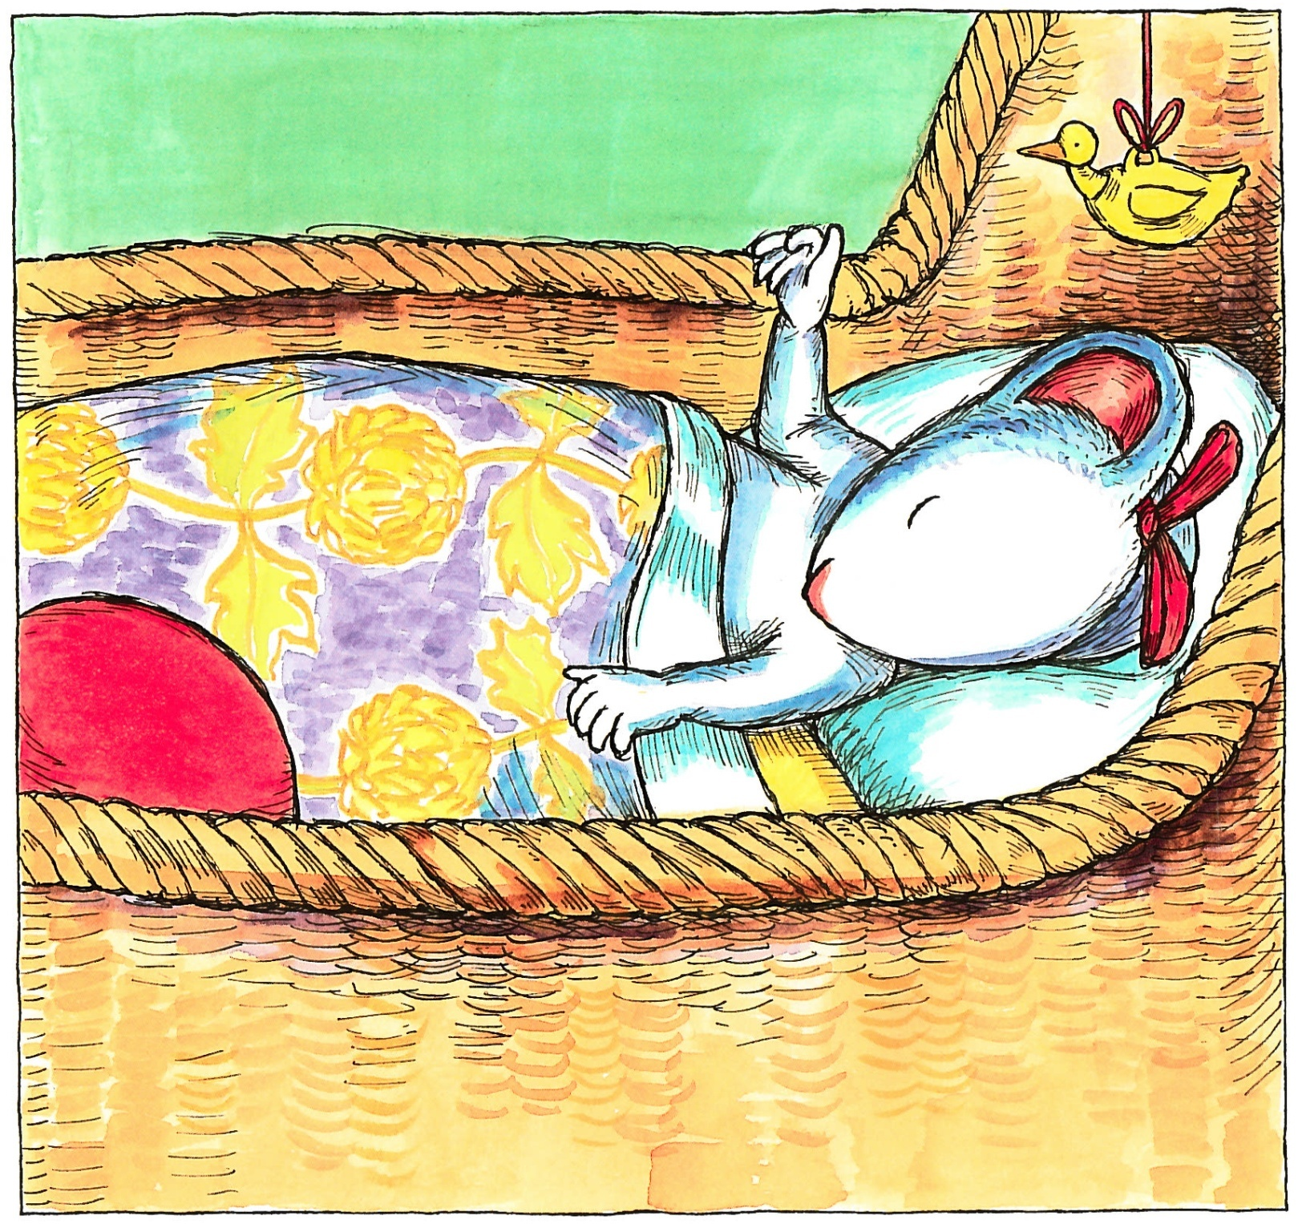
The day she was born was the happiest day in her parents’ lives.
“She’s perfect” says her mother
“Absolutely” says her father
She is absolutely perfect
“Her name must be everything she is”, says her mother
“Her name must be absolutely perfect” says her father.
And it is.
Chrysanthemum. Chrysanthemum. Chrysanthemum.

Slide 3
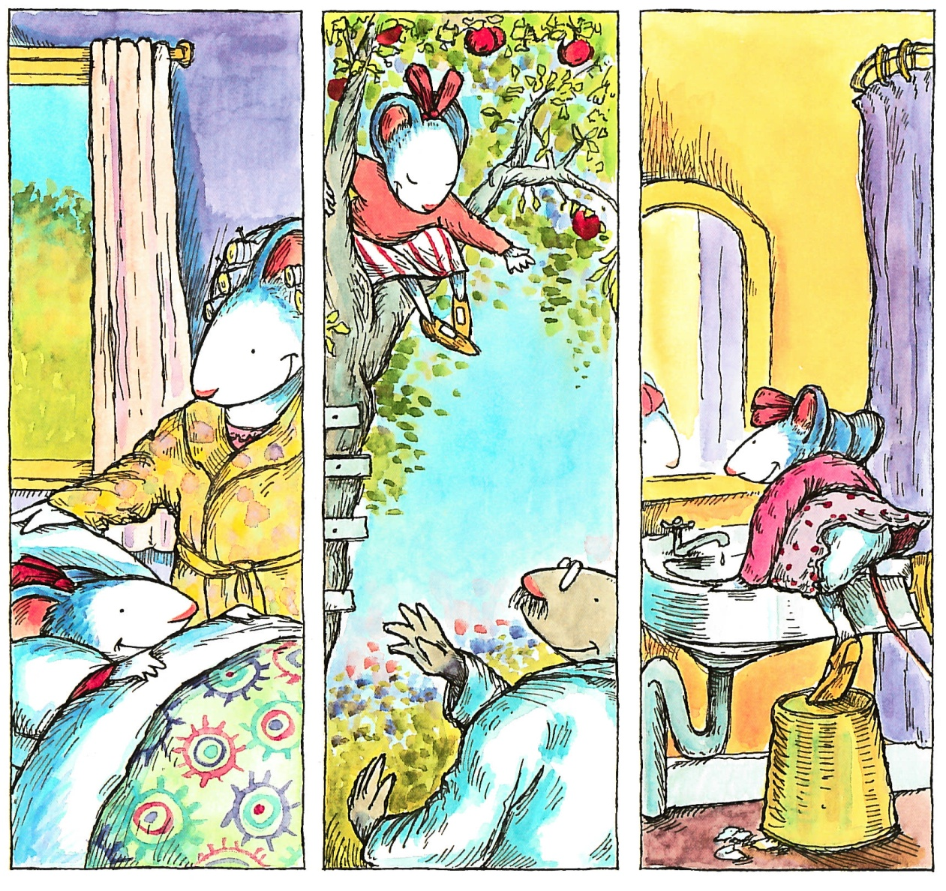
Chrysanthemum grows and grows and grows and she loves her name.
She loves the way it sounds when her mother wakes her up.
She likes the way it sounds when her father calls her for dinner
And she loves the way it sounds when she whispers it to herself in the
bathroom mirror.
Chrysanthemum. Chrysanthemum. Chrysanthemum.

Slide 4
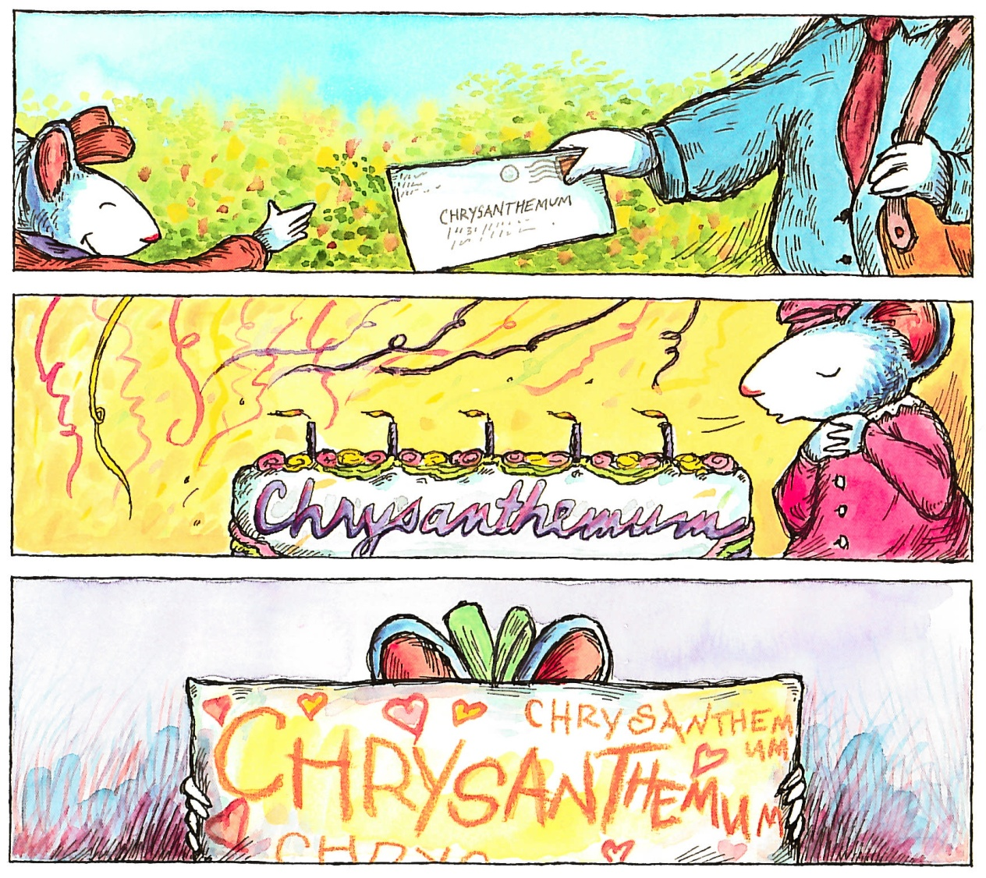
Chrysanthemum loves the way her name looks when it is written with
ink on an envelope.
She loves the way it looks when it is written with icing on her birthday
cake.
And she loves the way it looks when she writes it herself with her fat
orange crayon.
Chrysanthemum. Chrysanthemum. Chrysanthemum.

Slide 5
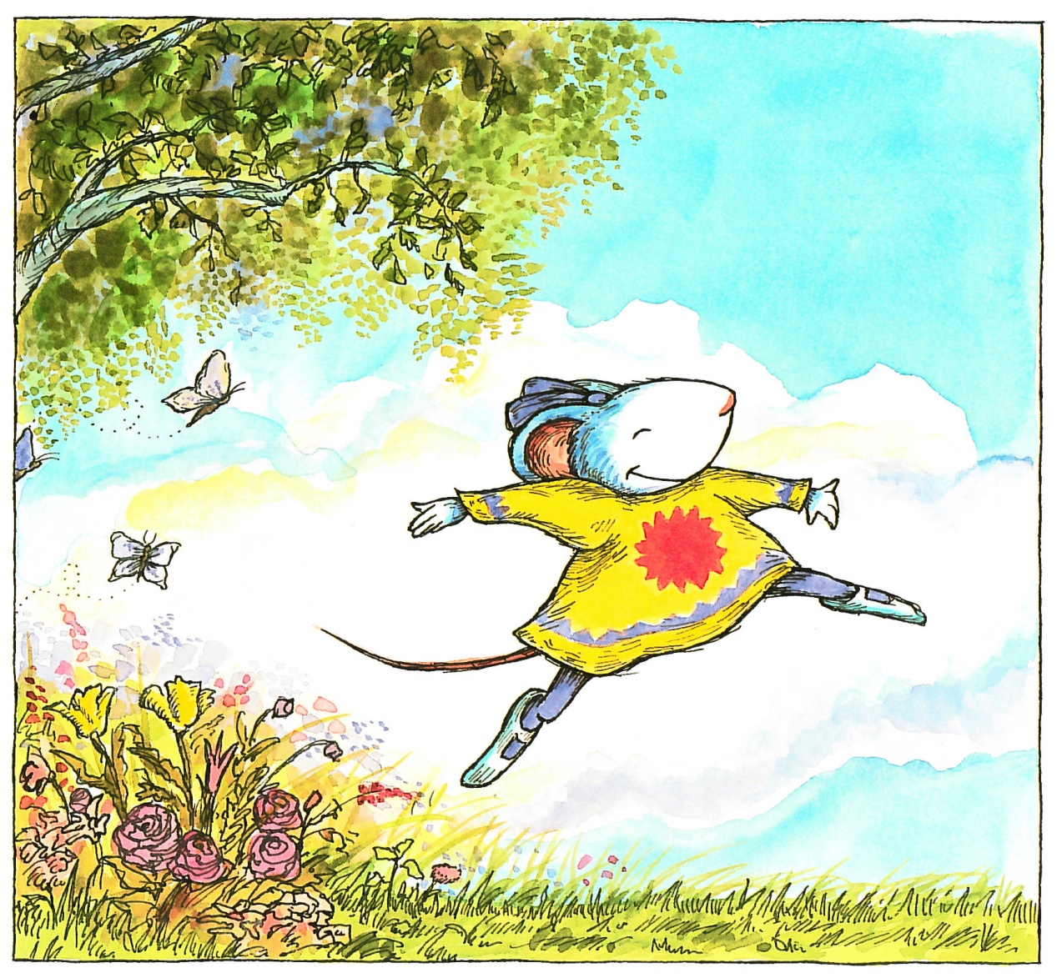
Chrysanthemum thinks her name is absolutely perfect.
And then she starts school.
On her first day, Chrysanthemum wears her sunniest dress and her
brightest smile.
She runs all the way.
“Hooray!” says Chrysanthemum ”School!”

Slide 6
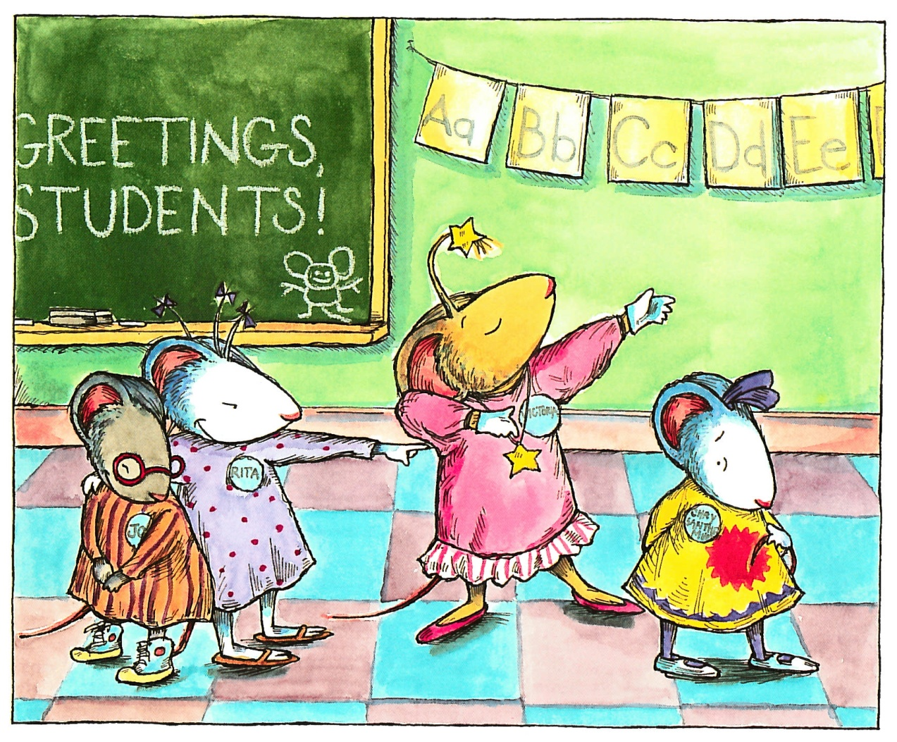
But, when Mrs Chud takes roll call, everyone giggles upon hearing
Chrysanthemum’s name.
“It’s so long” says Jo
“ It scarcely fits on your name tag” says Rita, pointing.
“I’m named after my grandmother” says Victoria “You’re named
after a flower!”
Chrysanthemum wilts.
She does not think her name is absolutely perfect.
She thinks it is absolutely dreadful.

Slide 7
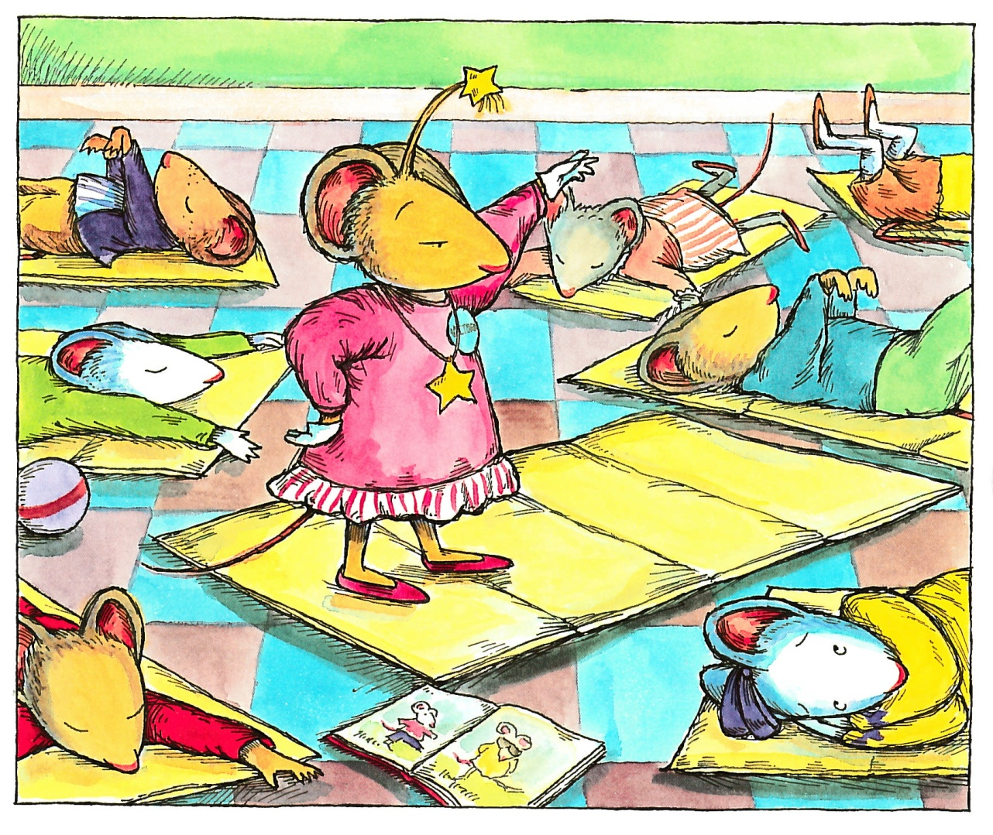
The rest of the day is not better.
During naptime Victoria raises her hand and informs Mrs Chud that
Chrysanthemum’s name is spelled with thirteen letters.
“That’s exactly half as many letters as there are in the entire alphabet”,
Victoria explains.
“Thank you for sharing that with us, Victoria” says MrsChud.
“ Now put your head down”
“If I had a name like yours, I’d change it”, Victoria says.

Slide 8
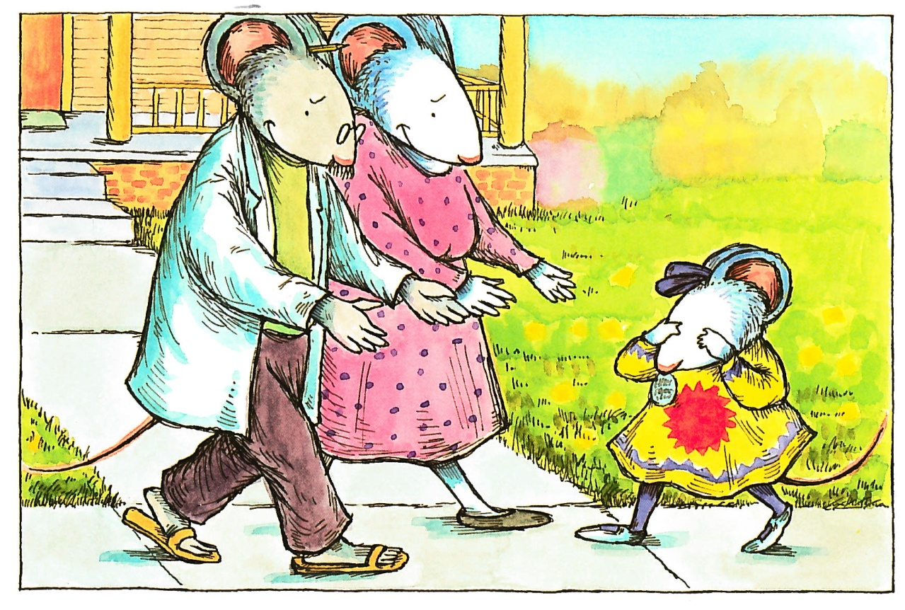
“Welcome home” says her mother.
“Welcome home” says her father.
“School is no place for me”, says Chrysanthemum.
“My name is too long. It scarcely fits on my name tag and I’m
named after a flower!”.
“Oh, pish” says her mother.
“Your name is beautiful.
“It is everything you are” says her mother.
“Absolutely perfect” says her father.

Slide 9
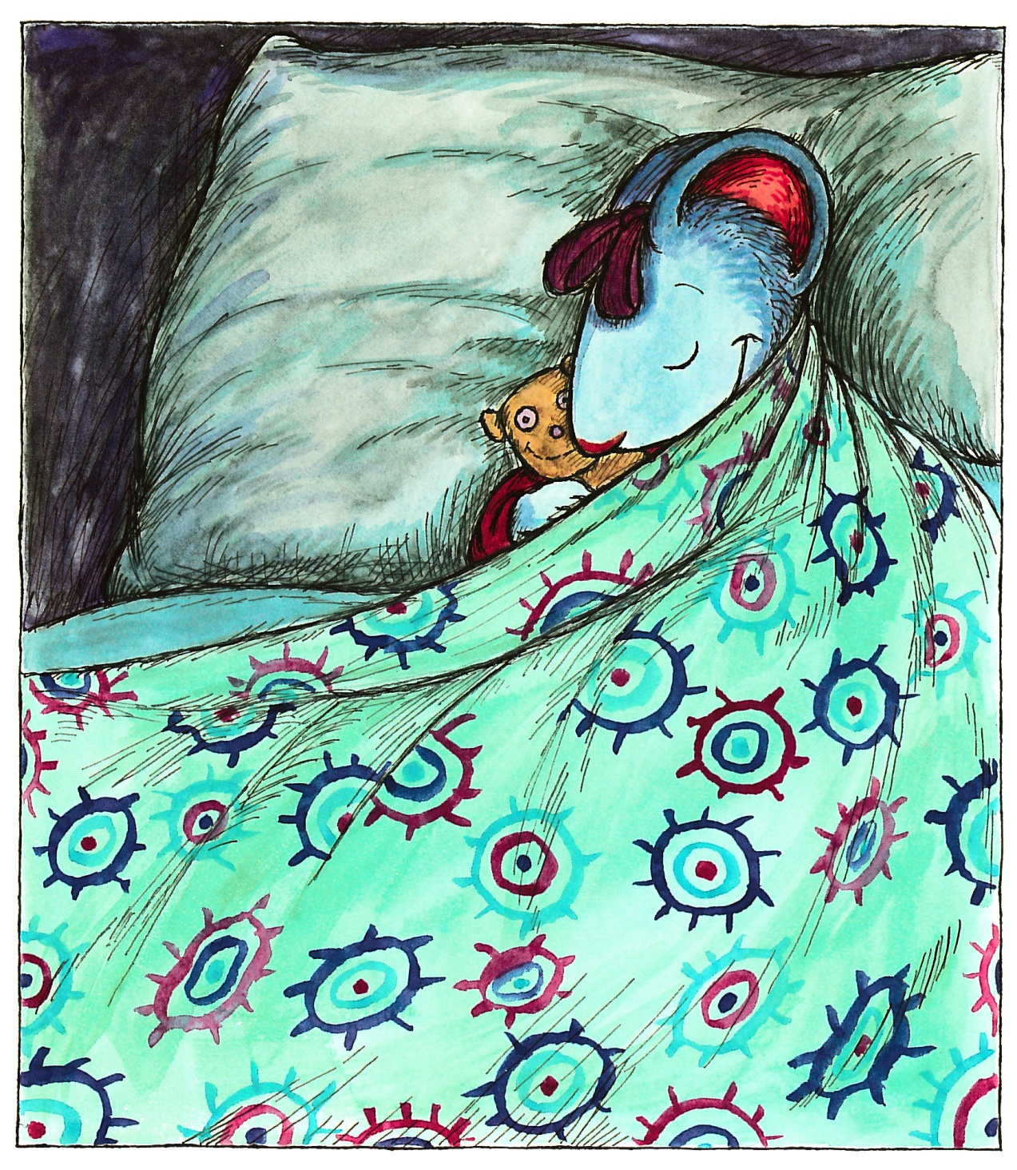
Chrysanthemum feels much better after her favourite dinner
(macaroni and cheese with ketchup) and an evening filled
with hugs and kisses and Parcheesi.
That night she dreams that her name is Jane.
It is a pleasant dream.

Slide 10
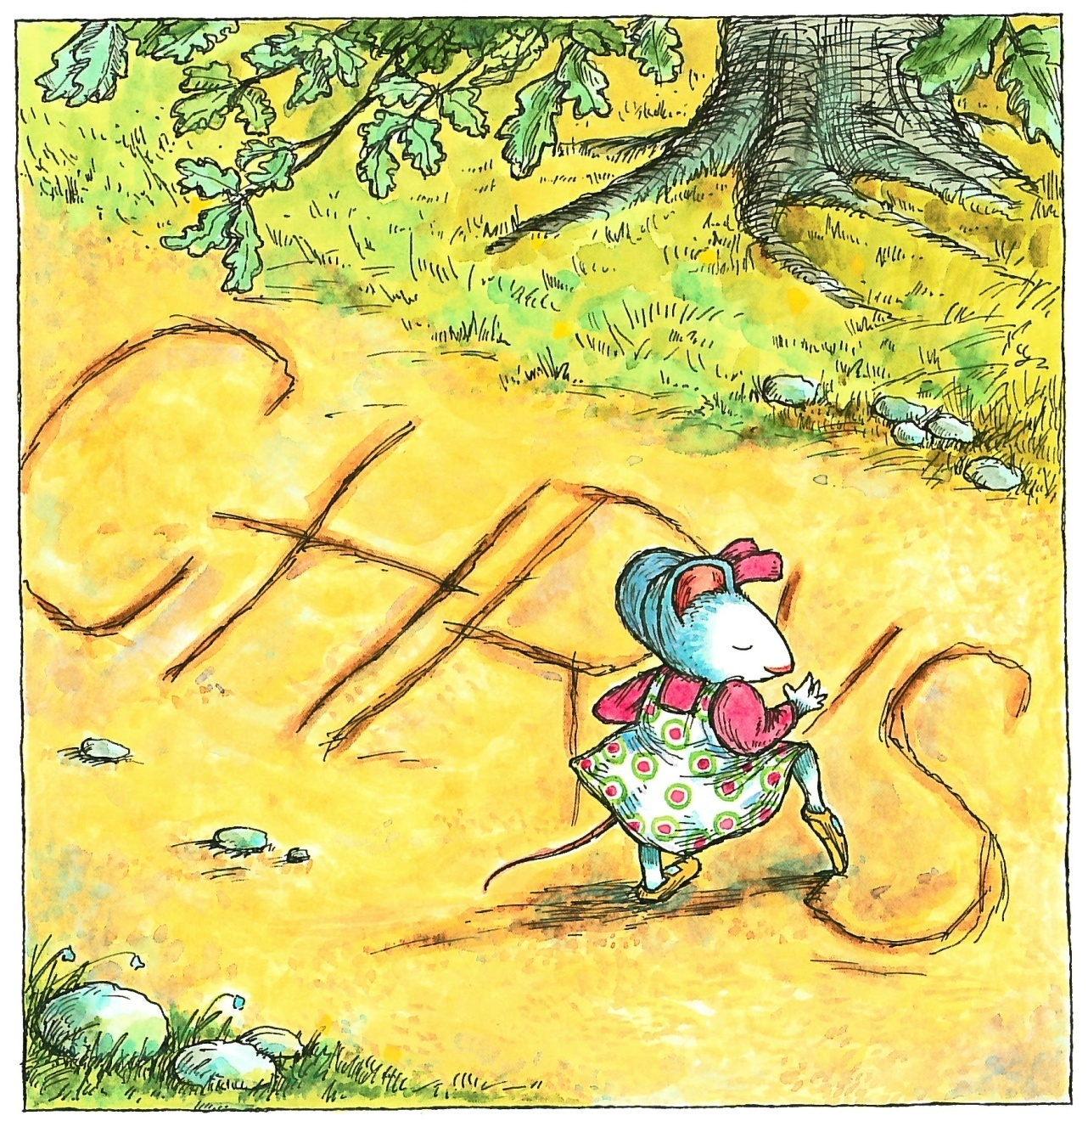
The next morning Chrysanthemum wears her most comfortable
jumper.
She walks to school as slowly as she can.
She drags her feet in the dirt.
Chrysanthemum, Chrysanthemum, Chrysanthemum, she writes.

Slide 11
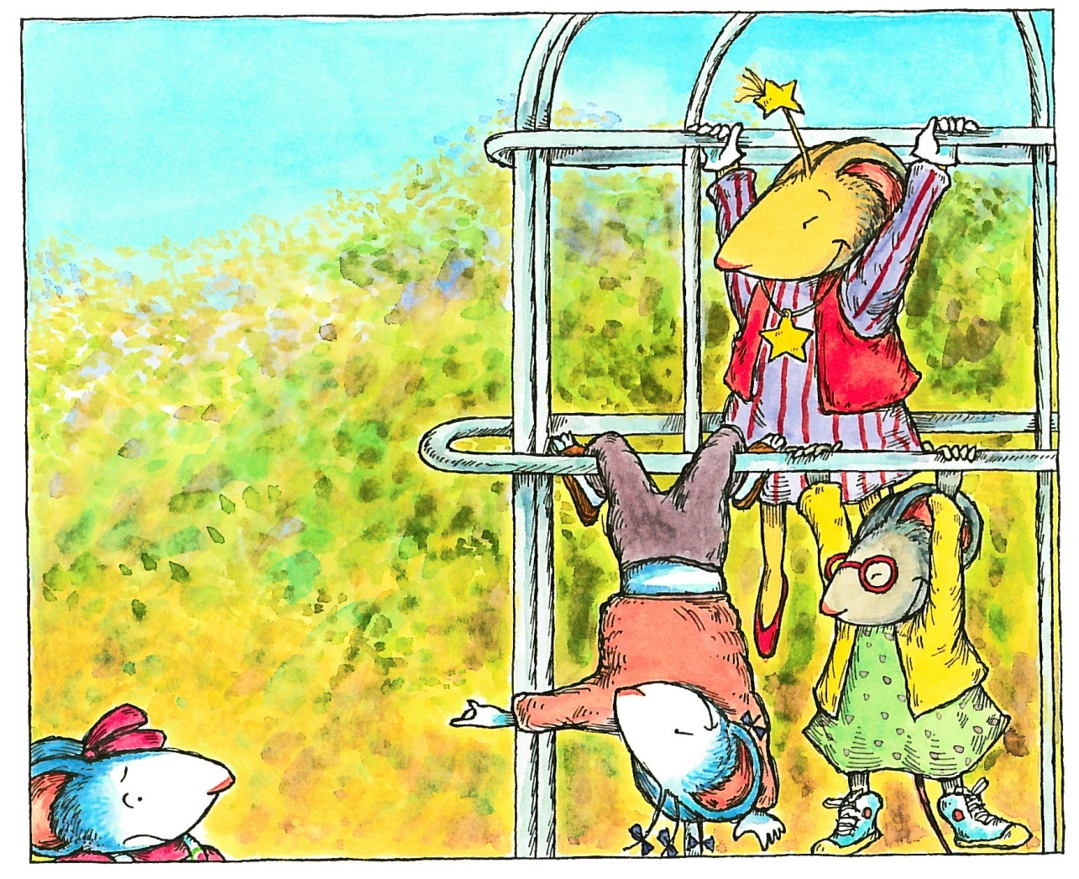
“ She even looks like a flower” says Victoria as Chrysanthemum
enters the playground.
“Let’s pick her” says Rita.
“Let’s smell her” says Jo
Chrysanthemum wilts.
She does not think her name is absolutely perfect.
She thinks it is absolutely dreadful.

Slide 12
The rest of the day is not much better.
During naptime Victoria raises her hand and says,
“ a chrysanthemum is a flower: it lives in the garden with worms
and other dirty things”
“Thank you for sharing that with us, Victoria” says Mrs Chud
“Now put your head down”

Slide 13
“Welcome home” says her mother.
“Welcome home” says her father.
“School is no place for me” says Chrysanthemum
“They said I even look like a flower. They pretended to pick me
and smell me”
“Oh, pish” says her mother “They’ re just jalous”
“Who wouldn’t be jalous of a name like yours?”
“After all, it’s absolutely perfect” says her father.

Slide 14
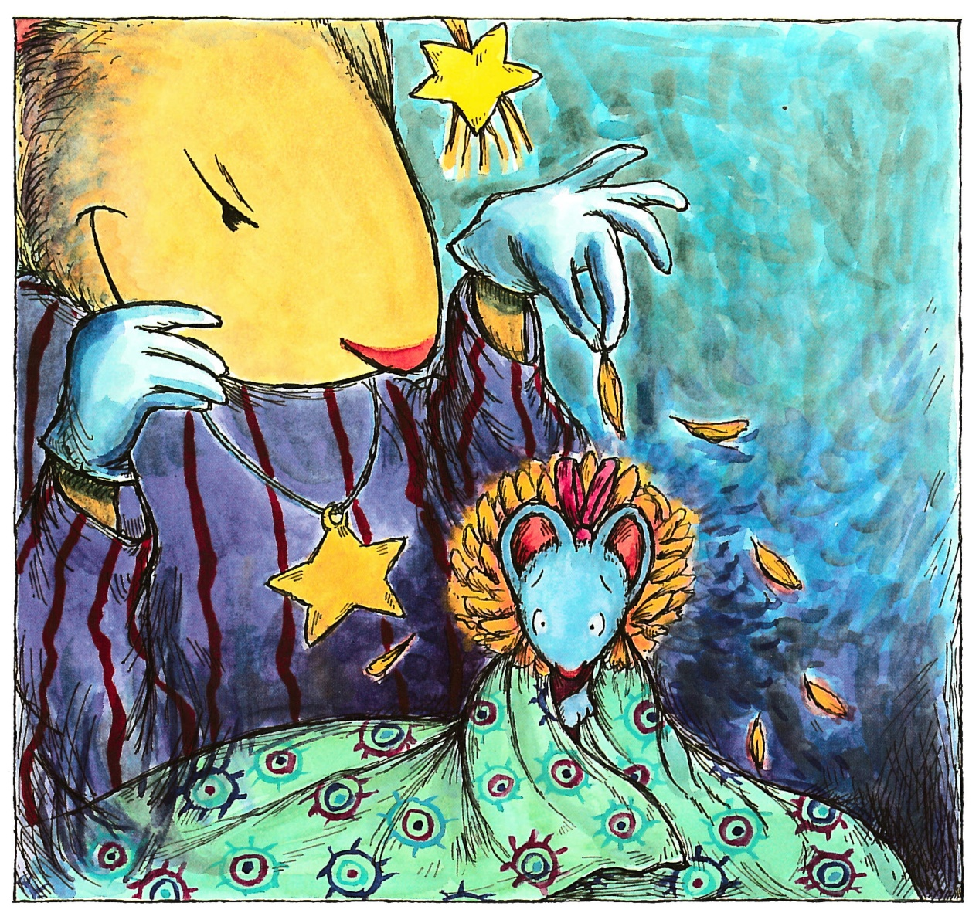
That night Chrysanthemum dreams that she really is a chrysanthemum.
Victoria picks her and plucks leaves and petals one by one until there
is nothing left but a scrawny stem.
It is the worst nightmare of Chrysanthemum’s life.

Slide 15
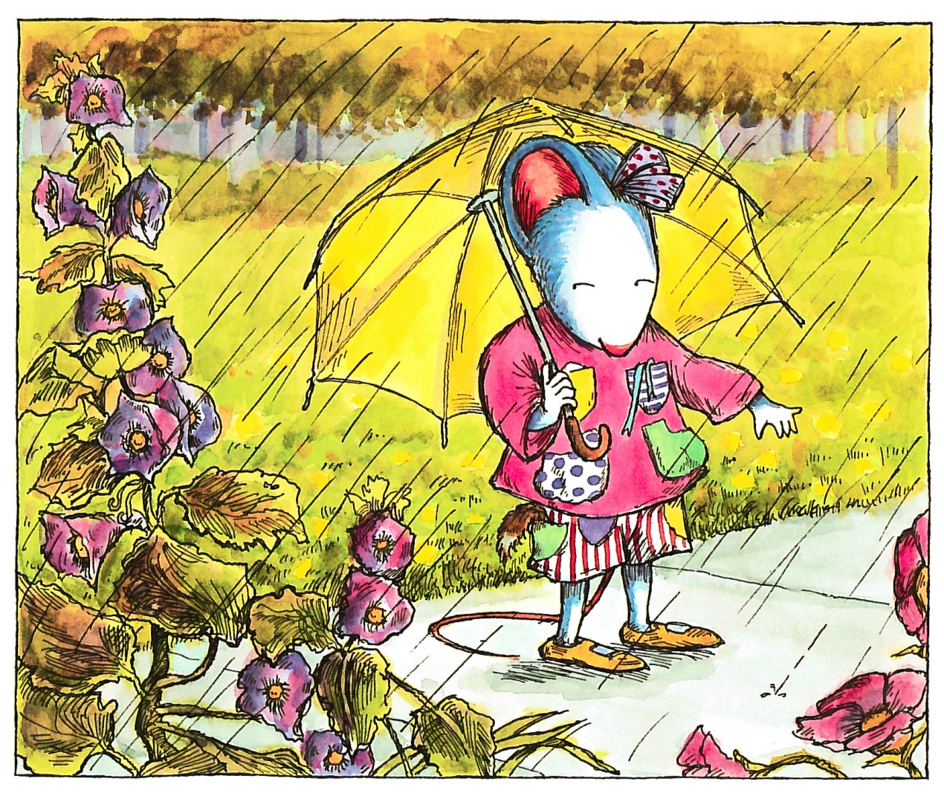
Chrysanthemum wears her outfit with seven pockets the next morning.
She loads the pockets with her good-luck charms.
Chrysanthemum takes the longest route possible to school.

Slide 16
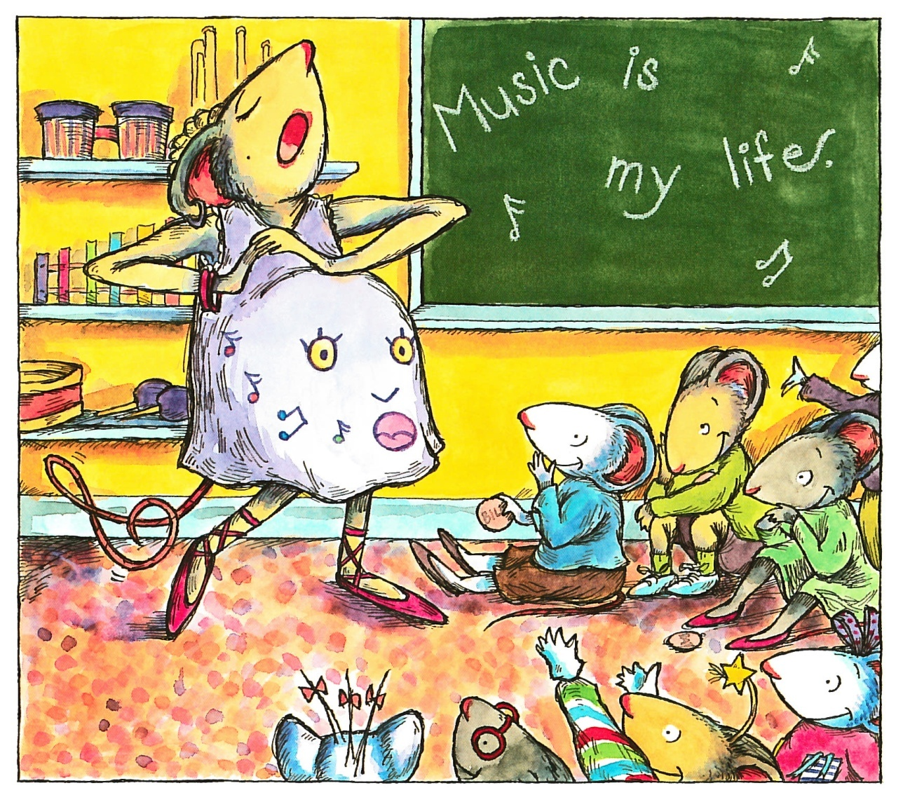
That morning the students are introduced to Mrs Twinkle, the music
teacher.
Her voice is like something out a dream.
The students are speechless.
Mrs Twinkle assignes role for the class musicale.
Victoria is the Fairy Queen, Rita the Butterfly Princess,
Jo the Pixie-messenger and Chrysanthemum is a daisy.

Slide 17
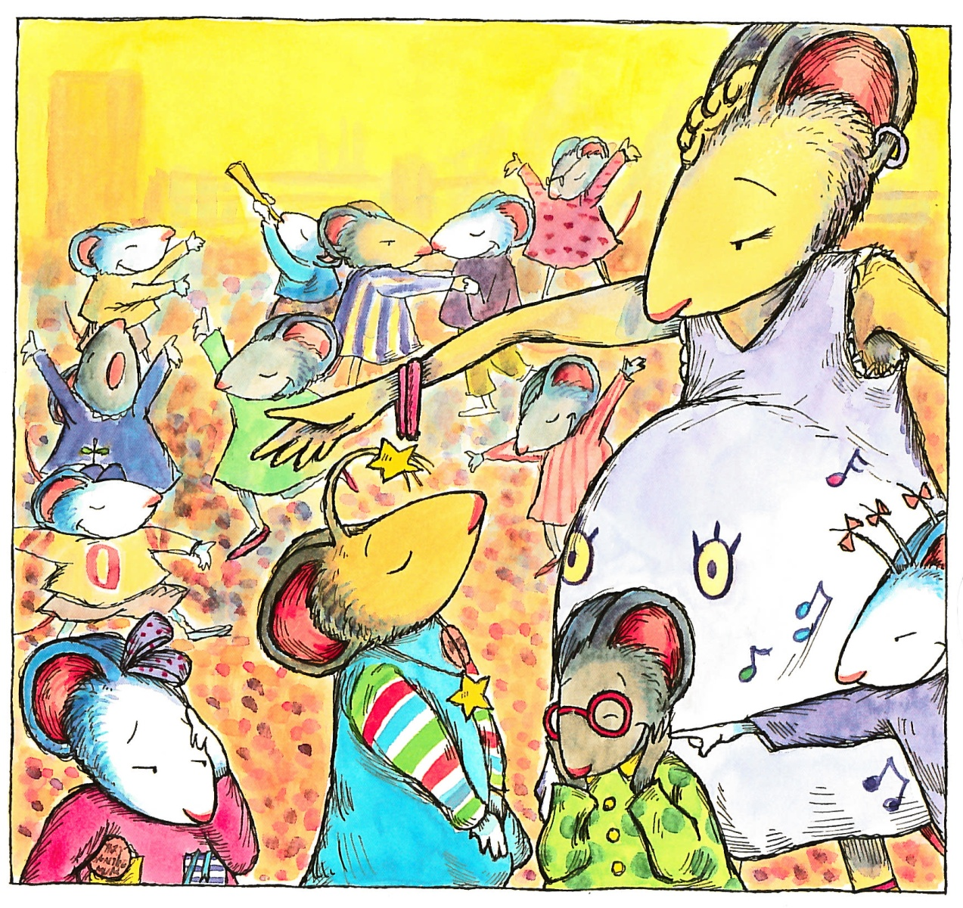
“Chrysanthemum’s a daisy! Chrysanthemum’s a daisy!”
Jo, Rita and Victoria chants
Chrysanthemum wilts.
She does not think her name is absolutely perfect.
She thinks it’s absolutely dreadful “
What’s so rumorous!” aks Mrs Twinkle.
“Chrysanthemum” is the answer.
“Her name is too long” says Jo.
“It scarcely fits on her name tag” says Rita

Slide 18
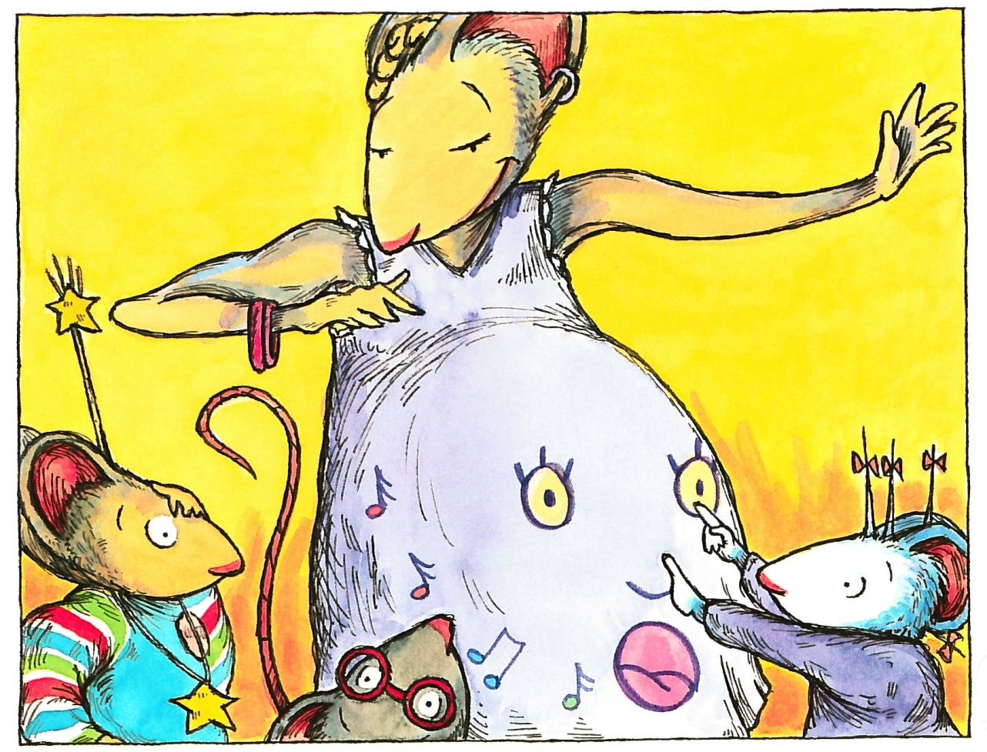
“What’s so rumorous!” aks Mrs Twinkle.
“Chrysanthemum” is the answer.
“Her name is too long” says Jo.
“It scarcely fits on her name tag” says Rita.
“I’m named after my grandmother, says Victoria
“She’s named after a flower!”
“My name is long. It would scarcely fit on a name tag
and I’m named after a flower, too!” says Mrs Twinkle
“You are?” says Victoria.
“Yes”, says Mrs Twinkle . “My name is Delphinium.
Delphinium Twinkle.
And if my baby is a girl, I’m considering Chrysanthemum as a name.
I think it is absolutely perfect”

Slide 19
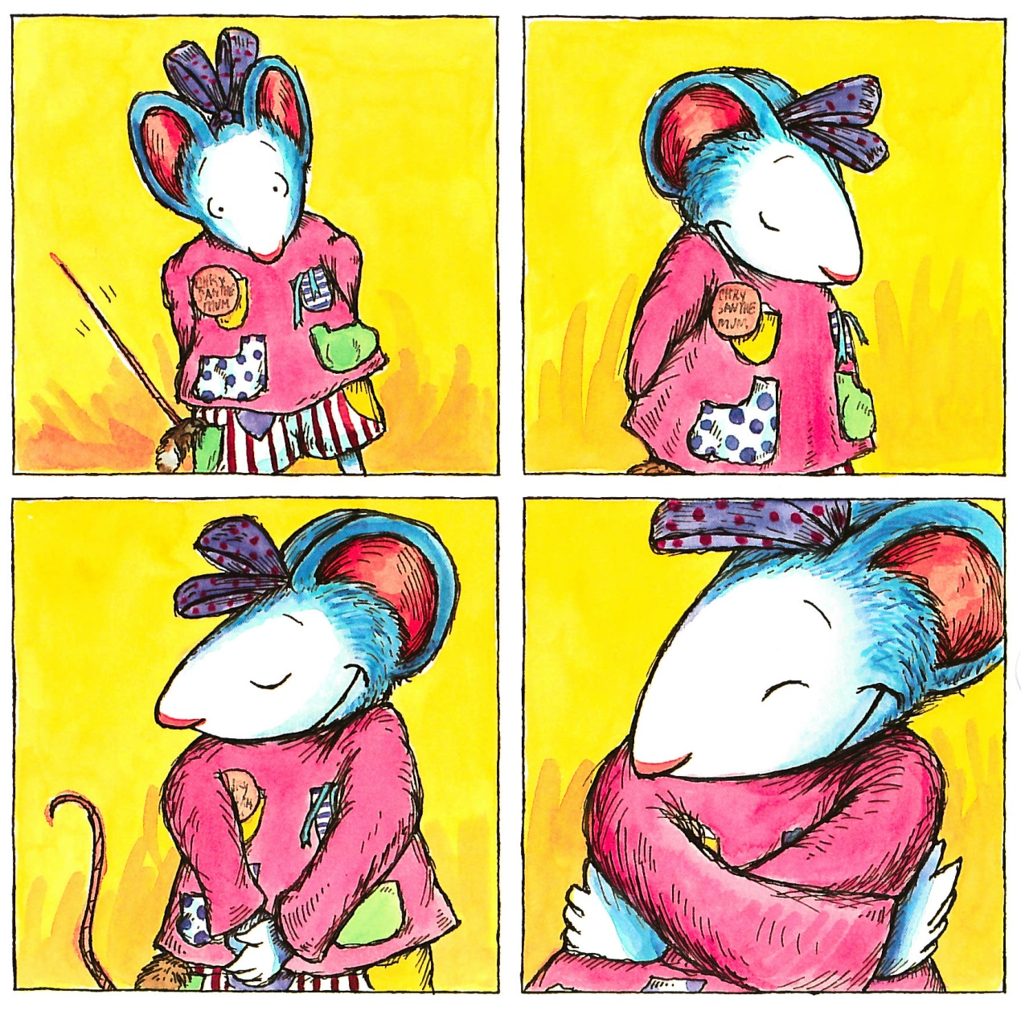
Chrysanthemum can scarcely believe her ears.
She blushes.
She beams.
She blooms.
Chrysanthemum, Chrysanthemum, Chrysanthemum.
Jo, Rita and Victoria looks at Chrysanthemum longingly.
“Call me Marigold” says Jo
“I’m Carnation”, says Rita
“My name is Lily of the Valley” says Victoria
Chrysanthemum doesn’t think her name is absolutely perfect.
She knows it.

Slide 20
The class musicale is a success.
Mrs Twinkle gives birth to a baby girl.
And, of course, she names her Chrysanthemum.

