Slide 1
Method:
Once the mixture has been filtered, the extract released is moved to a test tube, where ethyl alcohol is added.
Successivamente si aggiunge il sale, che permette alle molecole di DNA di avvicinarsi e raggrupparsi.
Dopo di che bisogna rompere le cellule

Slide 2
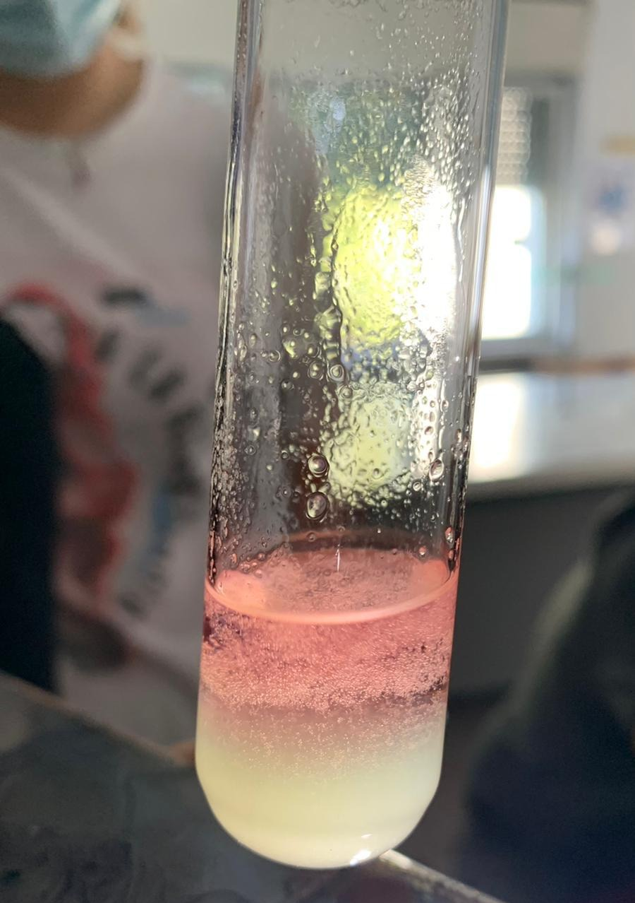
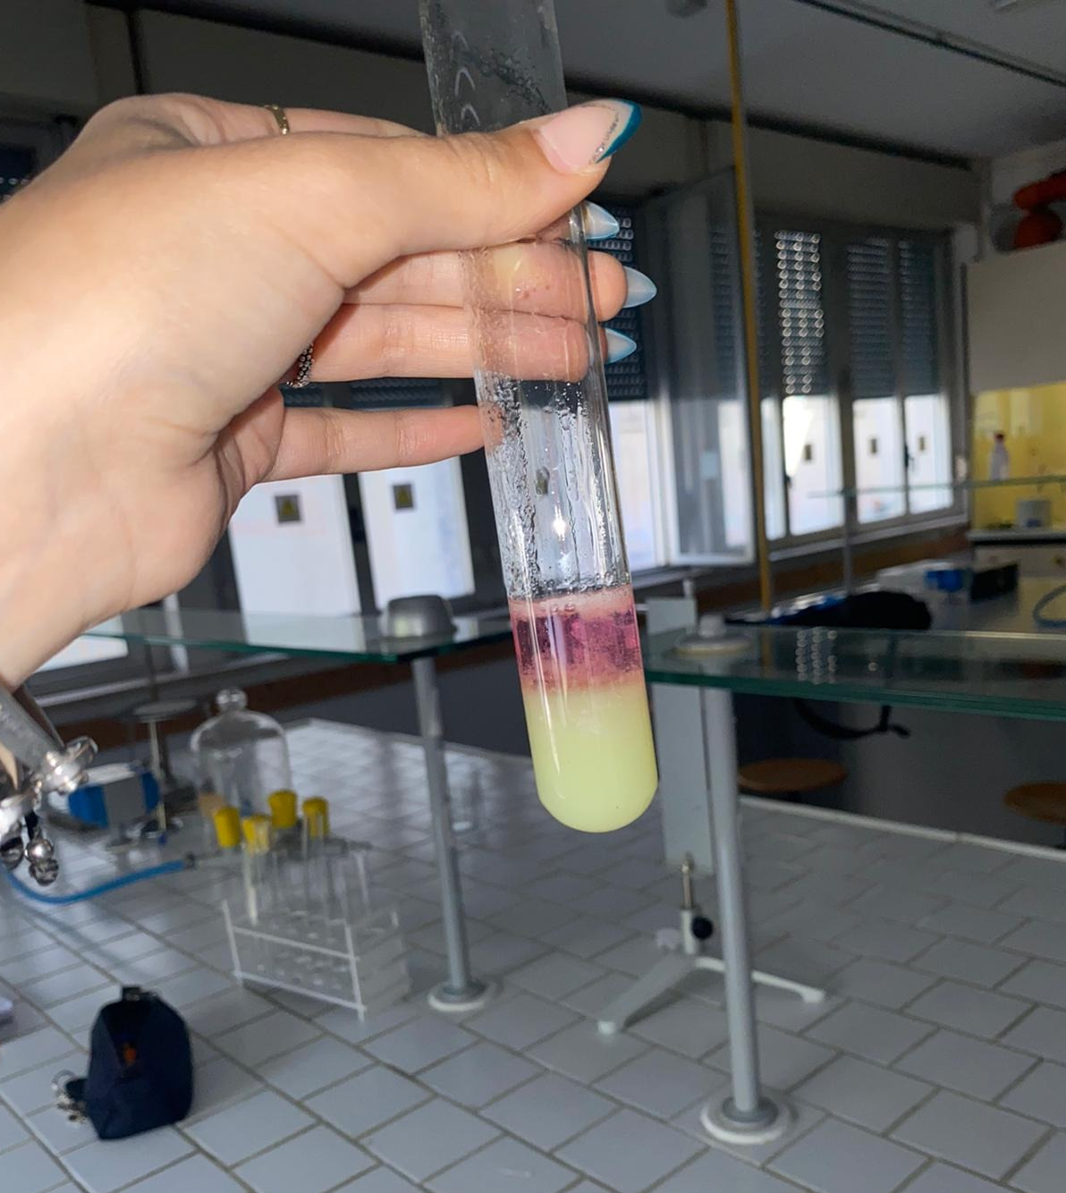
Remarks and conclusion:
It can be seen that alcohol having a lower density than water does not mix with the extract. After a few minutes it can be seen that a "ball" of DNA has formed between the two solutions.

