Slide 1
ERASMU+ Thinking globally, acting locally

Slide 2
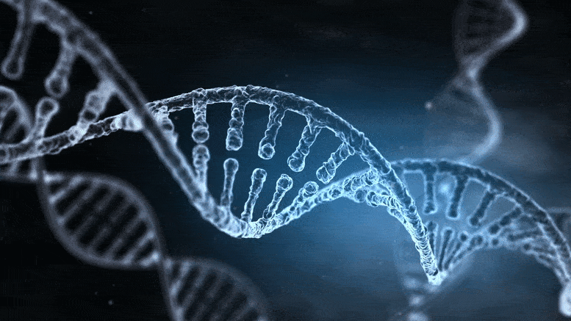
THE DNA
DNA is the essential molecule of all living organisms. It contains the genetic information that makes an organism or a cell what it is. It is a polymer, a long molecule formed by the union of nucleotides. Each nucleotide is formed by: a phosphate group, a sugar, a nitrogenous base. DNA is shaped like a spiral staircase:
the two external filaments are made up of phosphoric acid and deoxyribose sugar.
the pegs are the paired nitrogenous bases. They are of four types: Adenine, Cytosine, Guanine and Thymine.
They are also complementary: Adenine always binds with Thymine and Cytosine always binds with Guanine, and they are held together by hydrogen bonds. A DNA chain is very long and thin and in order to fit inside the cell nucleus it has to fold many times forming structures called chromosomes. There are 46 chromosomes in each of our cells, meaning 46 DNA molecules.

Slide 3
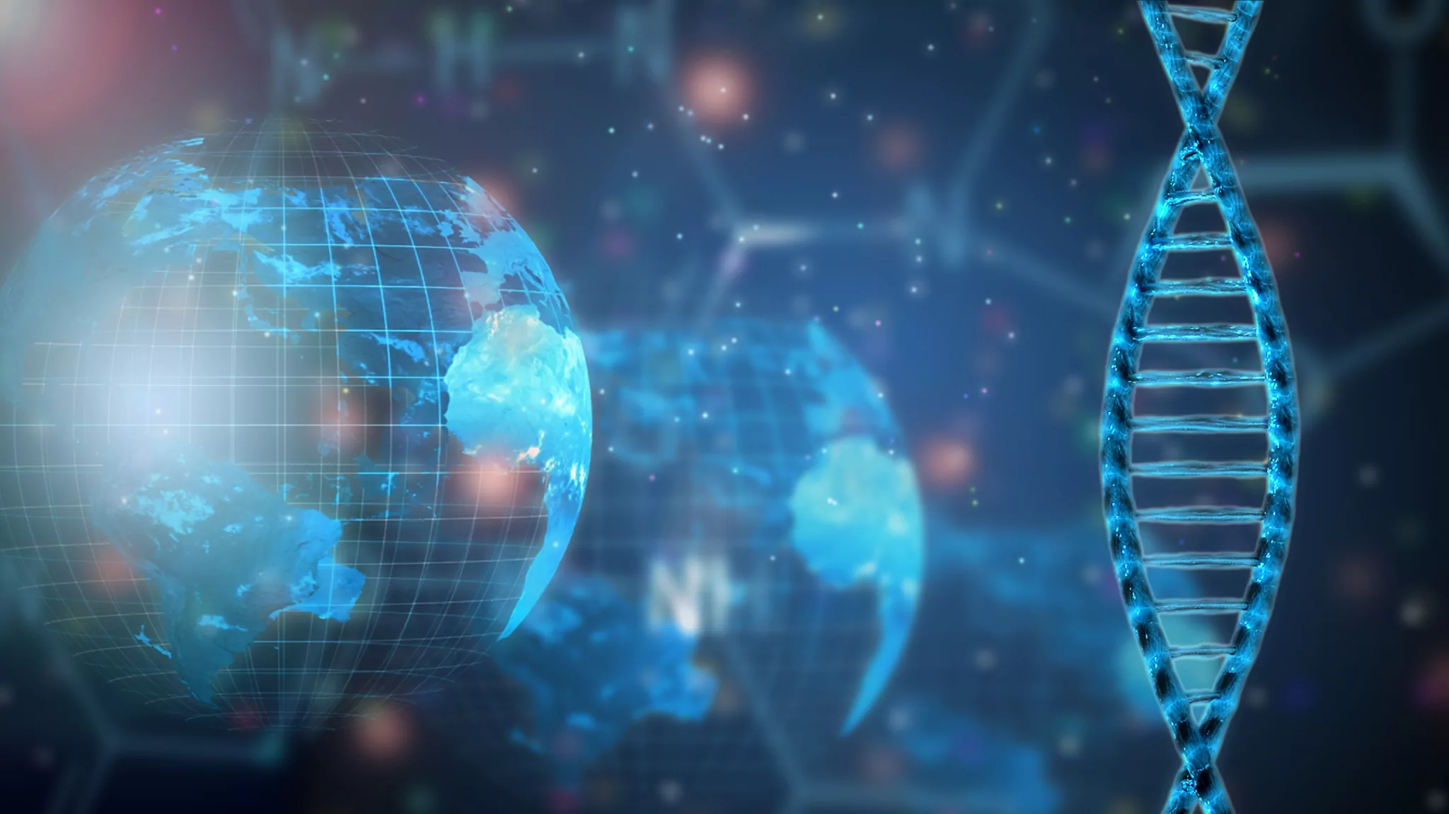
DNA extraction from banana

Slide 4
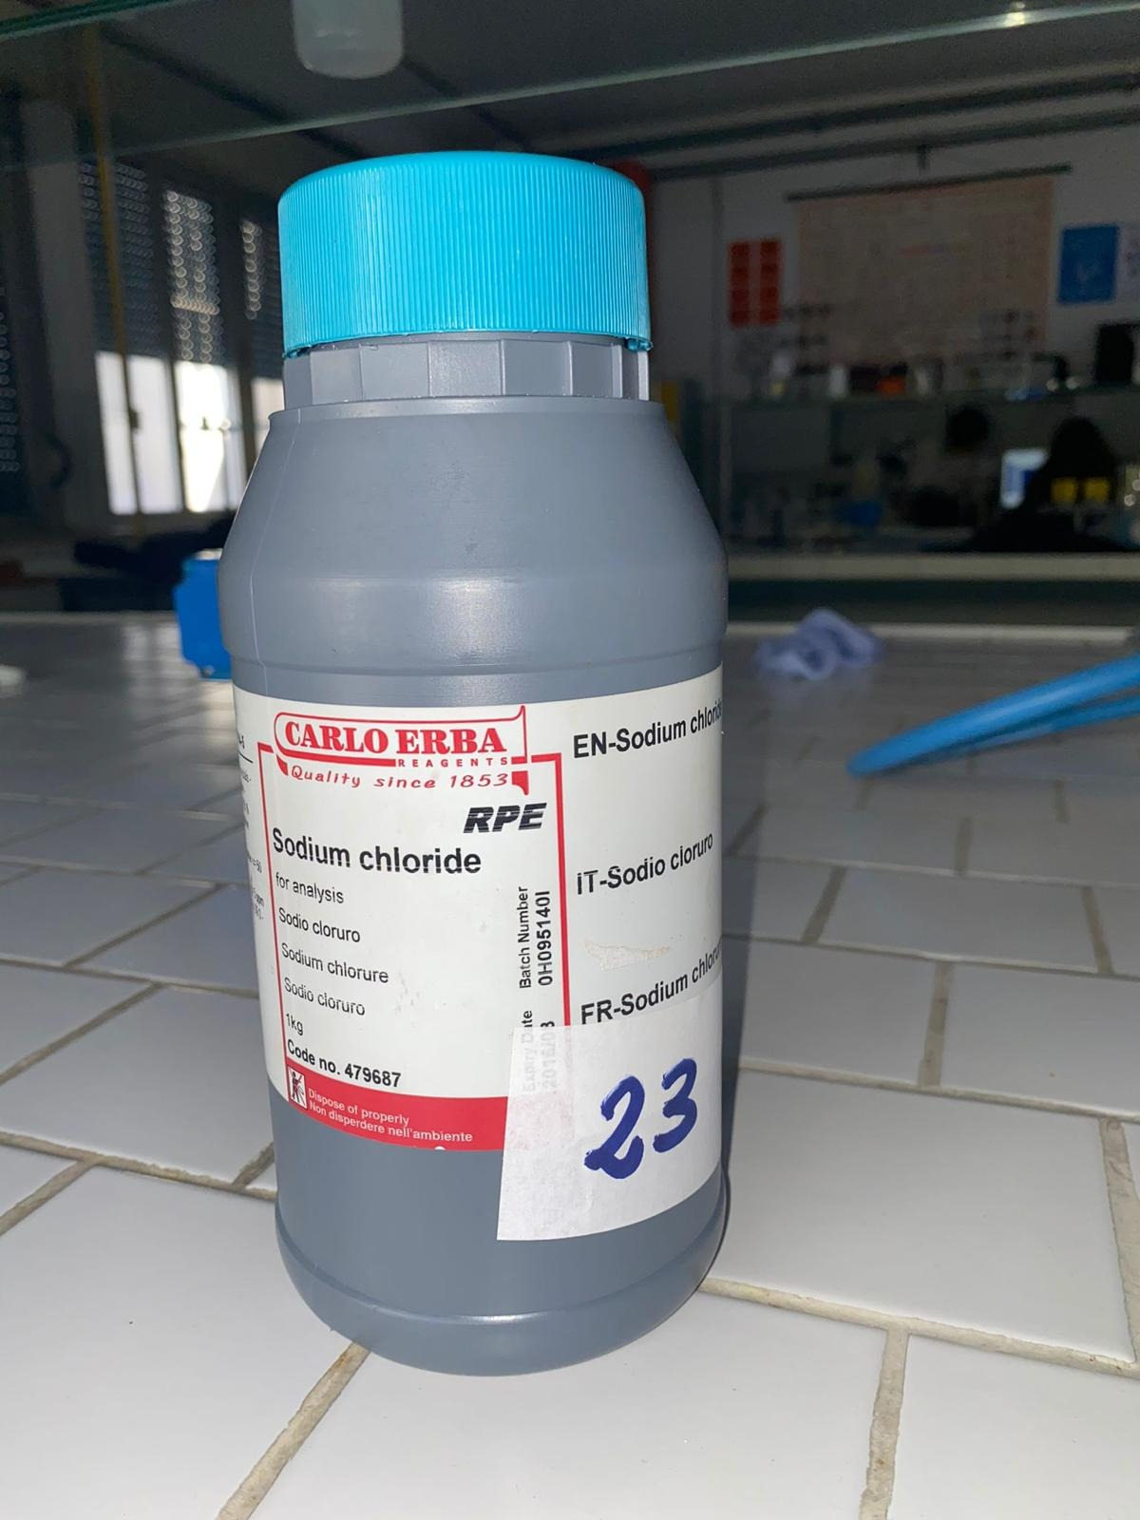
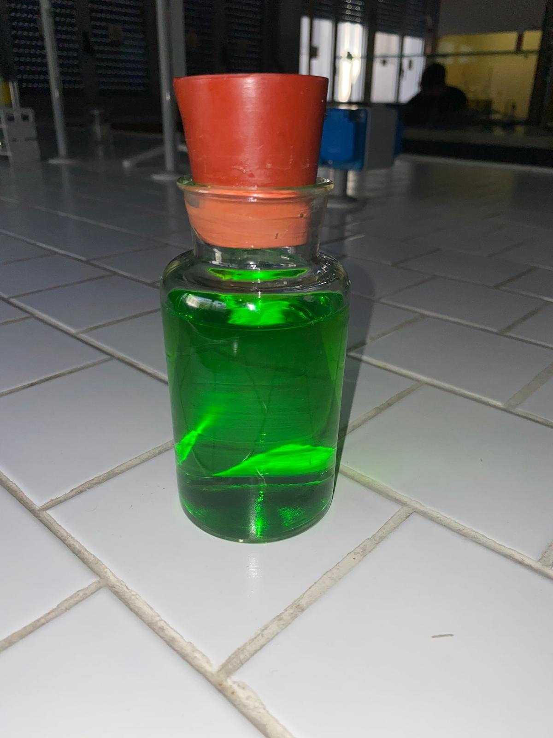
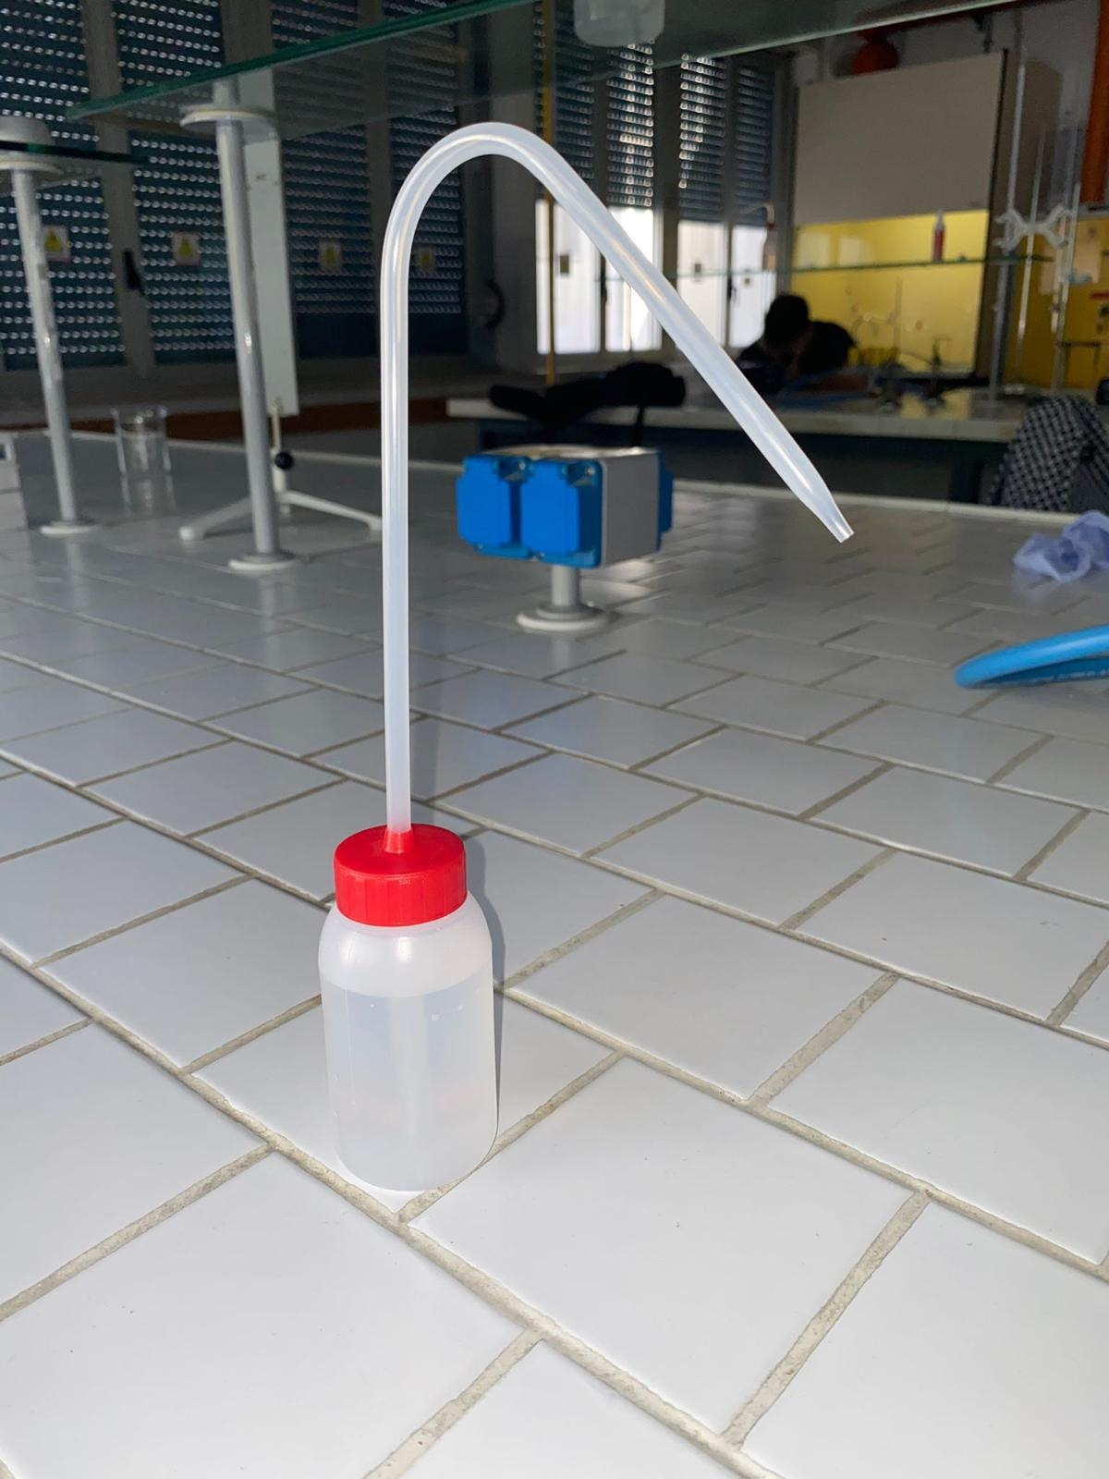
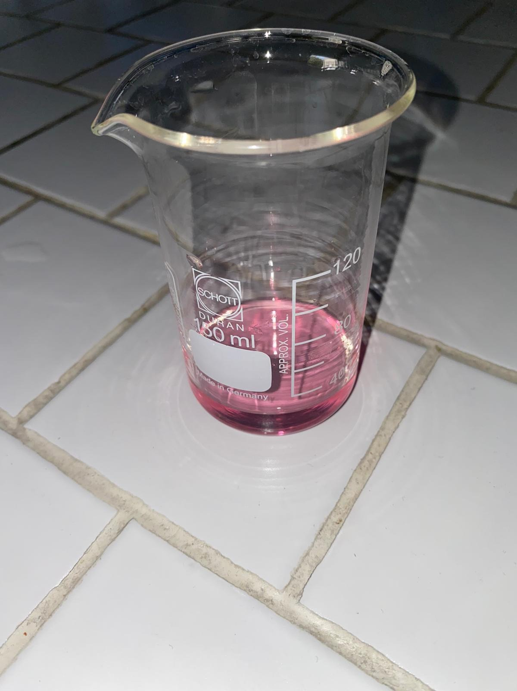
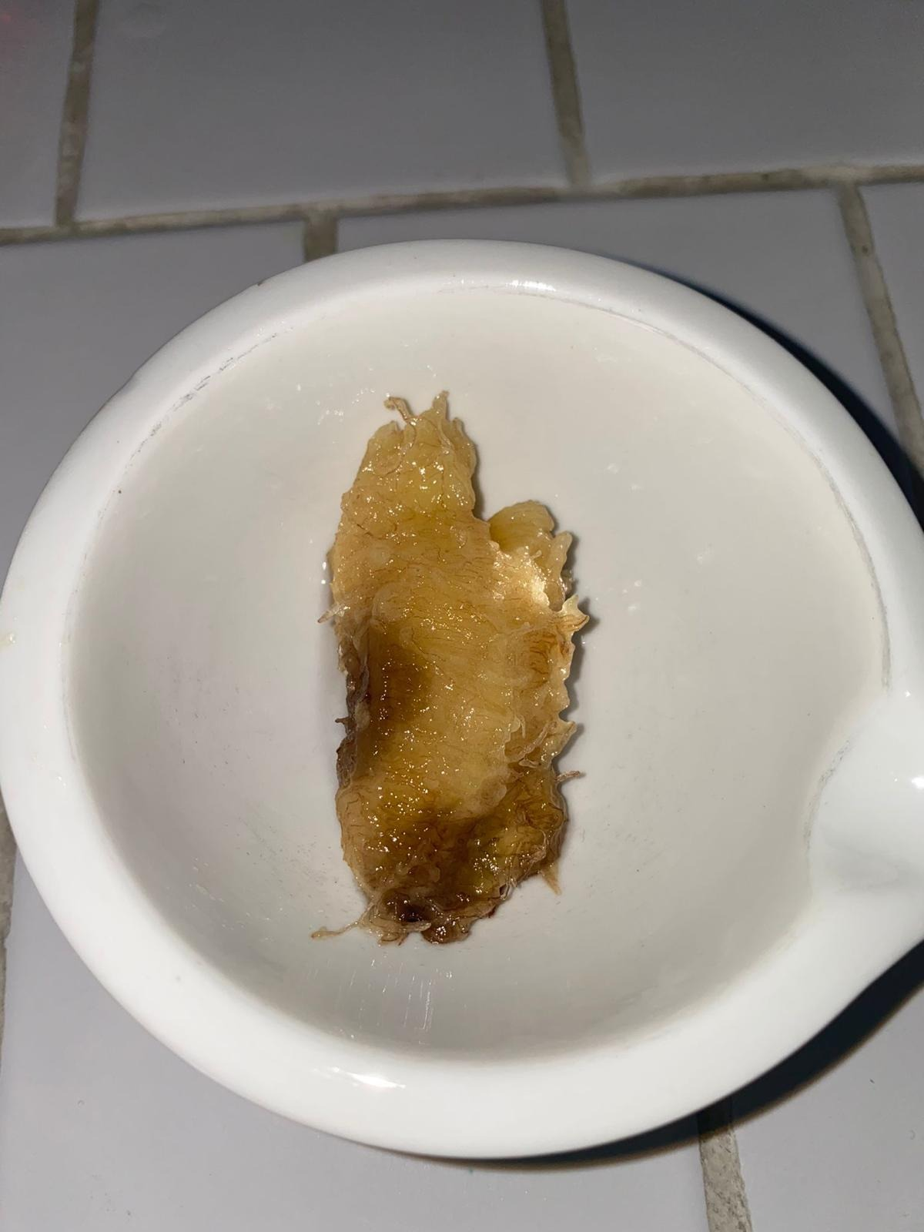
USED MATERIAL:
Half a banana
1 teaspoon of sodium chloride
10 ml of detergent
6 ml of ethyl alcohol
90 ml of distilled water
A mortar
A syringe
A beaker
A sieve
A teaspoon

