Slide 1
Permaculture
IIS Enrico FERMI – Montesarchio –
ITALY
Developed by students 3 class High School(scientific liceo): Carmen Castaldo, Chiara Troiano and Dolores Silvestro
10 October 2021

Slide 2
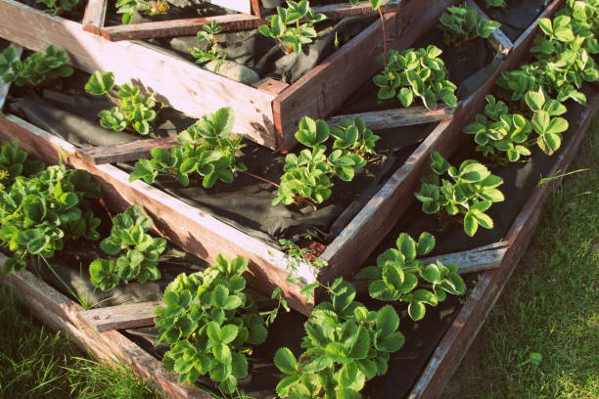
Meaning of Permaculture
Permaculture is a set of design principles centered on whole systems thinking, directly utilizing the patterns and resilient features observed in natural ecosystems. It satisfies the needs of population such as food, fibres and energy.

Slide 3
The History of Permaculture
The concept of Permaculture has developed starting from the 70s’ thanks to Bill Mollison and David Holmgren in Australia. Originally, the term was “Permanent Agriculture”. Permaculture is a mix of the following subjects: Architecture, Biology, Agriculture and Animal Husbandary. By the early 1980s, the concept has broadened from agricultural systems design towards sustainable human habitats.

Slide 4
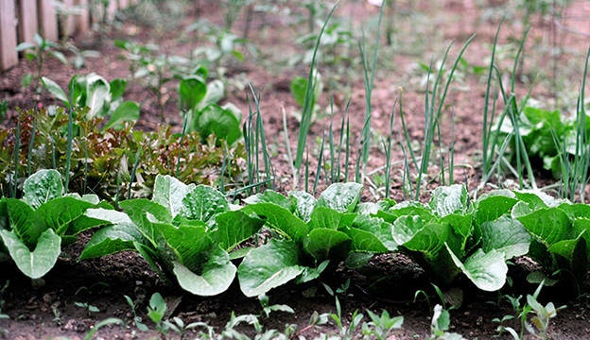
The principles of Permaculture
The important principles of Permaculture are:
Observe and interact: By taking time to engage with nature we can design solutions that suit our particular situation.
Catch and store energy: By developing systems that collect resources at peak abundance, we can use them in times of need.
Obtain a yield: Ensure that you are getting truly useful rewards as part of the work that you are doing.
Apply self-regulation and accept feedback: We need to discourage inappropriate activity to ensure that systems can continue to function well.
Use and value renewable resources and services: Make the best use of nature's abundance to reduce our consumptive behavior and dependence on non-renewable resources.
Produce no waste: By valuing and making use of all the resources that are available to us, nothing goes to waste.

Slide 5
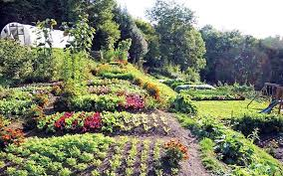
The principles of Permaculture
The important principles of Permaculture are:
Design from patterns to details: By stepping back, we can observe patterns in nature and society. These can form the backbone of our designs, with the details filled in as we go.
Integrate rather than segregate: By putting the right things in the right place, relationships develop between those things and they work together to support each other.
Use small and slow solutions: Small and slow systems are easier to maintain than big ones, making better use of local resources and producing more sustainable outcomes.
Use and value diversity: Diversity reduces vulnerability to a variety of threats and takes advantage of the unique nature of the environment in which it resides.
Use edges and value the marginal: The interface between things is where the most interesting events take place. These are often the most valuable, diverse and productive elements in the system.
Creatively use and respond to change: We can have a positive impact on inevitable change by carefully observing, and then intervening at the right time.

Slide 6
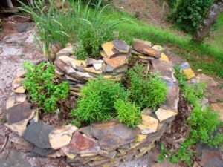
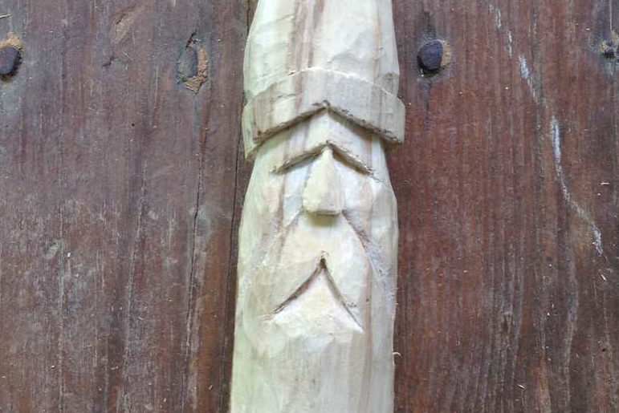
Permaculture in Arts
Wood Carvings
Permaculture is also used to make art, as an example we have wood carvings. People do these amazing wizard faces carved into posts, into logs, and upon various other wooden surfaces. They are expressive and impressive!
Carpentry
Carpentry is created from repurposed (reused) woods like lumber and pallets. You can start by creating a small end table. You can make a screen door and decorate corners and flashes of the yard. You can build a wooden cabin for a home that can come in handy.

Slide 7
Permaculture in the world

