Slide 1
Traditional turkish instruments

Slide 2
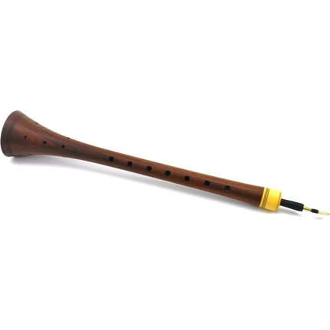
ZURNA (CLARION)
Zurna is a wind instrument known for its loud voice. It is made of plum, walnut, willow or mulberry tree and is often played with drums due to its loud sound. Considered to have a history of three thousand years, zurna is used in the music of almost every part of the country.

Slide 3
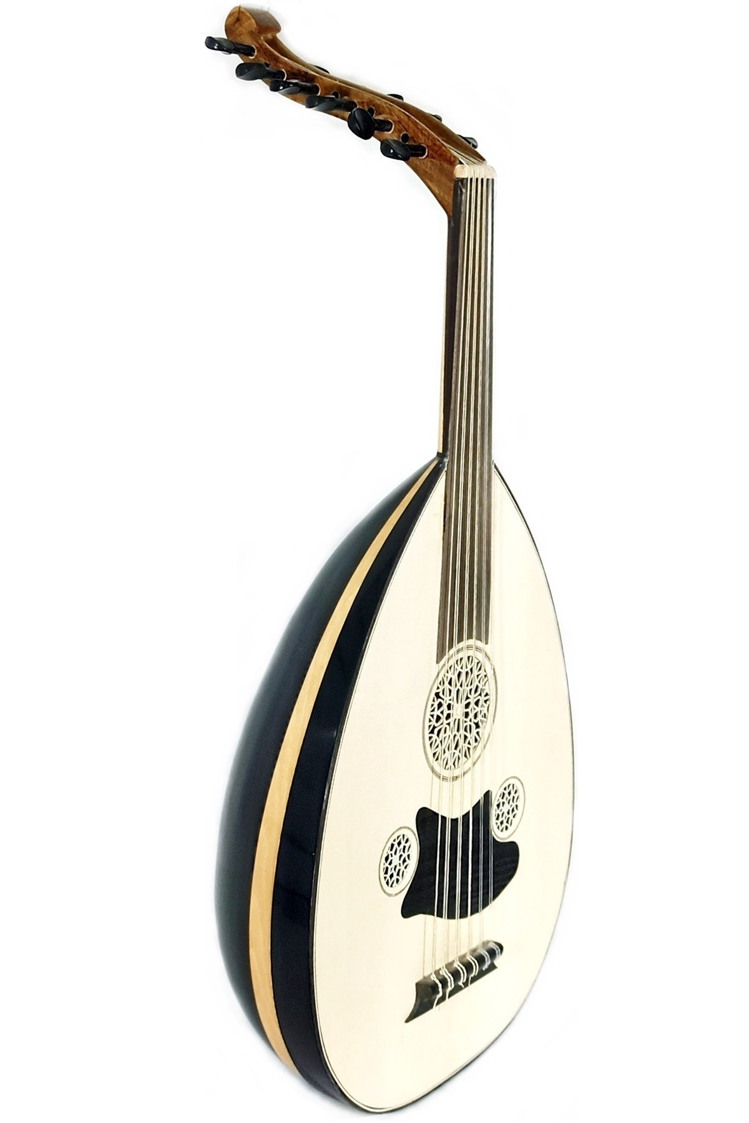
ud
It is thought that Farabi developed the tuning system of ud, one of the oldest instruments in human history. One of the indispensable instruments of Turkish Music in the 20th century, fascinates those who listen to the harmony of the oud and the law.

Slide 4
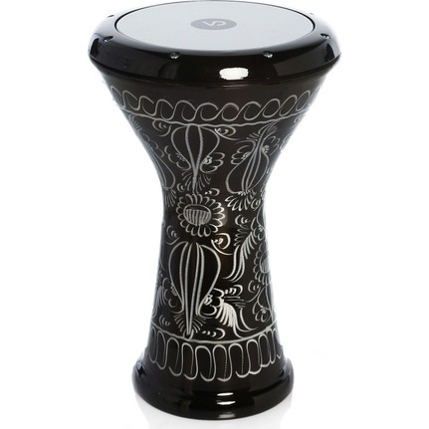
Darbuka (TOMTOM)
Darbuka is a percussion instrument used in the Middle East and the Balkans. Darbuka only gives two sounds, node and single, and is played by hand. It is an instrument especially used in wedding, engagement and circumcision celebrations.

Slide 5
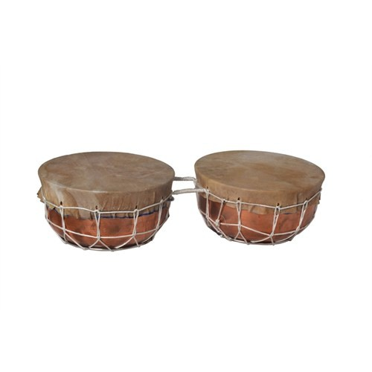
delbek
Yörükler migrating from Central Asia and an instrument coming to our land, delbek, is similar to def and is mostly used around Fethiye. Delbek is played by women and usually takes part in henna nights and soldier farewell.

Slide 6
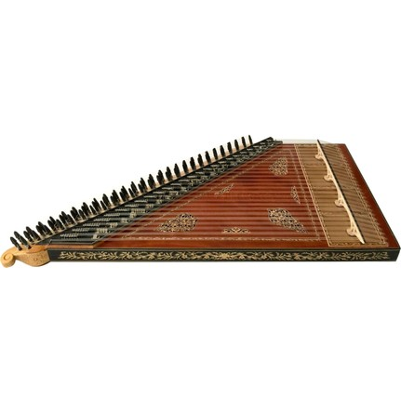
Kanun (law)
Kanun is one of the indispensable instruments of Turkish Art Music. It consists of 24 or 27 frets, although this structure resembles the harpsichord used in Western music, but the law used in Turkish Music is different from both the classical music and its counterparts.

Slide 7
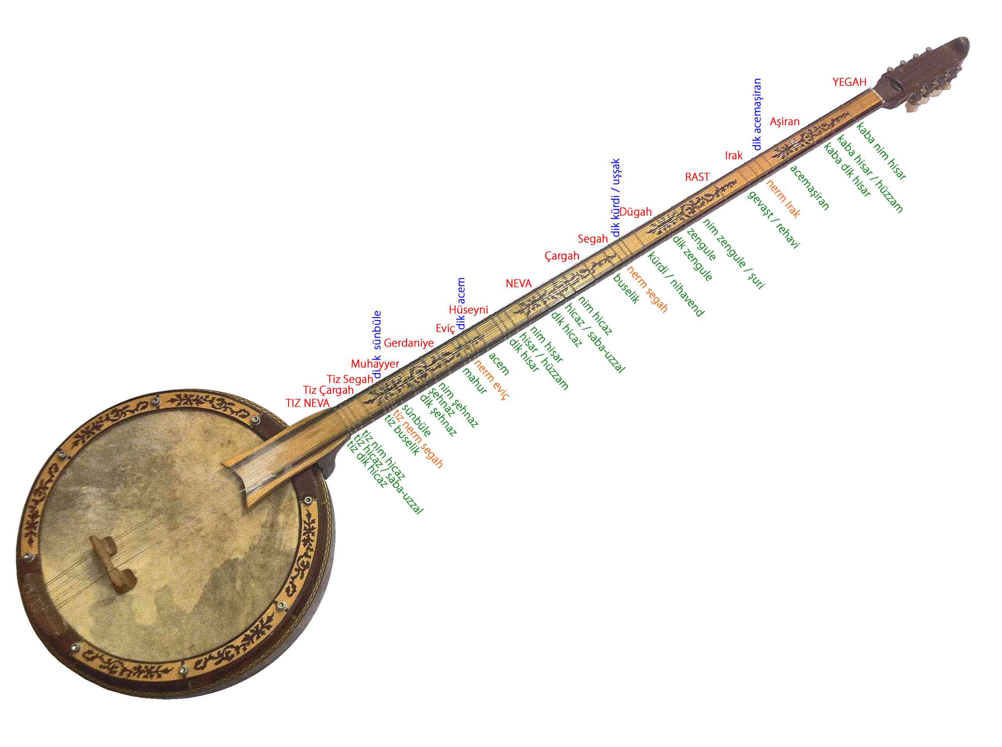
YAYLI TAMBUR
Yaylı Tambur is a type of drum played with a bow and it was invented by Tanburi Cemil Bey. Cemil Bey, one of Turkey's most valuable musicians, music wants to give a voice to the floor and raising the fiddle player with the spring wire of the drum instrument, thereby save the spring drum music world.

