Slide 1
YILDIZ COLLEGE
By Koray ÖZEL
Class 11/B

Slide 2
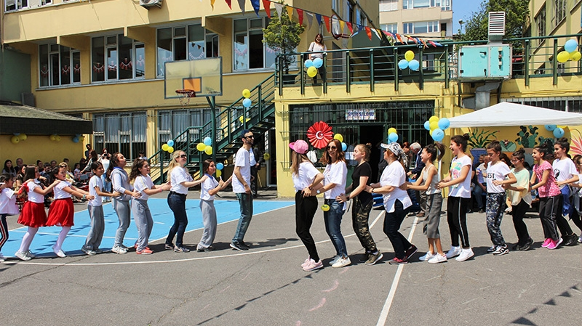
OUR school
Our school is a small school with only 100 students. It is a high school combined with a middle school. The building is 3-stories tall. Classes have upto 15 students in them. It`s teachers are really helpful. Our school`s favorite sport is basketball. During breaktime, many students play basketball and listen to music.

Slide 3
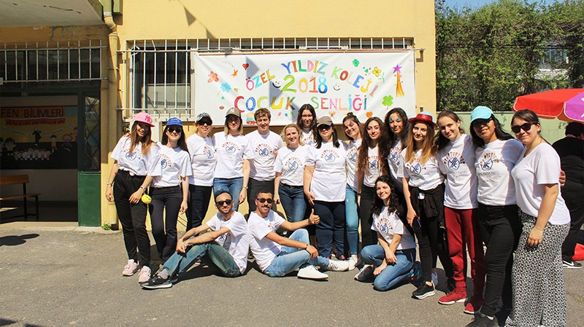
Our school is 65 years old, and every year we celebrate it`s birthday. Those days are like a festival.
The photos behind these slides, are from some of our past activities. I'm not in these photos though!

Slide 4
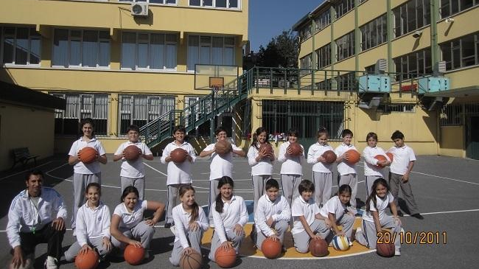
Our school is in the middle of Istanbul and is easily accessible from anywhere in Istanbul. That's what made me choose this school in the first place!

Slide 5
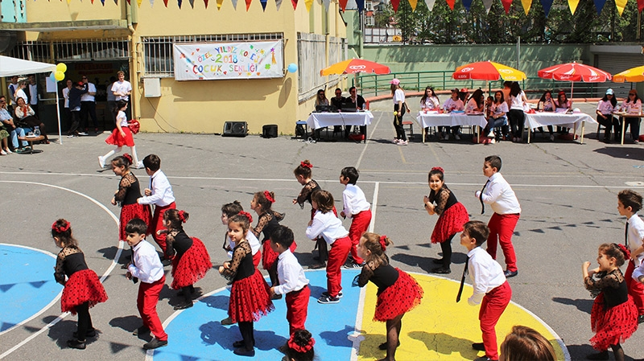
We have a primary school too, in a different location in Istanbul.

Slide 6
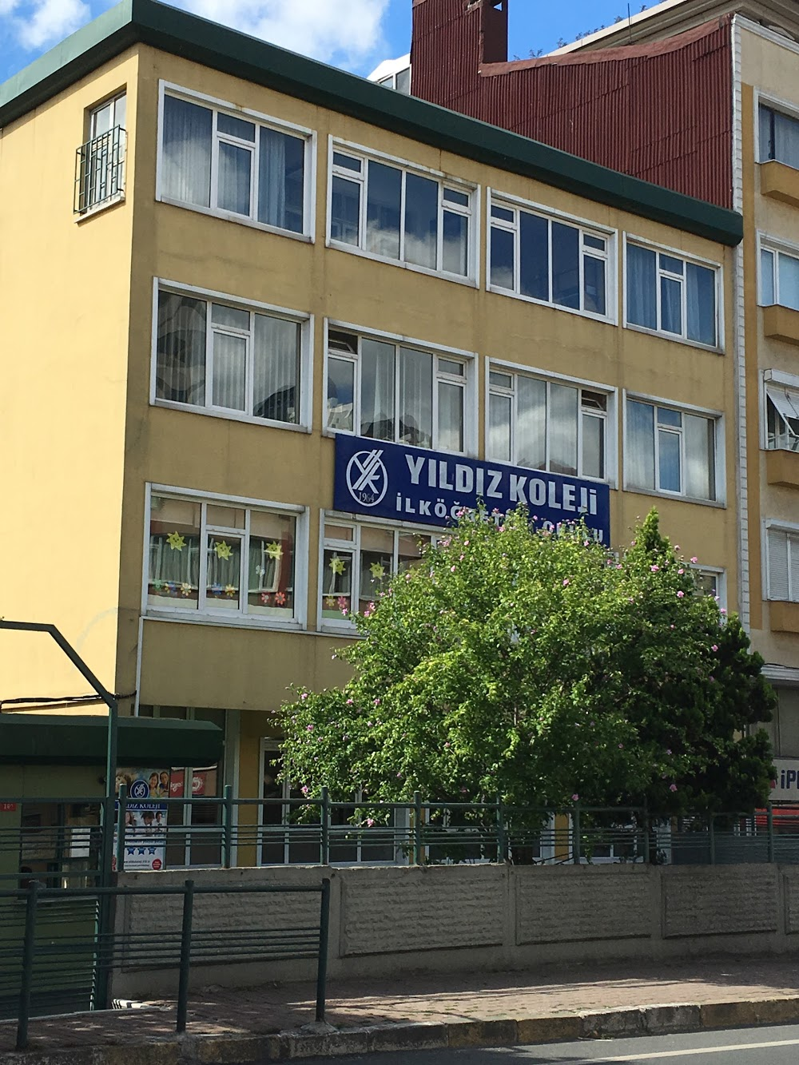
Yıldız college
By Çağla Erdoğan, Cemre Ulusoy and
Öznur Şentürk
Class 11/B

Slide 7
Yıldız Koleji was made in 1964, Turkey and is one the oldest educational institutions in Istanbul.

Slide 8
Yıldız Koleji was established in 1963 by a music teacher called A.Hulusi KUZUCU. From the 1970s, the school has been a Primary, Middle and High School, and it has gained a "College" status. Yildiz Koleji translates to `Star College`.

Slide 9
This building is our middle and high school…

Slide 10
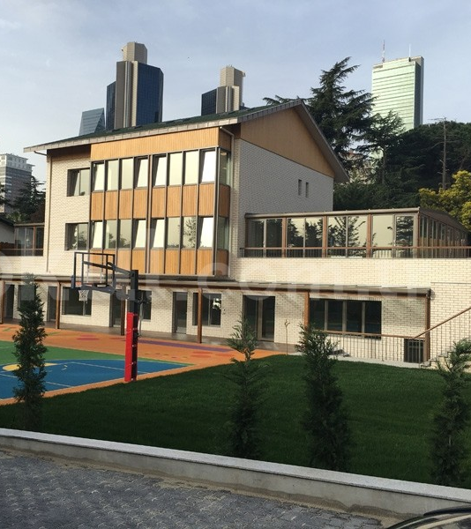
…and this building is our primary school!

Slide 11
After the death of A.Hulusi KUZUCU in 1989, his wife, who was a Maths teacher called E.Nafia KUZUCU, gained full responsibility. Their son Ahmet KUZUCU took responsibility between 1992-1998. Later, their daughter Gülnur ATAY became the General Director of the School. The Primary School changed locations last year in 2018.

Slide 12
Our dear founders and managers

Slide 13
This is a picture of our conference room, last year.

Slide 14
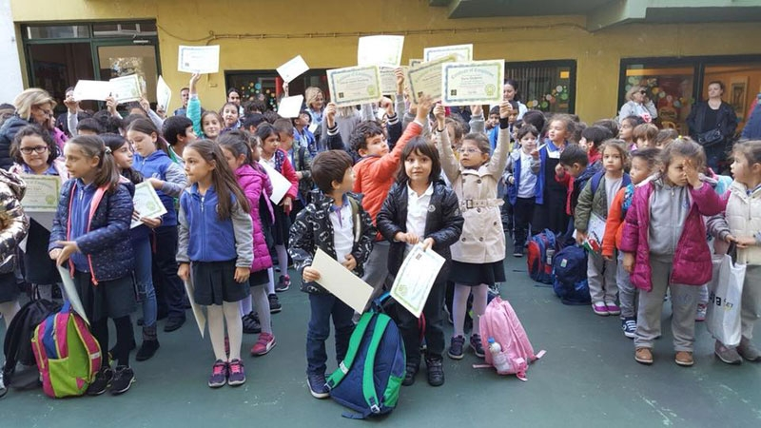
This is a picture of our primary school students.

Slide 15
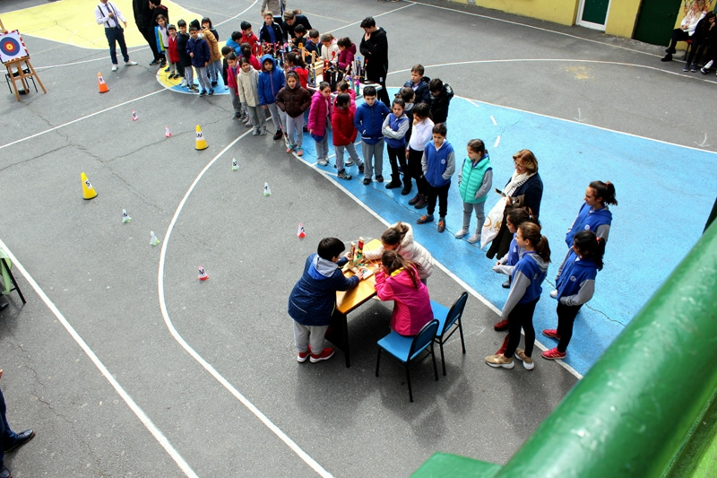
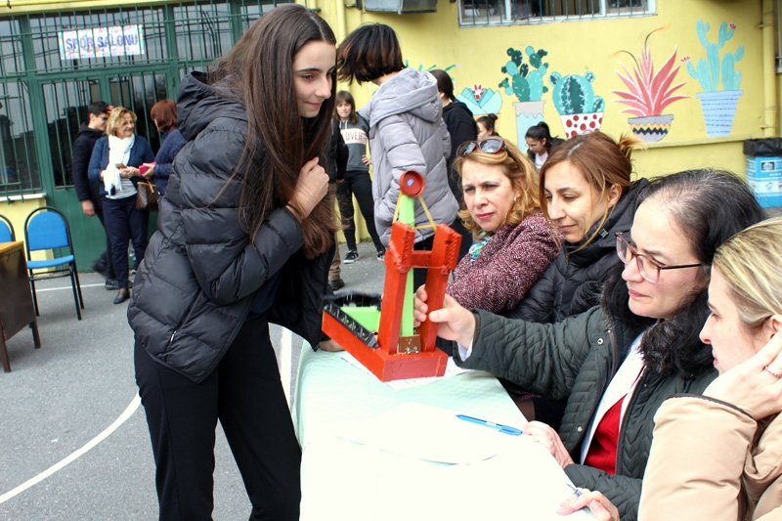
Every year we make catapults and have a competition.

Slide 16
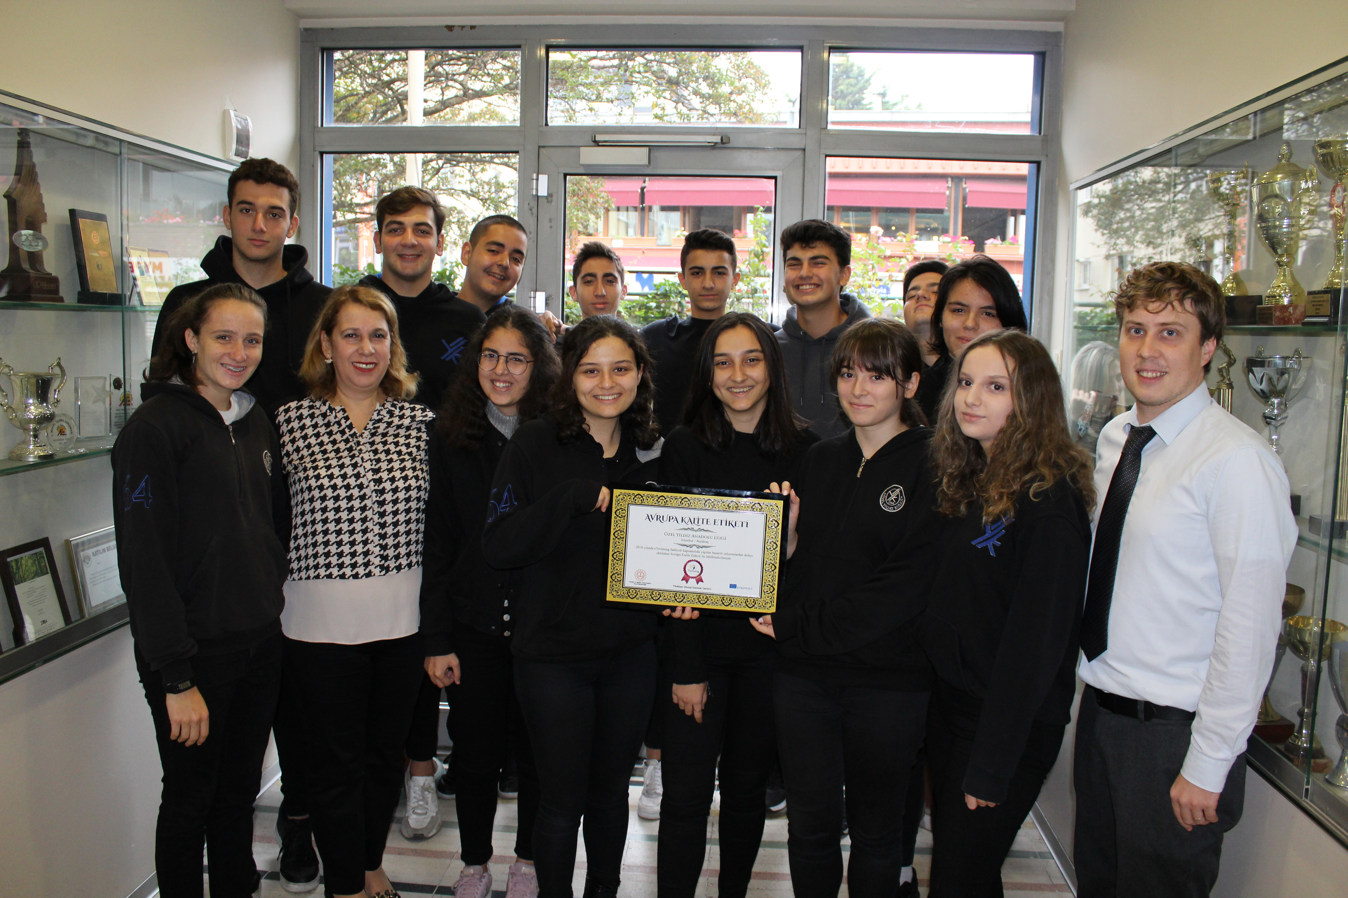
This is a picture of our high school receiving an award from eTwinning, 2018!

Slide 17
