Slide 1
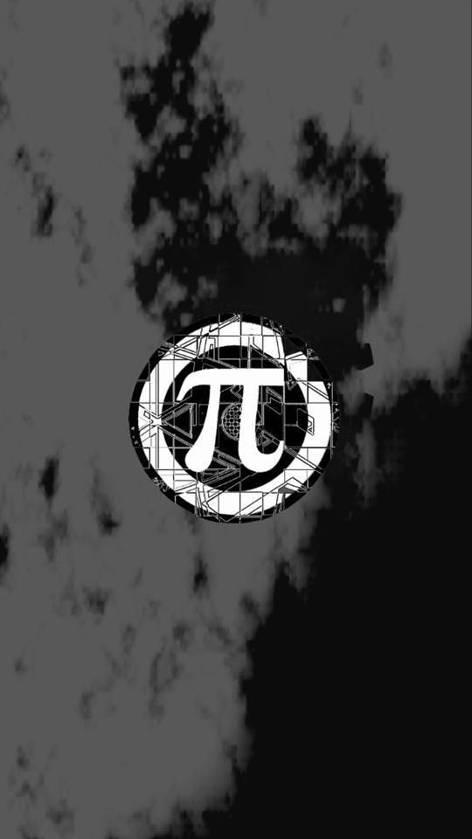
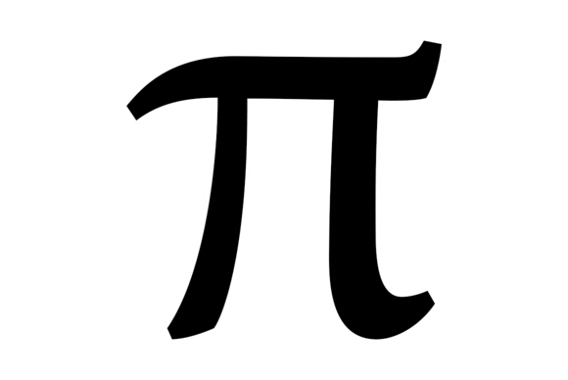
Happy Pi Day!!

Slide 2
What Pi means?
The number π (/paɪ/) is a mathematical constant. Originally defined as the ratio of a circle's circumference to its diameter, it now has various equivalent definitions and appears in many formulas in all areas of mathematics and physics. It is approximately equal to 3.14159. It has been represented by the Greek letter "π" since the mid-18th century, though it is also sometimes spelled out as "pi". It is also called Archimedes' constant.

Slide 3
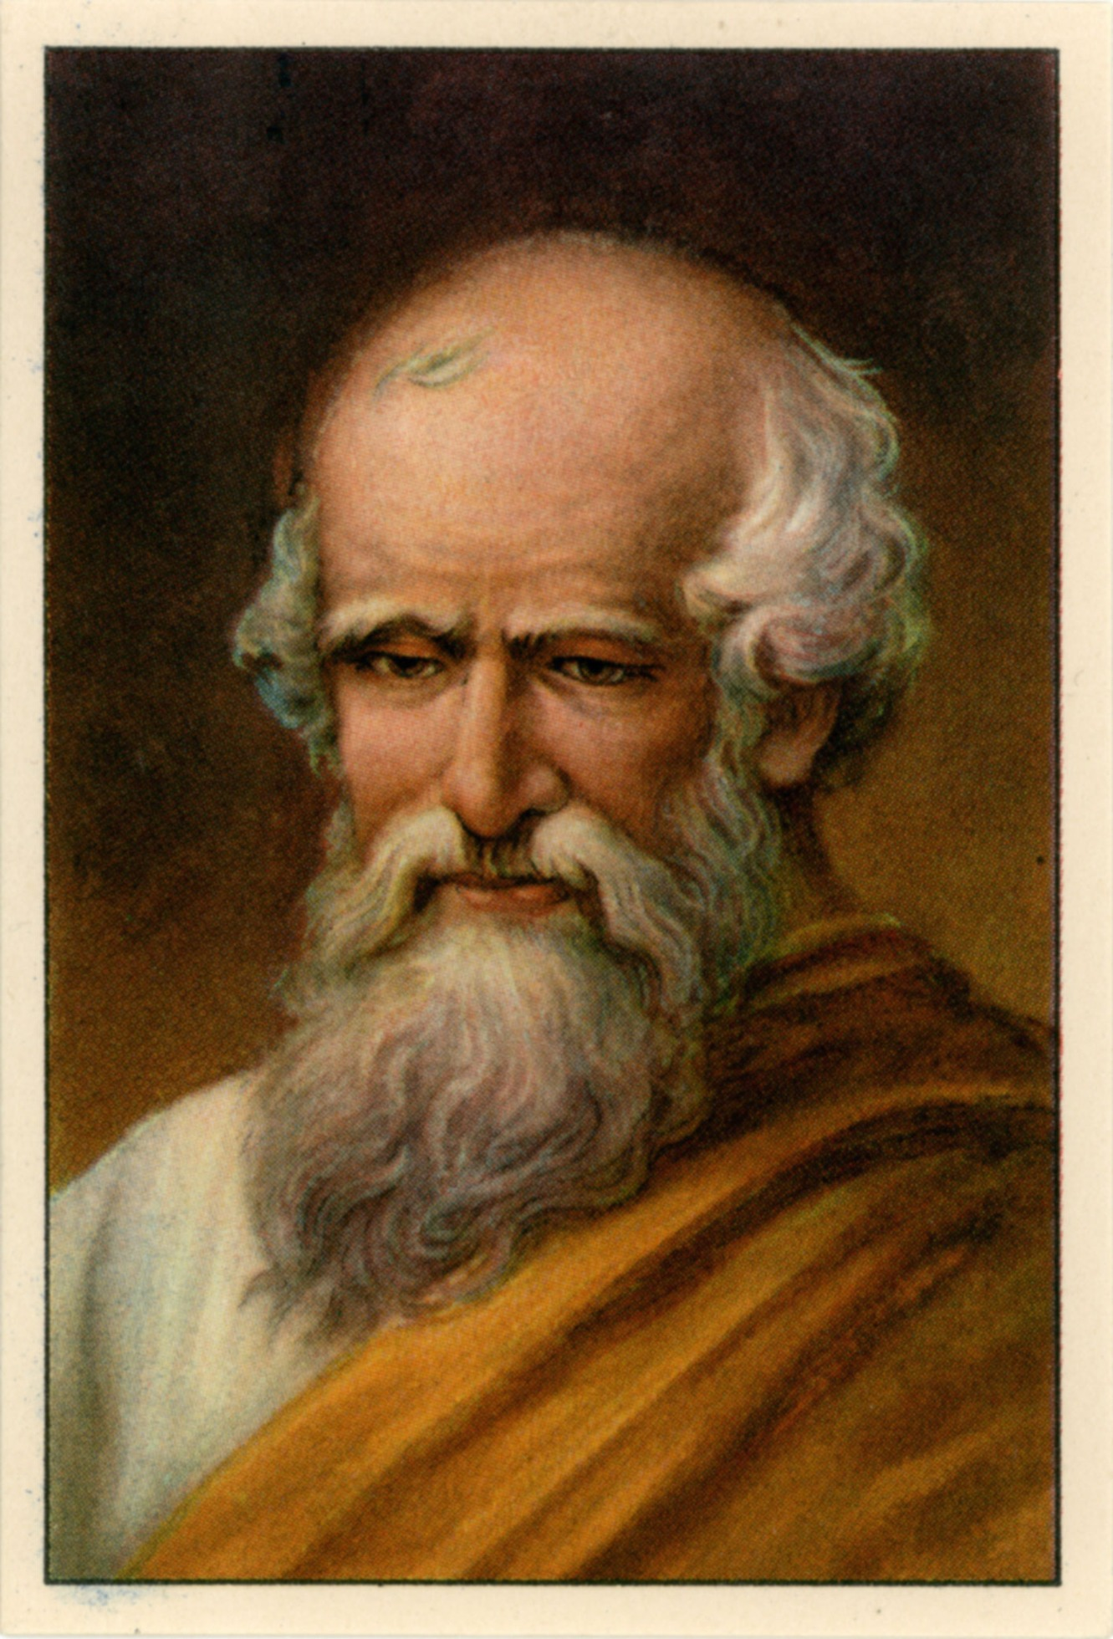
Who discovered Pi number?
The first recorded algorithm for rigorously calculating the value of π was a geometrical approach using polygons, devised around 250 BC by the Greek mathematician Archimedes.This polygonal algorithm dominated for over 1,000 years, and as a result π is sometimes referred to as "Archimedes' constant". Archimedes computed upper and lower bounds of π by drawing a regular hexagon inside and outside a circle, and successively doubling the number of sides until he reached a 96-sided regular polygon. By calculating the perimeters of these polygons, he proved that 223/71 < π < 22/7(that is 3.1408 < π < 3.1429).

Slide 4
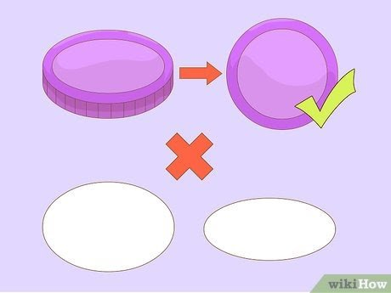
How to calculate Pi?
1
Make sure you are using a perfect circle. This method won't work with ellipses, ovals or anything but a real circle. A circle is defined as all the points on a plane that are an equal distance from a single center point. The lids of jars are good household objects to use for this exercise.You should be able to calculate pi roughly because in order to get exact results of pi, you will need to have a very thin lead(or whatever you are using). Even the sharpest pencil graphite could be huge to have exact results.

Slide 5
How to calculate Pi?
2
Measure the circumference of a circle as accurately as you can. The circumference is the length that goes around the entire edge of the circle. Since the circumference is round, it can be difficult to measure (that's why pi is so important).Lay a string over the circle as closely as you can. Mark the string off where it circles back around, and then measure the string length with a ruler.

Slide 6
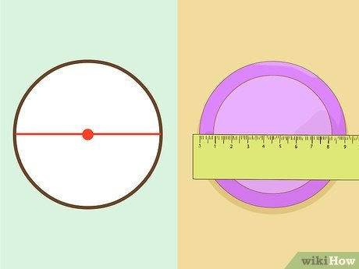
How to calculate Pi?
3
Measure the diameter of the circle.The diameter runs from one side of the circle to the other through the circle's center point.

Slide 7
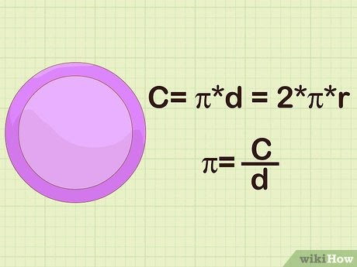
How to calculate Pi?
4
Use the formula. The circumference of a circle is found with the formula C= π*d = 2*π*r. Thus pi equals a circle's circumference divided by its diameter. Plug your numbers into a calculator: the result should be roughly 3.14.

Slide 8
How to calculate Pi
5
Repeat this process with several different circles, and then average the results. This will give you more accurate results. Your measurements might not be perfect on any given circle, but over time they should average out to a pretty accurate calculation of pi

Slide 9
Thank you!!
Made by Xenia Stratulat

