Slide 1
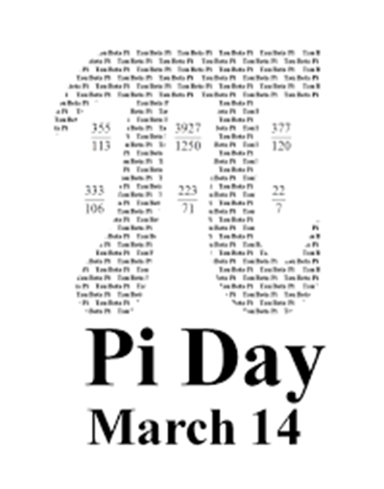
KEREM ÜNAL / SENA NARİN

Slide 2
Pİ DAY
I LOVE Pİ DAY.

Slide 3
Pİ DAY
WE ARE HAPPY. We can draw, sing, write poems etc.

Slide 4
Pi day
Thank you

