Slide 1
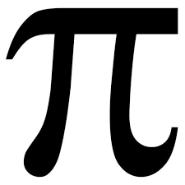
PI

Slide 2
The number π is a mathematical constant. Originally defined as the ratio of the circumference of the circle to its diameter, it now has different equivalent definitions and occurs in many formulas in all fields of mathematics and physics. It is roughly equal to 3.14159. It was represented by the Greek letter "π" from the middle of the eighteenth century, although it is sometimes also described as "pi". It is also called the constant of Archimedes.

Slide 3
As an irrational number, π can not be expressed as an ordinary fraction. However, fractions such as $\frac{22}{7}$ and other rational numbers are commonly used to approximate π. Figures appear to be randomly distributed. In particular, the digit sequence of π is conjectured to satisfy a certain random statistical character, but so far no evidence has been found of this.

Slide 4
Ancient civilizations have demanded values ​​that are quite accurate to approximate for practical reasons, including Egyptians and Babylonians. Around 250 before Jesus Christ, the Greek mathematician Archimedes created an algorithm for calculating it. In the 5th century, Chinese mathematics approximated up to seven digits, while Indian mathematics made a five-digit approximation, both using geometric techniques.

Slide 5
In the 20th and 21st centuries, mathematicians and scientists have discovered new approaches that, combined with increasing computational power, have extended the decimal representation of π to many trillion digits after the decimal point. Virtually all scientific applications require no more than several hundreds of π and many substantially lower figures, so the primary reason for these calculations is to try to find more efficient algorithms for calculating long numerical series and the desire to break records

Slide 6
Since the most elementary definition refers to a circle, π is found in several formulas in trigonometry and geometry, especially those relating to circles, ellipses and spheres. In the more modern mathematical analysis, the number is defined instead of the spectral properties of the actual number system, as its own value or period, without any reference to geometry.

