Slide 1
Pi day
Ege Atlas

Slide 2
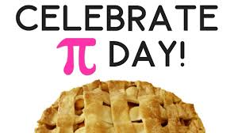
Pi day
Pi Day is an annual celebration of the mathematical constant π (pi). Pi Day is observed on March 14 (3/14 in the month/day format) since 3, 1, and 4 are the first three significant digits of π.

Slide 3
Pi day
Thank you

