Slide 1
“LETTERS FROM NATURE”
CLASSE 1 B ^
Plesso : S. ANGELO
C.D. MONDRAGONE TERZO

Slide 3
HI ! MY NAME IS NOEMI
“N” IS FOR
NATURE
NATURA

Slide 4
HI! by CHRISTIAN AND CARLO
“C” IS FOR…
CARROT
CAROTA

Slide 5
MY NAME IS FRANCESCA
“F” IS FOR…
FRUIT
FRUTTA

Slide 6
MY NAME IS SIMONE
“S” IS FOR…
SAND
SABBIA

Slide 7
HI! MY NAME IS MARIA
“M” IS FOR …
MAIZE
MAIS

Slide 8
VINCENZO e VINCENZA
“V” IS FOR….
VEGETABLE
VERDURA

Slide 9
RAFFAELLA e RAFFAELE
“R” IS FOR…
ROSE
ROSA

Slide 10
MY NAME IS EMANUELE
WITH MY FRIENDS I TAKE…
ENERGY
ENERGIA
from EARTH

Slide 11
Hi ! My name is beniamino
“b” is for…
BANANA
BANANA

Slide 12
HI ! MY NAME ‘S GIUSEPPE
“G” IS FOR …
GAME
GIOCO

Slide 13
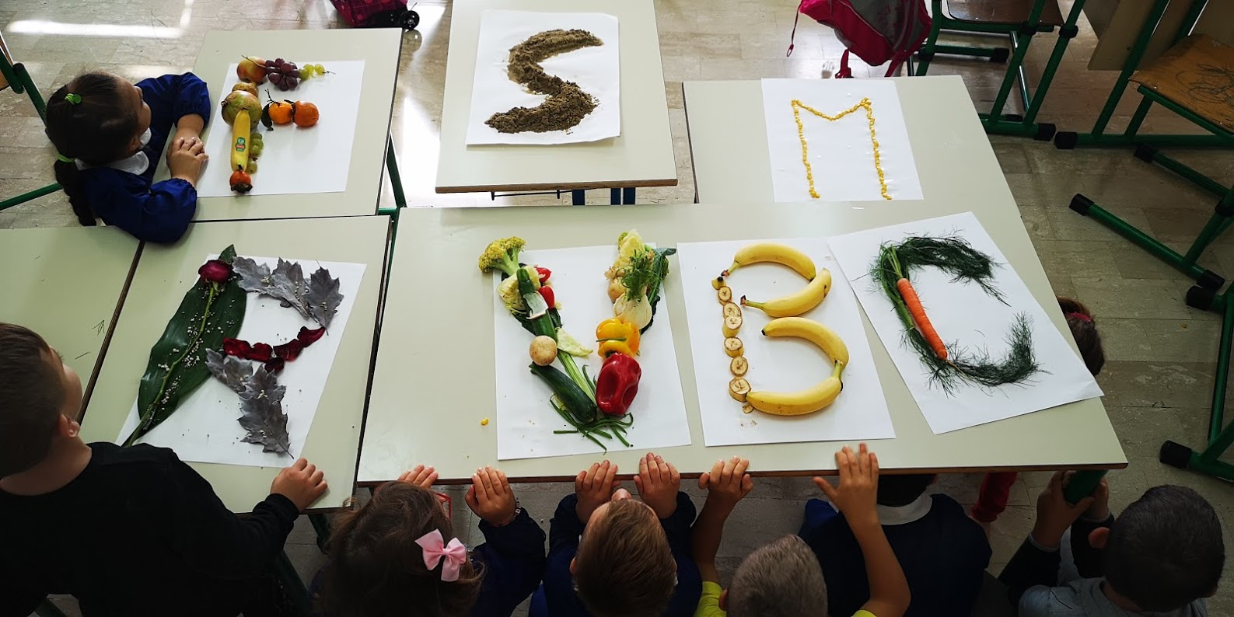
CIAO CIAO

Slide 14
Bye bye from ITALIA

