Slide 1
croatian experience
Alice, Chiara, Francesca, Ingrid, Nicole, Noemi

Slide 2
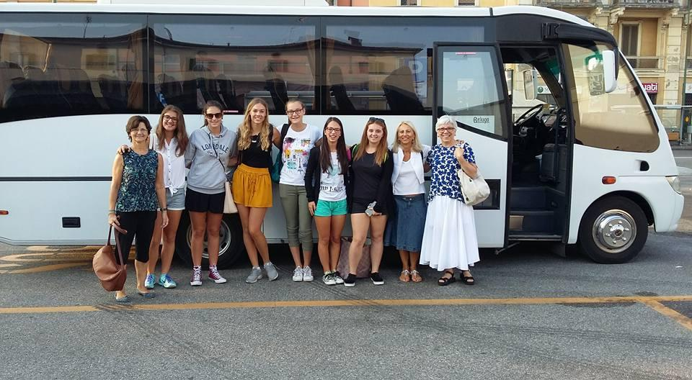
Sunday
We started the Erasmus experience in Croazia on 11 September 2016. We left Cremona at 8.00 with our teachers: Ardoli, Bondanese and Maglia.

Slide 3
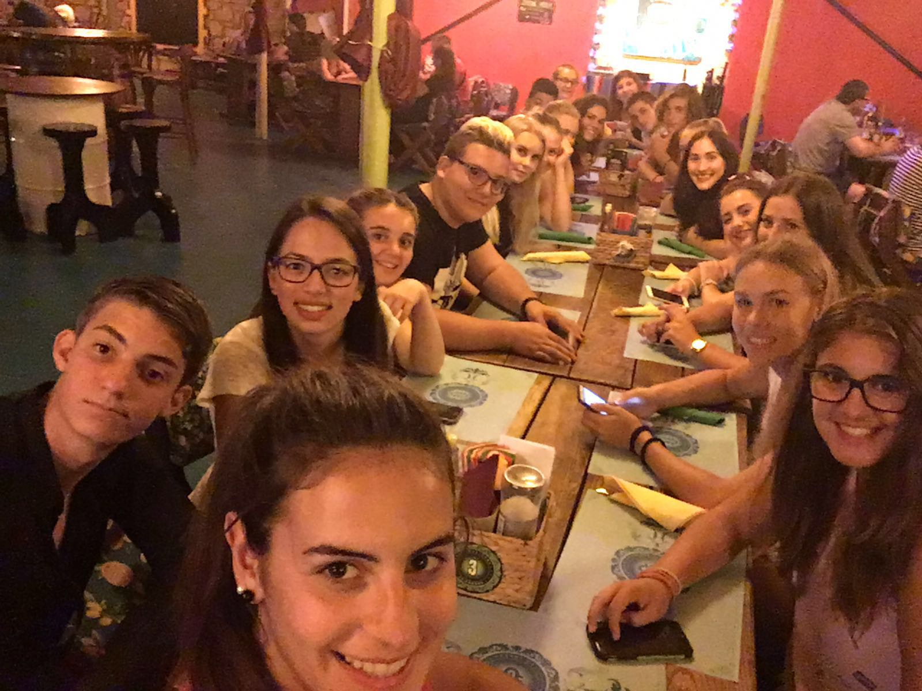
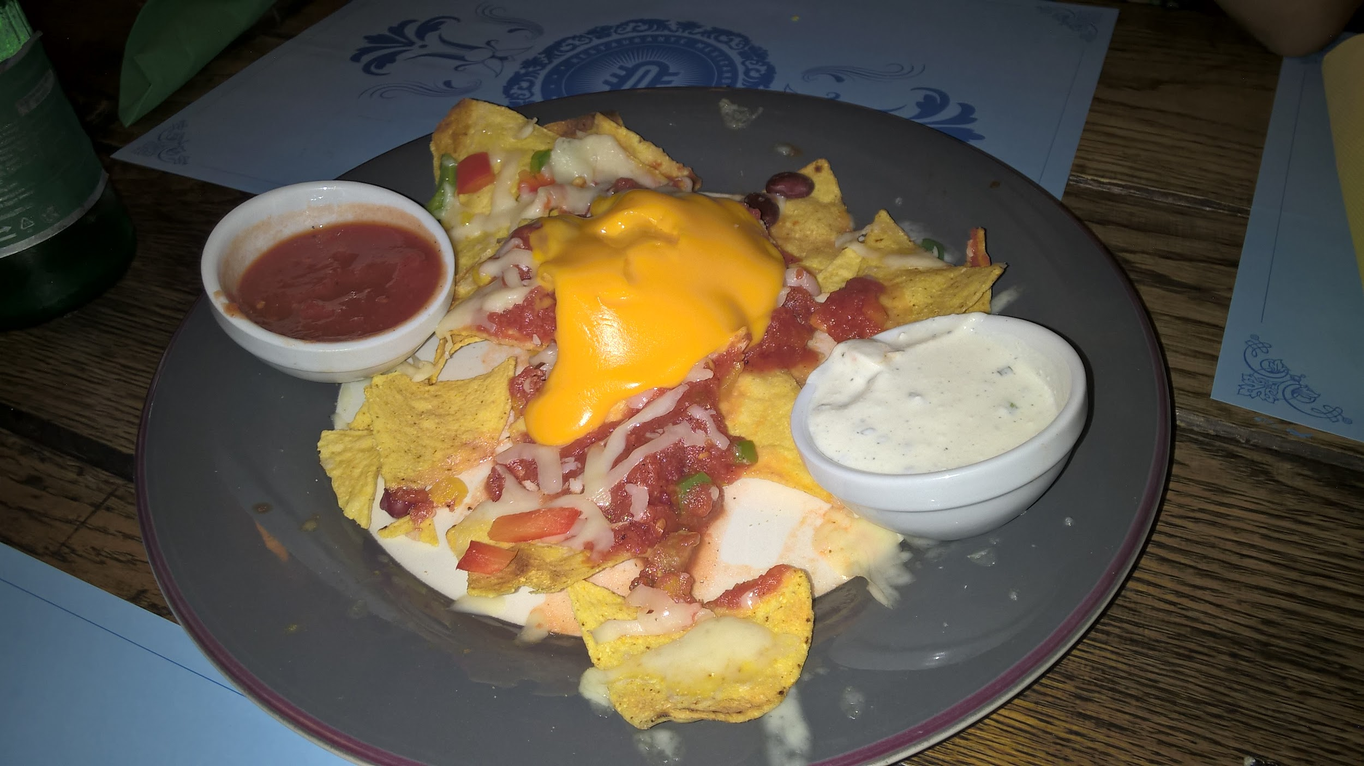
We arrived in Rovigno at 3.oo pm and we went to our Croatian families. In the evening we went to a Mexican restaurant with the Croatians, Swedish and Germans friends to have a dinner together.
We waited for too long, meanwhile we chatted and we knew each other.
The time just flew!
The food was delicious and we appreciated the dinner!

Slide 4
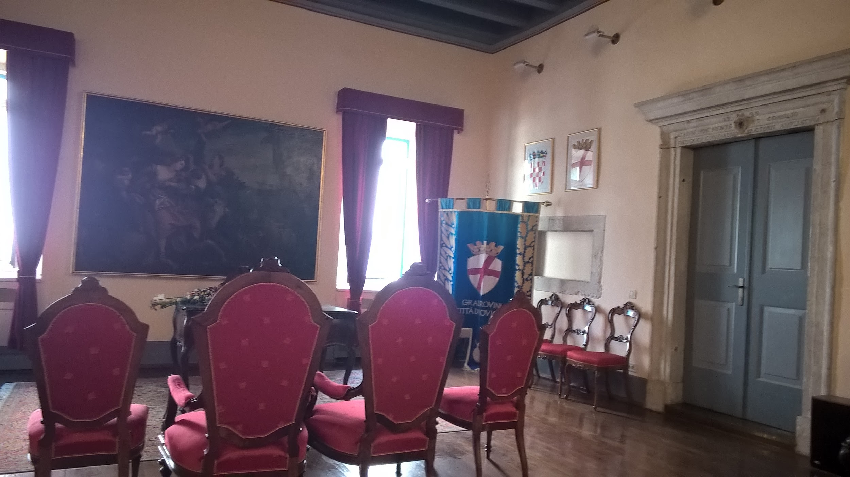
monday
On Monday morning we went to school where we met the Principal, Ms Ines Venier. Then we went to the town hall to meet the Deputy Mayor, Mr Marino Budicin.

Slide 5
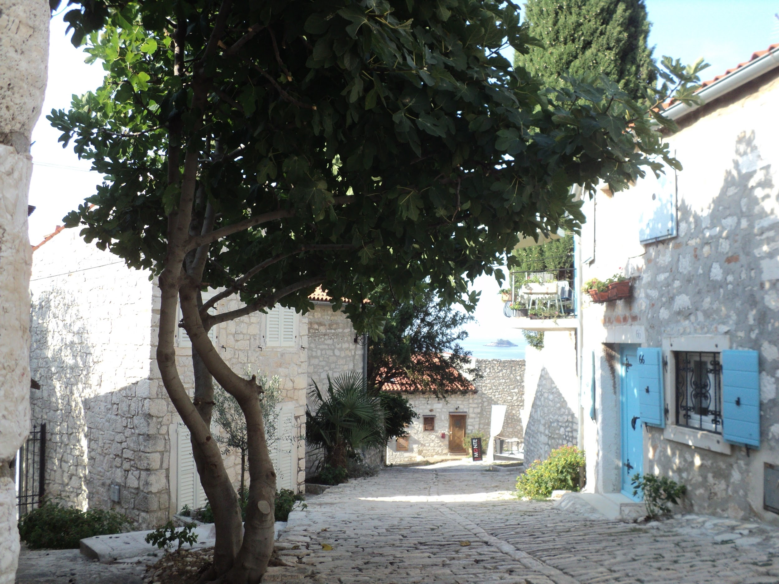
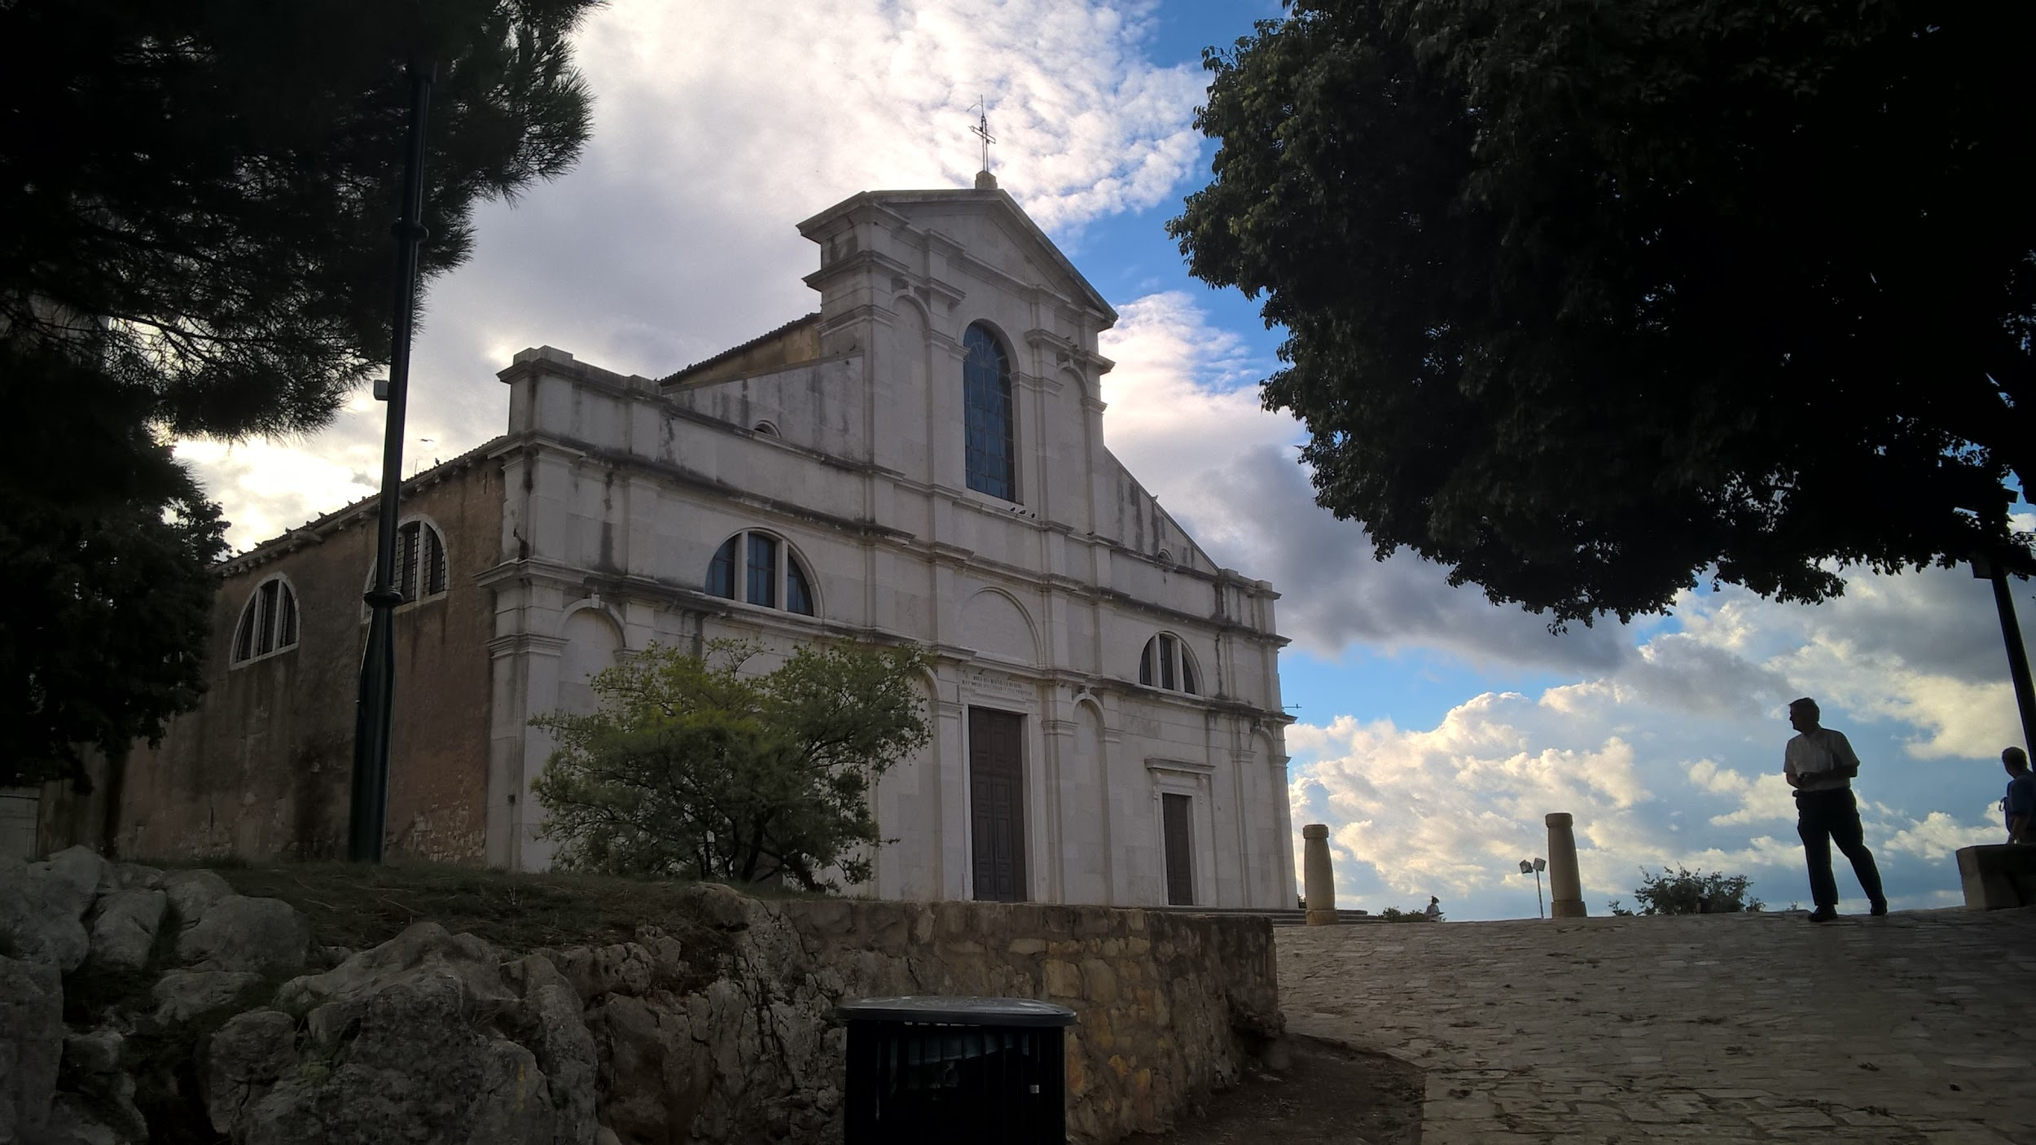
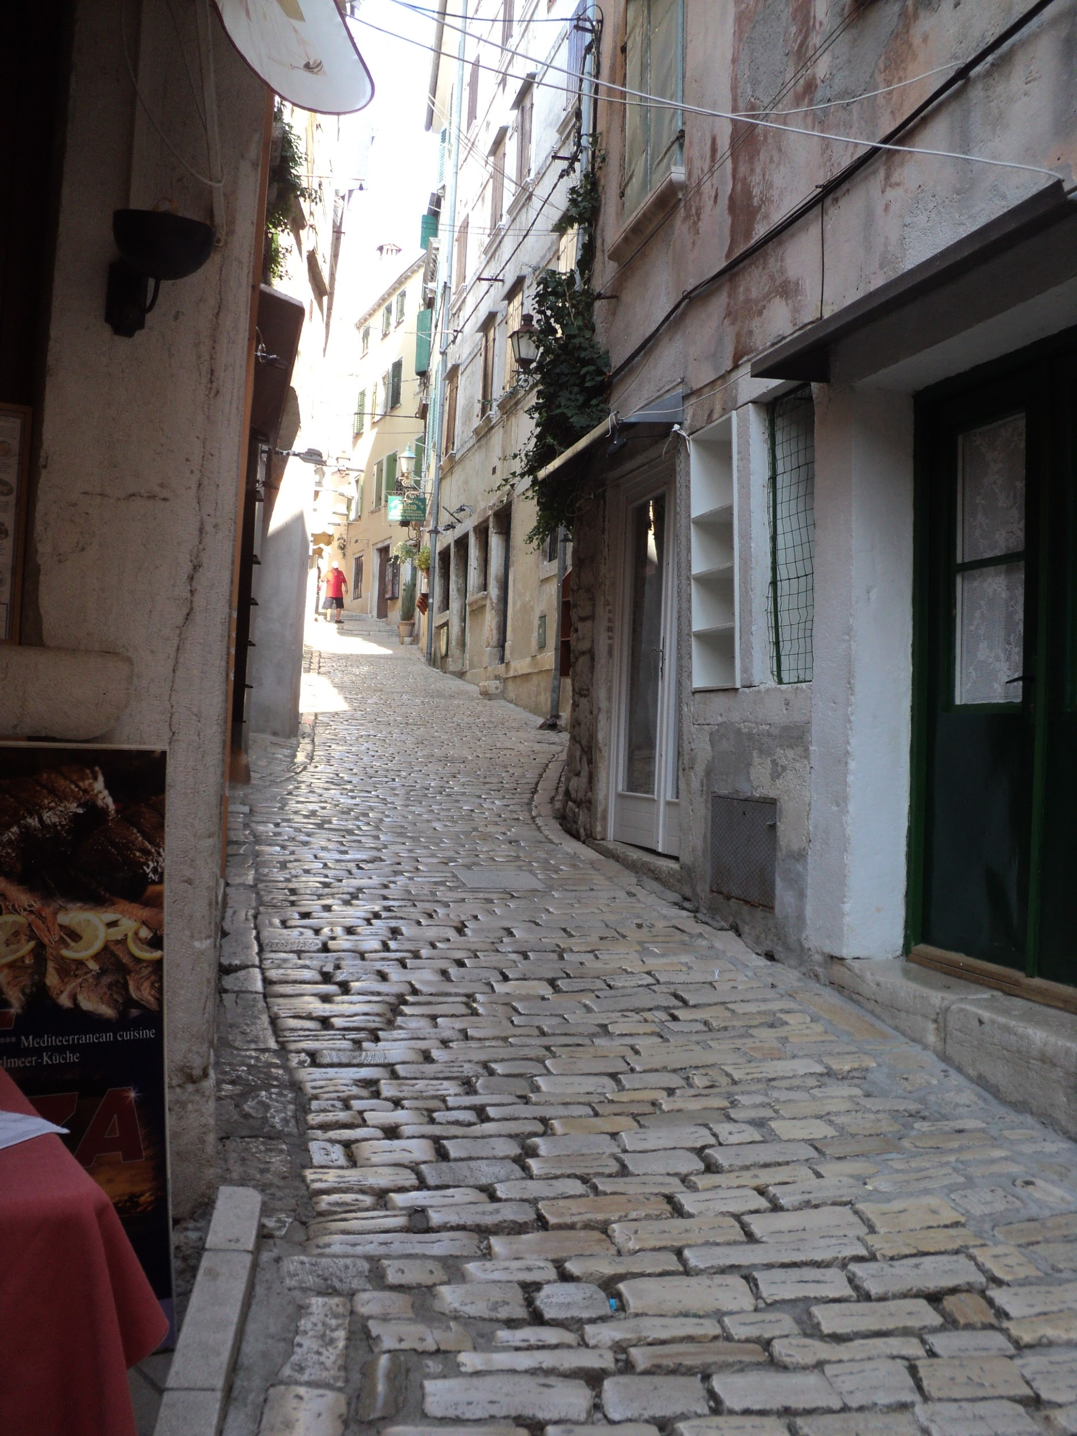
After that some Croatian students guided us during the sightseeing of the city centre.
In the afternoon we were divided into three groups and we started our workshop

Slide 6
tuesday
On Tuesday morning we met the Deputy Prefect of Istria, Ms Viviana Benussi. She came to school and talked to us about Istria.
Later in the morning, we visited an exhibition devoted to Massimo Sella, an Italian scientist, photographer and writer.

Slide 7
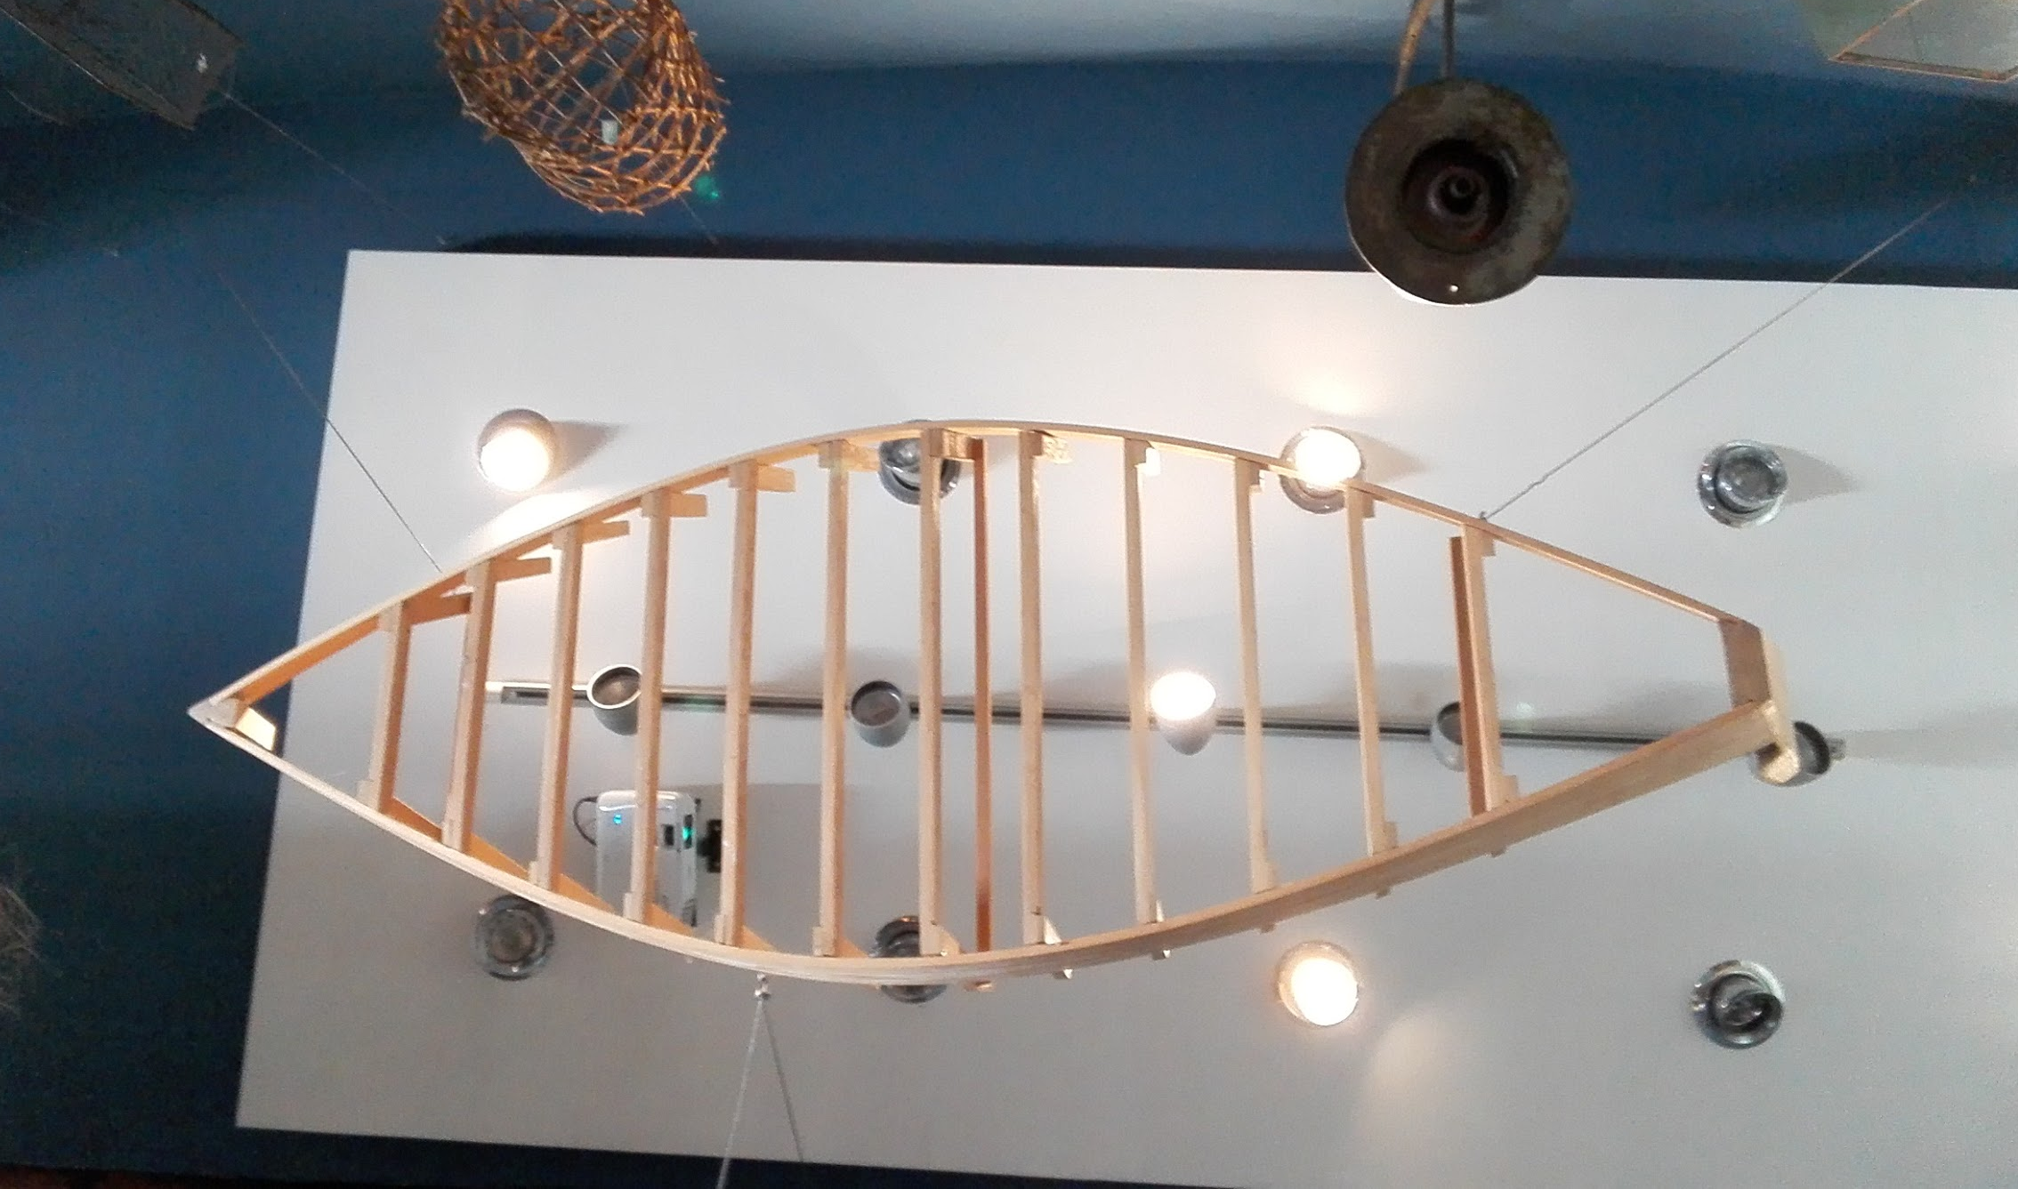
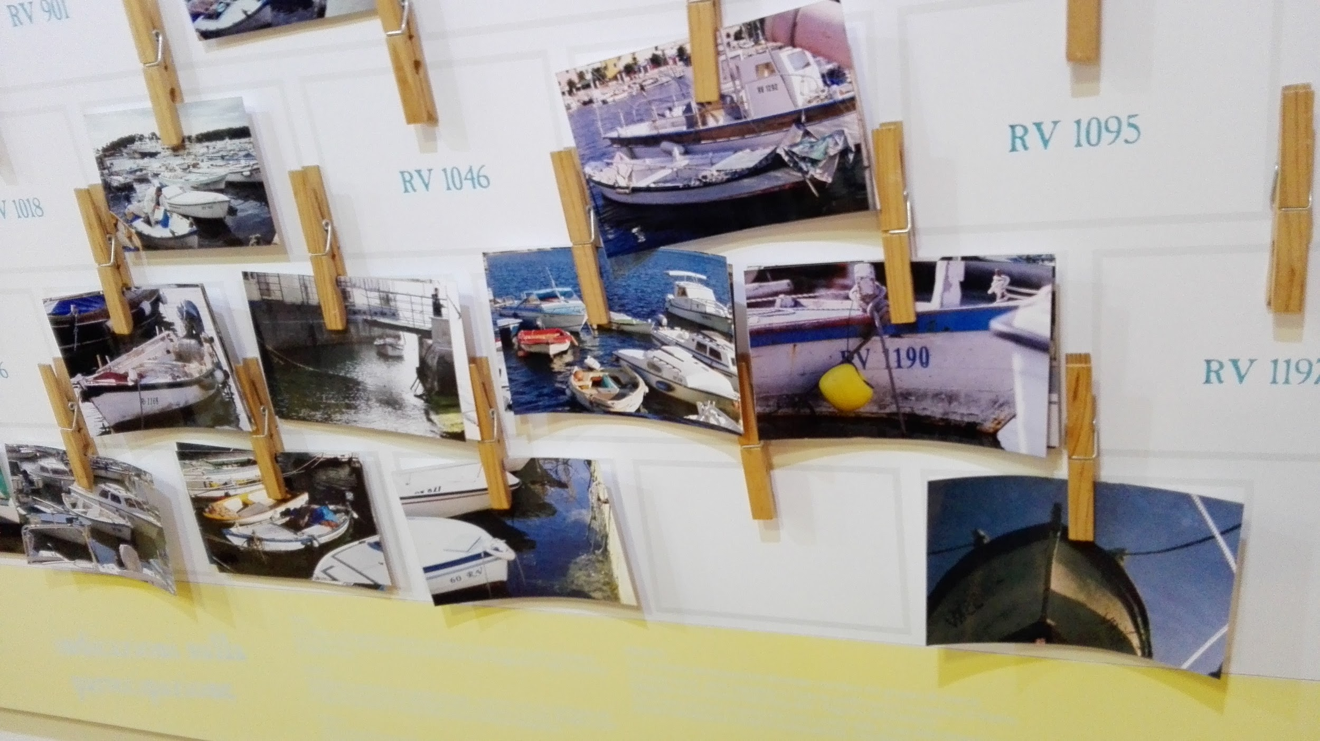
Then, we went to the “Batana Eco-Museum” where the guide showed us the typical Rovigno’s boat, the “Batana” and how it’s built.
In the afternoon, we did our workshop as always.

Slide 8
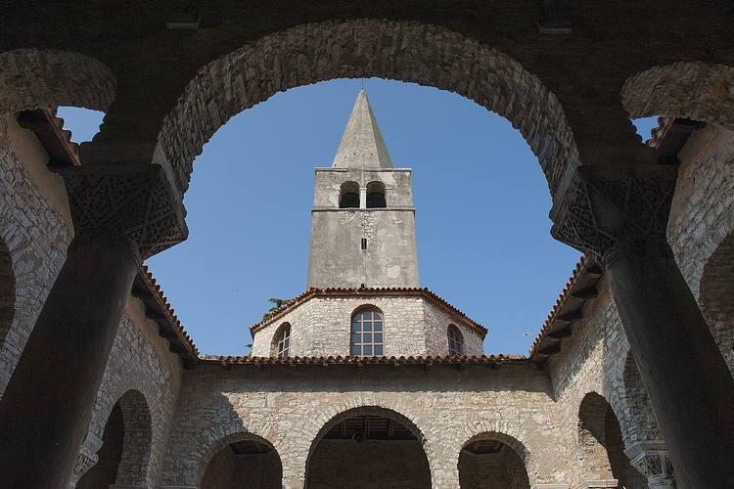
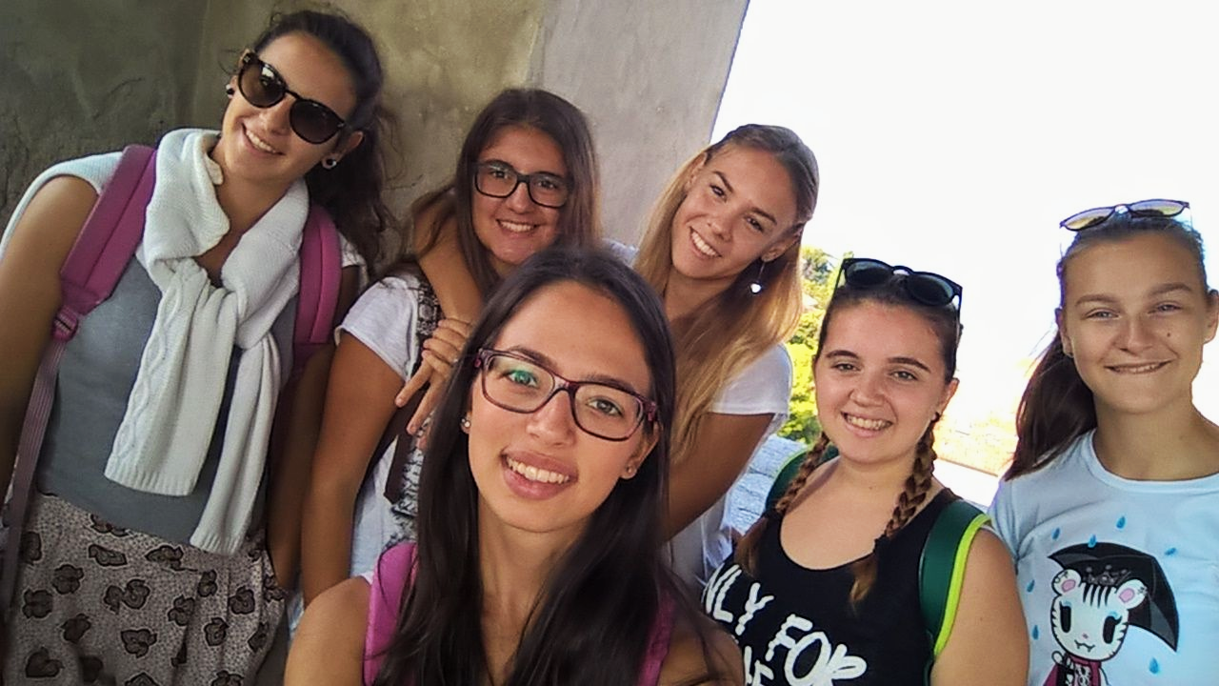
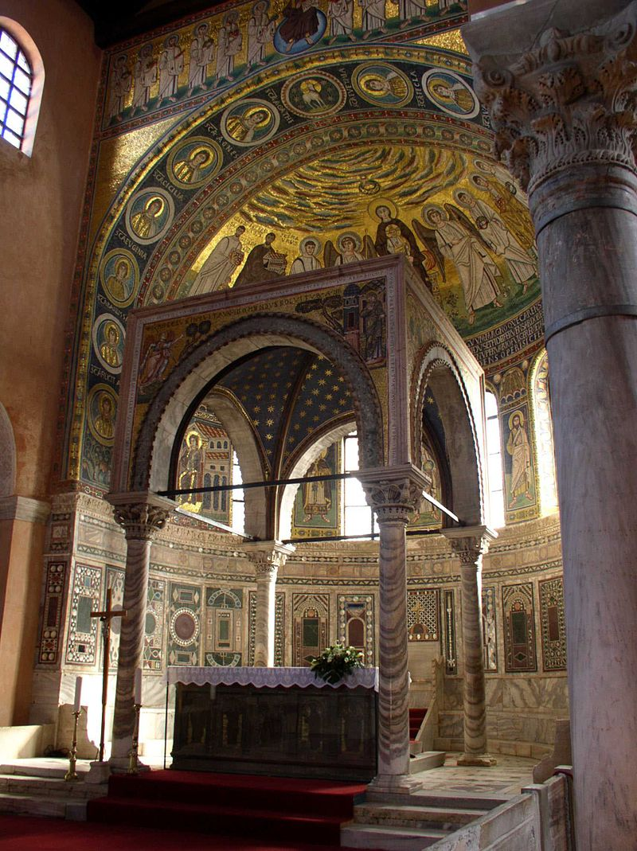
wednesday
Wednesday was very busy because we visited different places in different cities.
We left Rovinj at 7:45 for going to Porec where we visited the Euphrasian Basilica. It has retained, for the most part its original shape, but accidents, fires and earthquakes have altered a few details. We climbed on the top of the bell tower. Then we went inside the basilica.

Slide 9
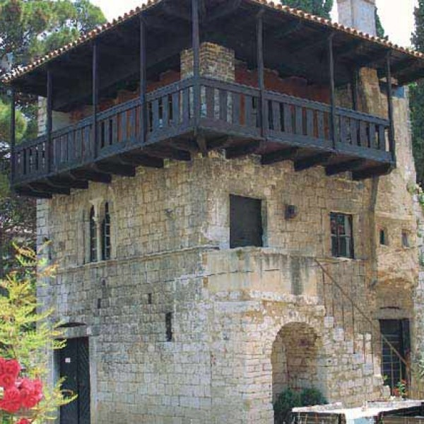
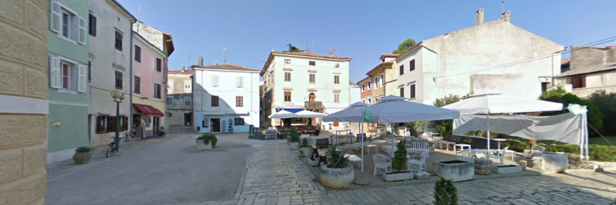
WEDNESDAY
After that we walked down the Decumanus and we saw the romantic house. It was characterized by a wood balcony. We also saw the Marafor square, the oldest and biggest place in Parenzo. Even today we can see the remains of the ancient pavement.

Slide 10
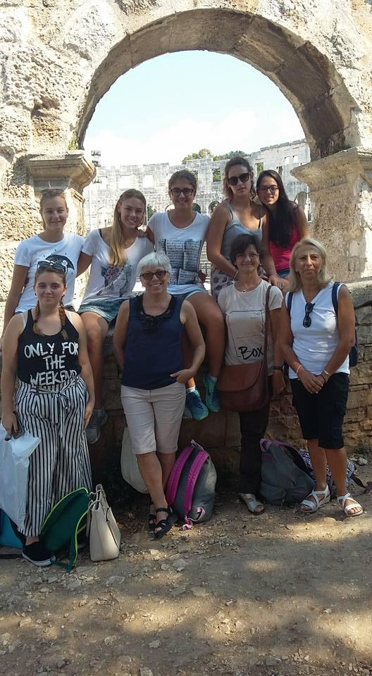
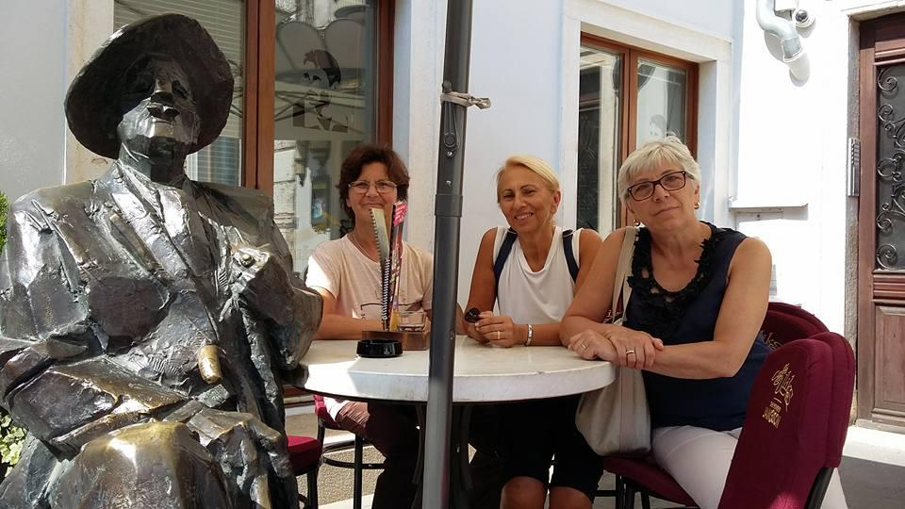
WEDNESDAY
Pola has been the second destination. Here we saw the Arena, that is smaller than the Colosseum in Rome and as big as the Arena of Verona.
In addition to the Arena, we also saw the Augustus’s temple, but we didn’t go inside. For lunch we had free time and we spent it for visiting the city and our teachers had coffee with the famous James Joyce.

Slide 11
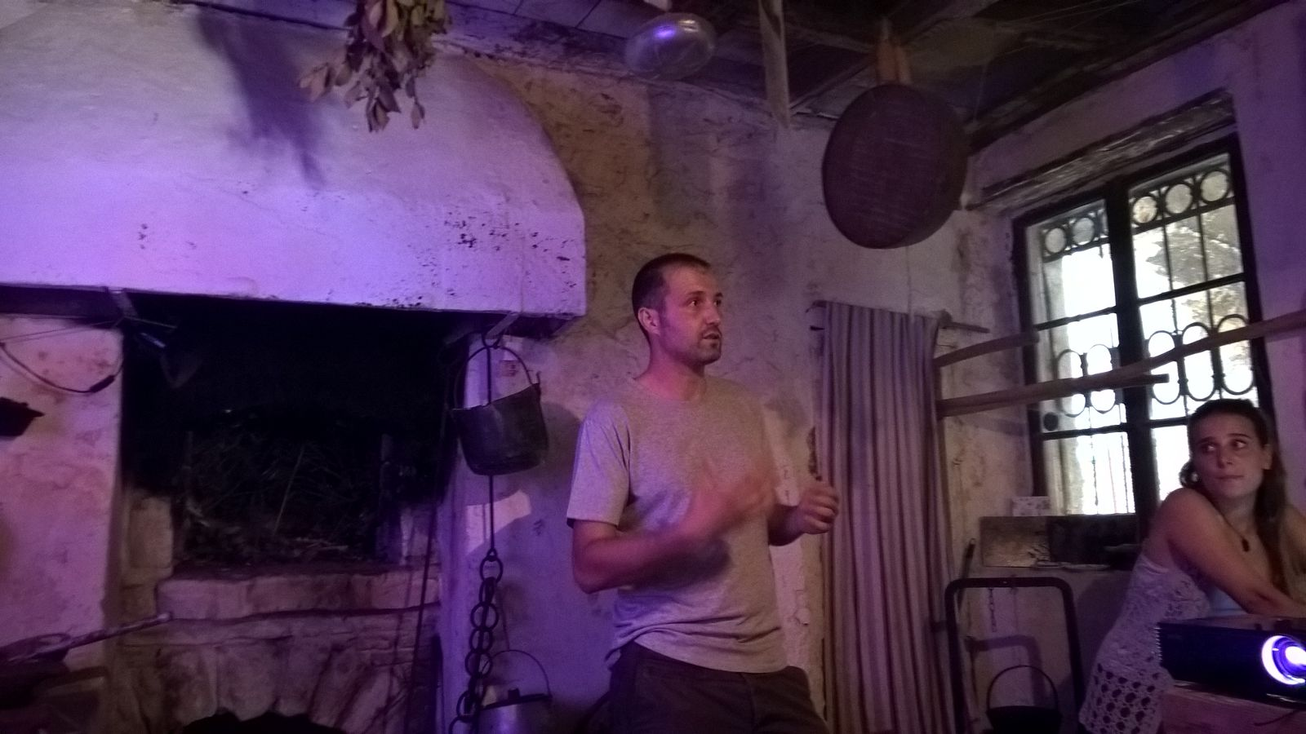
WEDNESDAY
We left Pola for going to Dignano, where we visited the “Eco-Museum Istrian de Dignan” and we listened to presentation of local olive oil production. When the expert had finished his explanation he showed us an old kitchen on the first floor.

Slide 12
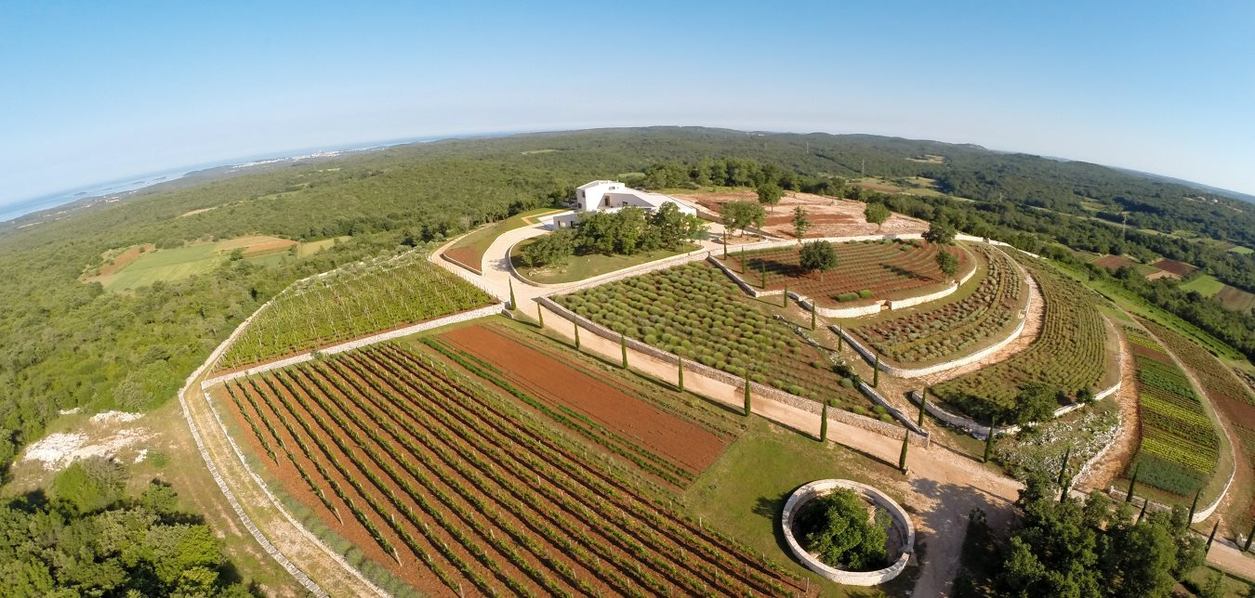
WEDNESDAY
At the end of the trip we went to a beautiful place, surrounded by nature where we met the owners of a company that produces products made of essential oil. We could see how, from essential oil, also produced by them, they create products of various kinds.

Slide 13
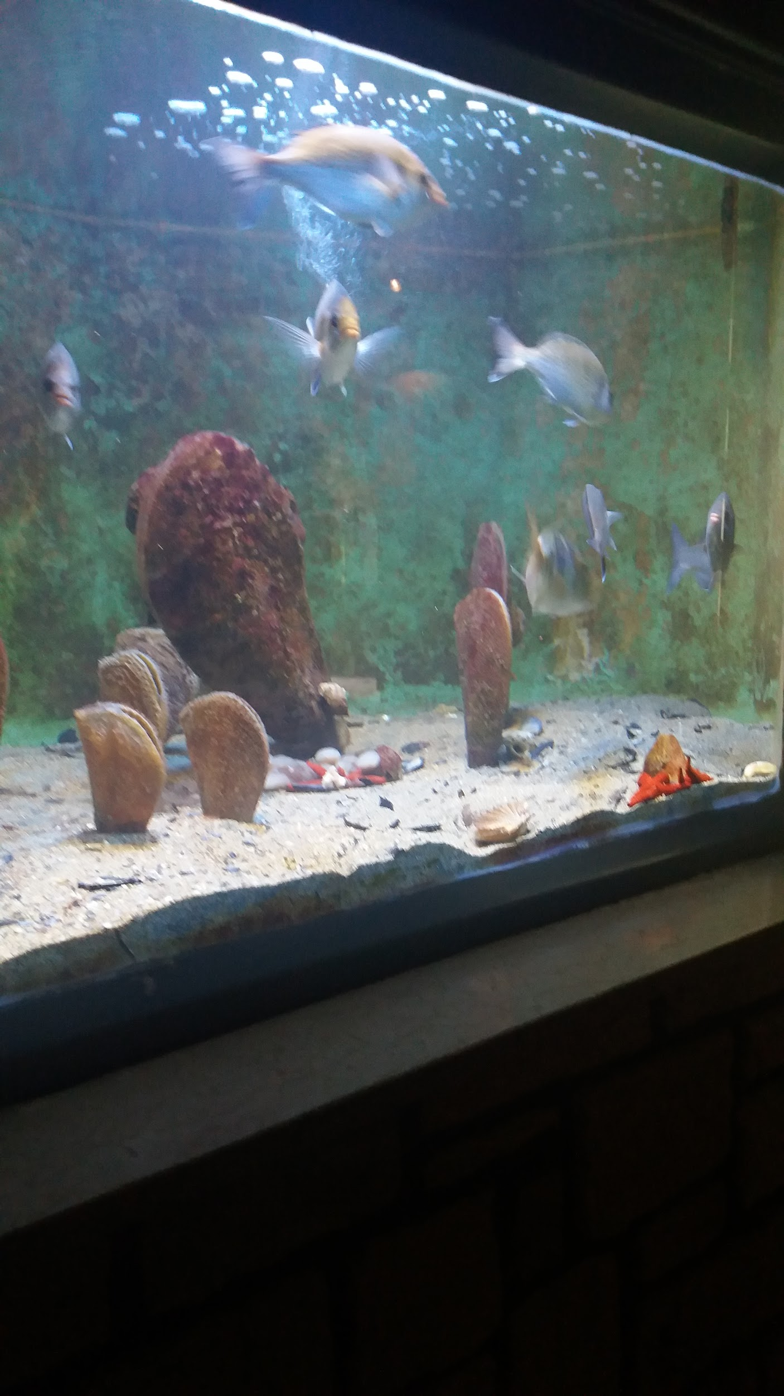
THURSDAY
On Thursday morning, we visited
the Centre for Marine Research
and the aquarium.
After that, we participated in a
lecture on marine sustainability,
overfishing and the nanotechnologies
applied to aquatic environment

Slide 14
THURSDAY
In the afternoon,at 2:30 p.m,
we visited Rovigno’s arcipelago by boat.

Slide 15
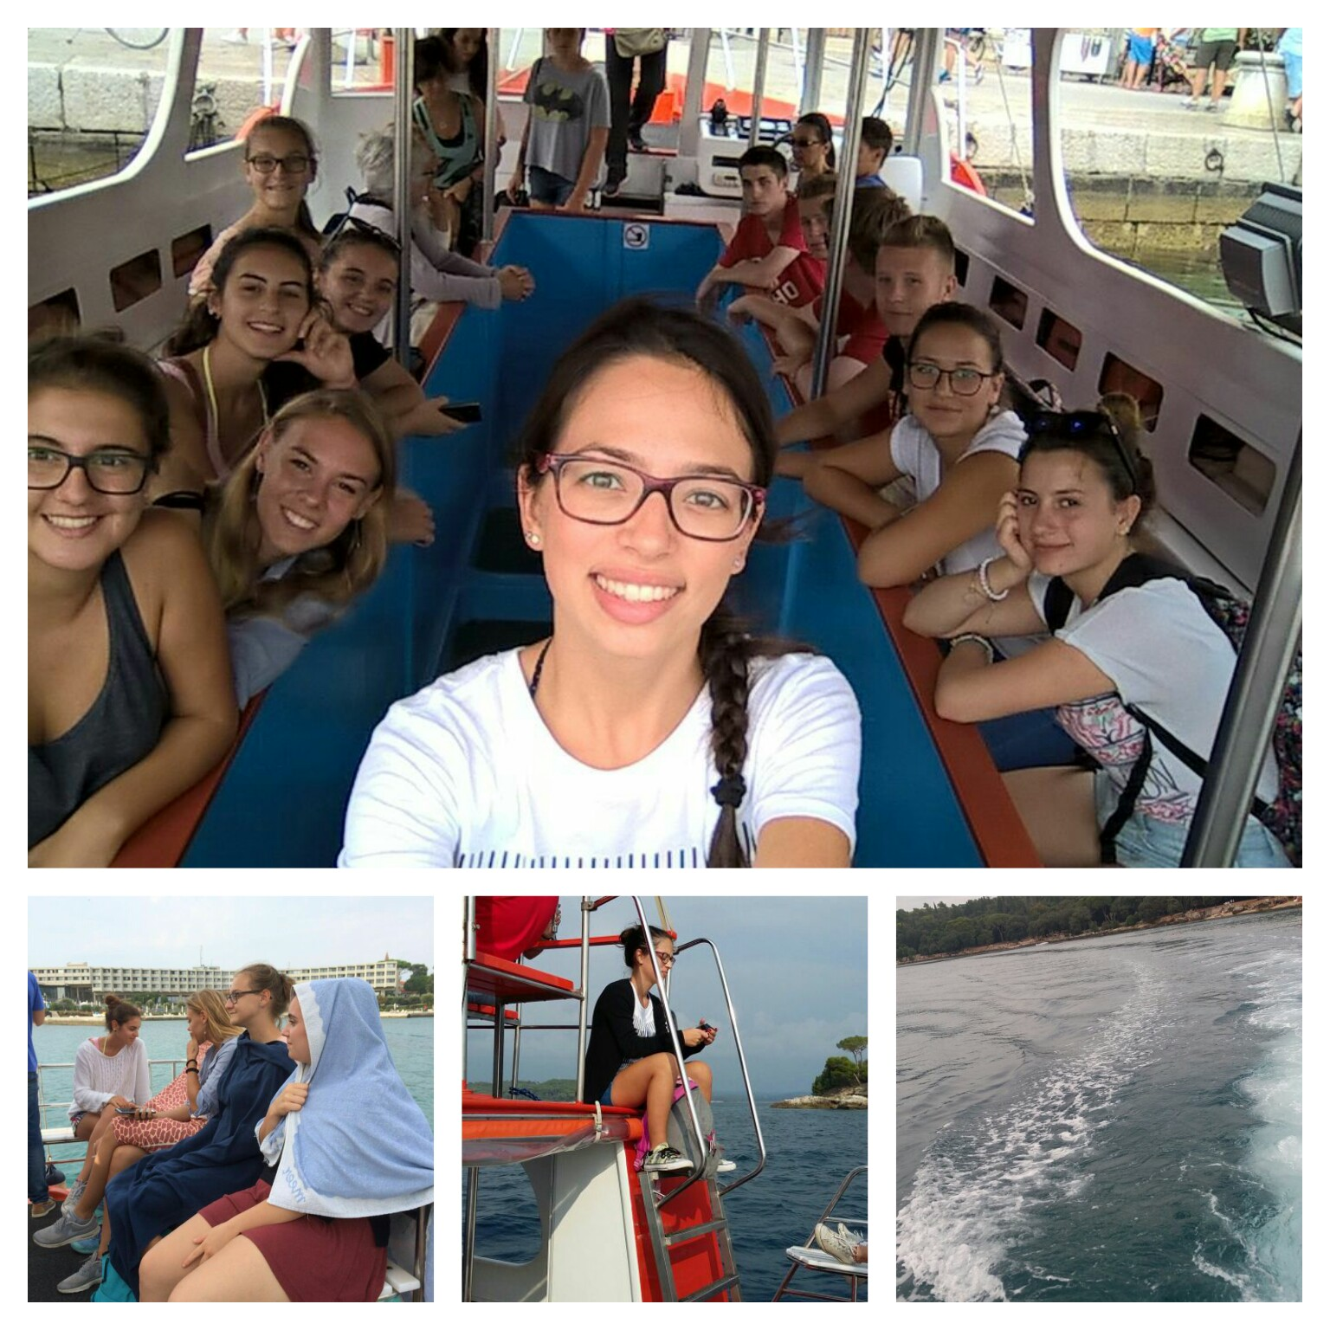
THURSDAY

Slide 16
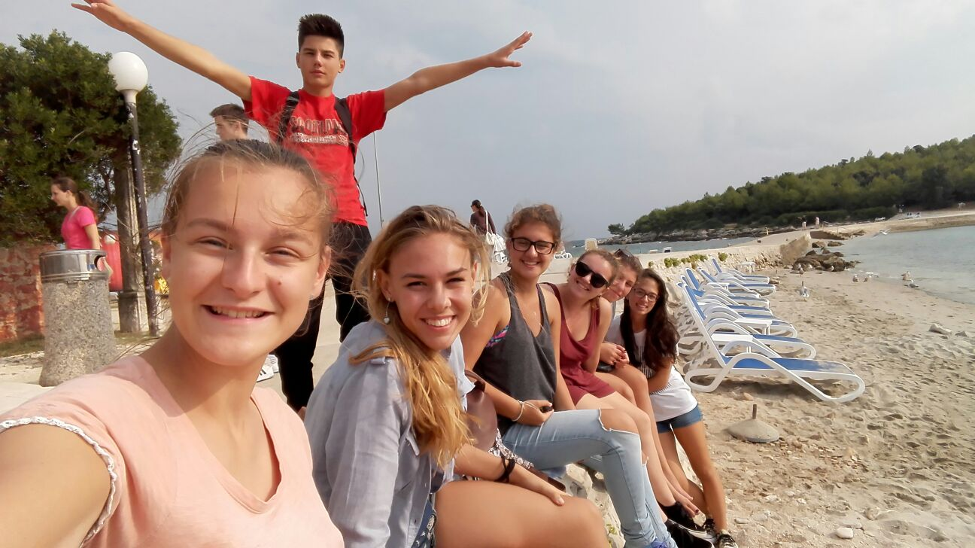
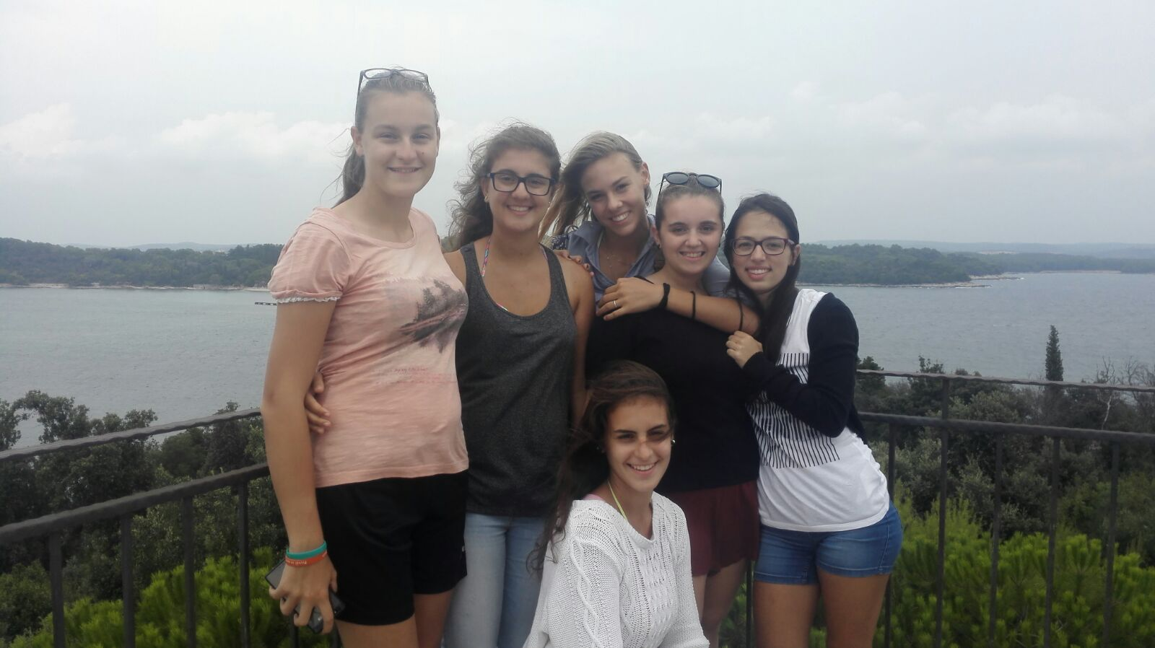
THURSDAY
During our trip, we visited
a beautiful island.
its name is Maškin.
We really enjoyed!

Slide 17
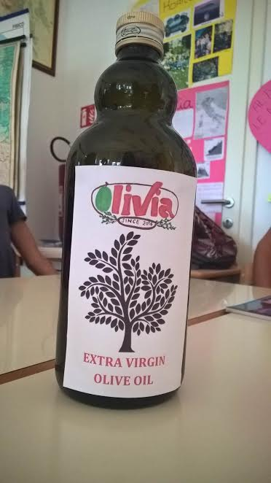
friday
On Friday morning we went to school
for the presentation of the
student’s workshops results.
Each group carried out his workshop
and we discussed it with our teacher
and the other class of our school.

Slide 18
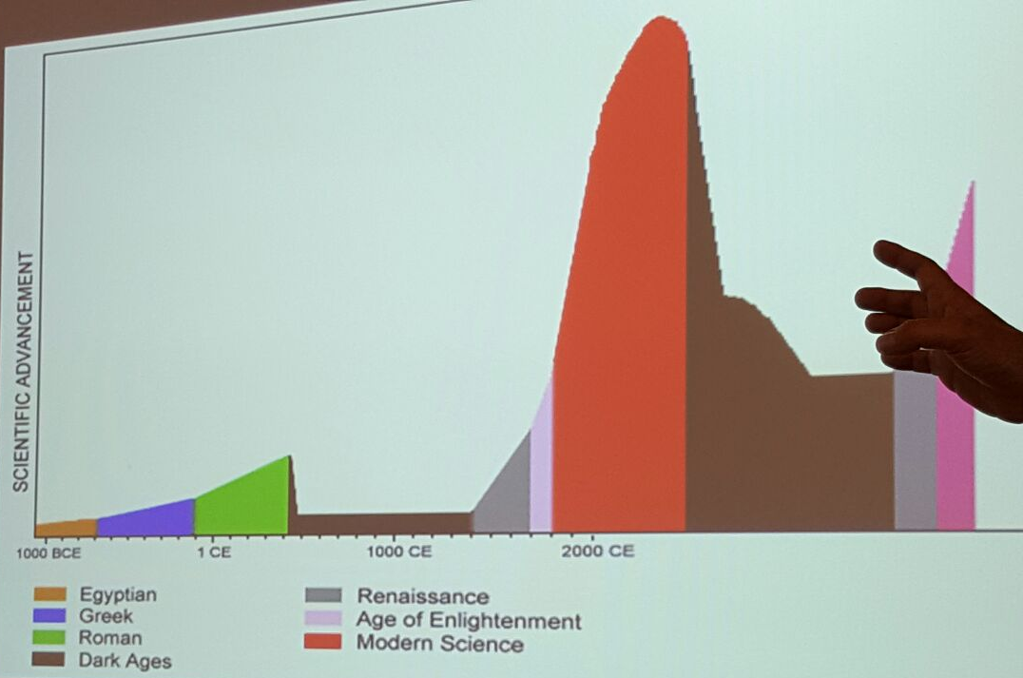
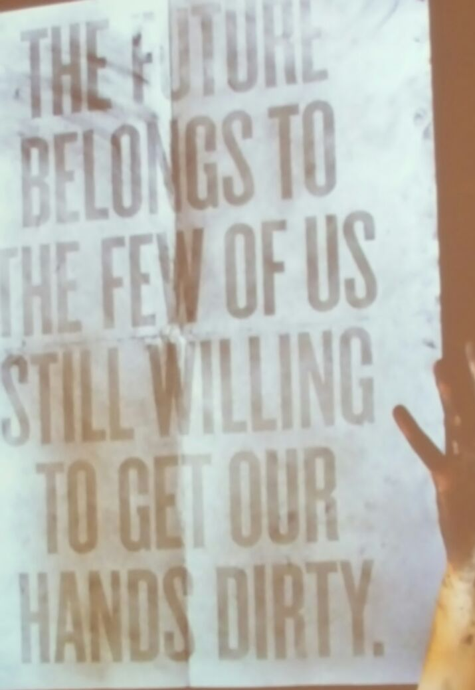
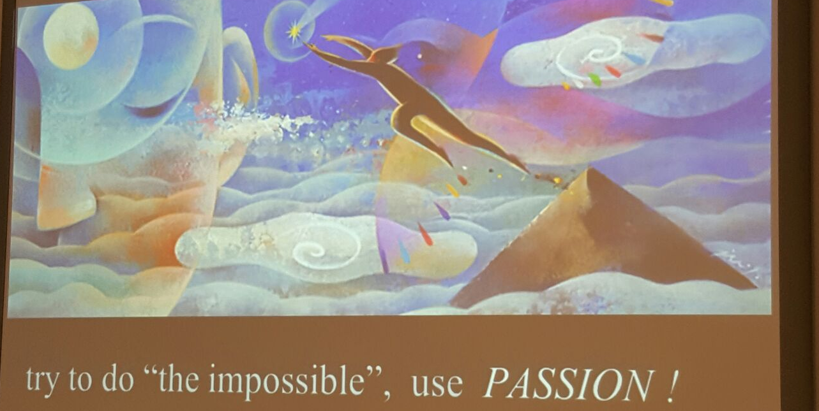
Later we went to a lecture on the topic of light pollution by Mr Korado Korlevic. He also spoke about the end of the world, the human future related to the environment and to our behaviour. We think he is an interesting man, teacher, scientist and astronomer.

Slide 19
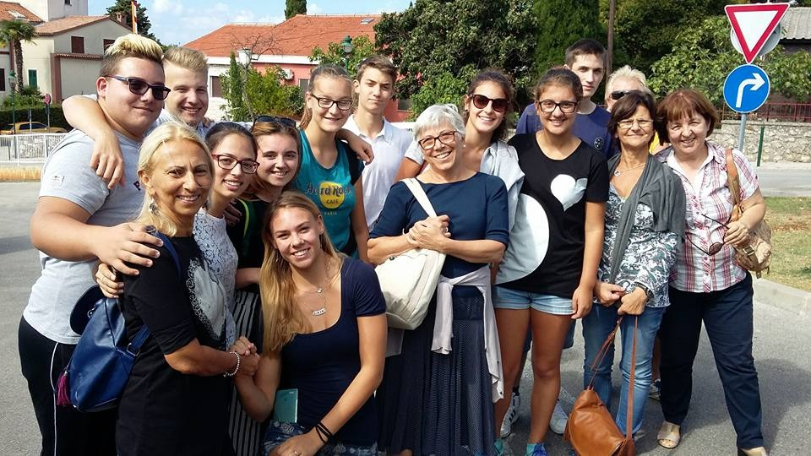
saturday
On Saturday morning, when we were ready, we met all of our Croatians friends in front of their school for saying goodbye.
At about 10 o’clock we left Rovinj and we started our return to Cremona.

Slide 20
We really enjoyed this experience
And we want to thank the teachers that were with us! Thank you!

