Slide 1
The Right Use of Food can End Hunger
Introduction
to the sustainable development goals

Slide 2
What are the 3 most important goals for you in 2030?

Slide 3
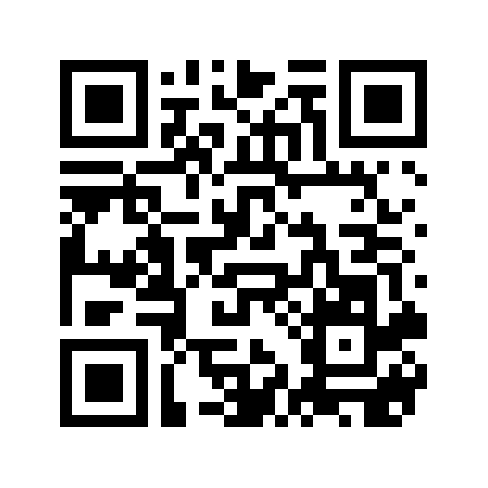
Answer with max. 3 words or a short sentence.
http://bit.ly/sg-ictalt

Slide 4
Look at the video

Slide 5
Memory game
Remember all 17 sustainable development goals in pairs of 2 students for two minutes.

Slide 6
Go to www.Kahoot.it
pin 825769

Slide 7
Go to the link and give your answer in.
https://answergarden.ch/539526

Slide 8
Memory game

Slide 9
The projectgroup
Guy Verzele (Belgium)
Maria Sebastiana Adamo (Italy)
Hendrien Exel (The Netherlands)
Maria Cândida Tavares (Portugal)
September 13th, 2017

Slide 10
Teachers appendix
Subject: Global Citizenship
Targetgroup/age range: >12 years
Time: 40 minutes
Software tools: Padlet, Kahoot, video, Answergarden, Powerpoint
Hardware: Projection/audio/beemer (teacher), laptops/pc or mobile devices for students
Outcomes: Awareness of the global sustainable goals improving ict in active learning, practicing English language

